Slide 1
vec3
vec2
mat3
mshtopo
color
dyntri_v3
mshsrch_v3

Slide 2
2
3
1
0
QUAD
3
4
6
6
7
5
7
2
2
4
5
4
5
3
2
4
2
3
1
3
2
3
1
z
0
1
0
1
y
TET
0
PYRAMID
WEDGE
0
HEX
0
VOXEL
1
x

Slide 3
positive depth
dirPrj ^ dirWidth
orgPrj
dirWidth
dirPrj

Slide 4
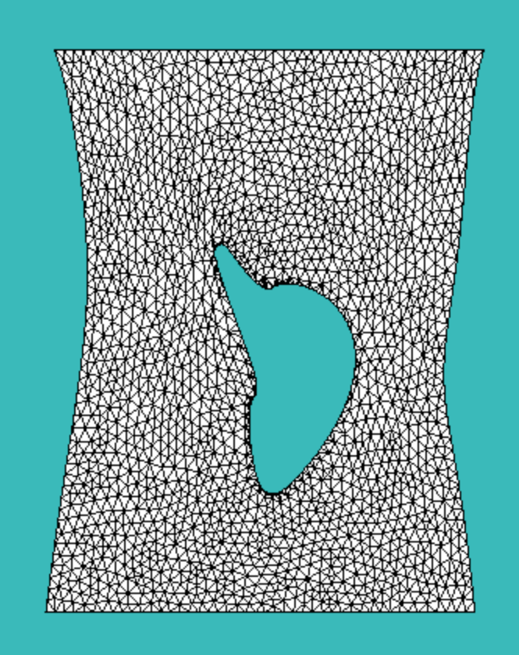
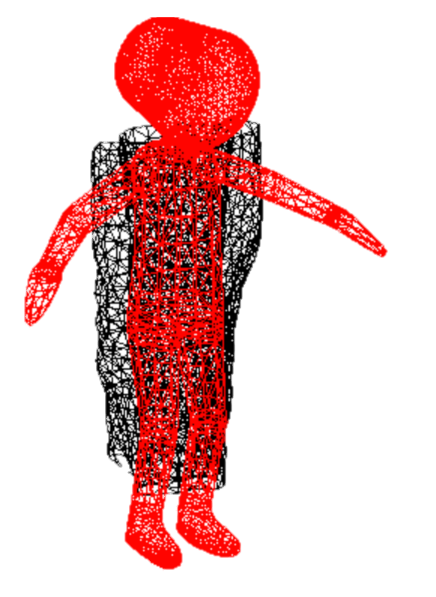
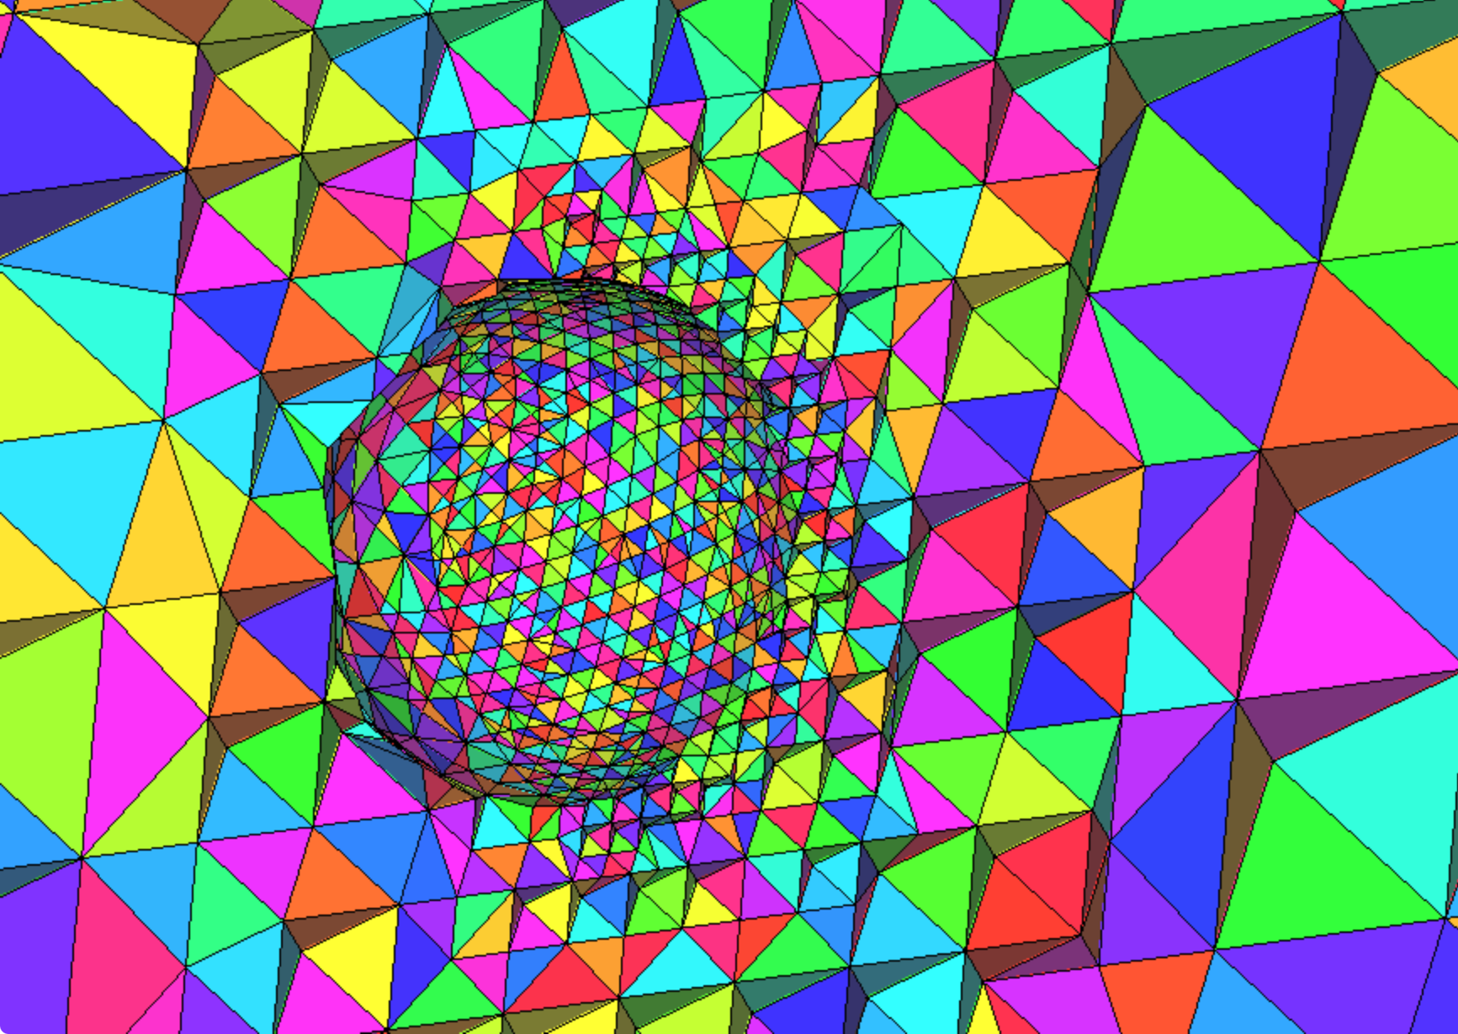
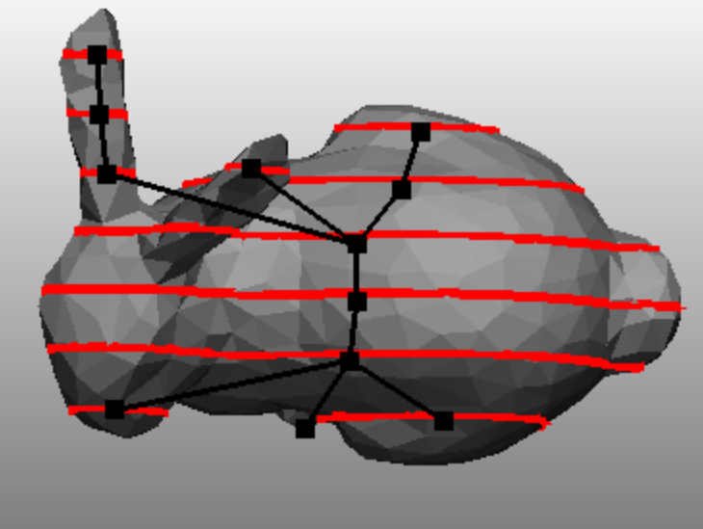
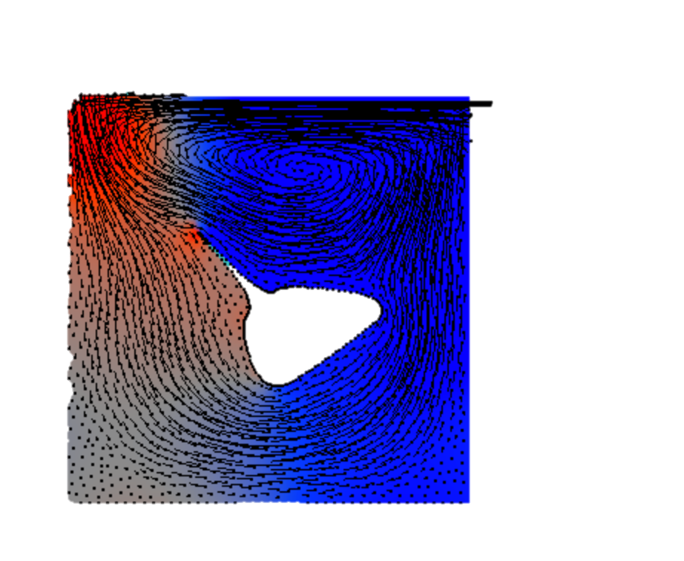
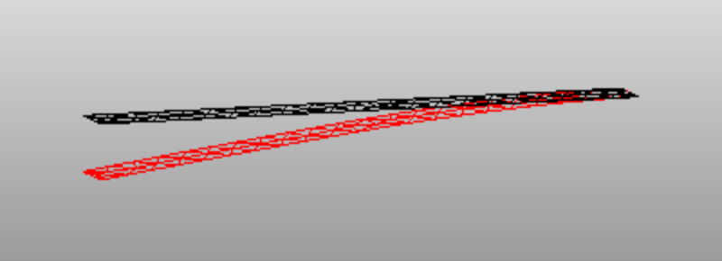
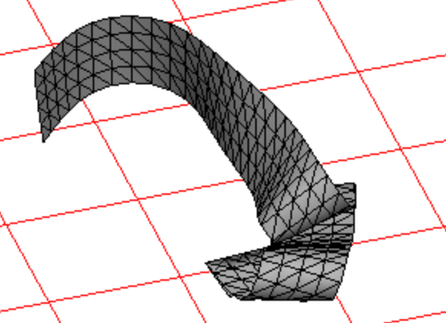
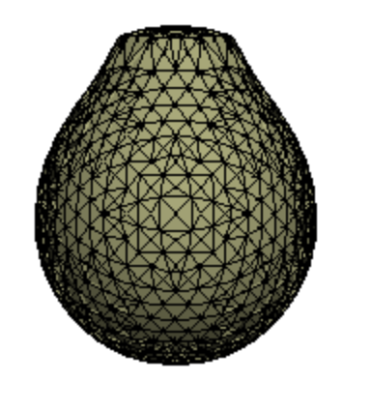
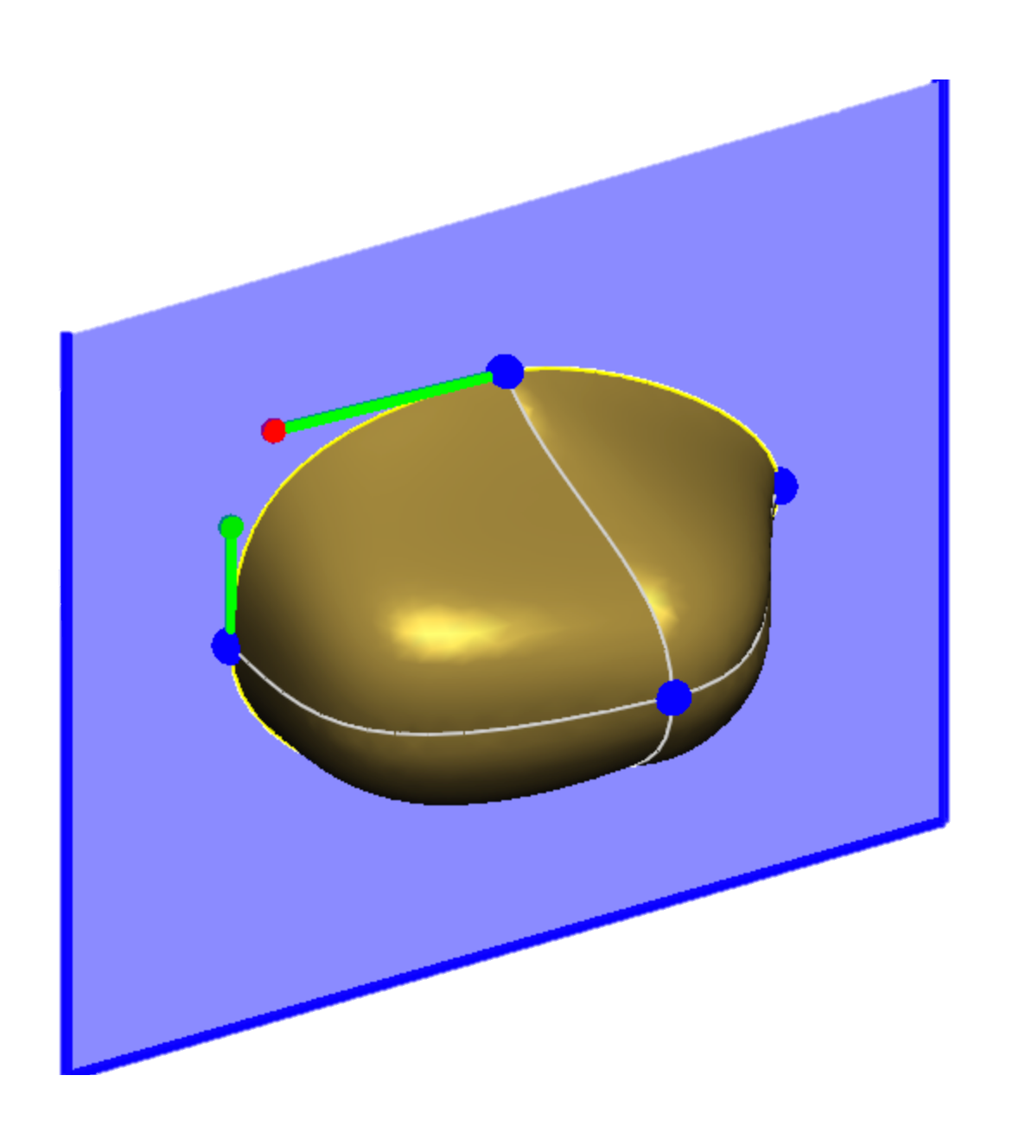
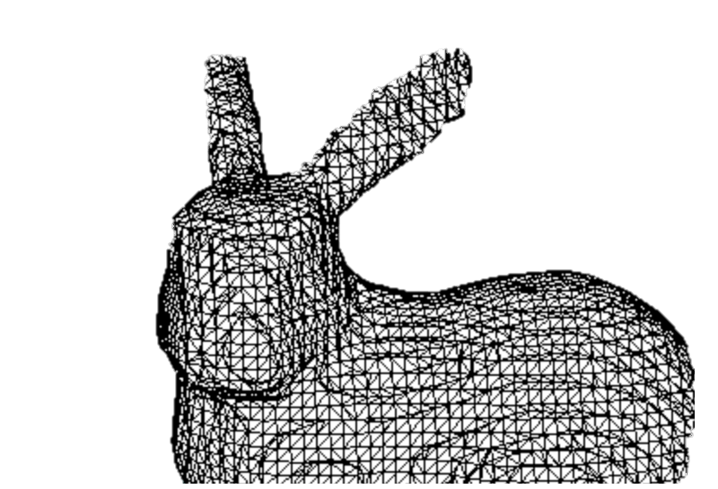
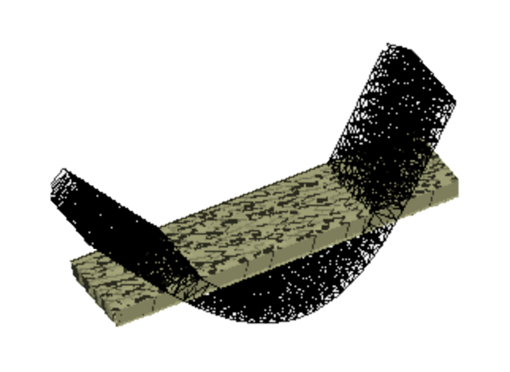
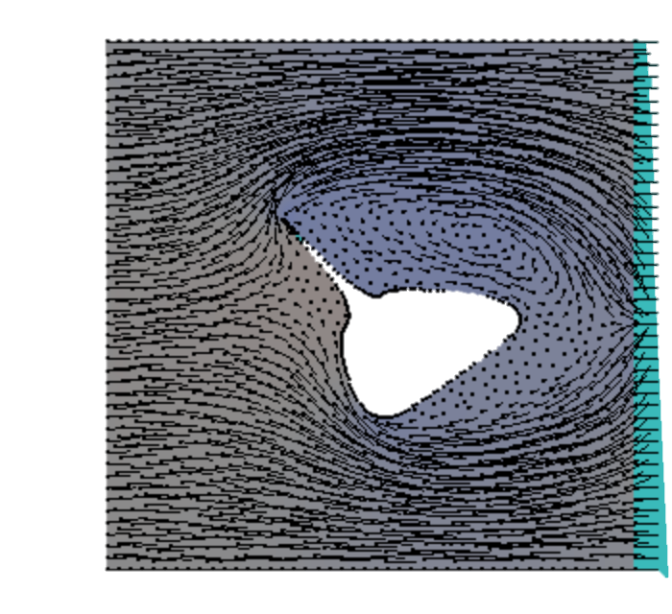
DelFEM2

