Slide 1

ELEC-E7120 Wireless Systems
“A Comparative Analysis of 4G Networks Provided by Three Different Operators and Wi-Fi Networks in Five Distinct Locations”
11.10.2023
Noor Maham Chen Xingji Okoroego Ihechukwudere Al-Humairi Mohammed

Slide 2
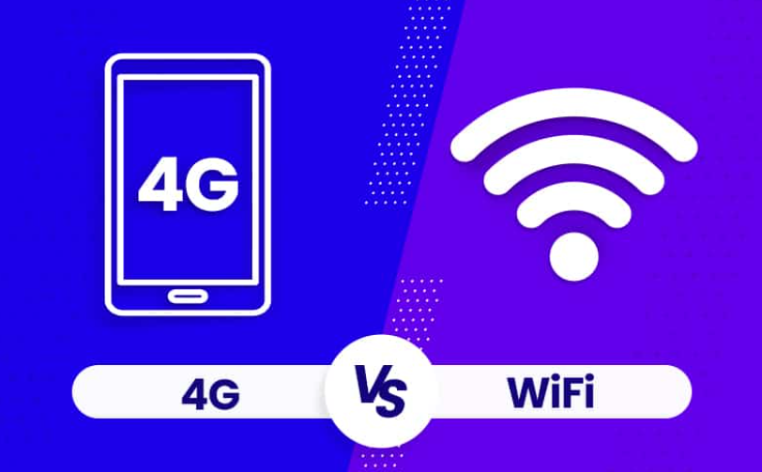
Introduction:
4G in Different Operators VS Wi-Fi: In today's digitally connected world, network performance is crucial. This presentation explores the key differences between 4G networks offered by three operators, DNA, Telia, and Elisa, and Wi-Fi networks. We will delve into the unique aspects of 4G networks, including frequency bands, signal strengths, data rates, and latency, as provided by these operators. We'll also examine Wi-Fi networks, which are widely accessible, and discuss how they compare to 4G in terms of performance.

Slide 3



Introduction:
Measurement Tools:
CellMapper
Opensignal
Wi-Fi Analyzer

Slide 4
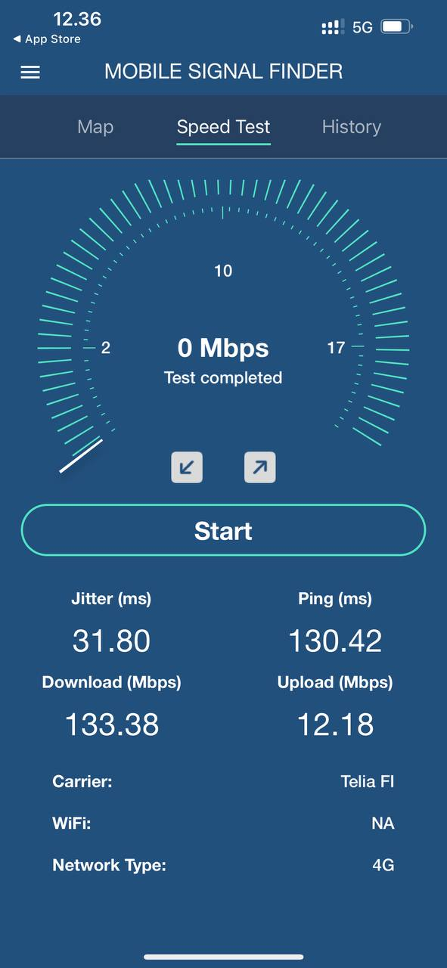

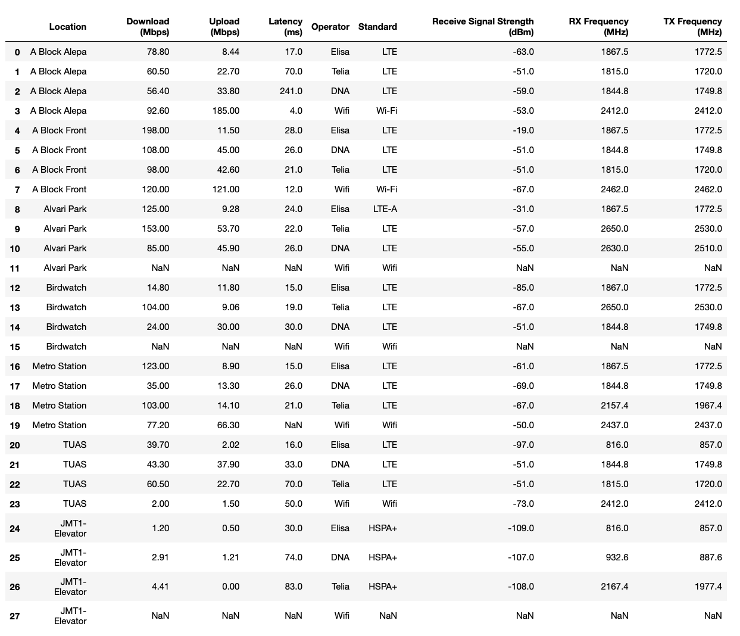
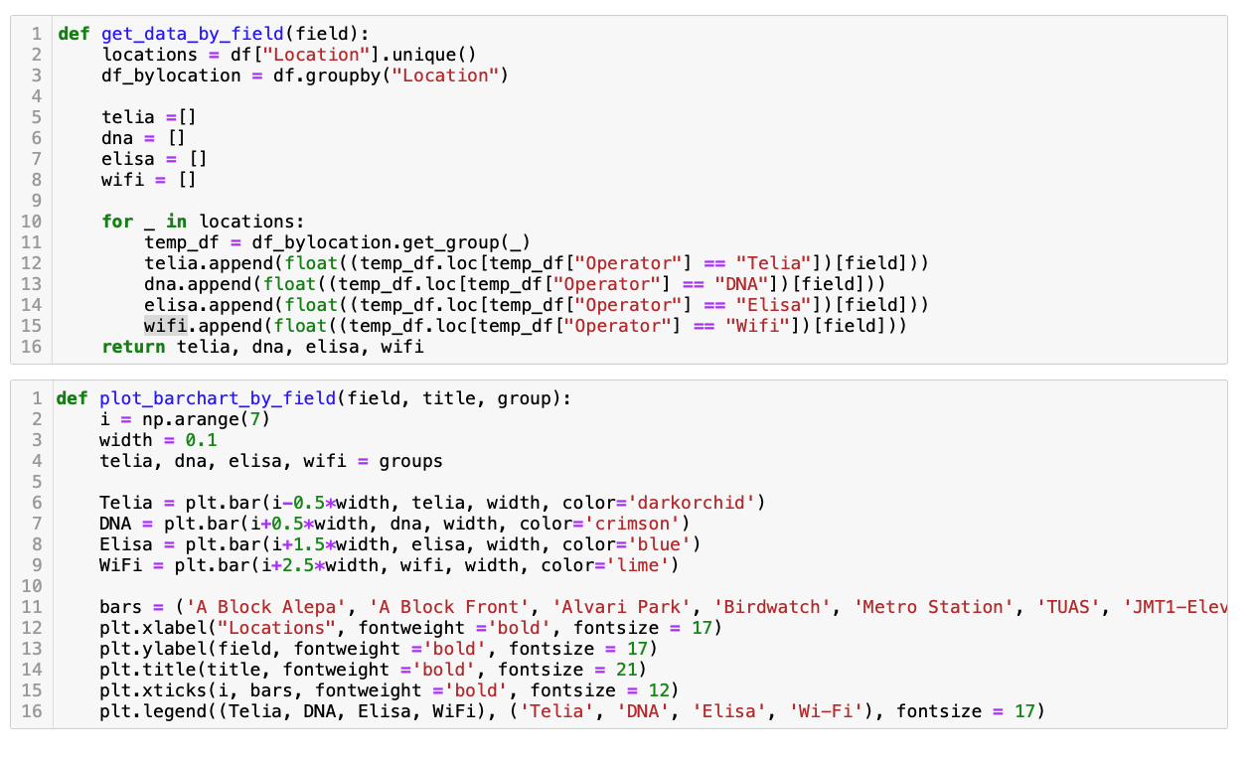
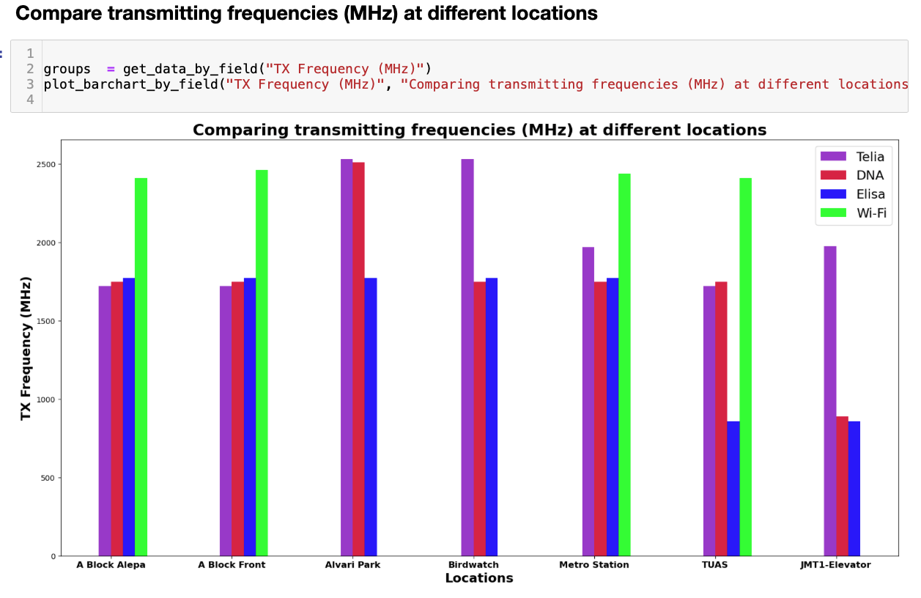
Our approach
The methodology for analyzing and visualizing the coverage of 4G and Wi-Fi networks
Conduct measurements in few locations around the campus
Organize data in an Excel sheet (Dataset)
Analyse the dataset using Python and some its libraries
Visualize dataset for comparison of the network coverages using Python and some its libraries

Slide 5
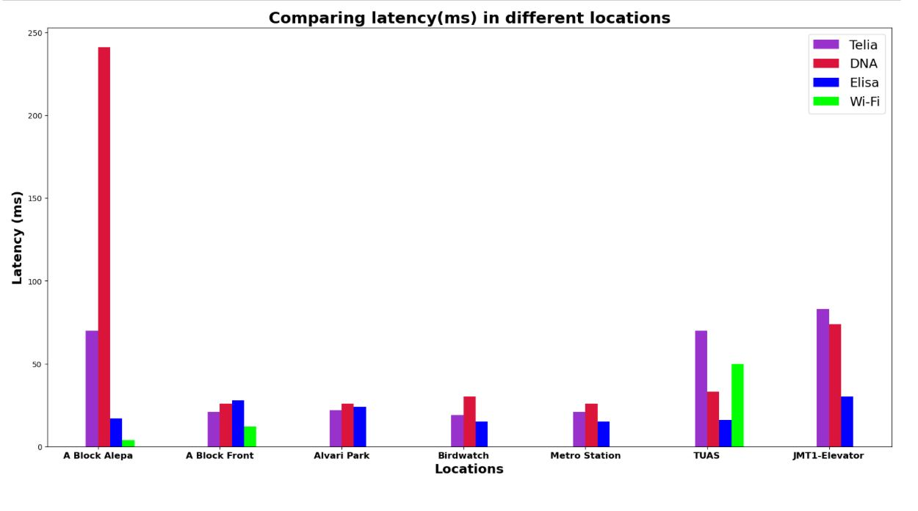
Latency
Notes:
In A bloc alepa, Teila and DNA have high latency, compared to Elisa and Wi-Fi. Due to the complex environment in the indoor situation that lead to increased latency.
The latency is low in A bloc, alvari park, birdwatch and metro station. This is understandable because outdoor environments can often achieve line of sight conditions with less signal interference.
Surprisingly, the latency did not increase significantly at the metro station, which we think is because of the installation of specific signal amplification devices to ensure the quality of the communication.
However, in TUAS, because of the high density of devices, the delay is high. Inside the elevator at JMT1, latency was high due to the familiar shielding effect of elevators on signals.
For the three different operators, elisa had relatively low latency.

Slide 6
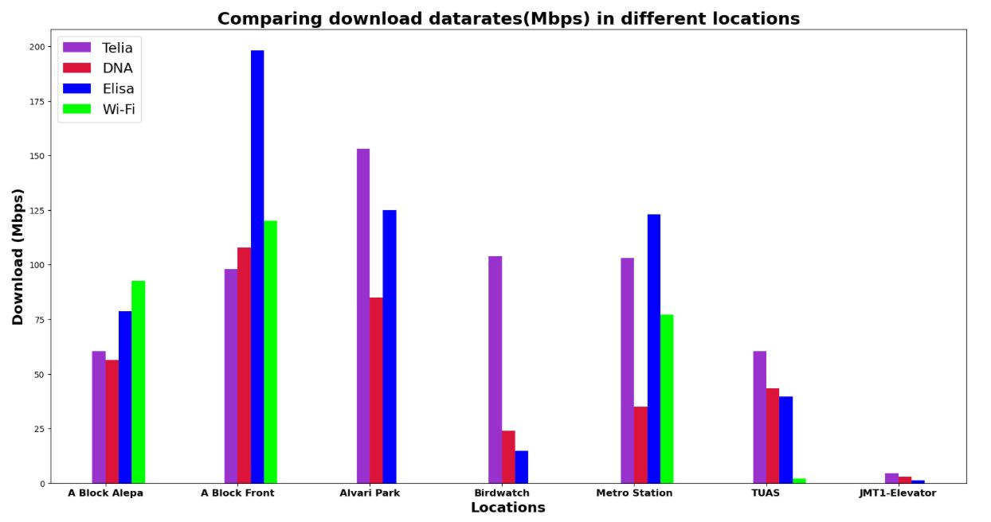
Download Data Rates
Notes:
For download rates, compared to indoor environments, rates in outdoor environments are almost always improved, except for Birdwatch, which we presume the reason is it's too far away from the base station and the signal strength is lower.
When in the elevator, the data rate was almost 0, which is not a good time to use the network.
DNA's rates tend to be worse in different operators, perhaps DNA needs to upgrade their service.

Slide 7
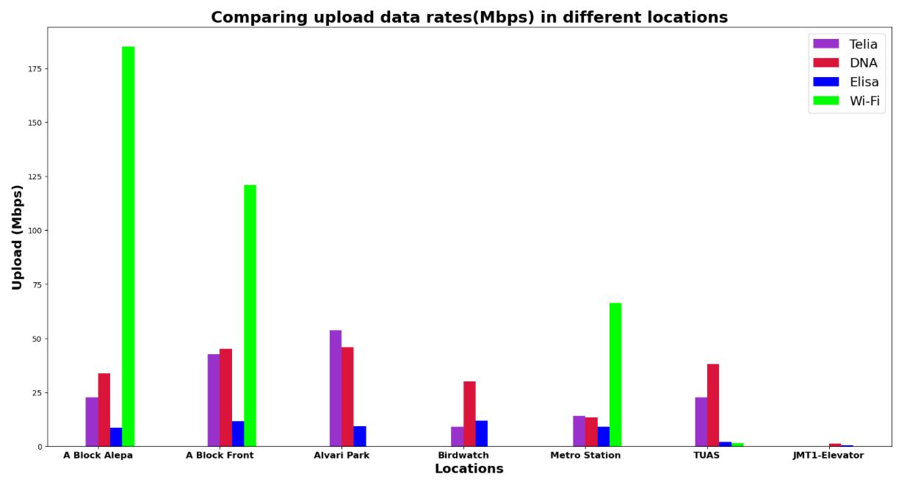
Upload Data Rates
Notes:
For upload rates, WIFI can be used to its advantage, and in many scenarios WIFI can achieve higher rates, if WIFI is available.
This changed at TUAS, where WIFI suddenly became bad, we presume because of the number of devices using WIFI is too big. Of course, in this case we would recommend using the mobile network.
We can see that DNA's upload rate is higher than the other two operators, and DNA pulls one back.

Slide 8
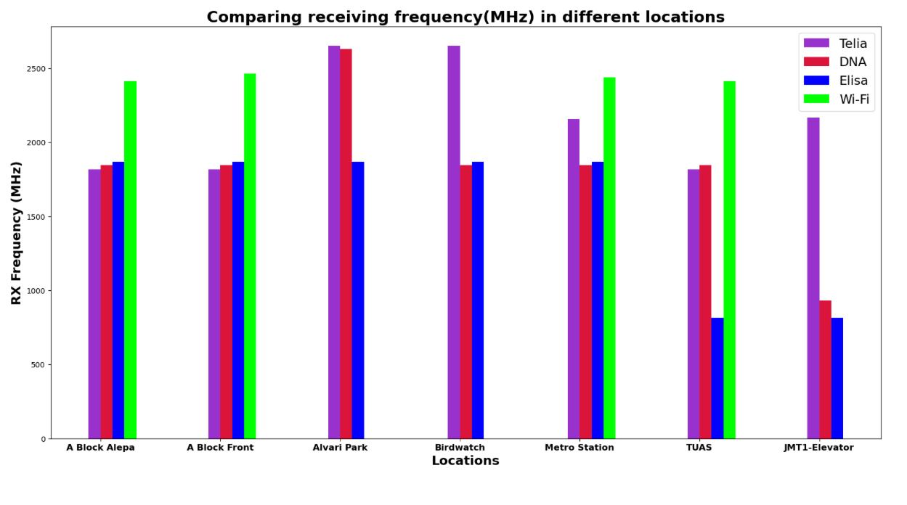
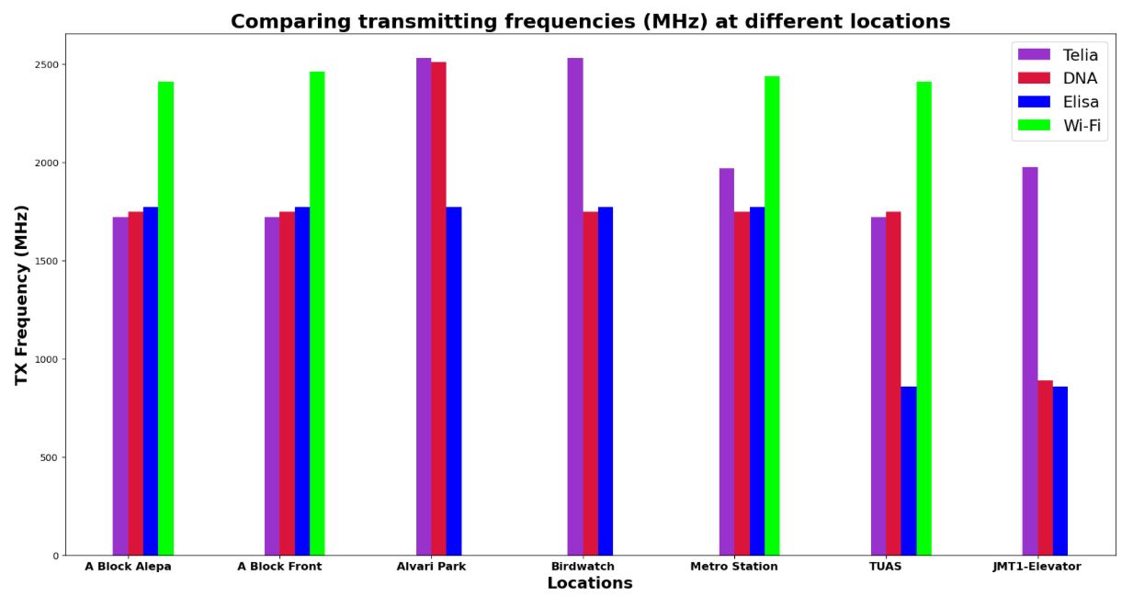
Frequency Bands
Cellular:
B3 (1800 MHz) is mostly used
JMT-1 connections were 3G
Wi-Fi: Eduroam, "only" 2.4 GHz
Few measurements used 5 GHz instead of 2.4 GHz
2.4 GHz is congested

Slide 9
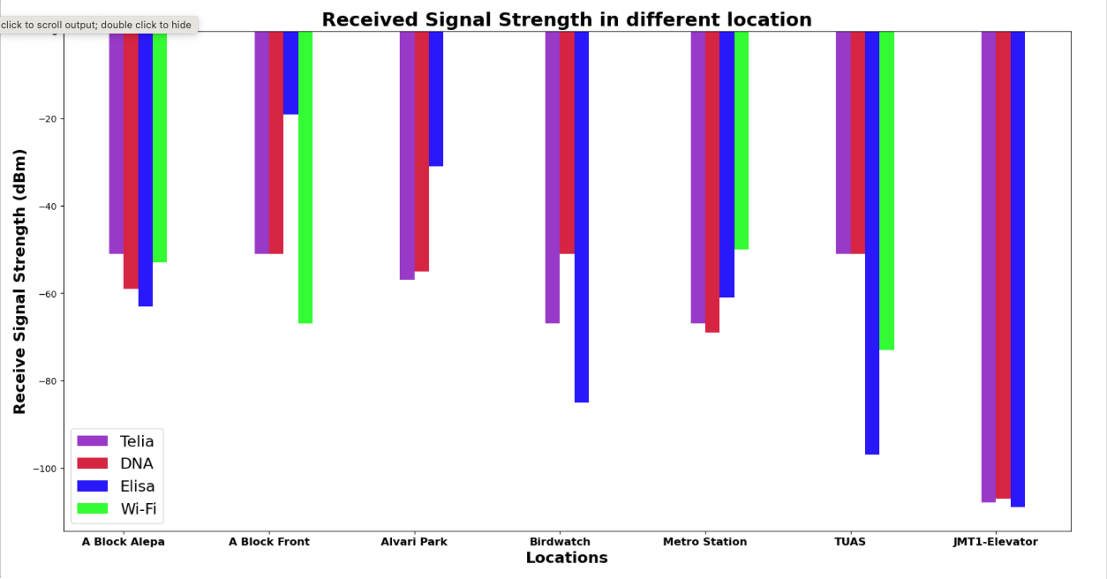
Signal Strength

Slide 10
Signal Strength
With the exception of Alvari Park and A Block, Elisa has always displayed stronger signal strength, particularly at the TUAS Building.
Additionally, there is a strong connection between DNA and Telia.
However, Wifi has had some issues and often disappears.

Slide 11
Conclusion
Analysis
Significance
Elisa has improved signal strength and download speed and minimal latency.
Though not always available, wi-fi has the fastest upload speeds.
DNA and Telia are displaying average records.
Coverage Assessment
Performance Optimization
Comparing Network Performance

Slide 12


