Slide 1

Imaging Analysis
  Aneta Siemiginowska
  Chandra X-ray Center
  Harvard-Smithsonian Center for Astrophysics

Slide 2
What are the goals of
Image Analysis in Astronomy?
Create a nice picture.
Understand the nature of the source:
    Understand the shape and size of the emitting regions
    Understand temperature distribution, velocity density distribution, composition and metallicity etc.
    Differentiate between emission processes.
    Understand energy and power involved in the observed emission
Evolution of the source and how it relates to other sources.

Slide 3
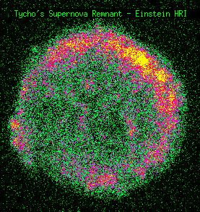
First X-ray Imaging Telescope The Einstein Observatory (HEAO-2)
Nov. 1978-April 1981
High Resolution Imager
Energy: 0.15-3 keV
Effective Area
5-20 cm2
FOV ~25 arcmin
Angular resolution
~6 arcsec!
Tycho Supernova
Remnant (1572)
Credit: HEASARC

Slide 4
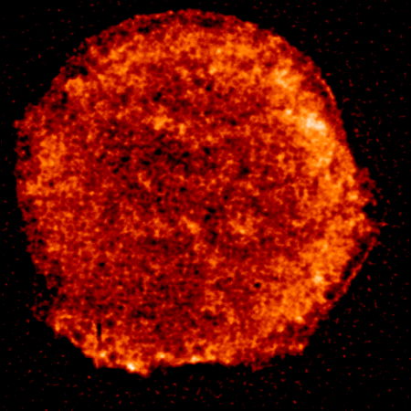
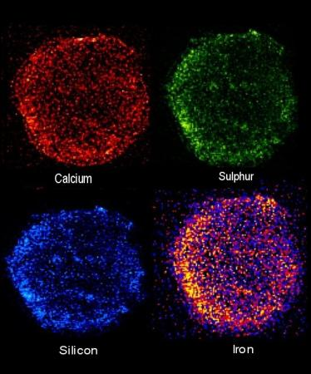
XMM Newton
Launched in Dec.1999
Energy Range: 0.1-15 keV
Effective Area:
1500 cm2 at 1 keV
FOV ~27-33arcmin
Angular resolution ~6 arcsec
Energy resolution:
E/E ~ 20-50
Tycho Supernova Remnant
Aschenbach et al (2000)

Slide 5
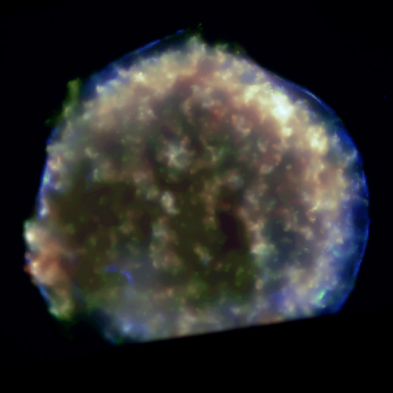
CHANDRA X-ray Observatory
Launched in July 1999
Energy Range: 0.1-10 keV
Effective Area:
ACIS-I ~ 500 cm2
HRC-I ~ 225 cm2
FOV: ACIS-I 16'x16' HRC-I: 30'x30'
Energy Resolution: E/E ~ 20-50 at 1keV
Angular Resolution < 1 arcsec
Tycho Supernova
Color-coded image
Credit: CXC

Slide 6
Angular Resolution
Einstein
Chandra
XMM
FWHM ~ 0.5 arcsec
FWHM ~ 6 arcsec

Slide 7
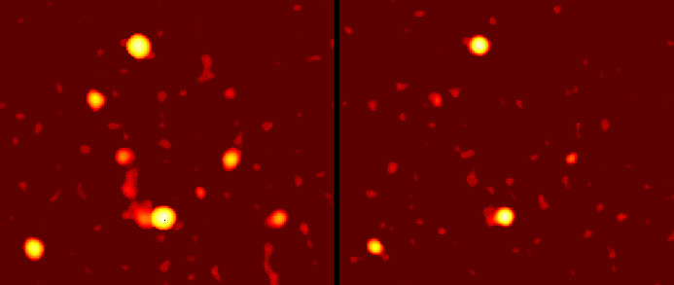
Galactic Center GRANAT/SIGMA
in high energy X-rays and gamma-rays
30-100 keV
100-1000 keV
Credit: SIGMA team
14x14 deg field
Angular resolution: 10 arcmin
Notes:
X-ray and Gamma-ray images
left panel: X-rays, 30-100keV
right panel Gamma-Rays 100-1000 keV

Slide 8
Summary
I will use CIAO software in image analysis.
(but see IRAF, FTOOLS, XIMAGE, XSPEC)
* Difference between Image and the Event file?
Binning options
* Display data in different coordinates, detector vs. sky
* Understanding the instrument.
* Instrument characteristics
* Detecting sources
building the source list for further spectral analysis
excluding the sources for the extended source analysis
* PSF effects
* Radial Profile
* 2D fitting in Sherpa
* Smoothing the image
* Image Reconstruction and Deconvolution

Slide 9
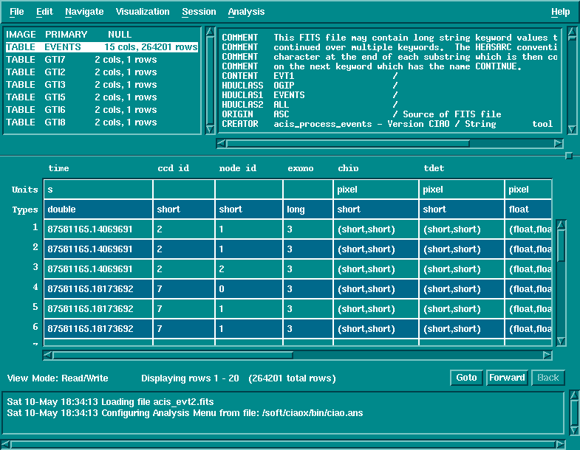
Event list and Binning
PRISM view of the Event file.

Slide 10
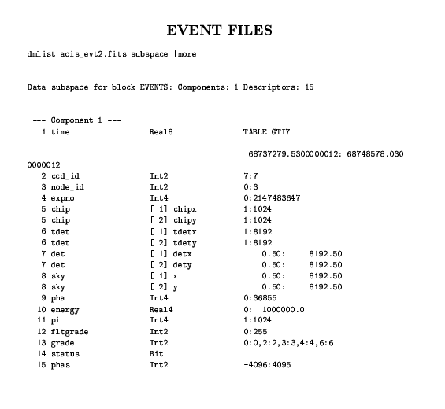

Slide 11
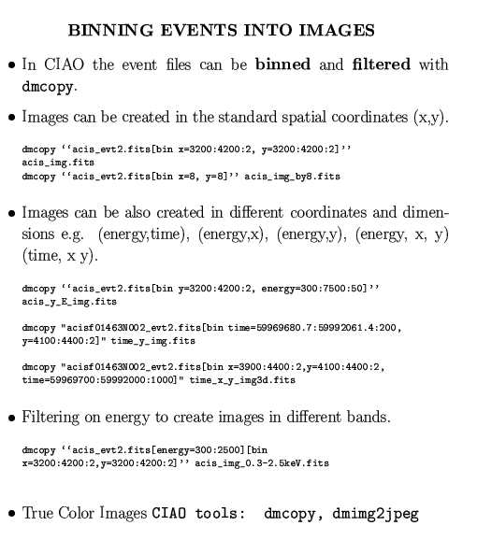

Slide 12
X-ray Images
Intensity Maps
    color represents variations in the intensity
Raw vs. Smoothed images
    true counts per pixel
    average counts/pixel
True/False color images
    color represents energy
Temperature maps
    Color represents temperature
Images from different bands: X-rays/radio/optical

Slide 13
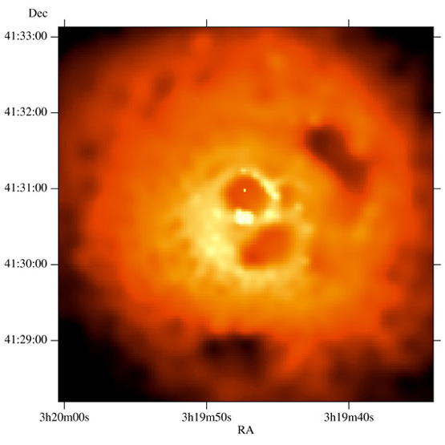
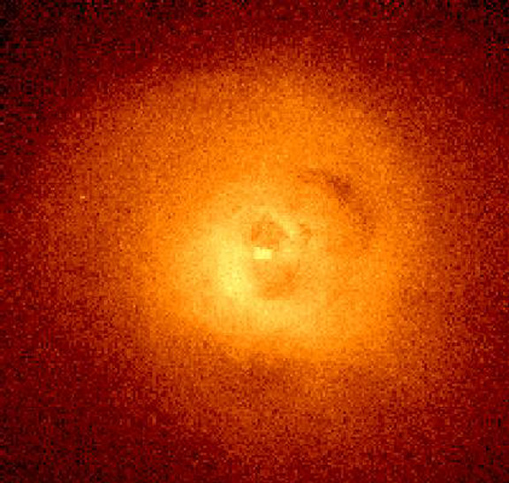
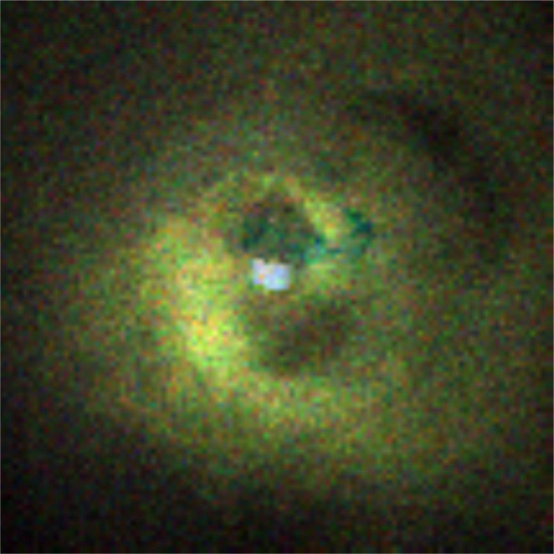
Perseus A
CHANDRA ACIS-S
Smoothed
Raw
Color coded
Fabian et al (2000)

Slide 14
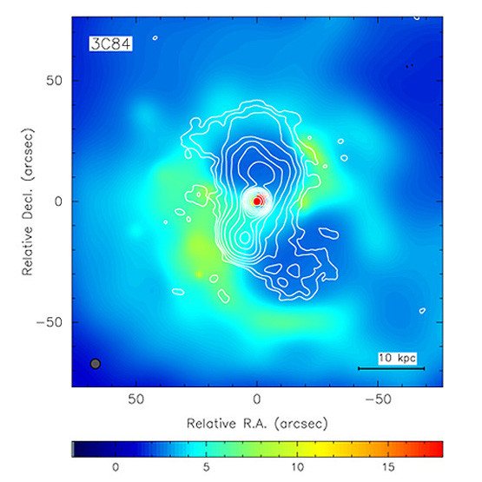
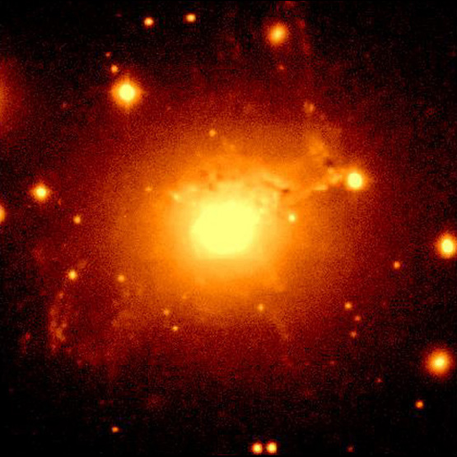
Perseus A
X-ray/Radio
Optical
Fabian et al (2000)

Slide 15
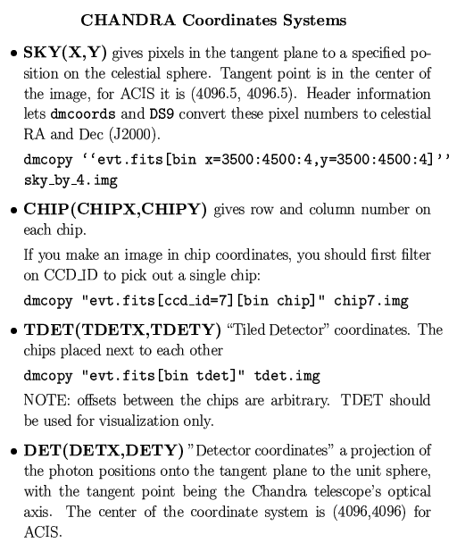
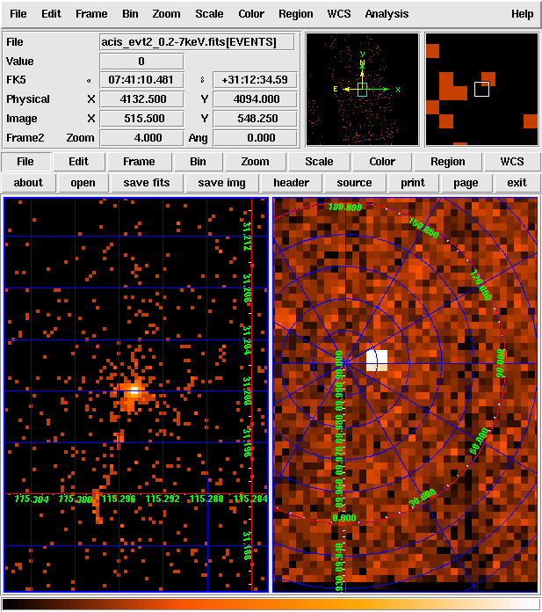
Coordinates and WCS
SKY
DET

Slide 16
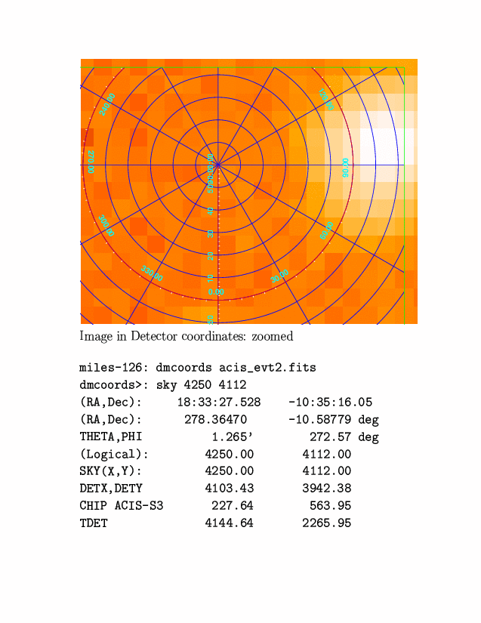
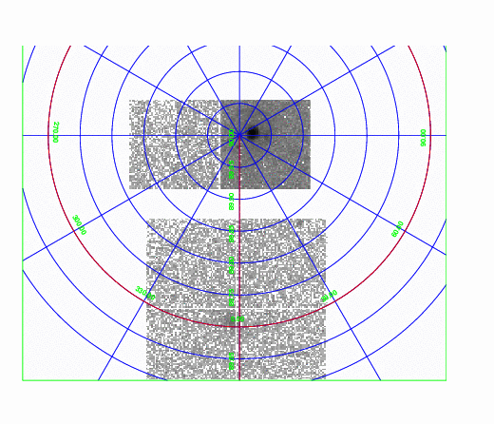
Detector Coordinates:
dmcopy "evt.fits[bin det=16]" det_by_16.img
ds9 det_by_16.img

Slide 17
Instrumental Features
Understanding the instrument:
    CCD is different than microchannel plate
Bad pixels or columns:
Hot pixels, node boundaries
Trail images

Slide 18
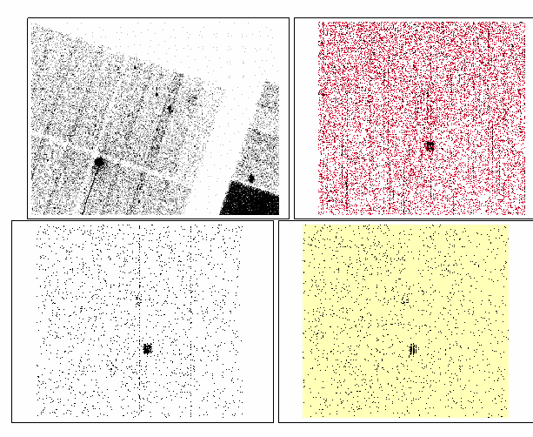
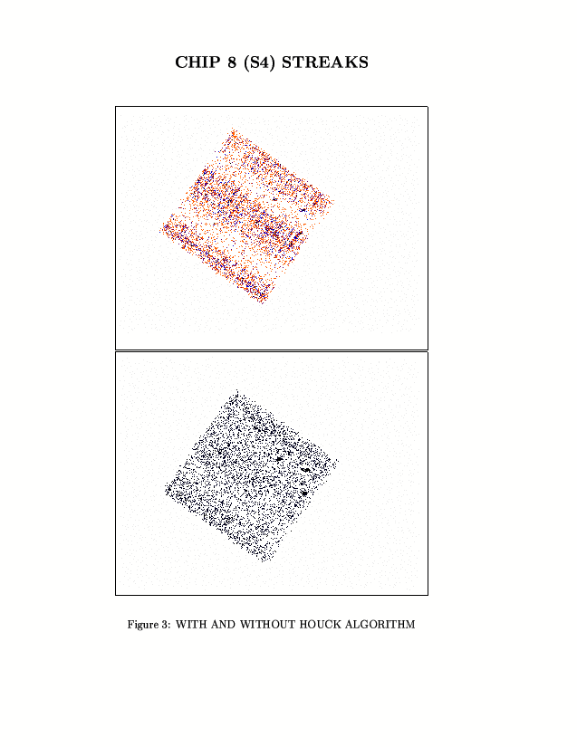
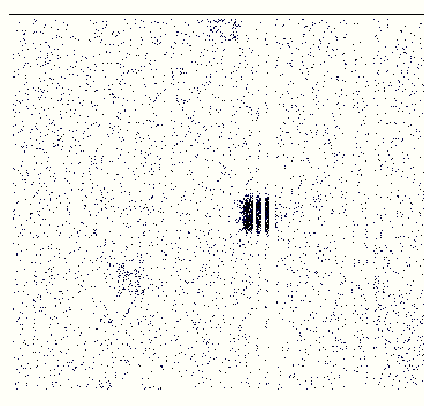
Chandra ACIS
McDowell 2001

Slide 19
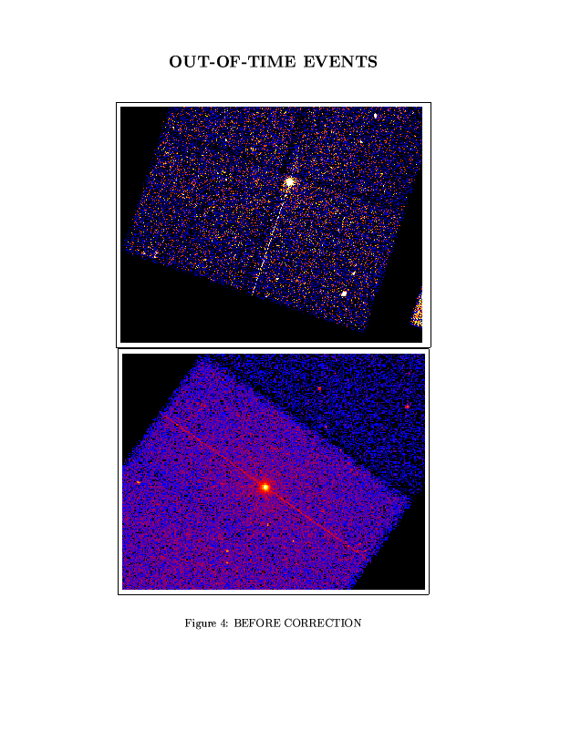
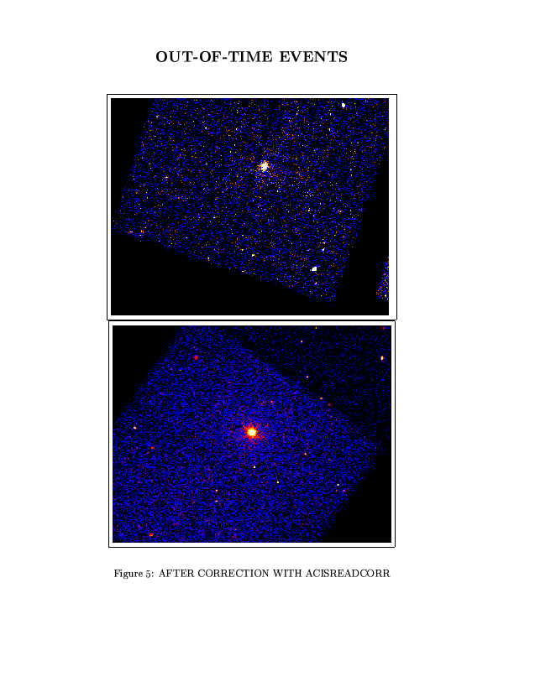
McDowell 2001

Slide 20
Instrument Characteristics
Exposure Maps
Background: instrumental and cosmic
Point Spread Function (PSF)

Slide 21
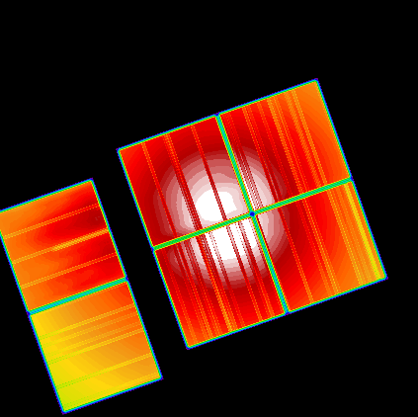
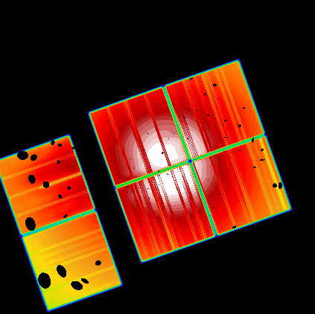
Exposure Maps
Includes:
detector quantum efficiency (QE), non-uniformity across the detector (QUE), mirrors vignietting, bad pixels and columns, chip gaps etc.
Units [cm² cts /photon]
CHANDRA ACIS
Filtered

Slide 22
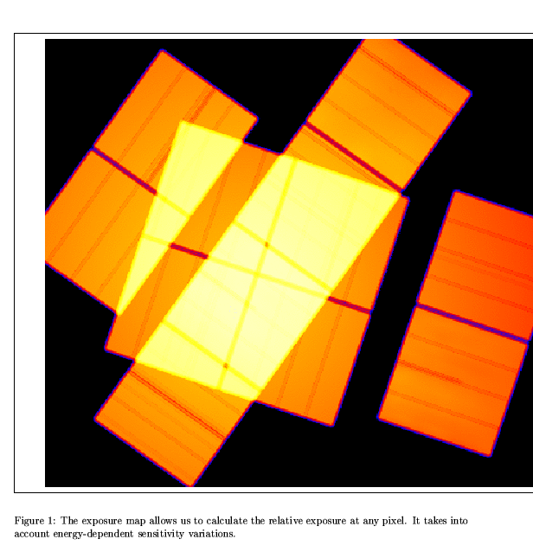
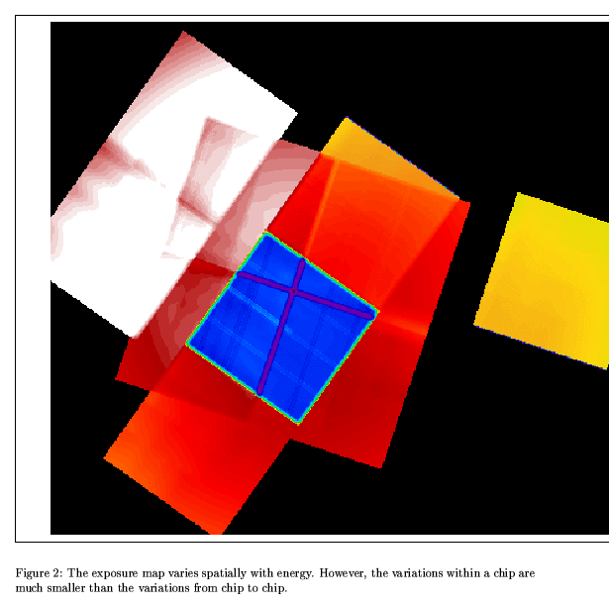
Exposure Maps
McDowell 2001

Slide 23
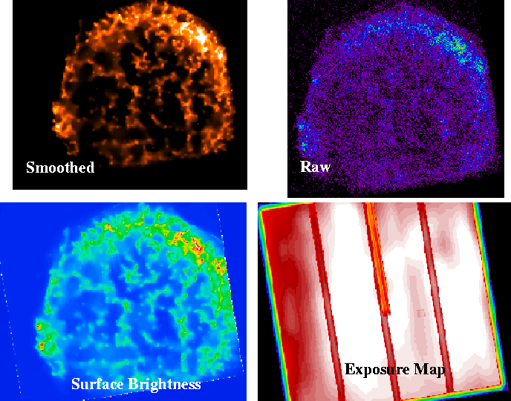
CHANDRA Image of Tycho Supernova
S = Data / (ExpMap*ExpTime)
Credit: CXC

Slide 24
Point Spread Function
Describes the shape of the image produced by a point source (delta function) on the detector: “blurring”
Depends on photon energy and the location on the sky in respect to the optical axis of the telescope.
Usually consists of the core and wings => dynamic range

Slide 25
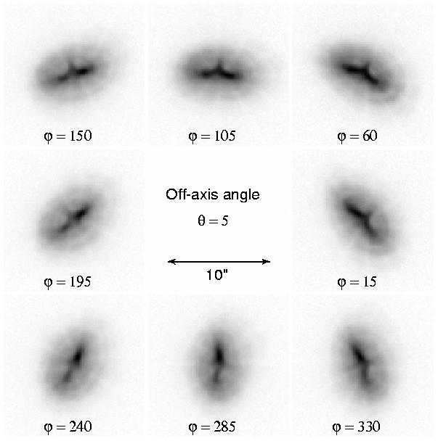
CHANDRA
PSF
5 arcmin off-axis

Slide 26
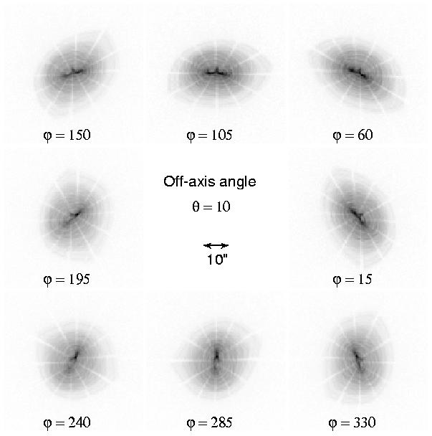
CHANDRA
PSF off- axis
10 arcmin

Slide 27
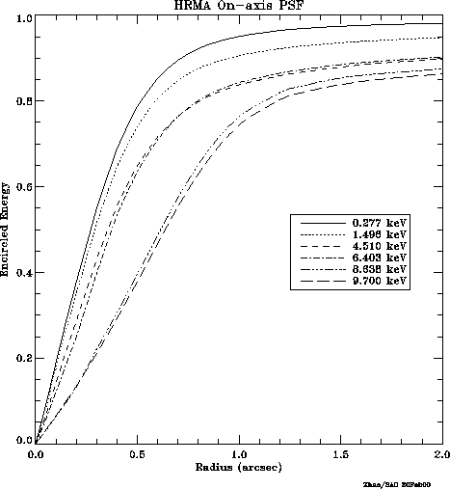
Chandra/HRMA on axis PSF
Encircled Energy:
0.277 keV
Fraction of Counts enclosed within the area of a given radius.
Energy dependent:
@ 0.277 keV 95% in 1''
@ 9.7 keV 75% in 1''
9.7 keV
Radius (arcsec)

Slide 28
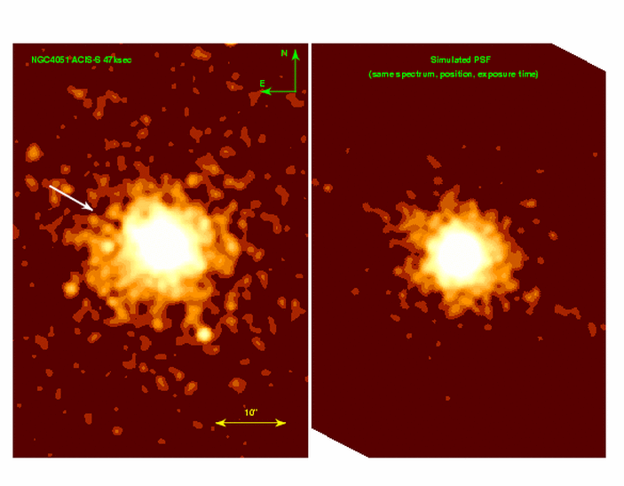
ACIS-S data
Simulated PSF
Fruscione et al 2002

Slide 29
Analysis Challenges
PSF needs to be included in the X-ray analysis.
PSF variations across the detector have to be taken into account in any multi-scale analysis.
PSF affects determination of a shape of the source.
Separation of overlapping sources:
    Size and boundaries of each source
    Luminosity of each source
Pile-up modification of the PSF

Slide 30
Background
Background radiation is common to X-ray detectors:
    Background due to diffuse X-ray background emission => contribution from unresolved sources
    Charged particle background => non-X-ray background
    Unrecognizable source contribution (trail images)

Slide 31
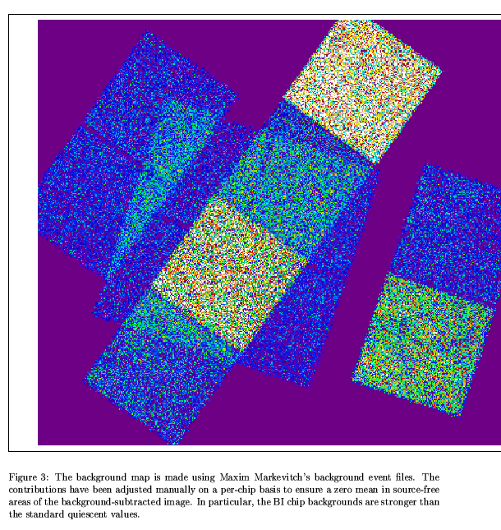
Chandra ACIS

Slide 32
Analysis Challenges
Non-uniformity of the background radiation.
Time-Variability in background intensity.
Spurious events not recognized as background and interpreted as source.

Slide 33
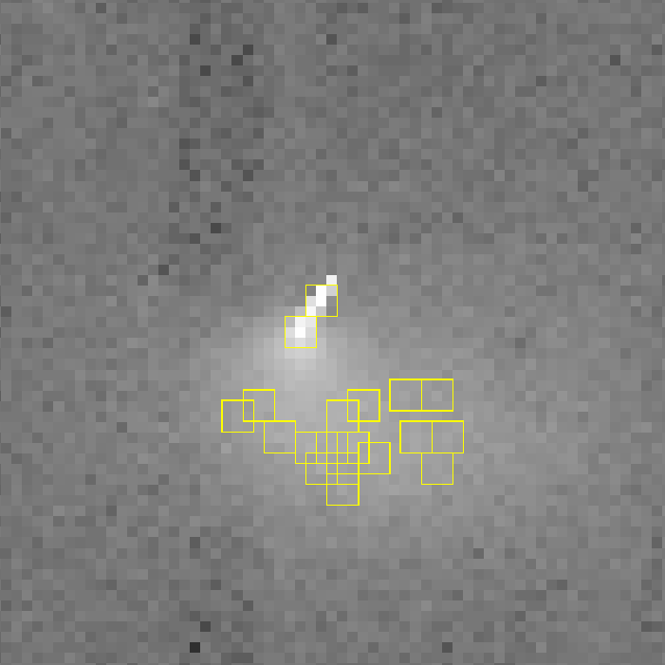
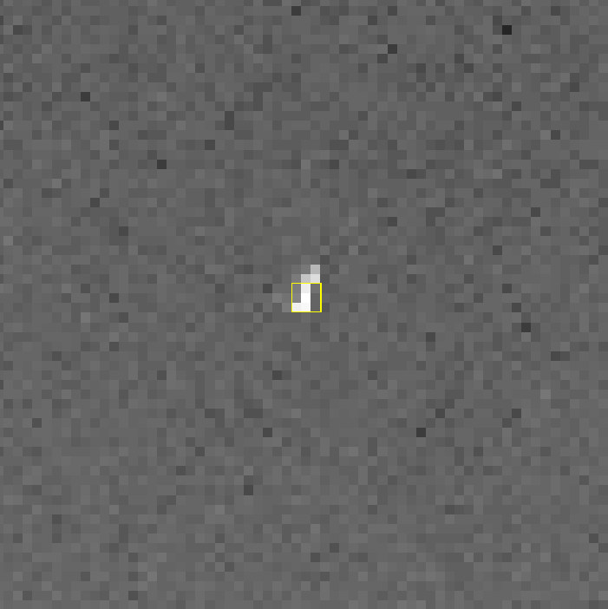
CHANDRA ACIS BACKGROUND
FI CCD
BI CCD
Effect of a Charged Particle Event

Slide 34
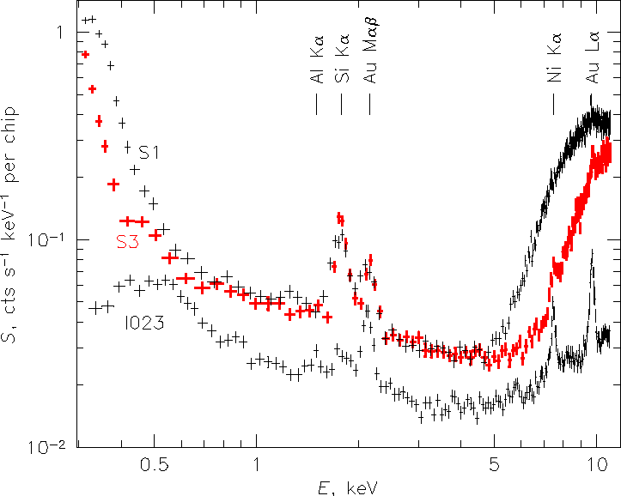
Energy Dependence of Non-X-ray Background
Chandra ACIS-S

Slide 35
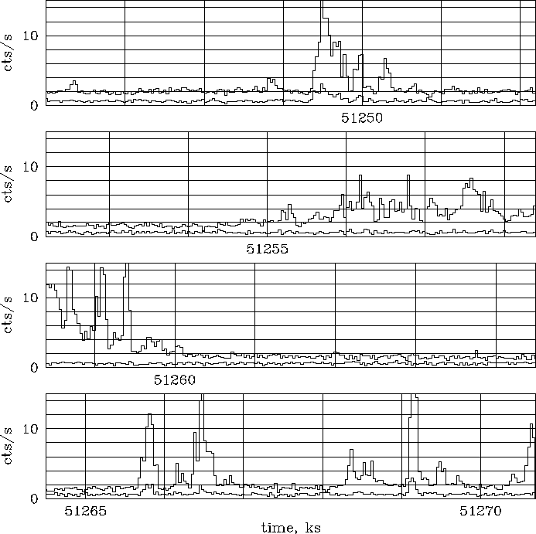
Variability and Background Flares
Chandra ACIS-S
CXC/CAL
TIME

Slide 36
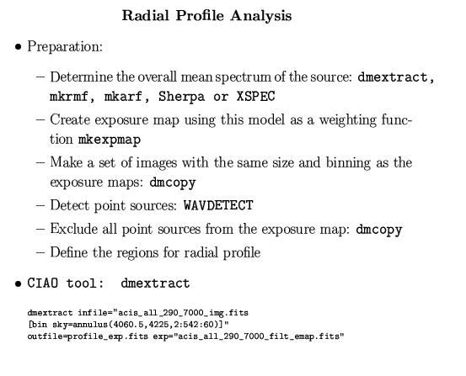
Radial Profile
Data
Simulated PSF
Fruscione et al 2002

Slide 37
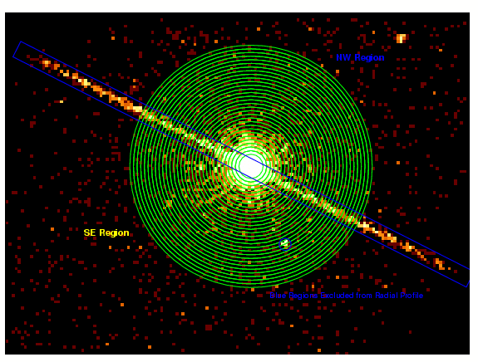
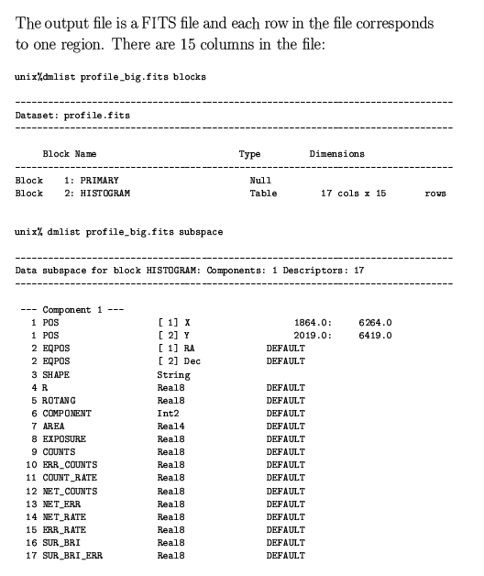
Profile file in FITS format:
NW-Region
SE -Region
Fruscione et al 2002
Excluded

Slide 38
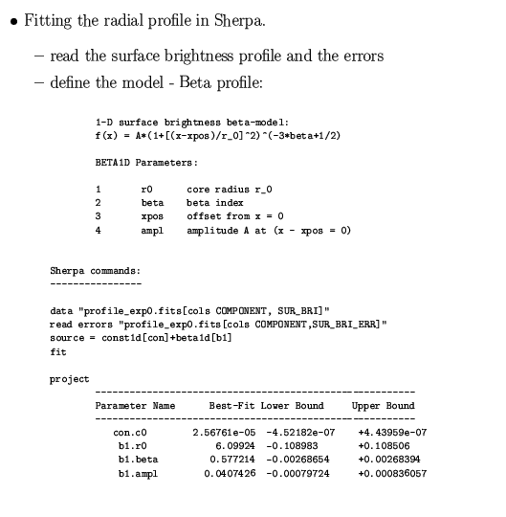
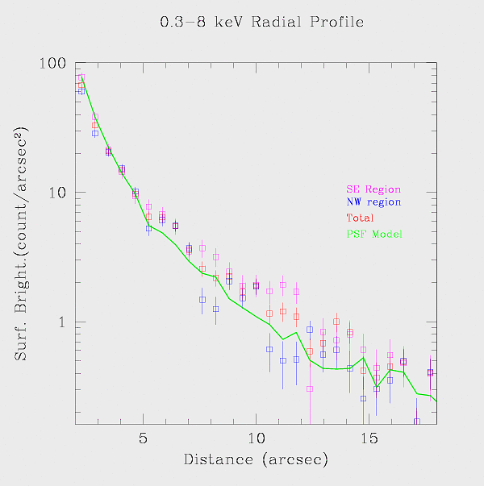
Fitting Radial Profile in Sherpa
Fruscione et al 2002

Slide 39
Image Fitting in Sherpa
* Read data: binned image
* Read error image or use Sherpa
statistics
* Display image “image data”
* Filter the image using ds9 or supply
2D filter
* Define 2D models
* Use PSF as a model or convolution
kernel
* Use Exposure Maps

Slide 40
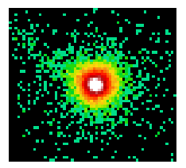
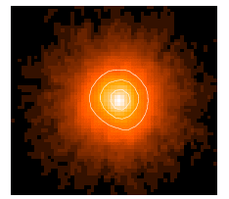
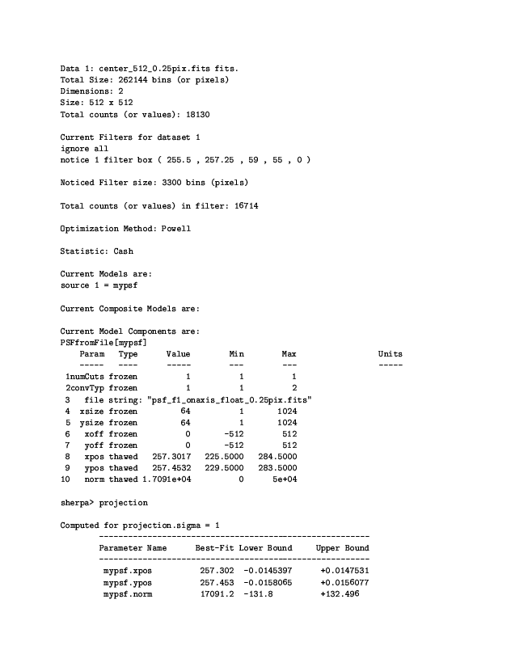
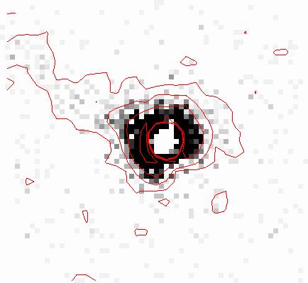
Image Data
PSF Model
Residuals

Slide 41
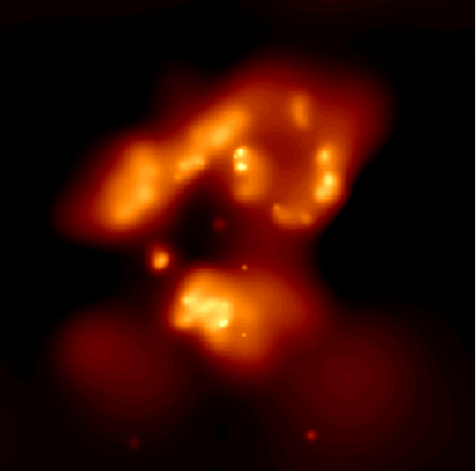
Create a Nice Picture!
=> Smoothed Images
Convolution of an Image with
a kernel function usually:
Gaussian, Box or Top Hat (wavelet)
=> aconvolve in CIAO
CSMOOTH – adaptive smoothing
with circular Gaussian or TopHat
kernel functions.
NGC 4038/39
Credit: CXC

Slide 42
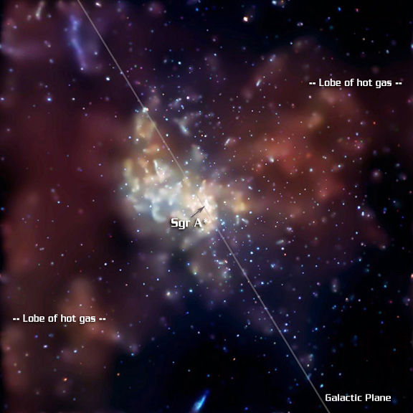
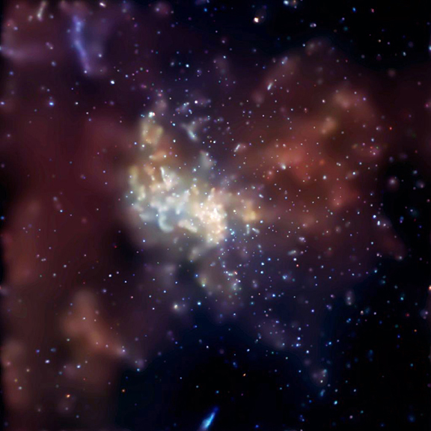
X-ray Image of the
Galactic Center
CHANDRA
ACIS 2-8 keV
Red: 2-3.3keV
Green: 3.3-4.7 keV
Blue: 4.7-8 keV
=> Smoothed Image
Exposure time
164 hrs
8.4x8.4 arcmin
Baganoff etal (2003)

Slide 43
Multiscale Statistical Methods
=> Mirroring human visual and mental processes,
in observing and interpreting phenomena
simultaneously on multiple scales
Multi-resolution methods => disentangle structures on different resolution scales in the observed image
Includes wavelet transforms, adaptive smoothing, slicing of the image.
Applications in Astronomy: filtering, image restoration, enhancements, image characterization.

Slide 44
Goals of Image Analysis
What are the shape, size and boundaries of my source?
“What degree of credibility is attached to the wispy arm structure we see emanating from the ring of supernova 1987a?” (Murtagh 1992)
How real is the X-ray jet seen in the Galactic Center?

Slide 45
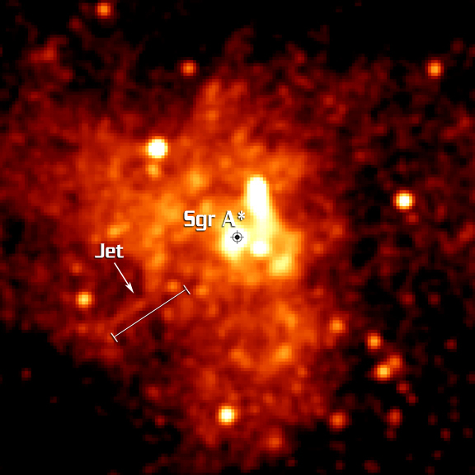
Galactic Center
Chandra/ACIS (2-8) KeV
Questions:
1. Where is the supermassive
black hole in Galactic Center?
2. Is the X-ray jet real?
1.23x1.23 arcmin
Baganoff et al (2003)

Slide 46
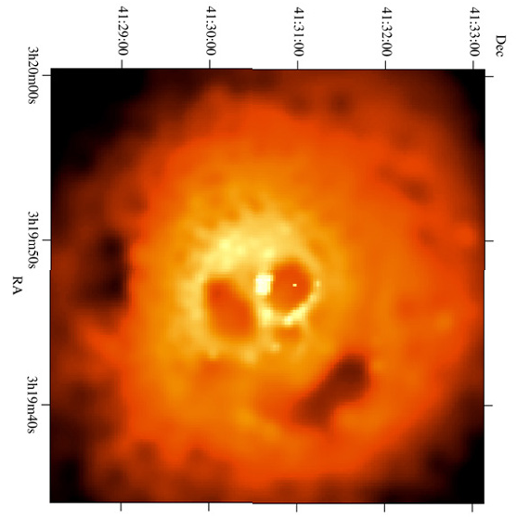

Summary

Slide 47
Some typical Questions
What is the flux of my source?
What is the detection limit in my image?
Modeling the surface brightness.
Obtaining a source centroid.
Is my source a point source? Is there an extended structure associated with this source? What is the statistical significance of this extended emission?
What is the source shape?

Slide 48



