Slide 1
Recovering High Dynamic Range Radiance Maps from Photographs
[Debevec, Malik - SIGGRAPH’97]
Presented by Sam Hasinoff
CSC2522 – Advanced Image Synthesis

Slide 2
Dynamic Range
“Range of signals within which we can operate with acceptable distortion”
Ratio = brightest / darkest
Human Eye | 10,000:1
CRT | 100:1
Real-life Scenes | up to 500,000:1

Slide 3
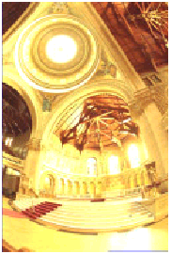
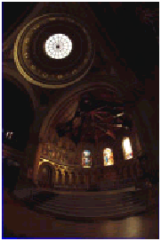
Limited Dynamic Range
saturated
underexposed

Slide 4
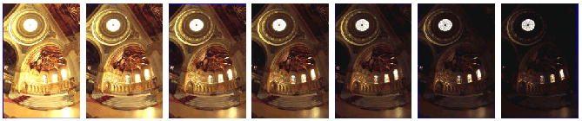
The Main Idea
How can we cover a wide dynamic range?
Combine many photographs taken with different exposures!

Slide 5
Where is this important?
Image-based modeling and rendering
More accurate image processing
  Example: motion blur
Better image compositing [video]
Quantitative evaluation of rendering algorithms, research tool

Slide 6

Image Acquisition
Pipeline
  physical scene radiance (L) →
  sensor irradiance (E) →
  sensor exposure (X) →
  { development → scanning → }
  digitization →
  re-mapping digital values →
  final pixel values (Z)

Slide 7
Reciprocity Assumption
Physical property
Only the product EΔt affects the optical density of the processed film
X := EΔt
  exposure X
  sensor irradiance E
  exposure time Δt

Slide 8
Formulating the Problem
Nonlinear unknown function, f(X) = Z
  exposure X
  final digital pixel values Z
  assume f increases monotonically (invertible)
Z_{ij} = f(E_{i}Δt_{j})
  index over pixel locations i
  index over exposures j

Slide 9
Some Manipulation
We invert to get f ^{–1}(Z_{ij}) = E_{i}Δt_{j}
g := ln f ^{–1}
g(Z_{ij}) = ln E_{i} + ln Δt_{j}
Solve in the least-error sense for
  sensor irradiances E_{i}
  smooth, monotonic function g

Slide 10
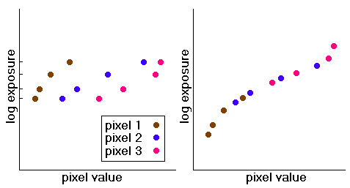
Picture of the Algorithm

Slide 11
Solution Strategy
Minimize
  Least-squared error
  Smoothness term
Exploit discrete, finite world
  N pixel locations
  Domain of Z is finite = (Z_{max} – Z_{min} + 1)
Linear least-squares problem (SVD)

Slide 12

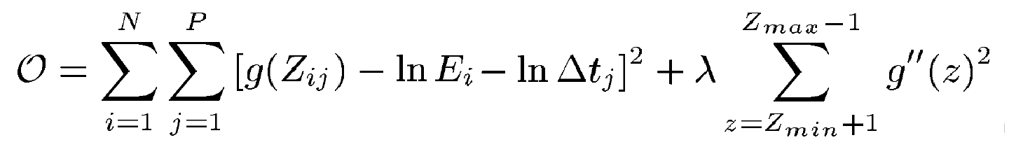
Formulae
Given
Find the
  N values of ln E_{i}
  (Z_{max} – Z_{min} + 1) values of g(z)
That minimizes the objective function

Slide 13

Getting a Better Fit
Anticipate the basic shape
  g(z) is steep and fits poorly at extremes
  Introduce a weighting function w(z) to emphasize the middle areas
Define Z_{mid} = ½(Z_{min} + Z_{max})
Suggested w(z) =
  z – Z_{min} for z ≤ Z_{mid}
  Z_{max} – z for z > Z_{mid}

Slide 14
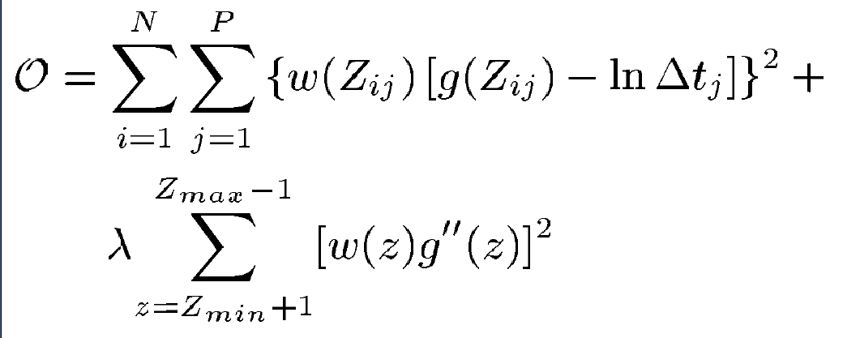
Revised Formulae
Given
Minimize the objective function

Slide 15
Technicalities
Only good to some scale factor (logarithms!)
  Add the extra constraint Z_{mid} = 0
  Or calibrate to a standard luminaire
Sample a small number of pixels
  Perhaps N=50
  Should be evenly distributed from Z
Smoothness term
  Approximate g´´ with divided differences
  Not explicitly enforced that g is monotonic

Slide 16
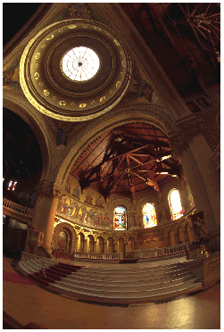
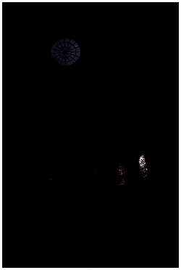
Results 1
actual photograph
(Δt = 2 s)
radiance map
displayed linearly

Slide 17
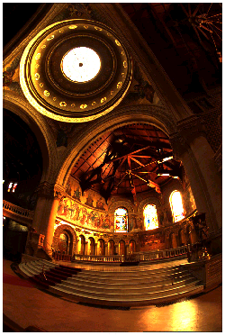
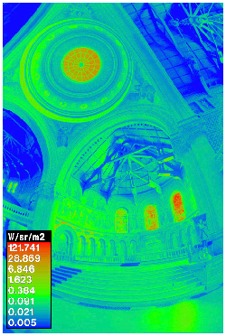
Results 2
lower 0.1% of the radiance map (linear)
false color (log) radiance map

Slide 18
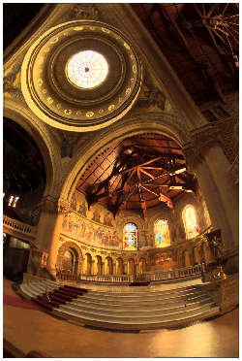
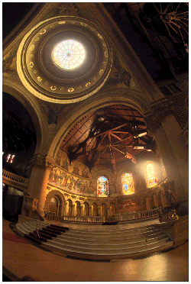
Results 3
histogram compression
…plus a human perceptual model

Slide 19
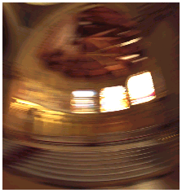
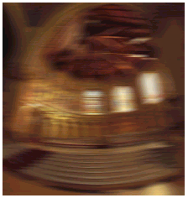
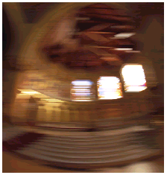
Motion Blur
actual blurred photograph
synthetically blurred
digital image
synthetically blurred
radiance map

Slide 20

[Video]
FiatLux (SIGGRAPH’99)
Better image compositing using high dynamic range reflectance maps

Slide 21

The End?
References (SIGGRAPH)
  High Dynamic Range Radiance Maps (1997)
  Synthetic Objects Into Real Scenes (1998)
  Reflectance Field of a Human Face (2000)
Questions

