Slide 1
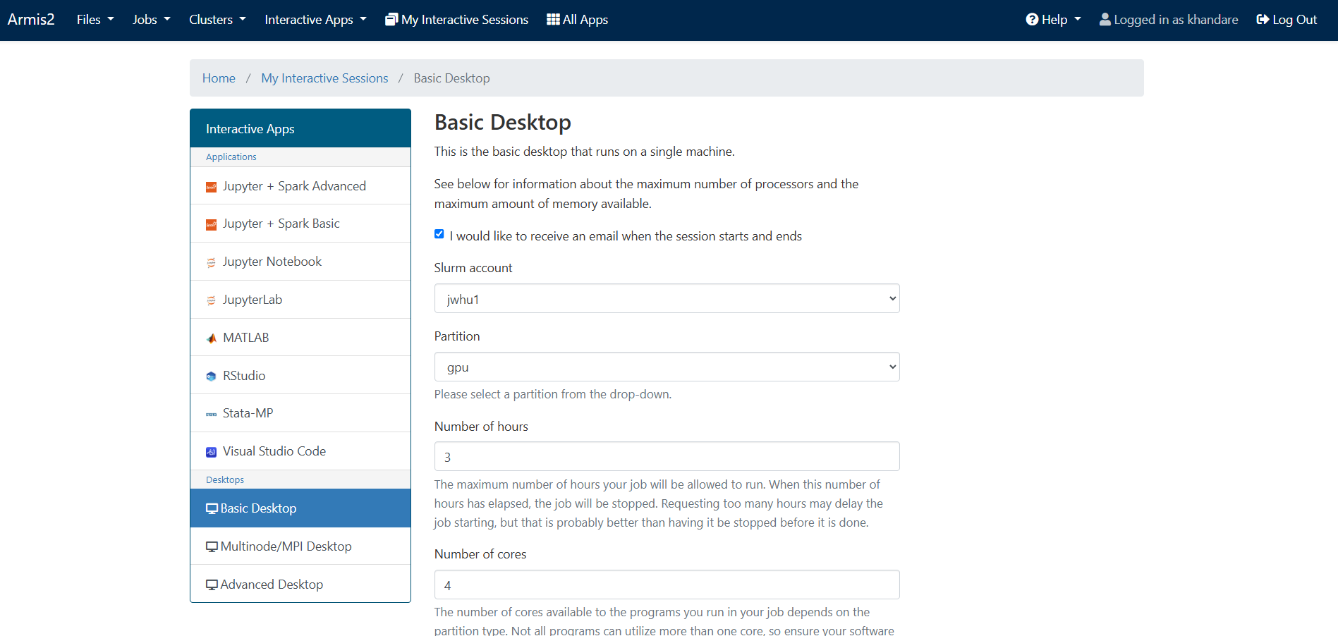
Installing 3DSlicer in Armis2
Login to Armis2
Under “Interactive Apps”→ select “Basic Desktop”
Enter the partition, time, nodes, cores etc.
For now, enter the following:
  Slurm account jwhu1
  Partition gpu
  Number of hours 3
  Number of cores 4
  Memory (GB) 50
  Number of GPUs 1
Wait for the session to start

Slide 2
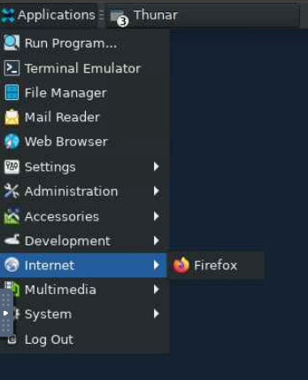
Installing 3DSlicer in Armis2
Once the session starts, navigate to “Applications” → “Internet” → “Firefox”
Go to https://download.slicer.org/
Download the latest stable version of 3DSlicer to the Downloads folder
Once it is downloaded, open the Terminal and unzip the downloaded file by running the following command
  tar xzvf ~/Downloads/Slicer-5.8.0-linux-amd64.tar.gz -C ~/ (ensure to modify the version if necessary)
Navigate to the following directory “/home/khandare/Slicer-5.8.0-linux-amd64/lib/Slicer-5.8/”
Delete the file “libcrypto.so.1.1” (It is apparently a bug in 3DSlicer’s linux version)

Slide 3
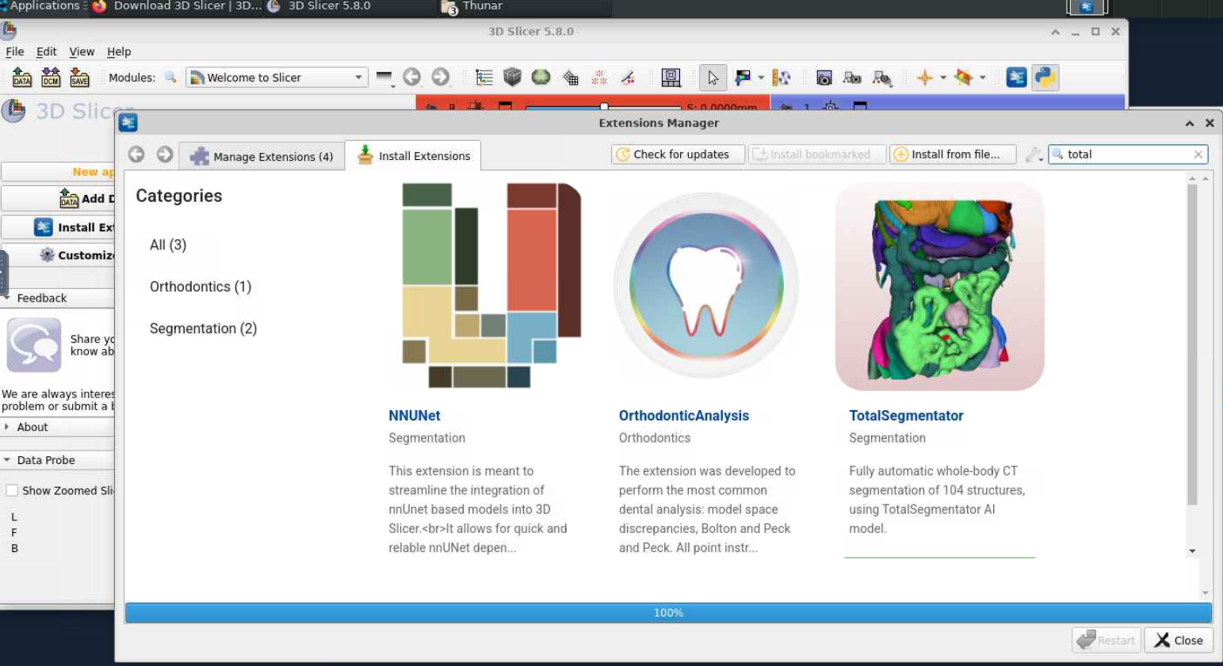
Installing TotalSegmentator in 3DSlicer
Go to “/home/khandare/Slicer-5.8.0-linux-amd64/” and open Slicer
From “Extension Manager”, search for “TotalSegmentator” and install it
In the Python Console, run the following to install the dependencies
  slicer.util.pip_install("torch==2.0.0 torchvision==0.15.1 torchaudio==2.0.0 --index-url https://download.pytorch.org/whl/cu118")
Once everything is installed, run TotalSegmentator on a sample scan to to verify that everything is installed correctly.

Slide 4
Installing Dependencies
In the Terminal, run the following commands
  module load python
  pip install --user torch==2.5.0+cu118 torchvision==0.20.0+cu118 torchaudio==2.5.0+cu118 --index-url https://download.pytorch.org/whl/cu118
  pip install --user "numpy<2"
  pip install --user nnunetv2==2.5.2
  pip install --user totalsegmentator
To ensure everything is correctly installed, run the following
  python -c "import torch; print(torch.__version__); print(torch.cuda.is_available()); print(torch.version.cuda)"
  python -c "import torchvision; print(torchvision.__version__)"
  python -c "import totalsegmentator; print(totalsegmentator.__version__)"
  python -c "import nnunetv2; print(nnunetv2.__version__)"
  python -c "import numpy; print(numpy.__version__)"

Slide 5
Setting up data for nnU-Net
The following steps are assuming you have CT data in dicom (.dcm) format and ground truth segmentations in STL or PLY format.
The required MATLAB and python scripts for executing the following steps are located in
“K:\Processing\Chest\Khandare_Scripts” or
“K:\Processing\Foot_and_Ankle\SK\Khandare_Scripts”.
DO NOT MODIFY THESE SCRIPTS DIRECTLY, MAKE A COPY OF THE FILE BEFORE MAKING ANY CHANGES
Ensure to take a closer look at what exactly the scripts are doing, this will help you make changes if/when necessary.
If you already have the CT data in .nii.gz format, you can skip the first 2 steps.
Copy folder which has max slices (Count_Max_Slices.m) – the CT data for a subject sometimes has multiple folders, this script chooses the folder which has the maximum number of slices for resampling
Resample and save as nii.gz (Khandare_Reslice_TotalSeg_Foot_Ankle_App_Bones.py) – this code also runs TotalSegmentator. If you only need resampling, comment out the TotalSegmentator-related sections.
Run the .py code (modify the file name when necessary) in the python console as “exec(open('K:/Processing/Chest/Khandare_Scripts/Khandare_Reslice_TotalSeg_Foot_Ankle_App_Bones.py').read())”

Slide 6
Setting up data for nnU-Net
Convert .ply/.stl files to label maps/segmentations (Creating_Binary_Labelmaps_SK.py)
Rename files such that they are in the following format (Rename_and_Copy_Data_for_nnUNet.m) – nnU-Net requires a specific file structure. This code ensures that segmentation and CT data are correctly named and organized.
│── SK/
│ │── meta.csv # Metadata file defining train/val/test splits
│ │── CF2002/
│ │ │ ── ct.nii.gz # The CT scan of subject CF2002
│ │ │ ── segmentations/
│ │ │ │ ── rib_left_1.nii.gz # Segmentation for rib left 1
│ │ │ │ ── rib_left_2.nii gz # Segmentation for rib left 2
│ │ │ │ ── ...
│ │ │ │ ── sternum.nii.gz
│ │ │ │ ── costal_cartilages.nii.gz
│ │── CF2003/
│ │ │ ── ct.nii.gz # The CT scan of subject CF2003
│ │ │ ── segmentations/
│ │ │ │ ── rib_left_1.nii.gz # Segmentation for rib left 1
│ │ │ │ ── rib_left_2.nii gz # Segmentation for rib left 2
│ │ │ │ ── ...
│ │ │ │ ── sternum.nii.gz
│ │ │ │ ── costal_cartilages.nii.gz

Slide 7
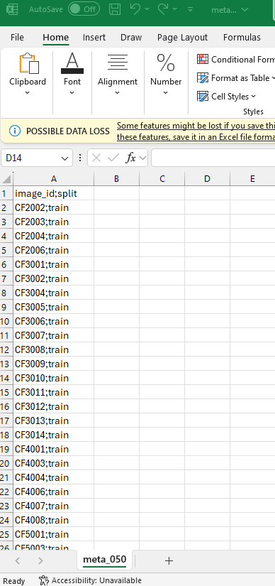
Converting the dataset to nnU-Net
The meta.csv should be in the following format. It is a metadata file defining training (train) or validation (val) or test (test) splits
To convert the dataset to nnU-Net format, run the following command in the Terminal
  python convert_dataset_to_nnunet.py /nfs/turbo/coe-mreedsensitive/Processing/Chest/TotalSegmentator_FineTuning/SK/ /nfs/turbo/coe-mreedsensitive/Processing/Chest/TotalSegmentator_FineTuning/nnUNet_raw/Dataset050_TotalSegmentator_part_ribs class_map_part_ribs
convert_dataset_to_nnunet_050.py
  This is calling a Python script (convert_dataset_to_nnunet.py) that converts a dataset into a format compatible with nnU-Net
/nfs/turbo/coe-mreedsensitive/Processing/Chest/TotalSegmentator_FineTuning/SK/
  This is the directory where your dataset is stored.
  Changing this path would mean using a different dataset as input.
NOTE: The above step is CPU intensive, and it will take a long time (~3-5 mins per subject) depending on the number of cores requested.

Slide 8
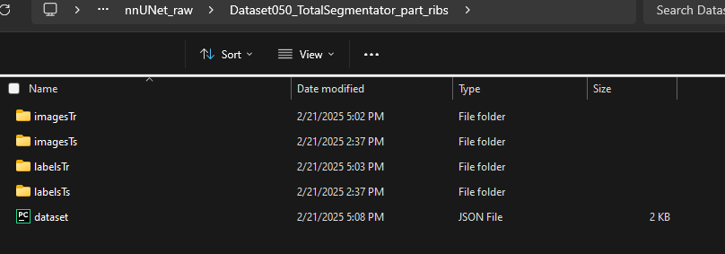
Converting the dataset to nnU-Net
/nfs/turbo/coe-mreedsensitive/Processing/Chest/TotalSegmentator_FineTuning/nnUNet_raw/Dataset050_TotalSegmentator_part_ribs
  This is where the converted dataset will be saved in nnU-Net’s expected format.
  This path should be inside nnUNet_raw folder since nnU-Net requires datasets to be stored under specific directories: “nnUNet_raw/Dataset###_Name”
  The number 050 in Dataset050_TotalSegmentator_part_ribs represents the Dataset ID.
  If you change the number (050 → 051), it will create a new dataset entry.
  If you rename it (TotalSegmentator_part_ribs → Rib_Segmentation), nnU-Net will reference a differently named dataset
class_map_part_ribs
  This is a class mapping file that defines the mapping between the labels in your dataset and the class labels expected by nnU-Net
  To make changes or provide a different class mapping file, refer to “map_to_binary.py” in “/home/khandare/.local/lib/python3.11/site-packages/totalsegmentator/”
  Looks like the following
    1: "rib_left_1",
    2: "rib_left_2",……….
    24: "rib_right_12",
    25: "sternum",
    26: "costal_cartilages“
A converted dataset will look like this:
  imagesTr/ → Training images(.nii.gz); labelsTr/ → Segmentations (.nii.gz); imagesTs/ → Testing images (.nii.gz)

Slide 9
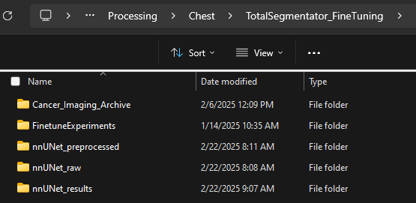




Preprocessing the data for training nnU-Net
To preprocess/prepare the dataset for training nnU-Net, run the following command in the Terminal
  nnUNetv2_plan_and_preprocess -d 050 -pl ExperimentPlanner -c 3d_fullres -np 8
It performs dataset planning and preprocessing, including resampling, normalization, and spacing adjustments.
The preprocessed data in stored in the directory “nnUNet_preprocessed” under “K:\Processing\Chest\TotalSegmentator_FineTuning”
-d 050 (Dataset ID)
  Specifies the dataset to preprocess.
  050 refers to Dataset050_* inside the nnUNet_raw folder.
  If changed to 051, it will process Dataset051_* instead.
  Must match the dataset folder name in nnUNet_raw folder
-pl ExperimentPlanner (Experiment Planner)
  Specifies which experiment planner to use (ExperimentPlanner is a default planner)
  The experiment planner determines target image spacing, patch size for training, batch size during training and other preprocessing configurations.

Slide 10
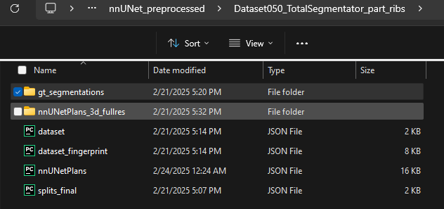
Preprocessing the data for training nnU-Net
-c 3d_fullres (Configuration Mode)
  nnU-Net supports different training configurations:
    3d_fullres → Uses full-resolution 3D images.
    3d_lowres → Uses low-resolution images. Reduces resolution for memory-efficient training.
    3d_cascade_fullres → Used after 3d_lowres to refine predictions.
    2d → Processes slices in 2D instead of full 3D.
-np 8 (Number of Processes)
  Runs preprocessing with 8 parallel processes.
  Increasing (-np 16) → Uses more CPU cores (faster but higher memory usage).
  Reducing (-np 4) → Uses fewer cores (slower but saves memory).
  Should be adjusted based on the number of cores requested in Basic Desktop on Armis2
Take a look at “splits_final.py” to change the training and validation data.

Slide 11
Training nnU-Net model
To train the nnU-Net model on your preprocessed dataset, run the following command in the Terminal
  nnUNetv2_train 050 3d_fullres 0 -tr nnUNetTrainerNoMirroring -num_gpus 4
  This command trains an “nnU-Net v2” model on dataset 050 using a 3D full-resolution configuration. It specifies a default trainer (nnUNetTrainerNoMirroring) and utilizes 4 GPUs for training.
050 (Dataset ID)
  This specifies which dataset to train on.
  The dataset must be preprocessed and stored inside nnUNet_preprocessed/Dataset050_3d_fullres
  If changed to 051, it will train on Dataset051_3d_fullres instead.
  If the dataset isn't preprocessed yet, the command will fail.
3d_fullres (Configuration Mode)
  Specifies the training configuration, aligning with preprocessing: 3d_fullres → Trains on full-resolution 3D images.
0 (Fold ID)
  nnU-Net uses 5-fold cross-validation (0, 1, 2, 3, 4). 0 specifies training on fold 0.
  Changing 0-4 → Trains a different fold.
  "all" → Trains on all folds sequentially.
  Recommended practice: Train all folds (0-4), then ensemble models for best performance. (Here I trained on fold 0)

Slide 12
Training nnU-Net model
-tr nnUNetTrainerNoMirroring (Trainer Class)
  Specifies a trainer for model training. In nnUNetTrainerNoMirroring , the "No Mirroring" means that data augmentation via mirroring (flipping) is disabled during training.
  Mirroring in nnU-Net?
    Mirroring (or flipping) is a common data augmentation technique used in deep learning to artificially increase the training dataset by flipping images along different axes.
    In medical imaging, mirroring is often applied along the left-right (x), anterior-posterior (y), and superior-inferior (z) axes to introduce variations and make the model more robust.
  Using a different trainer (e.g., nnUNetTrainerCustom) → Can modify loss functions, architectures, etc.
  Removing -tr → Uses default trainer (nnUNetTrainerV2).
-num_gpus 4 (Number of GPUs)
  Specifies how many GPUs to use for training.
  -num_gpus 1 → Runs training on a single GPU (slower but uses less memory).
  -num_gpus 2 → Uses two GPUs for parallel training (faster).
  -num_gpus 8 → Uses eight GPUs (requires hardware availability).
  If not set, nnU-Net defaults to 1 GPU.
  Should be adjusted based on the number of gpus requested in Basic Desktop on Armis2

Slide 13
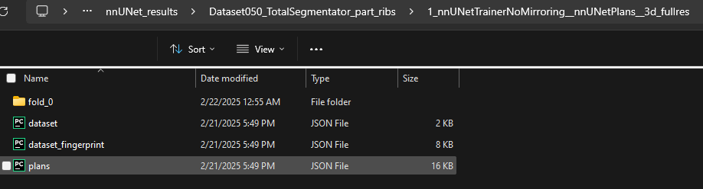
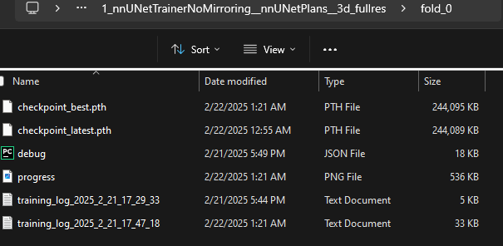
Training nnU-Net model
Trained model is stored in “nnUNet_results/Dataset050_TotalSegmentator_part_ribs/nnUNetTrainerNoMirroring__nnUNetPlans__3d_fullres/fold_0”
The folder shown contains the training outputs from nnUNetv2_train for fold 0 using the nnUNetTrainerNoMirroring and the 3d_fullres configuration
Model checkpoints (.pth files)
  checkpoint_best.pth → Stores the best model weights (parameters) from training.
  "Best" is usually determined based on validation loss or performance metrics like Dice score.
  checkpoint_latest.pth → Stores the most recent checkpoint from training. If training was interrupted, this checkpoint can be used to resume training.
debug.json A JSON file storing debugging information, containing hyperparameters, training settings, and errors encountered.
Training logs (progress.png, training_log.txt) →Contains a log of training progress, including:
  training_log.txt → Contains a log of training progress, including training losses (Dice loss, Cross-Entropy loss, etc.), Validation scores (Dice coefficient
  progress.png → A graphical representation of training progress over epochs.

Slide 14
Segmenting CT data with newly trained nnU-Net model
To predict/segment images in a dataset using the trained nnU-Net model, run the following command in the Terminal
  nnUNetv2_predict -i /nfs/turbo/coe-mreedsensitive/Processing/Chest/TotalSegmentator_FineTuning/Test_Retrained_Model/imagesTs -o /nfs/turbo/coe-mreedsensitive/Processing/Chest/TotalSegmentator_FineTuning/Test_Retrained_Model -d 050 -c 3d_fullres -tr nnUNetTrainerNoMirroring --disable_tta -f 0 -chk checkpoint_best.pth
nnUNetv2_predict
  This is the nnU-Net inference script, used to → Load a trained model, perform segmentation on new images and save the predicted segmentations.
-i /nfs/turbo/coe-mreedsensitive/Processing/Chest/TotalSegmentator_FineTuning/Test_Retrained_Model/imagesTs (Input Directory)
  Specifies the folder where the test images (CT data in .nii.gz format) are stored. Naming convention for the file is “CF3010_0000.nii.gz”
  If you use a different directory, the model will predict on a new dataset.
-o /nfs/turbo/coe-mreedsensitive/Processing/Chest/TotalSegmentator_FineTuning/Test_Retrained_Model (Output Directory)
  Specifies where to save the predicted segmentations. Predictions will be stored in .nii.gz format.
  If you set a different directory, the results will be stored elsewhere.
-d 050 (Dataset ID)
  Refers to Dataset050_3d_fullres in nnUNet_preprocessed/. Must match the dataset used during training.
  Changing it to 051, for example, would require a model trained on Dataset051_3d_fullres.

Slide 15
Segmenting CT data with newly trained nnU-Net model
-c 3d_fullres (Configuration Mode)
  Tells nnU-Net to use the 3D full-resolution model. If a different configuration was used for training, predictions may not work correctly.
-tr nnUNetTrainerNoMirroring (Trainer Class)
  Specifies the trainer used during training.
  Must match the one used when training (here, nnUNetTrainerNoMirroring).
--disable_tta (Disables Test-Time Augmentation (TTA))
  TTA applies transformations (like mirroring and rotations) during inference to improve segmentation quality.
  Effect of disabling it leads to faster predictions, but potentially lower accuracy.
  If you remove --disable_tta, the model will predict multiple augmented versions and ensemble them for better results.
-f 0 (Fold ID for Prediction)
  Refers to fold 0 of cross-validation.
  If all five folds (0-4) were trained, using -f all will ensemble predictions from all folds for better accuracy.
-chk checkpoint_best.pth (Checkpoint File)
  Uses the best trained model checkpoint for inference.
  If changed to checkpoint_latest.pth, the model will use the most recent checkpoint instead.
  If omitted, nnU-Net defaults to checkpoint_best.pth.

Slide 16
Useful Links
https://github.com/MIC-DKFZ/nnUNet
https://github.com/wasserth/TotalSegmentator/blob/master/resources/train_nnunet.md
To login to Armis2: https://armis2.arc-ts.umich.edu/pun/sys/dashboard
https://github.com/wasserth/TotalSegmentator/blob/master/totalsegmentator/nnunet.py
https://github.com/wasserth/TotalSegmentator/blob/master/resources/train_nnunet.sh
https://github.com/wasserth/TotalSegmentator/blob/master/resources/convert_dataset_to_nnunet.py
https://github.com/wasserth/TotalSegmentator/blob/master/resources/evaluate.py

Slide 17
Contact Details
If you have any questions regarding any of the steps, please feel free to contact me via email or gchat (faster)
Sujata Khandare
khandare@umich.edu

