Slide 1
JagTrack LCO Milestone Briefing
Presented by:
Hayden Chudy
and
Robert Fornof

Slide 2
Project Overview
Scope:
This project will provide a tracking mechanism for the University of South Alabama's transportation system, the JagTran.
This will give students a way to track the bus, plan out their schedule, and know when to get to a bus stop.

Slide 3
Project Overview
Give the knowledge of Buses (for the passenger)
Provide Passenger Information (for the administrators).
The vision document contains:
Who the stakeholders are and what they want
Who the passengers are and what they want
How our solution will help them with their problem .
The main Issue :
The buses are not as reliable as needed by the passengers
The Solution :

Slide 4
Use Case: Boarding JagTran
Actor:
User (Passenger)
Goals:
Knowing when the last bus left from a specific stop
Knowing when the next bus will arrive at a specific stop
Notes:
Can make the goals as one: Check bus status; make all use cases use one model, have different texts and flows for each; use case model = primary source for functional req; slide with more circles should express all use cases, actors should be shown

Slide 5
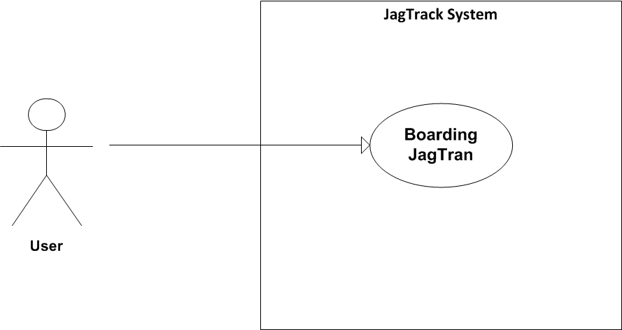
Use Case Model

Slide 6
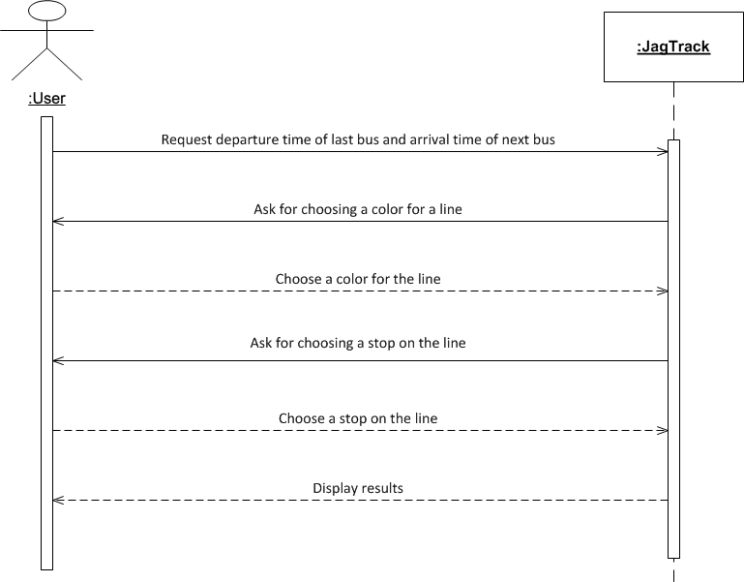
Brief Format Use Case Description

Slide 7
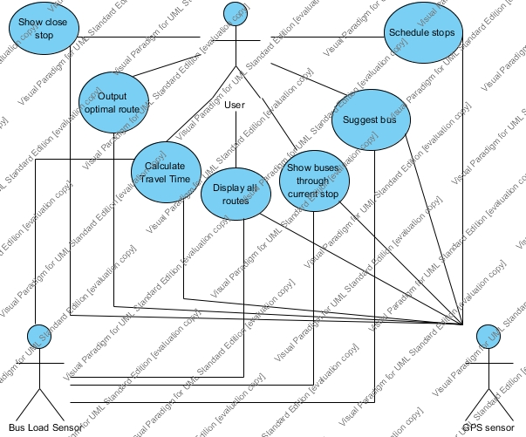
Use Case Model: Load Scheduling

Slide 8
Main Brief Use Cases
User accesses application and chooses desired Jag Tran stop. System outputs the amount of time since last departure of a bus and amount of time before another bus arrives. Check bus status
Application is accessed and the system tells how many people are on each JagTran bus. Check bus load

Slide 9
Nonfunctional Requirements
Usability
Android Compliance
The user interface shall be Android compliant.
Design for ease-of-use
The user interface of the JagTrack System shall be designed for ease-of-use and shall be appropriate for a smartphone-enabled user community with no additional training on the System.

Slide 10
Nonfunctional Requirements
Reliability
Availability
The availability requirements will be defined in the next iteration.
Mean time between failures
The MTBF requirements will be defined in the next iteration.
Performance
Database access response time
The system shall provide access to the legacy route catalog database with no more than a 10 second latency.
Transaction response time
The system must be able to complete 80% of all transactions within 30 seconds.
Notes:
Want rider to be able to rely on this, so base MTBF off this, exact info will be given by McDonald

Slide 11
Risk List & Mitigation Strategy
Technology
The Android hardware used for testing may fail at critical times during the project.
Mitigation Plan: Currently, we are making use of Android simulators to reduce the affect of this risk.
People
The staff may not be familiar with the specific tools needed to design the Android application or other system components.
Mitigation Plan: Prototype development and working code development is being done by individuals with some experience with the technology
Organizational
Group communication lacks as semester gets busier.
Mitigation Plan: Group is currently using GitHub and email to relay due date and goal.
Notes:
There are people at school who have done android development for databases (Mike Weaver, Craig Williams, Dominic); Google is changing rules, regulations, and implementations. May cost money to use Google Maps API, possible software cost

Slide 12
Risk List & Mitigation Strategy
Tools
Plugins/SDK that are required for Android development may be difficult to install and configure
Mitigation Plan: We will have setup instructions for the tools posted on GitHub
Requirements
The JagTran management may not fully specify what they want from the system, causing requirements to change in the middle of the project.
Mitigation Plan: By using an iterative development process, the JagTrack team is prepared to handle changing requirements
Estimation
The time required to complete the project is underestimated since most of the staff involved will be learning new skills
Mitigation Plan:
The work has been divided amongst many different staff members so that each member doesn’t have to do too much work
GitHub contains links to tutorials do decrease the amount of overhead for mundane tasks such as configuration management and version control
Notes:
According to the risk mitigation rup template, we need to list the “top 10” risks in the project.

Slide 13
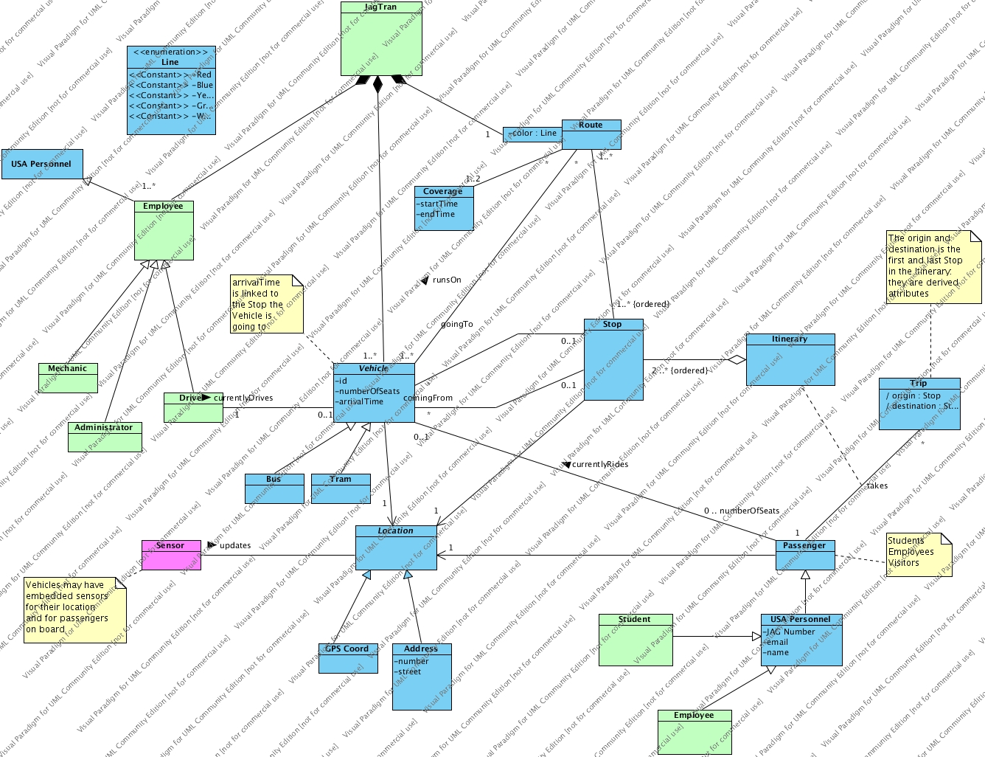
Initial Domain Model

Slide 14

Requirements Traceability
Phase
At the beginning of each phase of the development process, the requirements and constraints will be assessed and changed according to new manifestations in the process and product.
Iteration
Much like the process at the end of each phase, requirements will be assessed at the end and all throughout the iterations until release. If changes in requirements are required mid iteration they will be addressed when needed.

Slide 15
Requirements Traceability
Whenever a prototype is released the information gathered from the prototype will be used to update the requirements and confirm that the project is holding to the requirements already established.
Customer Meeting
Every customer meeting will provide feedback from both team leaders and the customer as to assess whether the project is holding to the original and current requirements. Any changes needing to take place can be addressed at these meetings and implemented if deemed necessary.
Prototype Release

Slide 16
Recommendations on components to buy/build/reuse
Possibly motion sensors ($20 - $300)
Visual Paradigm (a software tool)
Possible software libraries
Devices & Tools:
GPS sensors ($40 - $200)

Slide 17
High Level Candidate Architecture
All data storage will be done via SQL database
Bus locations can be obtained via GPS sensors
Student's boarding & exiting the bus can be done in several ways:
Motion sensor on the bus
Interaction with the application
Data
[database model & provider subject to change]
Route times will be estimated and averaged based on length and previous times

Slide 18
Plans for Prototypes/Demos
One UI Prototype will be ready by the first LCO phase deadline
For the second iteration, research into OODBMS will be done
At the end of the second iteration, a demo for accessing the database should be done

Slide 19
Development Case
Major RUP changes:
Reports were omitted, unneeded due to team size and length constraints
Audits were omitted for same reasons
rough artifact deadline information
team information
See CM Plan for information on how we suggest to submit and manage code and artifacts.
Development case contains:

Slide 20
Estimated Project Schedule
LCO Artifacts Due : 03/12/2012
LCO Presentation Slides Due : 03/16/2012
LCO milestone : 03/20/2012
Project Iteration Briefing : 05/01/2012

