Slide 1
JagTrack LCO Milestone Briefing
Presented by:
Hayden Chudy
Robert Fornof

Slide 2
Project Overview
Scope:
This project will provide a tracking mechanism for the University of South Alabama's transportation system, the JagTran.
This will give students a way to track the bus, plan out their schedule, and know when to get to a bus stop.

Slide 3
n
Give the knowledge of Buses (for the passenger)
When last bus left.
When the next bus is due.
Provide Passenger Information (for the administrators).
How many potential passengers are at the stops?
How many passengers are on the buses ?
The vision document Contains the general ideas of :
Who the stakeholders are and what they want
Who the passengers are and what they want
How our solution will help them with their problem .
The main Issue:
The buses are not as reliable as needed by the passengers
The Solution :
Create a program that will do the following :

Slide 4
Use Case Boarding JagTran
Actor:
User (Passenger)
Goals:
Knowing when the last bus left from a specific stop
Knowing when the next bus will arrive at a specific stop

Slide 5
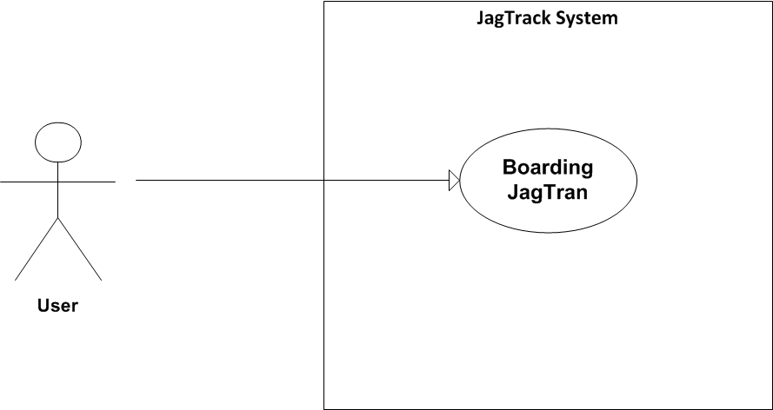
Diagram

Slide 6
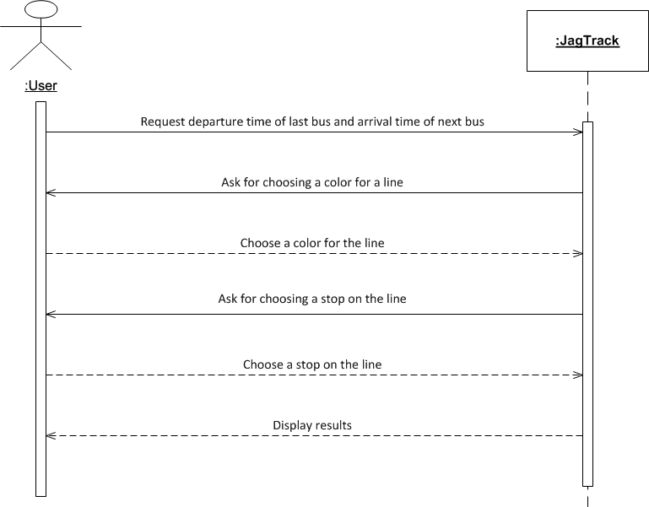

Slide 7
Nonfunctional Requirements
Usability
Android Compliance
The user interface shall be Android compliant.
Design for ease-of-use
The user interface of the JagTrack System shall be designed for ease-of-use and shall be appropriate for a smartphone-enabled user community with no additional training on the System.

Slide 8
Reliability
Availability
The availability requirements will be defined in the next iteration.
Mean time between failures
The MTBF requirements will be defined in the next iteration.
Performance
Database access response time
The system shall provide access to the legacy course catalog database with no more than a 10 second latency.
Transaction response time
The system must be able to complete 80% of all transactions within 30 seconds.

Slide 9
Risk List
Technology
The Android hardware used for testing may fail at critical times during the project.
Mitigation Plan: Currently, we are making use of Android simulators to reduce the affect of this risk.
People
The staff may not be familiar with the specific tools needed to design the Android application or other system components.
Mitigation Plan: Prototype development and working code development is being done by individuals with some experience with the technology
Organizational
Group communication lacks as semester gets busier.
Mitigation Plan: Group is currently using GitHub and email to relay due date and goal.

Slide 10
Risk List
Tools
Plugins/SDK that are required for Android development may be difficult to install and configure
Mitigation Plan: We will have setup instructions for the tools posted on GitHub
Requirements
The JagTran management may not fully specify what they want from the system, causing requirements to change in the middle of the project.
Mitigation Plan: By using an iterative development process, the JagTrack team is prepared to handle changing requirements
Estimation
The time required to complete the project is underestimated since most of the staff involved will be learning new skills
Mitigation Plan:
The work has been divided amongst many different staff members so that each member doesn’t have to do too much work
GitHub contains links to tutorials do decrease the amount of overhead for mundane tasks such as configuration management and version control
Notes:
According to the risk mitigation rup template, we need to list the “top 10” risks in the project.

Slide 11
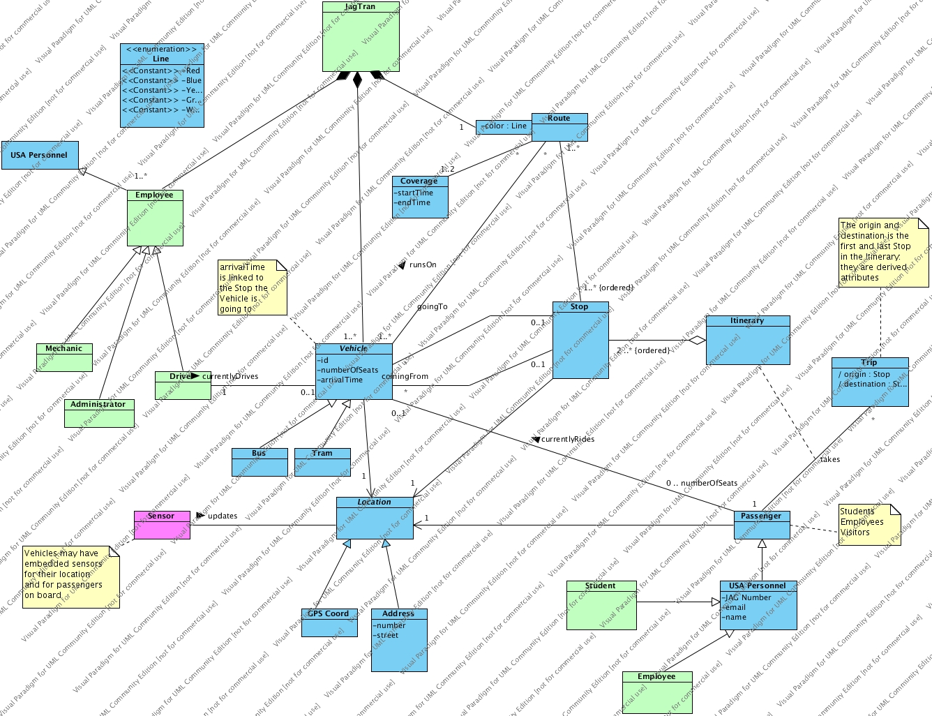
Initial Domain Model

Slide 12


Requirements Traceability
At the beginning of each phase of the development process, the requirements and constraints will be assessed and changed according to new manifestations in the process and product.
Phase
Iteration
Prototype Release
Customer Meeting

Slide 13
Requirements Traceability
Much like the process at the end of each phase, requirements will be assessed at the end and all throughout the iterations until release. If changes in requirements are required mid iteration they will be addressed when needed.
Phase
Iteration
Prototype Release
Customer Meeting

Slide 14
Requirements Traceability
Whenever a prototype is released the information gathered from the prototype will be used to update the requirements and confirm that the project is holding to the requirements already established.
Phase
Iteration
Prototype Release
Customer Meeting

Slide 15
Requirements Traceability
Every customer meeting will provide feedback from both team leaders and the customer as to assess whether the project is holding to the original and current requirements. Any changes needing to take place can be addressed at these meetings and implemented if deemed necessary.
Phase
Iteration
Prototype Release
Customer Meeting

Slide 16
Recommendations on components to buy/build/reuse
GPS sensors ($40 - $200)
Possibly motion sensors ($20 - $300)
Visual Paradigm
Possible software libraries

Slide 17
High Level Candidate Architecture
All data storage will be done via SQL database (database model /provider subject to change)
Bus locations can be obtained via GPS sensors
Student's boarding/exiting the bus can be done in multiple ways:
Motion sensor on the bus
Interact with application

Slide 18
High Level Candidate Architecture
Route times will be estimated and averaged based on length and previous times

Slide 19
Plans for Prototypes/Demos
One UI Prototype will be ready by the first LCO phase deadline
For the second iteration, research into OODBMS will be done
At the end of the second iteration, a demo for accessing the database should be done

Slide 20
Development Case
Major RUP changes:
Reports were omitted, unneeded due to team size and length constraints
Audits were omitted for same reasons
Has rough artifact deadline information
Has team information
See CM Plan for information on how to submit artifacts and code

Slide 21
Estimated Project Schedule
LCO Artifacts Due – 03/12/2012
LCO Presentation Slides Due – 03/16/2012
LCO milestone – 03/20/2012
Project Iteration Briefing – 05/01/2012

