Slide 1
Pro-Choice vs. Pro-Life: Tweets Exploratory Data Analysis
Xingyu(Tim) Chen
Notes:
8 mins

Slide 2
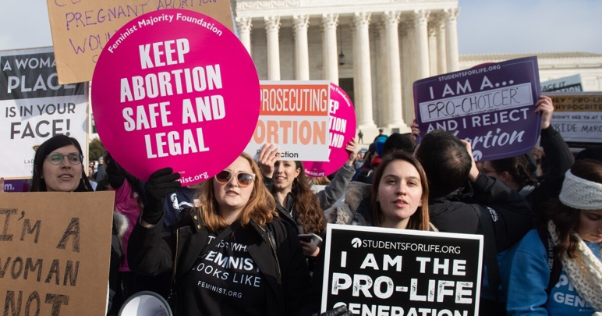
Motivation
On June 24, 2022, the Supreme Court issued a bill prohibiting women's access to out-of-state abortion services.
The Court banned abortions nationwide after 15 weeks of pregnancy, overturning the Roe v. Wade case.

Slide 3
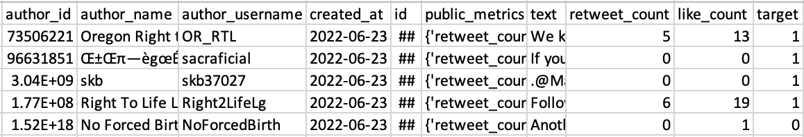
Original Data
56,040 tweets:
Lowercasing all the letters
Remove mentions ‘@.’
Remove hashtags ‘#.’
Remove links. Start with ‘HTTP’ or ‘www.’
Remove punctuations
Remove non-alphanumeric characters
Remove stop words
Tokenize and vectorize text with stemming

Slide 4
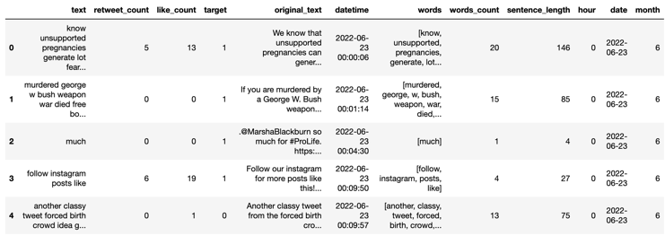
Preprocessed Data

Slide 5
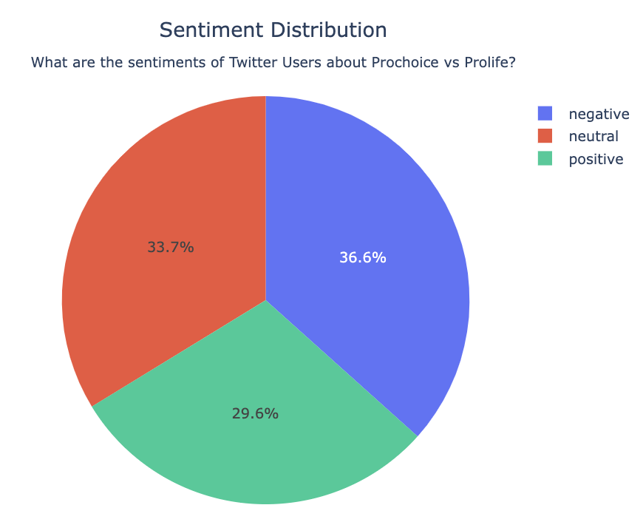
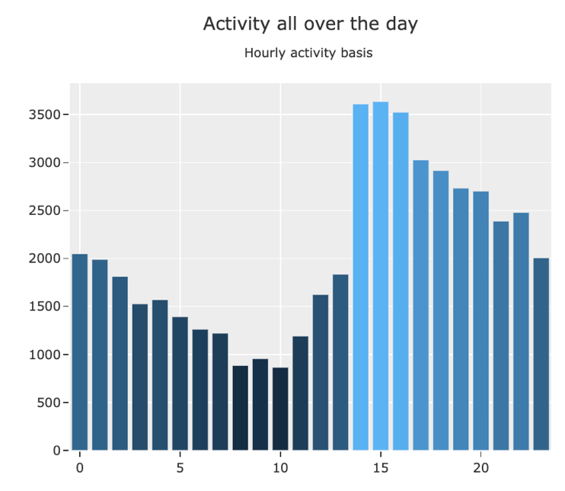
Data Visual

Slide 6
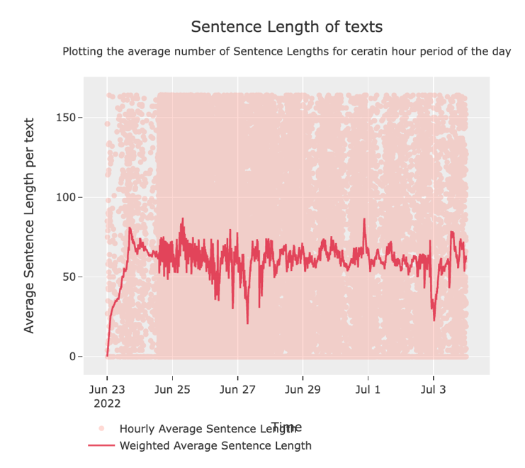
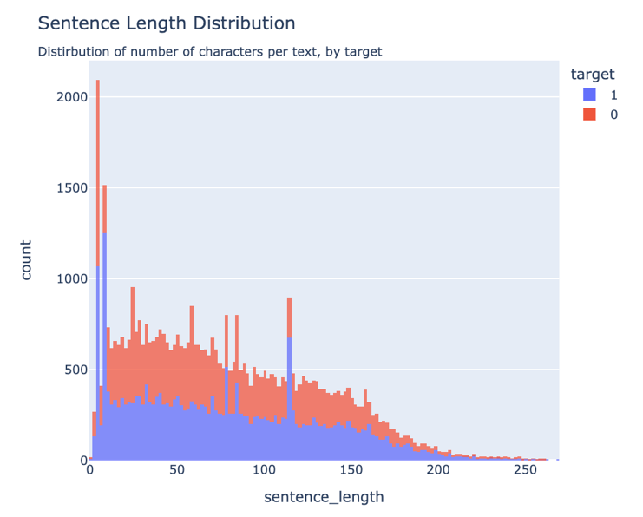
Data Visual

Slide 7
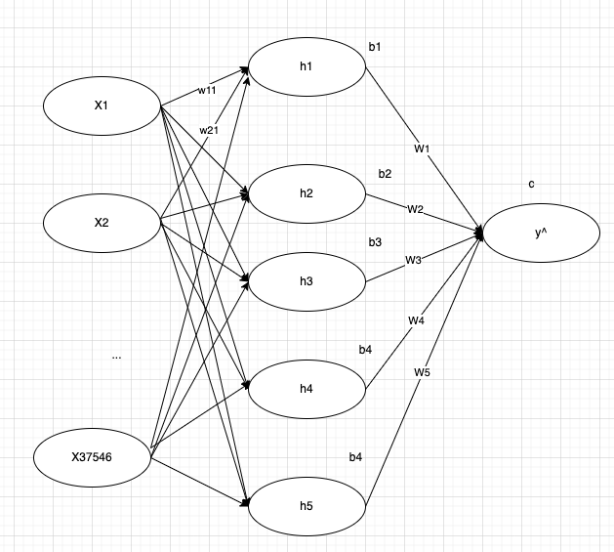
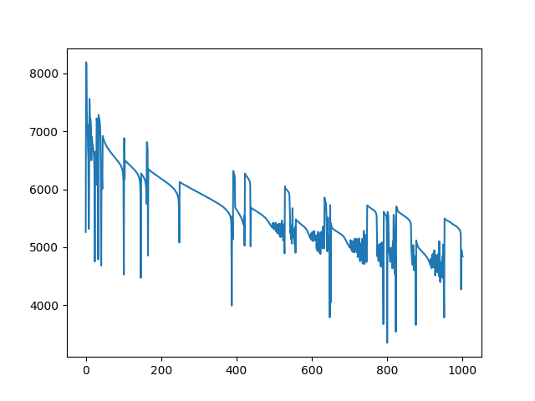
Baseline: Neural Net w/ Backpropagation

Slide 8
Parameter
 | ANN | RNN | LSTM | CNN
Time per epoch | 5s | 40s | 120s | 30s
Batch size = 256
132 sample per epoch
Train set: (33624, 12)
Validation set: (11208, 12)
Test set: (11208, 12)
Vocabulary set: (33624, 9697)
Embedding set: (33624, 500)

Slide 9
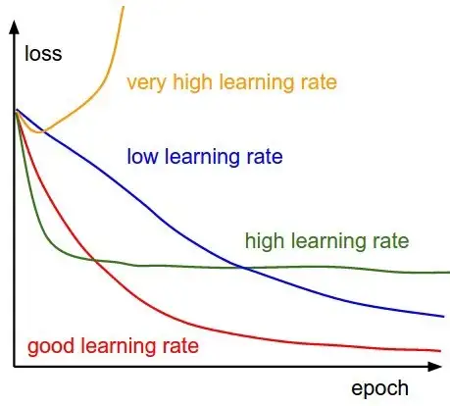
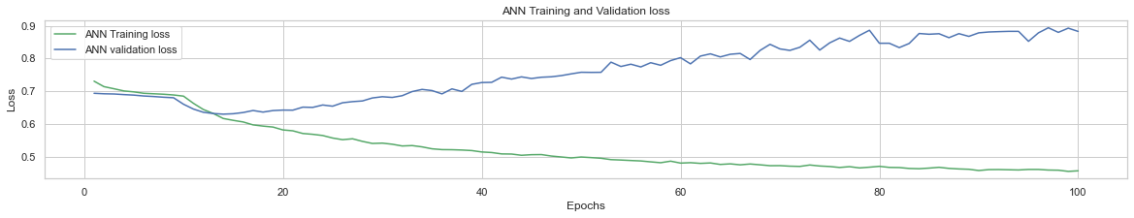
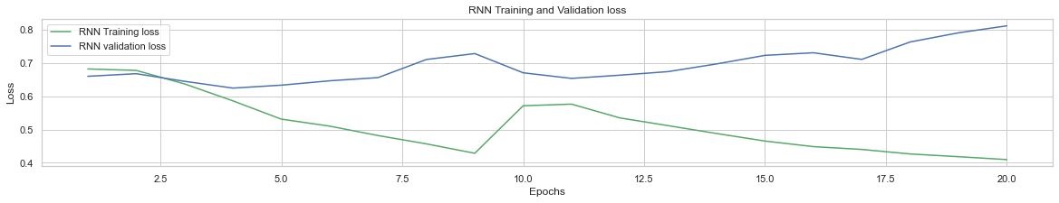
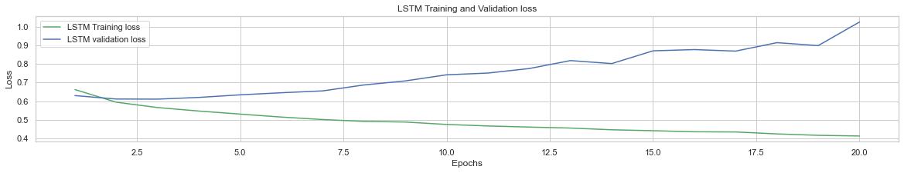
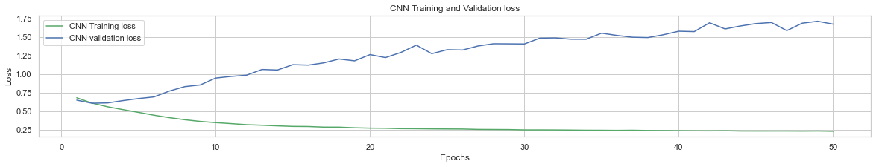
Training and Validation Loss

Slide 10
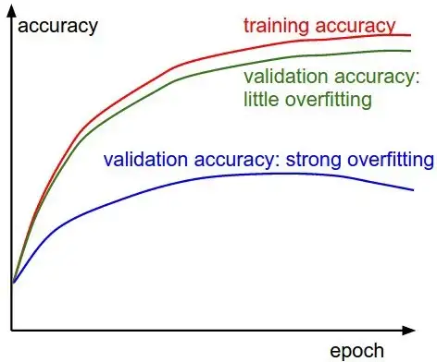
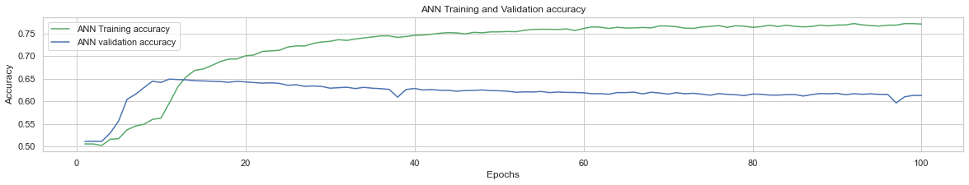
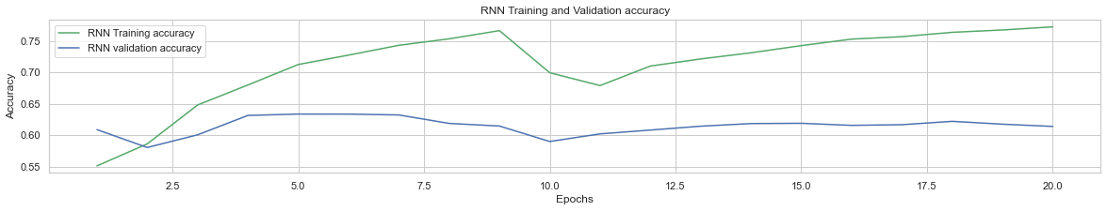
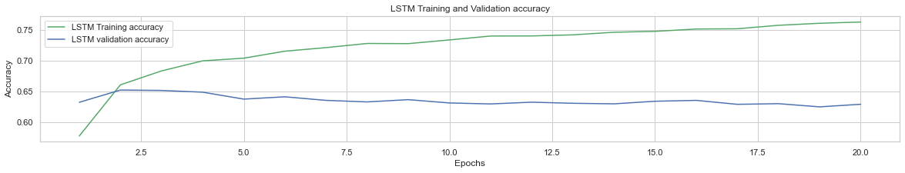
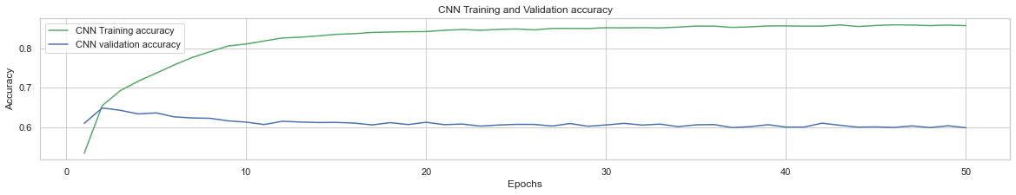
Training and Validation Accuracy

Slide 11
ANN, RNN, LSTM, CNN
 | ANN | RNN | LSTM | CNN
Train Loss | 0.4563 | 0.4098 | 0.4134 | 0.2343
Train Accuracy | 0.7713 | 0.7729 | 0.7627 | 0.8568
Validation Loss | 0.8828 | 0.8117 | 1.0254 | 1.6699
Validation Accuracy | 0.6130 | 0.6143 | 0.6291 | 0.5989
Test Loss | 0.8978 | 0.8269 | 1.0349 | 1.7021
Test Accuracy | 0.6077 | 0.6205 | 0.6246 | 0.6042
Confusion Matrix | 4116 3010 1386 2696 | 3619 2370 1883 3336 | 3625 2330 1877 3376 | 3490 2424 2012 3282

Slide 12
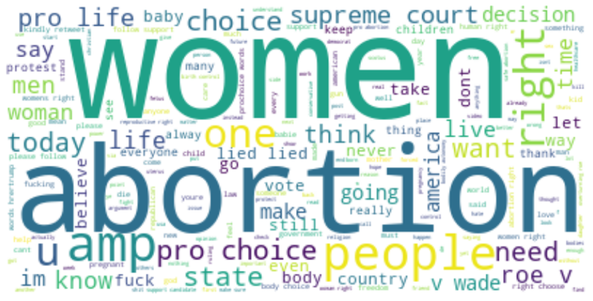
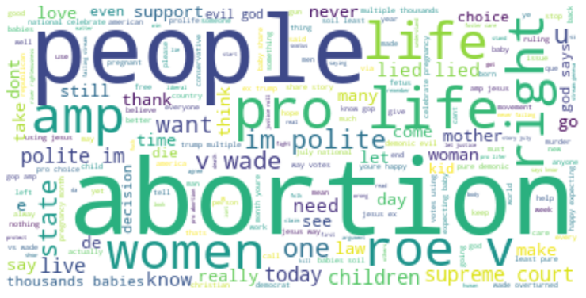
Word Cloud

Slide 13
Conclusion
Intro/Motivation
Data Gather
Data Prep
Data Visual
Baseline
Neural Nets
Conclusion

Slide 14
Bad sample
Original tweets: “Can you imagine if it were #ProLife groups!? https://t.co/TUaSq7r8NU”
Preprocess tweets: “imagine groups”
Embedding with padding tweets: [237, 1235, 9735, 9735, 9735, 9735, …] with label pro-choice (label as 0).
Put into Neural Nets
Neural Nets:

Slide 15

Thank you

