Slide 1
Natural Language Processing
CSCI 5832—Lecture 12
Jim Martin

Slide 2

Interesting Talk

Slide 3
Today
Finish skip-gram and word embeddings
Neural networks (Chapter 7)
Structure
Basic forward inference
Common NLP use cases for NNs
Language models
Sequence classification
Sequence labeling

Slide 4
Word2Vec
Instead of counting how often each word w occurs near "apricot"
Let’s train a classifier on a binary prediction task:
Is w likely to show up in the same kind of context as "apricot” ?
We don’t care about this classifier
But we’ll use the weights learned by the classifier as the word embeddings

Slide 5
Self-Supervised Training
Use raw unannotated text as supervised training data!
A word w occurring near apricot in real text serves as gold ‘correct answer’ to the question
“Is word w likely to show up near apricot ?”
No need for hand-labeled annotation
We’ll see additional examples of semi-supervised learning later in the class

Slide 6
Skip-Gram Objective
Given a tuple (t,c) = target word, context word
(apricot, jam)
(apricot, aardvark)
Return the probability that c is a real context word:
P(+ | t, c)
P(− | t, c) = 1−P(+|t,c)

Slide 7
How to Compute p(+|t,c)?
Intuition
Words that are similar in meaning should be near to each other in vector space.
Model similarity with dot-product.
Similarity(t,c) ∝ t ∙ c
Problem:
But dot product is not a probability, so…

Slide 8
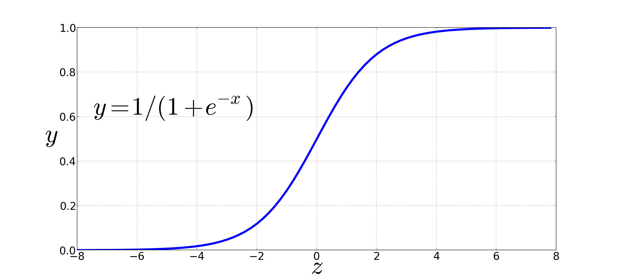
Dot Product into a Probability
Back to the sigmoid

Slide 9
Skip-Gram Training Data
Training sentence:
... lemon, a tablespoon of apricot jam a pinch ...
c1 c2 t c3 c4
Training data: input/output pairs centering on apricot
Assume a +/- 2 word window

Slide 10
Skip-Gram Training
Training sentence:
... lemon, a tablespoon of apricot jam a pinch ...
c1 c2 t c3 c4
For each positive example, we'll create k pseudo-negative examples.
Using noise words
Any random word in the corpus that isn’t t, the target word

Slide 11
Skip-Gram Training
Training sentence:
... lemon, a tablespoon of apricot jam a pinch ...
c1 c2 t c3 c4
This is a single training instance.

Slide 12
Setup
Represent words as vectors of some length (say 300), randomly initialized.
So, we start with 300 * |V| random parameters
Really 2 * that. We need both context C and target W vectors
Our goal to is to find values for the word vectors that:
Maximize the similarity of the target word, context word pairs (t,c) drawn from the positive data
Minimize the similarity of the (t,c) pairs drawn from the negative data.

Slide 13
Learning
Iterative process. Start with random weights
Then adjust the word weights to
Make the positive pairs more likely
More similar
And the negative pairs less likely
Less similar
Over the entire training set

Slide 14
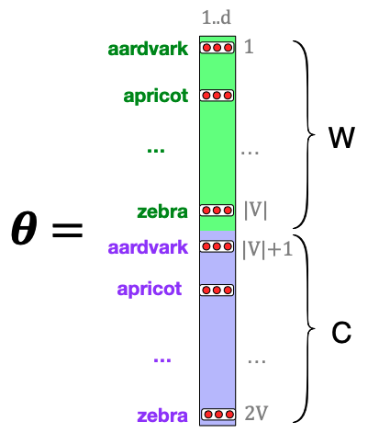
Setup
Each row is a 300-dimensional vector representing a word.
Separate vectors for each word in V for use as a target word (W) and a context word (C).

Slide 15
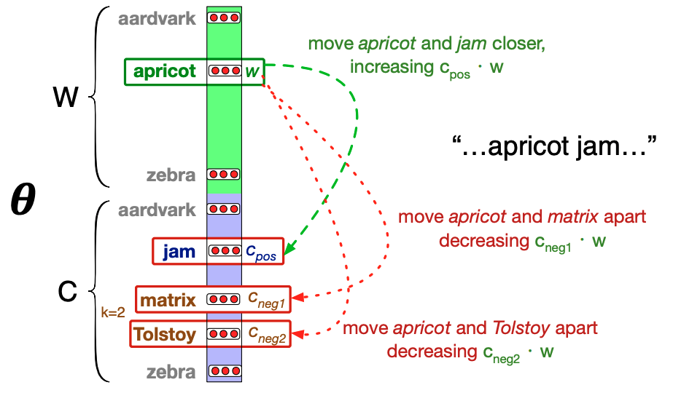
Learning

Slide 16
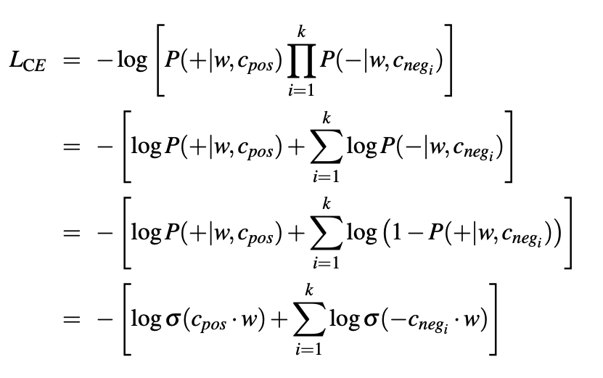
Training Loss

Slide 17
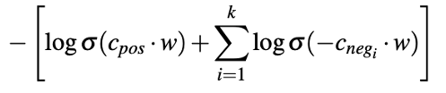

Slide 18
Gradient
Recall from logistic regression… for the current weights and a training example x partial derivative of the loss with respect to the weights comes out as
- (correct – computed) * x
That’s the gradient used for the weight update
Here we’re taking the dot product of the word vector w and the positive context vector c, as well as w and multiple negative context vectors.

Slide 19
Partial Derivatives
The point of the partial derivative is to measure how much the value of a function changes given some small change in a single variable. Holding the other variables fixed.
That’s why we talk about the partial derivative with respect to a particular variable. So a function F with three inputs x, y and z gives

Slide 20
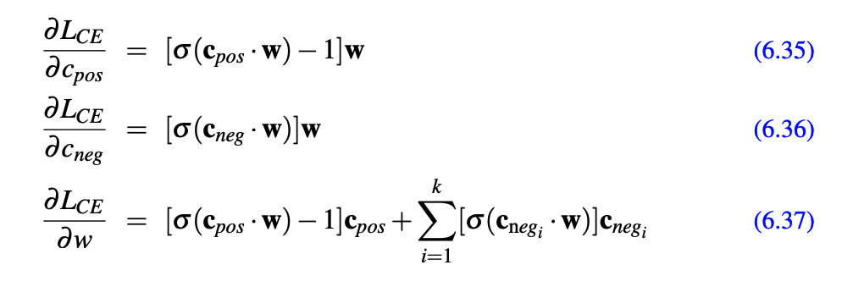
Gradient
Here we need the partial derivative of the loss with respect to the inputs to the loss

Slide 21
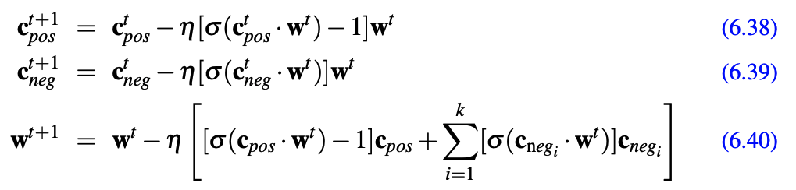
Weight Update
Given those gradients we update both C and W

Slide 22
Skip-Gram Algorithm
Treat a target word and a neighboring context word as positive examples.
Randomly sample other words in the lexicon to get negative samples
Train a classifier to distinguish those two cases using CE Loss
Use the resulting feature weights as the embeddings.

Slide 23
Which One?
The result of the training is two sets of embeddings, one for each word as a target and one for each word as a context word.
Throw away C and use W
Combine them somehow, add or average…

Slide 24
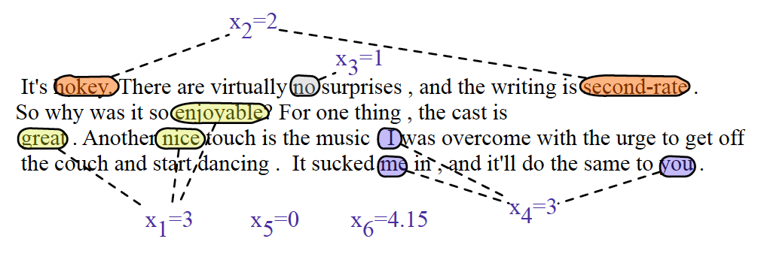
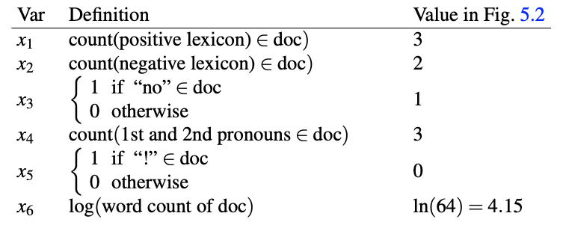
Preview

Slide 25
Preview
[3, 2, 1, 3, 0, 4.15]
[Vector of embeddings for all the words in the text]

Slide 26
Feedforward Neural Networks

Slide 27
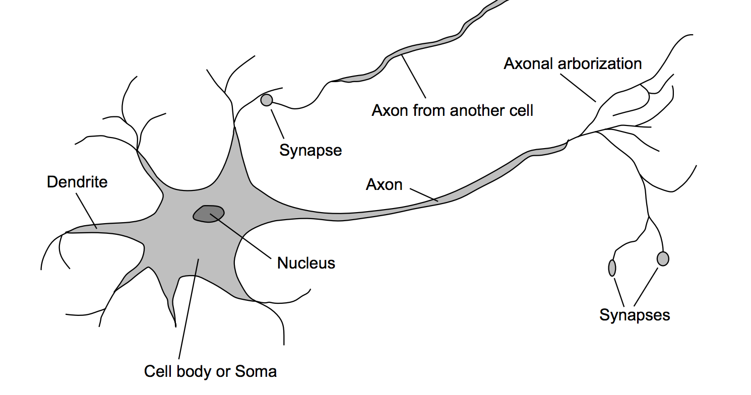
These are in your brain

Slide 28
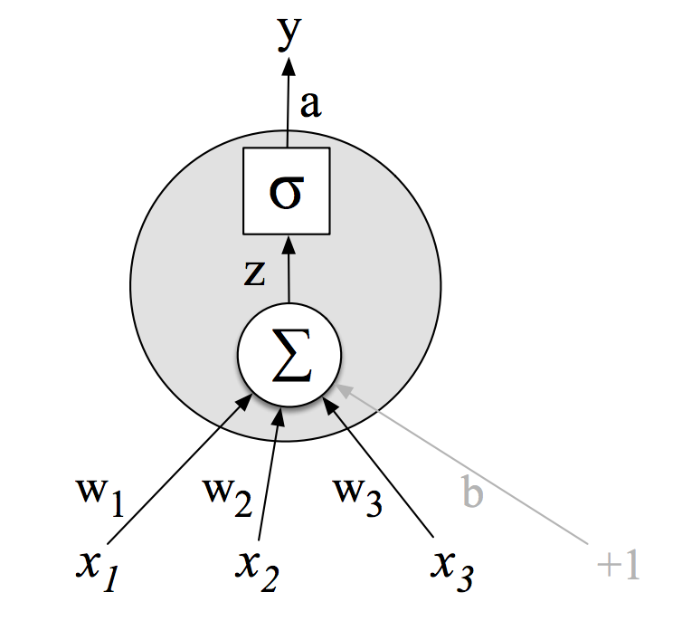
Biologically Inspired Unit This is not in your brain
Activation value
Non-linear transform
Weighted sum
Weights
Input layer

Slide 29
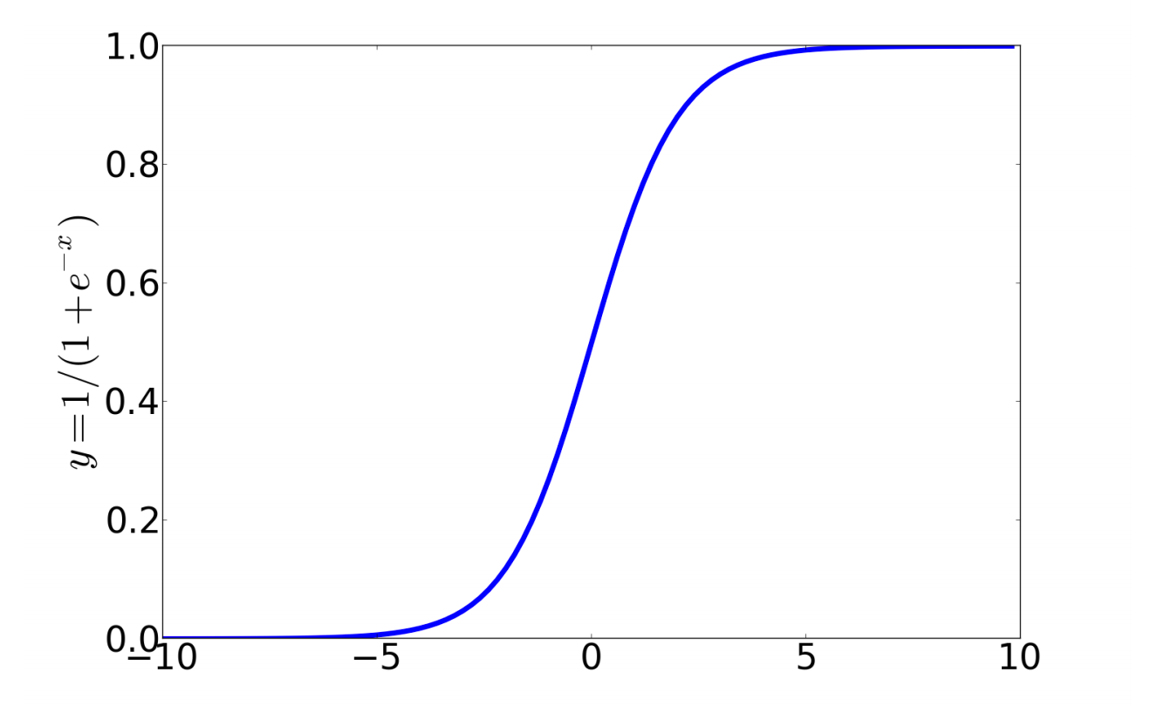
Non-Linear Functions
Sigmoid

Slide 30
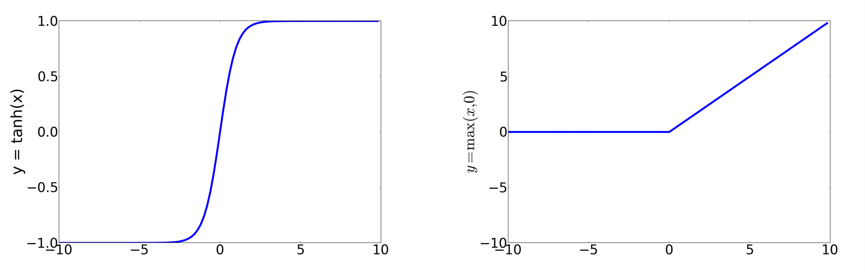
Non-Linear Functions
Tanh
Relu

Slide 31

Networks of Units
Binary logistic regression as a network
$$σ$$
W is a vector
W
x1
xn

Slide 32
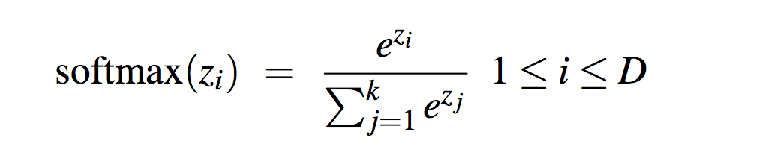
Network of Units
Multinomial logistic regression as a network
Fully connected single layer network
W
W is a matrix
x1
xn

Slide 33

Multilayer Network
y
U
W
x1
xn

Slide 34
2-Layer Network
y
U
W
x1
xn

Slide 35
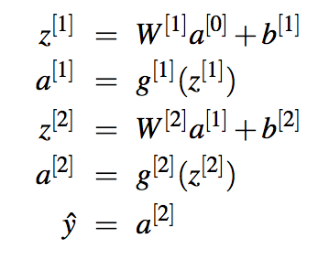
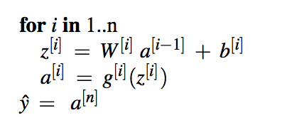
Multi Layer Notation

Slide 36
Use Cases
How do we apply neural networks to language problems?
Sequence/Text classification
Sentiment, etc.
Language modeling
Computing probabilities of sequences
Sequence labeling
POS tagging, BIO tagging

Slide 37
Classification: Sentiment Analysis
Let’s apply this approach to the problem of sentiment analysis doing exactly what we did with logistic regression
Input layer consists of binary features
Output layer is number between
0 and 1
U
W

Slide 38
Sentiment Features

Slide 39
NN Classification
This is an example of a classic approach to using NNs for classification
Take a set of training items with associated labels, extract features from the training text and apply your favorite network architecture
If it improves over logistic regression, it is due to that additional layer which allows the network to use interactions among the features.

Slide 40
Multiclass Outputs
What if you have more than two output classes?
Add more output units (one for each class)
And use a “softmax layer”
U
W
x1
xn

Slide 41
NN Classification
But the real power of “deep learning” comes from the ability to infer features from the raw data without the need for human analysts to engineer the features.
U
W
x1
xn

Slide 42
NN Sentiment w/ Embeddings

Slide 43
Issue
This assumes a fixed size (3) input for the length of reviews. Kind of unrealistic.
Make the network input size the size of the largest review
If shorter then pad the end with zero embeddings

Slide 44
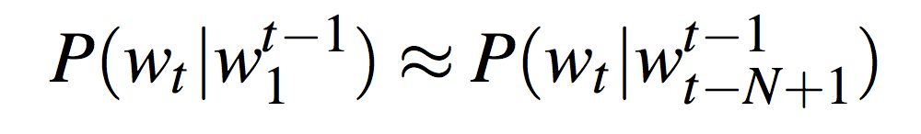
Neural Language Models
Let’s return to the problem of language modeling... Calculating the probability of the next word in a sequence given some history.
Problem: Now we’re dealing with sequences of arbitrary length.
Sliding windows (of fixed length)

Slide 45
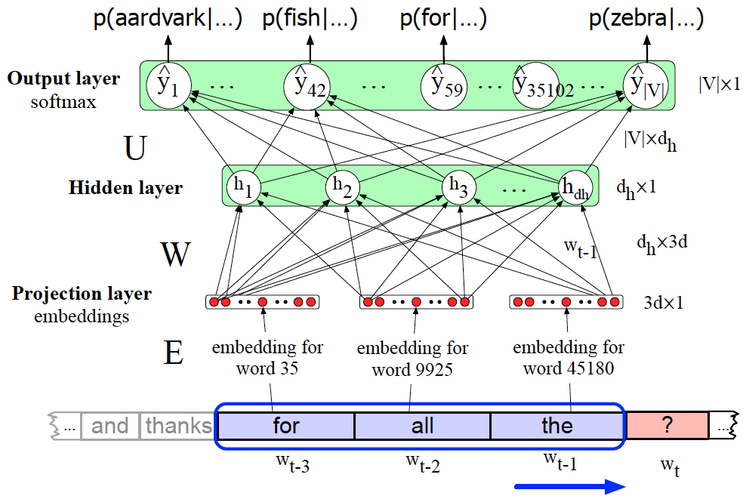
Neural Language Model

Slide 46
Neural Sequence Tagging

Slide 47
Summary
NNs → Logistic regression with
More layers
Non-linear activations across layers
Classification
Word embeddings as inputs
Softmax over classes as output
Language models
Sliding window over embeddings as input
Softmax over vocab as output
Sequence labeling
Sliding window over embeddings as input
Softmax over tagset as outputs

