Slide 1

Linear Regression and Multilayer perceptron
gates

Slide 2
Linear Regression
Resource:
https://d2l.ai/chapter_linear-regression/index.html
gates

Slide 3
Linear Regression: Predict a numeric value
Assumptions:
1) Features (variables), x, ~ linear relationship target (numeric label), y
E[Y | X = x] → weight sum of the features x.
Update the label - how?
What are the features?
Goal:
Label yi = w1x1 + w2x2 + w3x3
Label Cholesterol Weight Height
Risk 251 267 70
NoRisk 105 103 62
Medium 156 193 72
NoRisk 109 100 63
Risk 198 210 70
Risk 189 189 64
NoRisk 121 105 65

Slide 4
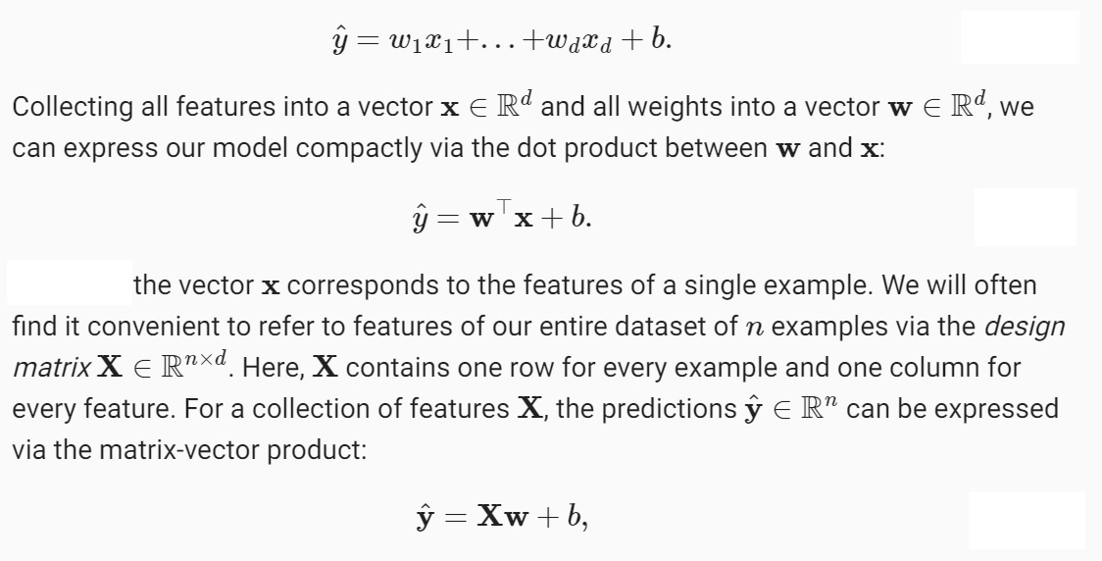
Math Terminology

Slide 5
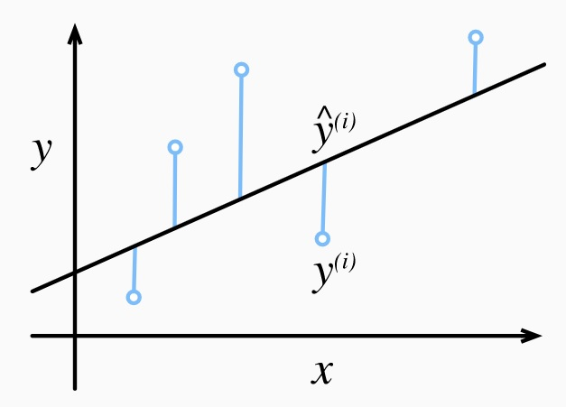
Linear Regression

Slide 6

Loss Functions
1) To FIT a model to data, we need a MEASURE of FITNESS.
2) A Loss Function will quantify the distance (difference) between the known/actual label and the label that is predicted by the model. We want to minimize this difference.
3) For regression, the most common loss function is squared error.
Terminology:
Let yi be the true/actual label for an observation x (a row or vector in the dataset).
Let y_h be the predicted label for that observation.
A LOSS FUNCTION L(i) (w, b) = ½ (y_h – yi)^2

Slide 7
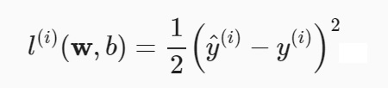
Solving Linear Regression Analytically: An Optimization Problem
1) One can include b into the weight matrix as a column of all “1”s.
2) Prediction problem is to minimize
|| y – Xw ||^2 →
3) Big X is the entire dataset and the y here are all the labels.
4) All features (columns/variables) in X are linearly independent. If they are not, we can remove those that are highly correlated.
5) Partial derivative of the loss with respect to w.
6) We set it to zero - solve for w - which gives us the optimization.

Slide 8
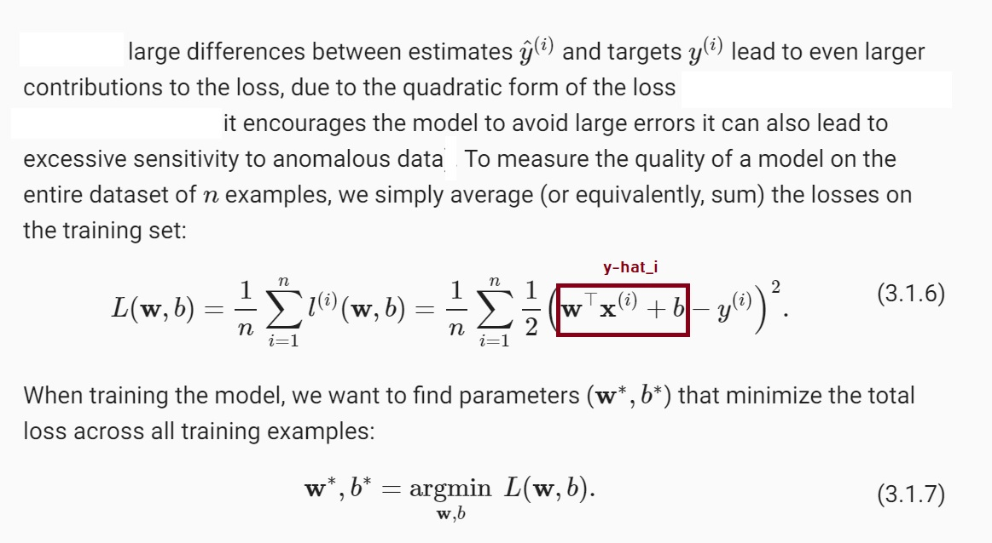

Slide 9
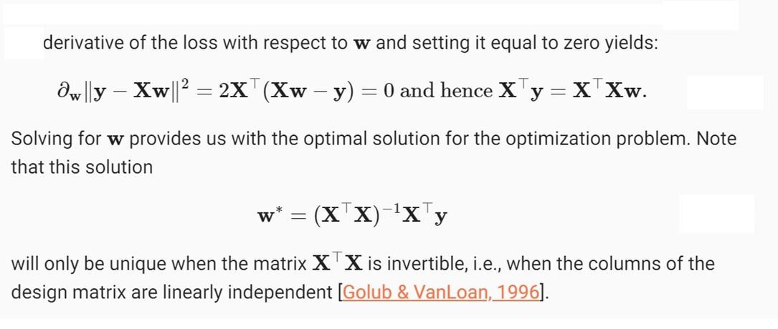

Slide 10
Stochastic Gradient Descent (SGD) Concepts
Regression - relatively easy way to find/optimize w - not always possible.
When models cannot be “solved” - they can be TRAINED
Goal: Find good parameter values.
Iteratively reduce the error by updating parameters - each update lowers the loss function.
This method is called GRADIENT DESCENT.
- Mini-batch SGD sends a sample of the dataset through the loss function.
- Stochastic GD is random

Slide 11
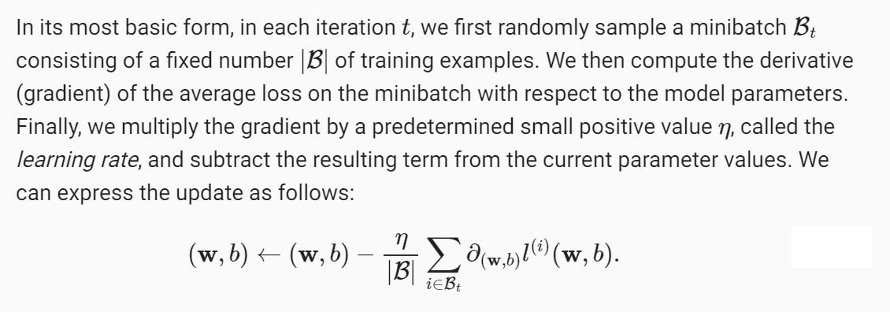
Mini – Batch SGD Math
Mini Batch GD Example

Slide 12
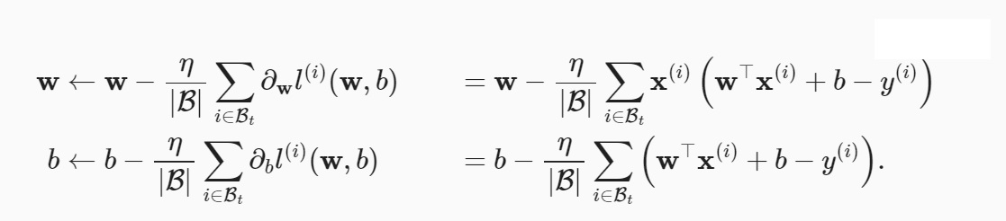
Loss Function and SGD Derivatives

Slide 13

Prediction
Once we have a model
We can make predictions for any new examples.
A new example of x would get multiplied by the weights and added to the bias to offer a predicted y-hat.
This concept extends to all ML models – not just regression.
:

Slide 14
Limitations of Linear Models
However, not all applications are linear.
For example, if our goal is to predict whether a person might pay back a loan, we could assume that the higher their income, the more likely they will repay. However, this may not be founded in data and may not be linear. Changes in 25K for example may have a much more significant affect at lower incomes (say 25K vs 50K) as opposed to higher incomes (1M vs 1.05M).
There are many examples where “monotonicity” is violated and so linear regression models may not be effective. As another example – if a person’s body temp is above 98.6F, then higher temps are bad – but if their temp is below 98.6, then lower temps are bad..
Non-linear problems have been formally studied since 1928. Some non-linear methods include decision trees and kernel methods.

Slide 15
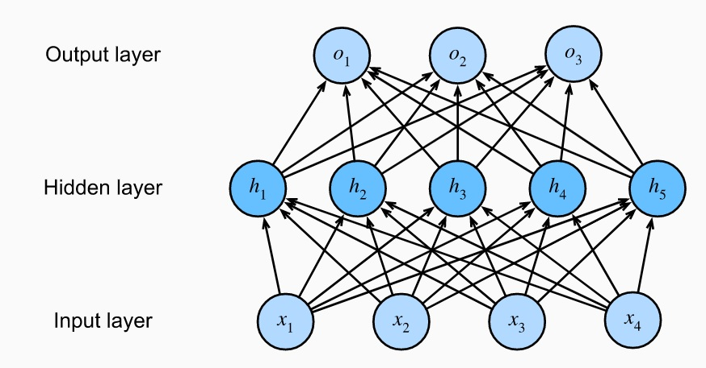
Hidden Layers in NNs
Hidden layers (one or more) will create non-linear models.
1) Four features (inputs). So each dataset row/vector has 4 values.
2) Five hidden nodes.
3) Three outputs – generally coded as 0,0,1 and 0,1,0 and 1,0,0

Slide 16
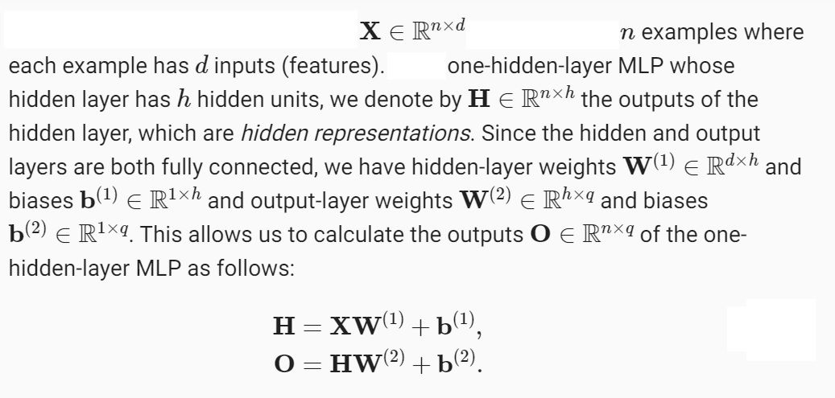

Slide 17
Still Linear?
Note that W⁽¹⁾ is w11 w12 w13 w14 w15
w21 w22 w23 w24 w25
w31 w32 w33 w34 w35
w41 w42 w43 w44 w45
b⁽¹⁾ is b1, b2, b3, b4
Yes! Still linear
Given that….

Slide 18
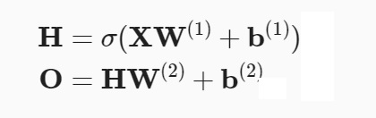
The Activation Function
In order to realize the potential of multilayer architectures, we need one more key ingredient: a nonlinear activation function σ to be applied to each hidden unit following the affine transformation.
A Few Common Activation Functions:
ReLU
Sigmoid
Tanh

Slide 19
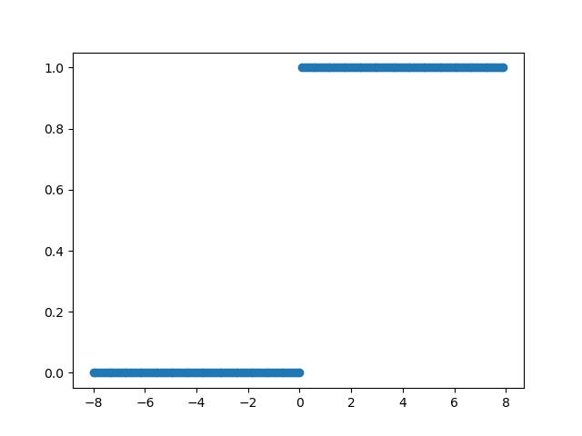
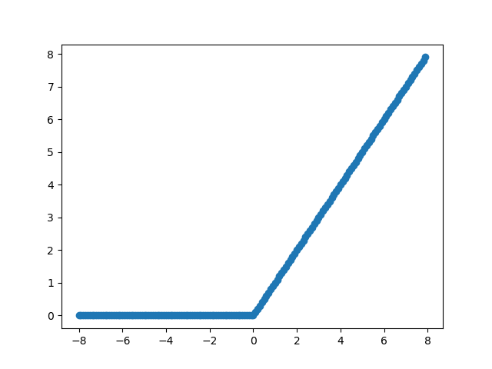
ReLU
with tf.GradientTape() as t:
y = tf.nn.relu(x)
plt.scatter(x.numpy(), t.gradient(y, x).numpy())
ReLU is significantly more amenable to optimization than the sigmoid or the tanh function. One could argue that this was one of the key innovations that helped the resurgence of deep learning over the past decade.
A popular choice for ([Nair & Hinton, 2010).
ReLU - nonlinear transformation.
ReLU (x) = max(x, 0)
x = tf.Variable(tf.range(-8.0, 8.0, 0.1), dtype=tf.float32)
print(x)
print(x.shape)
y = tf.nn.relu(x)
print(y.shape)
plt.scatter(x.numpy(), y.numpy())

Slide 20
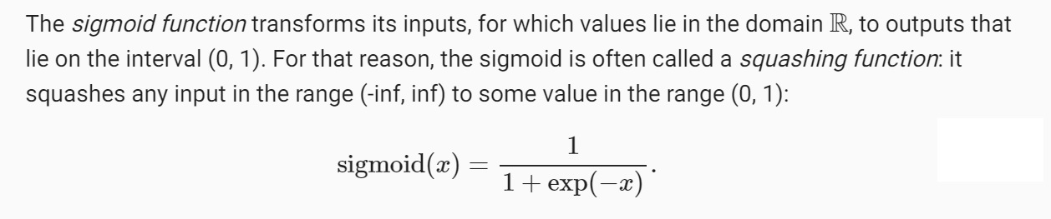
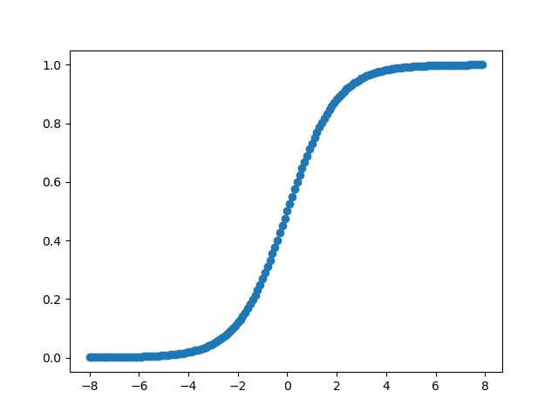
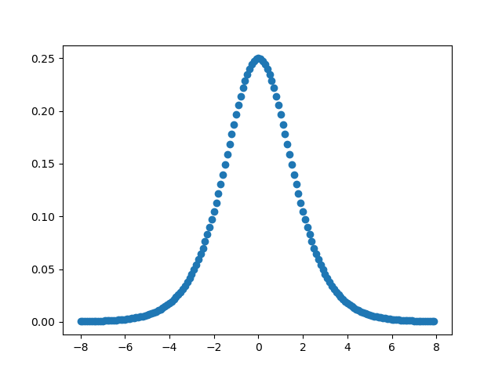
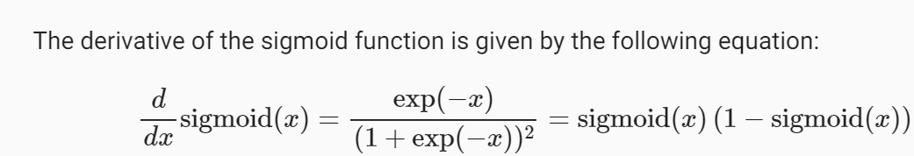
Sigmoid
Sigmoids are still widely used as activation functions on the output units, when we want to interpret the outputs as probabilities for binary classification problems: you can think of the sigmoid as a special case of the softmax.

Slide 21
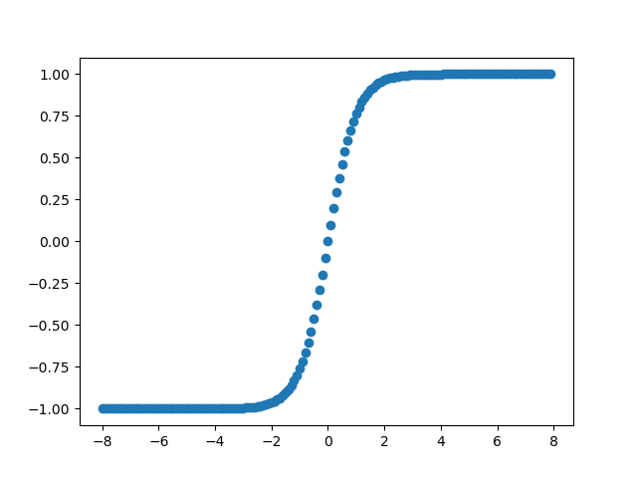
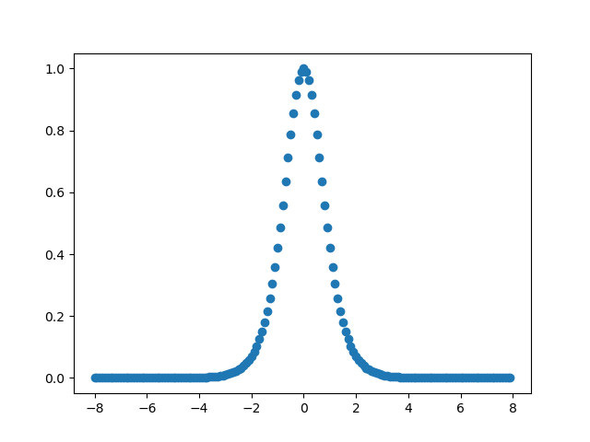
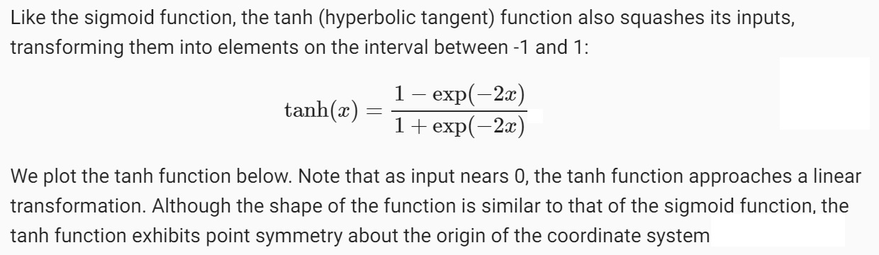
Tanh
Derivative of tanh

Slide 22
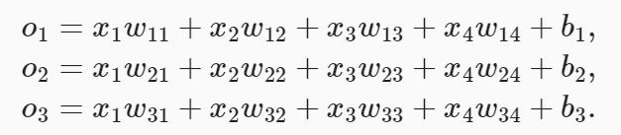
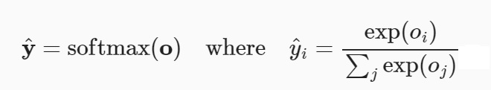

The Softmax
GOAL: Minimize the difference between o and y.
In other words, attempt to classify with the greatest possible accuracy.

Slide 23
Example
Step 2: Assume that we know the weights (for now)
O1 = 251*w11 + 267 * w12 + 70*w13 + b1
O2 = 251*w21 + 267 * w22 + 70*w23 + b2
O3 = 251*w31 + 267 * w32 + 70*w33 + b3
Let w11, w12, w13 be .001, .001, 0.01 and b1 = 1
Let w21, w22, w23 be -.001, -.001, -.001, and b2 = 1
Let w31, w32, w33 be .002, .002, .002, and b3 = 1
O1 = 251*.001 + 267 * .001 + 70*.001 + 1 = 1.6
O2 = 251*-.001 + 267 * -.001 + 70*-0.01 + 1 = -0.2
O3 = 251*.002 + 267 * .002 + 70*.002 + 1 = 2.2
Softmax: (Converts outputs to probabilities that sum to 1)
Y1_hat = e^(1.6) / [e^1.6 + e^ -0.2+ e^ 2.2] = .335
Y2_hat = e^(-0.2) / [e^1.6 + e^ -0.2+ e^ 2.2] = .055
Y3_hat = e^(2.2) / [e^1.6 + e^ -0.2+ e^ 2.2] = .61
The max is .61
Argmax(yi) = 0, 0, 1 (for Risk)
Step 1: Use hot-encoding.
Medium is 1, 0, 0 (o1)
NoRisk is 0, 1, 0 (o2)
Risk is 0, 0, 1 (o3)
Label | Cholesterol | Weight | Height
Risk | 251 | 267 | 70
NoRisk | 105 | 103 | 62
Medium | 156 | 163 | 72

Slide 24
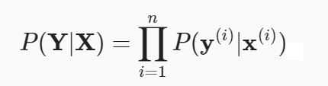
Example Part 2: The Loss Function
So far, we have used mean square error as a Loss Function to reduce the difference between y and y-hat.
Now we will look at the Log-Likelihood.
Recall that our application of Softmax gave us probabilities for each outcome. Using this, we can now apply log likelihood as our loss function.
First, we can say that the probability of getting a set of outcomes (Y) for a dataframe X can be broken down as the product of the individual probabilities….
From here and because working with products is less affective than with sums, we can convert this using logs. (See the next slide.

Slide 25
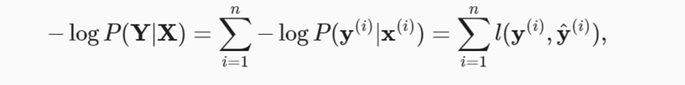
Log Likelihood
Above, we applied the negative log to both sides of our equation from the previous slide and solved. Using the log, we now have the sum of all rows (vectors in the dataset) of the –log of the probability of getting a certain outcome y given a certain vector of feature values, x.
We can write this also as - the sum over all rows - of differences between y (the known output) and y-hat (the predicted output).
As an example, if all predicted outcomes were exactly the same as all known outcomes – 100% accurate – the sum would be 0.

Slide 26
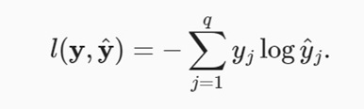
The Loss Function – Cross Entropy Loss
Recall
Y1_hat = e^(1.6) / [e^1.6 + e^ -0.2+ e^ 2.2] = .335
Y2_hat = e^(-0.2) / [e^1.6 + e^ -0.2+ e^ 2.2] = .055
Y3_hat = e^(2.2) / [e^1.6 + e^ -0.2+ e^ 2.2] = .61
The Loss Function for any single row (vector) can be expressed as the above.
Here, recall that we have three labels: 0,0,1 and 0,1,0 and 1,0,0.
Here, q is 3.
-[(y1 *log y-hat1) + (y2 *log y-hat2) + (y3* log y-hat3) ]
-[0 *log (.335) + 0 * log .055 + 1 * log .61] = -{ 0 + 0 + log .61] = .22 (this is the error or loss)
Now – have the y-hat values above. We used Softmax to get them.
We also know the y values because they are the labels of the data.
So for the first vector:
We know that the label is y1 is 0, y2 is 0, and y3 is 1. Again – this is one input vector that gives three outputs.
We have three y-hats (.335, .055, and .61) and we have three known values for y (0, 0, 1).
The Loss Function is the DIFFERENCE between these (see to the right)
Label | Cholesterol | Weight | Height
Risk (0, 0, 1) | 251 | 267 | 70

