Slide 1

Multilayer 2D convolutional NN on color dataset
Image processing with Python, NumPy
CIFAR-10 dataset
Author: Xingyu(Tim) Chen
Notes:
For this part of the Assignment, your goal is to dig in a bit deeper. Therefore, you will take several steps.
Step 1: Use THIS CODELinks to an external site. to get a basic multilayer 2D convolutional NN working for a color dataset. Everything you need is in the code.
Step 2: Once you get the code working, create a PowerPoint Tutorial that includes all of the code and explanations for what each line of code is doing. Include why sizes and shapes are as noted in the code. Include visual examples as often as possible. Pretend that it is your job to EXPLAIN and ILLUSTRATE each step to a person who is new to the topic.
For example - each slide in your PowerPoint Set might have 1 - 5 (with 5 as the max) lines of code that work together or individually to perform a task. You will include and explain the code. When possible, offer insightful illustrations. Include OUTPUT on slides as you go. Really assure that a viewer can SEE and understand what is going on.
There are 1000s of ways to do this :) Be creative and clear.

Slide 2
Import Library and Dataset
import tensorflow as tf import matplotlib.pyplot as plt (train_images, train_labels), (test_images, test_labels) = tf.keras.datasets.cifar10.load_data()
Get Dataset from tensorflow keras, split them into train set/label and test set/label
Notes:
# https://note.nkmk.me/en/python-numpy-image-processing/

Slide 3
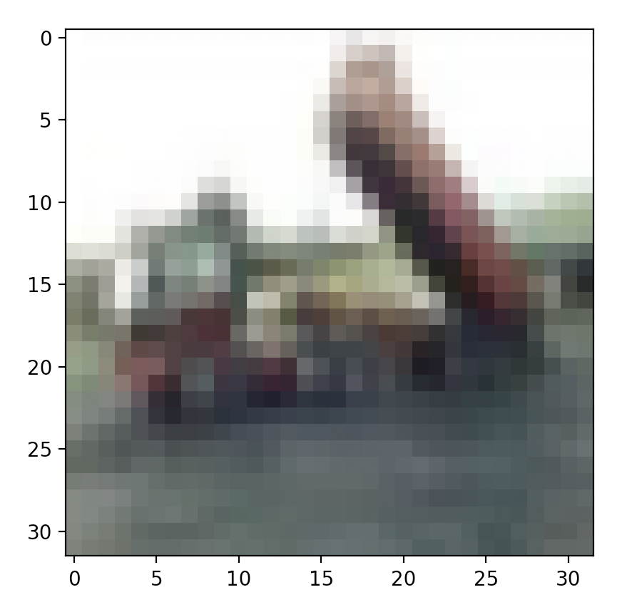
Insight of Dataset
print(type(train_images)) print(train_images.shape)
# 50000 rows, 32 by 32, depth 3 (R-G-B layer) plt.imshow(train_images[2]) plt.show()
<class 'numpy.ndarray'>
(50000, 32, 32, 3)
The CIFAR-10 dataset consists of 60000 32x32 colour images in 10 classes, with 6000 images per class. There are 50000 training images and 10000 test images.

Slide 4
Normalize
print(train_images[0, :, :, 0]) print(train_images[0, :, :, 0].shape) train_images, test_images = train_images / 255.0, test_images / 255.0 class_names = ['airplane', 'automobile', 'bird', 'cat', 'deer’, 'dog', 'frog', 'horse', 'ship', 'truck’]
[[ 59 43 50 ... 158 152 148]
[ 16 0 18 ... 123 119 122]
...
[180 173 186 ... 184 97 83]
[177 168 179 ... 216 151 123]]
(32, 32)
The images shape is 32 by 32 matrix, then we normalize pixel values to be between 0 and 1
There are 10 classes in the dataset 'airplane', 'automobile', 'bird', 'cat', 'deer’, 'dog', 'frog', 'horse', 'ship', 'truck

Slide 5
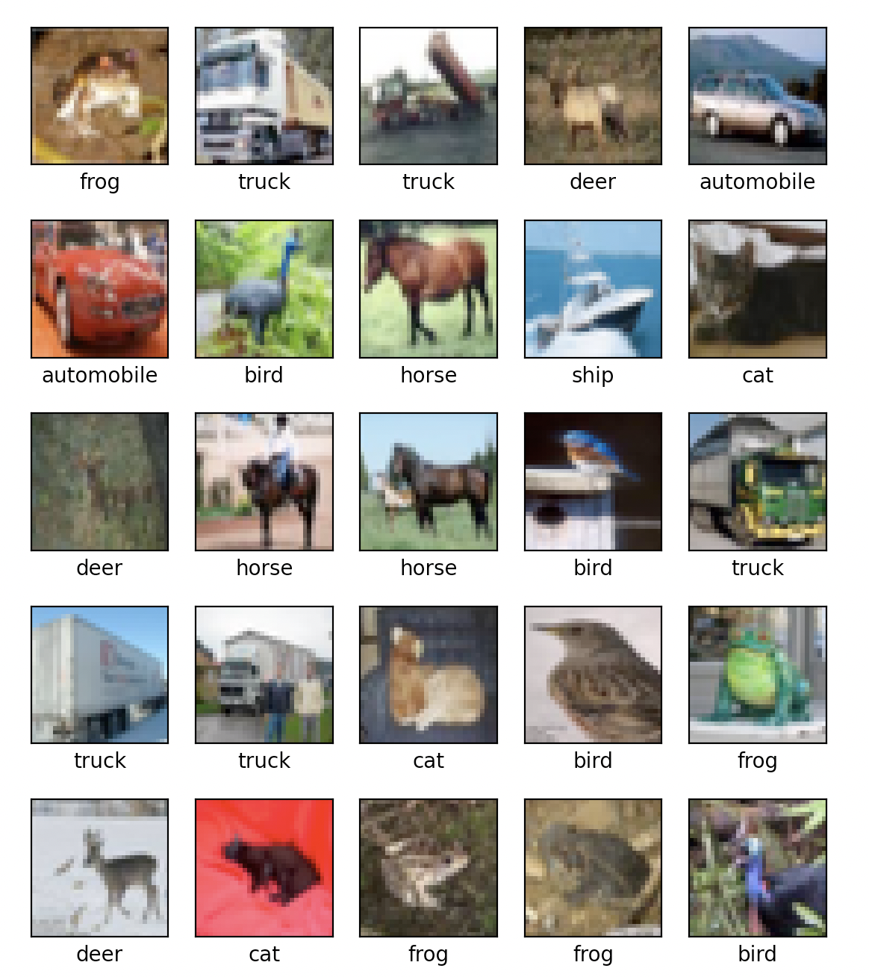
Check Images
plt.figure(figsize=(10, 10)) for i in range(25): plt.subplot(5, 5, i + 1) plt.xticks([]) plt.yticks([]) plt.grid(False) plt.imshow(train_images[i]) # The CIFAR labels happen to be arrays, # which is why you need the extra index plt.xlabel(class_names[train_labels[i][0]]) plt.show()

Slide 6
Define Model
model = tf.keras.models.Sequential()
model.add(tf.keras.layers.Conv2D(32, (3, 3), activation='relu', input_shape=(32, 32, 3))) model.add(tf.keras.layers.MaxPooling2D((2, 2))) model.add(tf.keras.layers.Conv2D(64, (3, 3), activation='relu')) model.add(tf.keras.layers.MaxPooling2D((2, 2))) model.add(tf.keras.layers.Conv2D(64, (3, 3), activation='relu’))

Slide 7
Conv2D & MaxPool2D
Conv2D - 2D convolution layer
This layer creates a convolution kernel that is convolved with the layer input to produce a tensor of outputs.
When using this layer as the first layer in a model, provide the keyword argument input_shape.
E.g. (32, 32, 3) for a 32 x 32 RGB pictures in this case
MaxPool2D - Max pooling operation for 2D spatial data.
Downsamples the input along its spatial dimensions (height and width) by taking the maximum value over an input window (of size defined by pool_size) for each channel of the input.
E.g. pool_size=(2, 2) for taking the max value over a 2x2 pooling window.
Notes:
# https://www.tensorflow.org/api_docs/python/tf/keras/layers/Conv2D
# https://www.tensorflow.org/api_docs/python/tf/keras/layers/MaxPool2D

Slide 8
Model Summary
model.add(tf.keras.layers.Flatten()) model.add(tf.keras.layers.Dense(64, activation='relu')) model.add(tf.keras.layers.Dense(10))
model.summary()
Model: "sequential"
Layer (type) Output Shape Param #
=================================================================
conv2d (Conv2D) (None, 30, 30, 32) 896
max_pooling2d (MaxPooling2D) (None, 15, 15, 32) 0
conv2d_1 (Conv2D) (None, 13, 13, 64) 18496
max_pooling2d_1 (MaxPooling2D) (None, 6, 6, 64) 0
conv2d_2 (Conv2D) (None, 4, 4, 64) 36928
flatten (Flatten) (None, 1024) 0
dense (Dense) (None, 64) 65600
dense_1 (Dense) (None, 10) 650

Slide 9
Model Compile and Fit
model.compile(optimizer='adam', loss=tf.keras.losses.SparseCategoricalCrossentropy(from_logits=True), metrics=['accuracy']) history = model.fit(train_images, train_labels, epochs=10, validation_data=(test_images, test_labels))
Define loss function = SparseCategoricalCrossEntropy
And optimizer = Adam optimizer
set epoch = 10
Using test_

Slide 10
Training Output
Epoch 1/10
1563/1563 [==============================] - 66s 42ms/step - loss: 1.5483 - accuracy: 0.4375 - val_loss: 1.3645 - val_accuracy: 0.5187
Epoch 2/10
1563/1563 [==============================] - 54s 35ms/step - loss: 1.1921 - accuracy: 0.5755 - val_loss: 1.0922 - val_accuracy: 0.6120
Epoch 3/10
1563/1563 [==============================] - 66s 42ms/step - loss: 1.0359 - accuracy: 0.6374 - val_loss: 1.0404 - val_accuracy: 0.6340
Epoch 4/10
1563/1563 [==============================] - 57s 36ms/step - loss: 0.9376 - accuracy: 0.6689 - val_loss: 0.9302 - val_accuracy: 0.6754
Epoch 5/10
1563/1563 [==============================] - 47s 30ms/step - loss: 0.8612 - accuracy: 0.6988 - val_loss: 0.9220 - val_accuracy: 0.6807
Epoch 6/10
1563/1563 [==============================] - 50s 32ms/step - loss: 0.8088 - accuracy: 0.7175 - val_loss: 0.8904 - val_accuracy: 0.6966
Epoch 7/10
1563/1563 [==============================] - 41s 26ms/step - loss: 0.7583 - accuracy: 0.7329 - val_loss: 0.9304 - val_accuracy: 0.6831
Epoch 8/10
1563/1563 [==============================] - 50s 32ms/step - loss: 0.7174 - accuracy: 0.7480 - val_loss: 0.8527 - val_accuracy: 0.7132
Epoch 9/10
1563/1563 [==============================] - 53s 34ms/step - loss: 0.6821 - accuracy: 0.7595 - val_loss: 0.8955 - val_accuracy: 0.6973
Epoch 10/10
1563/1563 [==============================] - 40s 26ms/step - loss: 0.6420 - accuracy: 0.7769 - val_loss: 0.8800 - val_accuracy: 0.7088
The accuracy of model is increasing during training process

Slide 11
Code for output plot
plt.plot(history.history['accuracy'], label='accuracy') plt.plot(history.history['val_accuracy'], label='val_accuracy') plt.xlabel('Epoch') plt.ylabel('Accuracy') plt.ylim([0, 1]) plt.legend(loc='lower right') plt.show()

Slide 12
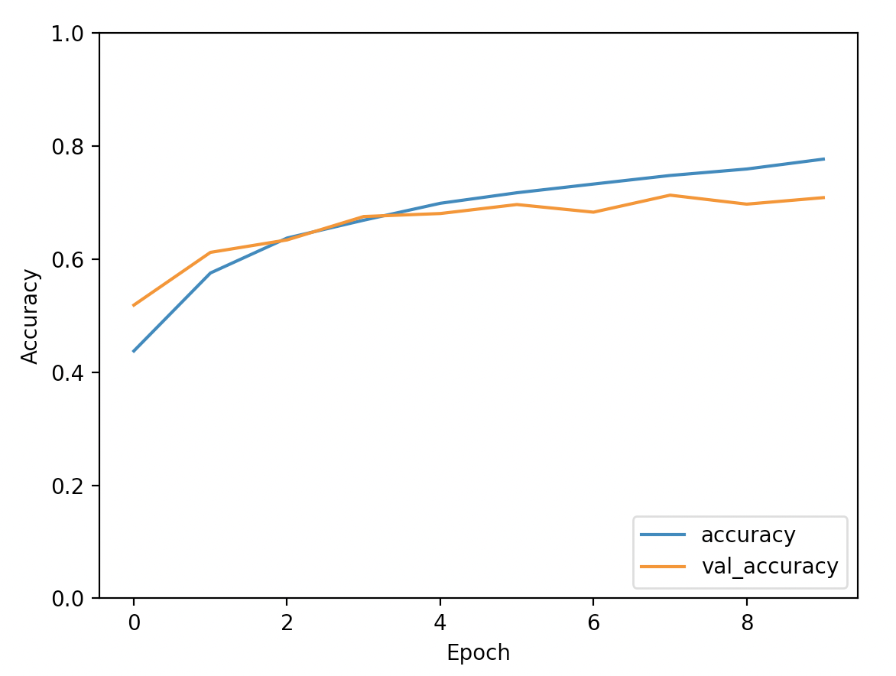
Training Output Plot

Slide 13
Model Evaluation on Test set
test_loss, test_acc = model.evaluate(test_images, test_labels, verbose=2) print(test_acc)
313/313 - 2s - loss: 0.8800 - accuracy: 0.7088 - 2s/epoch - 6ms/step
0.7088000178337097

