Slide 1
Neural Networks with Keras
Kevin Nguyen
Adapted from: https://towardsdatascience.com/building-our-first-neural-network-in-keras-bdc8abbc17f5

Slide 2


WHAT is KERAS?
High-level API that supports Google’s Tensorflow deep learning framework
Designed to be user-friendly
Can scale to large clusters of GPUs
Used by organizations like NASA, CERN, YouTube, and Waymo
This Photo by Unknown Author is licensed under CC BY-NC

Slide 3

GOAL: Predict price range of cell phones
Data
Mock data for 2000 cell phones
Contains 20 features
Target: “price_range” – a categorical variable that can take the following values
0 (low price)
1 (medium price)
2 (high price)
3 (very high price)
https://www.kaggle.com/datasets/iabhishekofficial/mobile-price-classification

Slide 4
How to structure a deep learning project
Preprocess and load data
Data is the key to a working neural network
Define the model
Specify the number of hidden layers and their size, number of inputs, number of outputs
Define the loss function and optimizer
Specify loss function, optimizer, learning rate and other hyperparameters
Fit the model
Specify the number of epochs
Train the model with our data

Slide 5
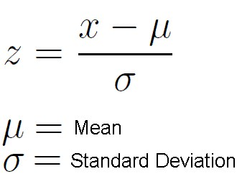
WHY Normalize our data?
Transform our data to fit a common scale without distorting the relative spread
Usually required when the features in our data vary by a large amount
E.g., “battery power” ~ 1000s while “clock speed” less than 3
With un-normalized data, gradients will change differently with each column -> learning will oscillate
Scaling creates consistency when comparing across models
This Photo by Unknown Author is licensed under CC BY-SA

Slide 6
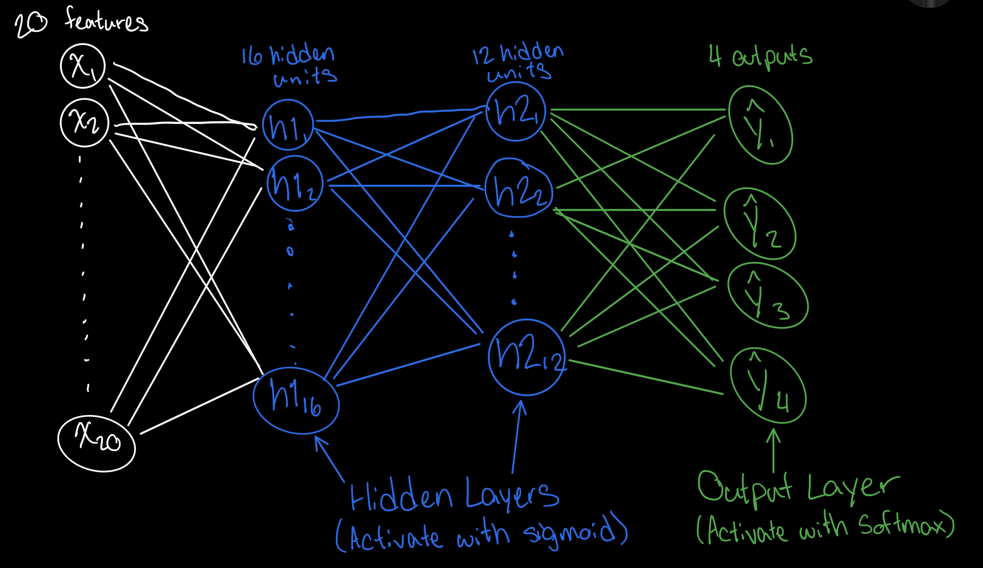
OUR Neural Network
W1: 20 x 16
b1: 16 x 1
W2: 16 x 12
b2: 12 x 1
W3: 12 x 4
c: 4 x 1

Slide 7
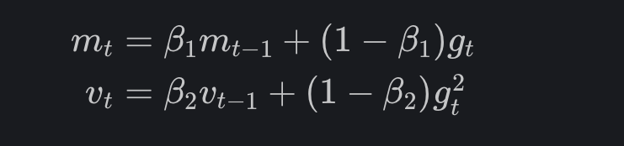
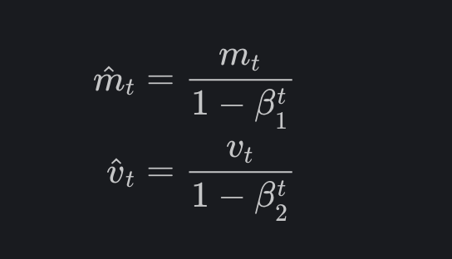
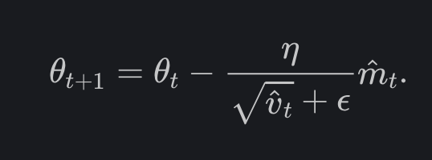

Adaptive Moment Estimation (ADAM)
Introduced by Kingma and Ba (2014)
Utilizes adaptive learning rates when updating weights
Said to be a combination of momentum and RMSProp
Popular optimizer for deep neural networks
Generally lower training cost and converges faster than other optimizers
Usually: $β_{1}=0.9$, $β_{2}=0.999$, and $ε={10}^{−8}$
Photos from: https://ruder.io/optimizing-gradient-descent/index.html#adam

Slide 8
References
https://keras.io
https://www.quora.com/Why-do-we-normalize-the-data
https://towardsdatascience.com/building-our-first-neural-network-in-keras-bdc8abbc17f5
https://ruder.io/optimizing-gradient-descent/index.html#adam

