Slide 1
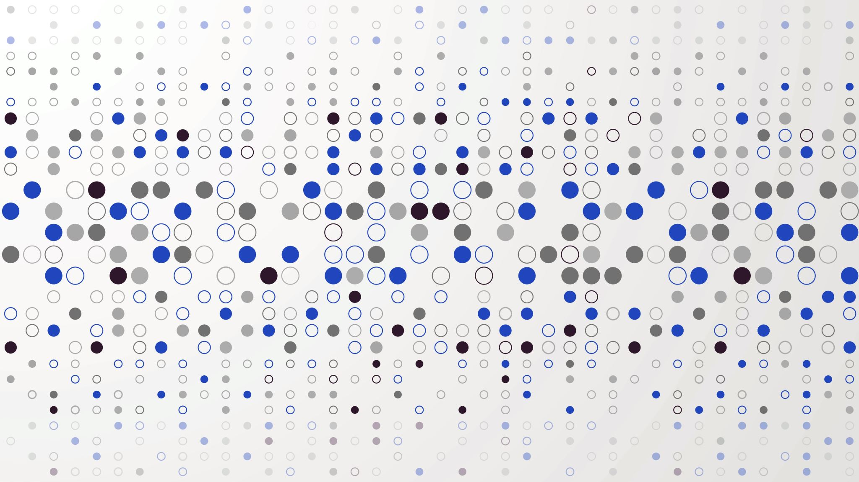
TikTok Sentiment Analysis: App Store Reviews and Tweets
Xingyu(Tim) Chen

Slide 2
Overview
Intro
Data
Model and Result
Findings

Slide 3
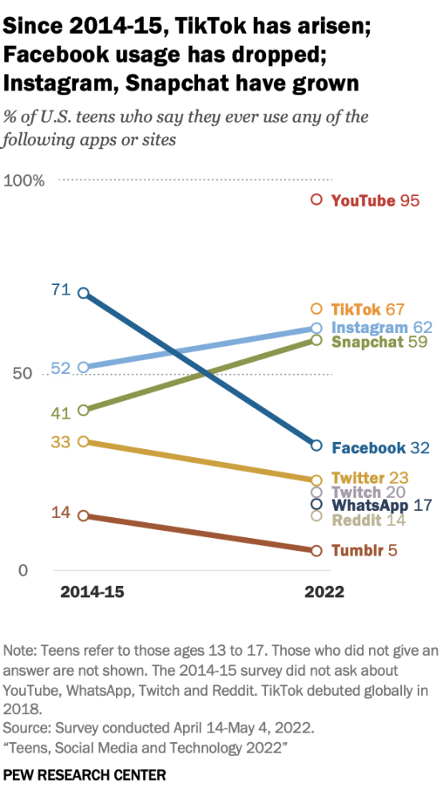

Motivation

Slide 4
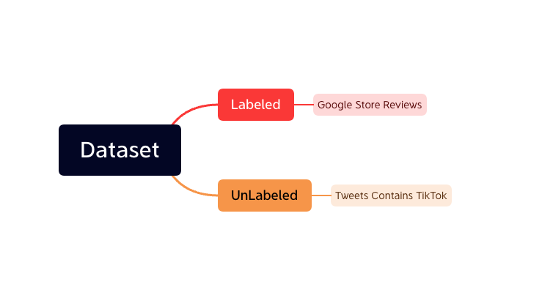
Data

Slide 5
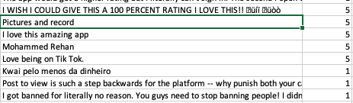
Raw Data
460,287 samples
Rating From 1 to 5
Jun 18 2022 – Nov 29 2022

Slide 6
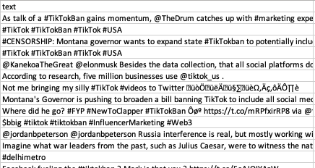
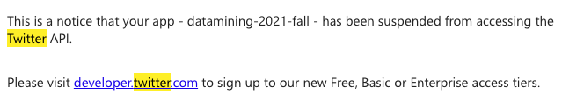
Raw Data
10,000 tweets
TikTok Ban

Slide 7
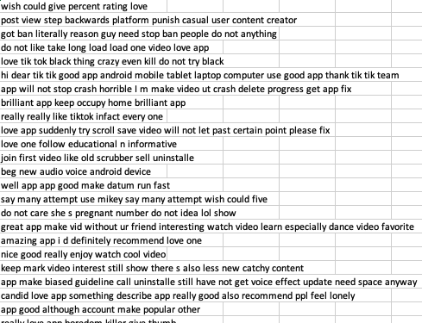
Cleaned data

Slide 8
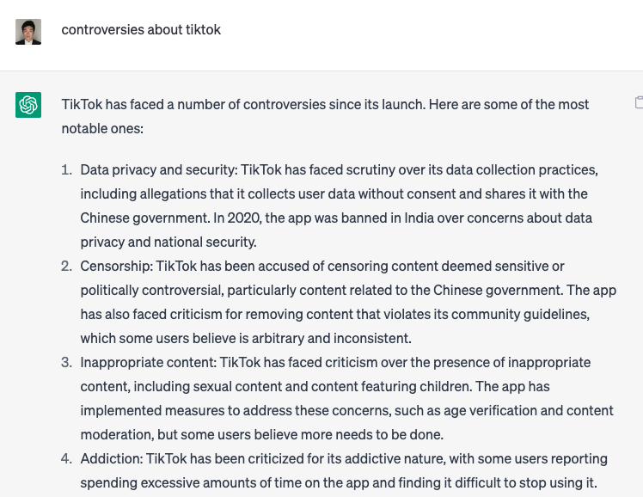
ChatGPT
Get some insights

Slide 9
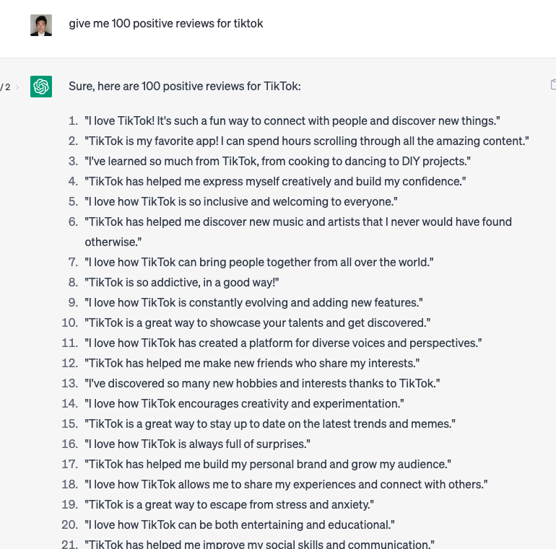
ChatGPT
ChatGPT3 only Based on data before 2021
Data Authority still need to be check

Slide 10
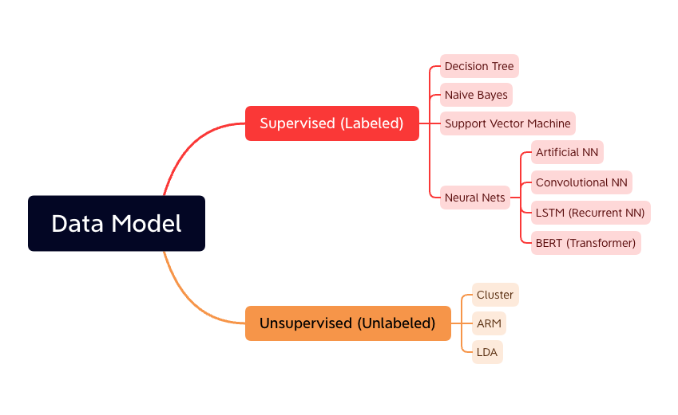

Slide 11
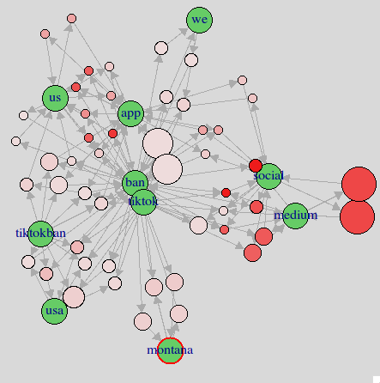
ARM
Montana Ban
Social Medium

Slide 12
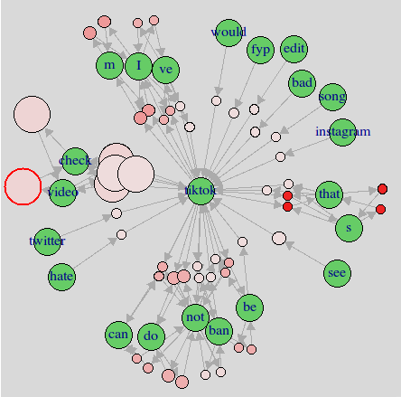
ARM
Check Video
Twitter/Instagram
Hate/Bad

Slide 13
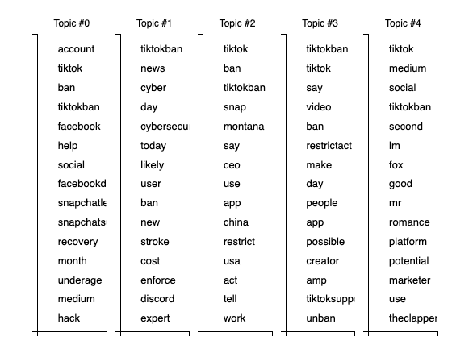
LDA
Snapchat/Facebook
Cyber Security
China Restrict
Notes:
Montana, ceo, china, restrict, usa, snap, unban, facebook, snapchat, cybersecurityawareness

Slide 14
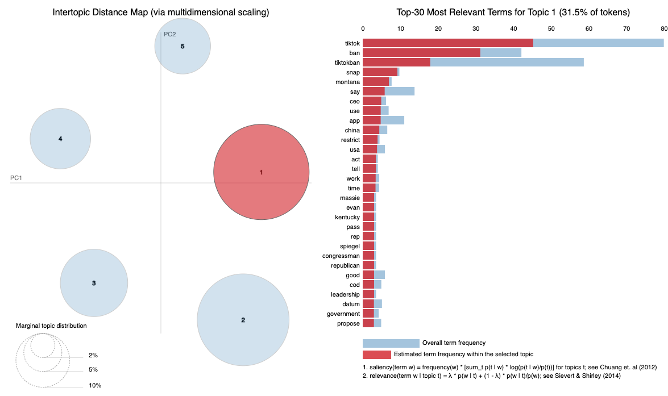
LDA

Slide 15
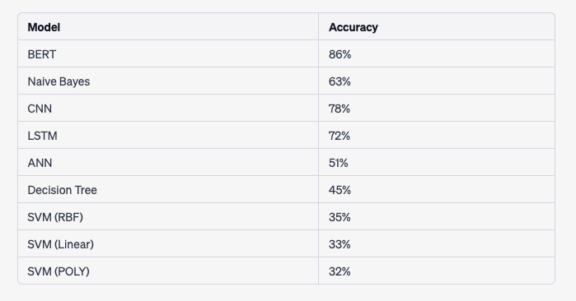
Supervised

Slide 16
BERT (Bidirectional Encoder Representations from Transformers)
GPT stands for "Generative Pre-trained Transformer"
Step 1: Pre-training: BERT is first pre-trained on a massive amount of text data, such as Wikipedia or books, in an unsupervised manner. During pre-training, the model learns to predict masked words in a sentence and next sentence prediction.
Step 2: Fine-tuning: BERT can be fine-tuned on a specific downstream task, such as sentiment analysis or question-answering, by training it on a smaller labeled dataset.
Step 3: Encoding: To encode a sentence or document using BERT, the input text is first tokenized into a sequence of word pieces, or subwords. Contextualized representations for each word piece in the input.
Step 4: Output: The output of BERT can be used for a variety of downstream tasks, such as classification, sequence tagging, and language generation.

Slide 17
Conclusion
Unban TikTok from Creators because they make living from the platform
Worried about Data Privacy and Safety related to China government
Switch to other social media: Instagram, Facebook, Snapchat, Twitter
“Check these videos”, people don’t care
Transformers is a typical deep neural networks for Text Mining or Natural language Processing, and usually perform better result compared to others

