Slide 1
An Iterative Algorithm for Joint Antenna Selection and Power Adaptation in Energy Efficient MIMO
Xingyu Zhou
Bo Bai
Wei Chen
Is there a promising way?
Tsinghua National Laboratory for Information Science and Technology (TNList)
Department of Electronic Engineering
Tsinghua University
IEEE International Communications Conference 2014
X. Zhou, B. Bo, W. Chen
Iterative AS and PA in Energy Efficient MIMO
IEEE ICC 2014

Slide 2
Outline
Background & Problem Formulation
An iterative approach
Simulation results
Conclusions
X. Zhou, B. Bo, W. Chen
Iterative AS and PA in Energy Efficient MIMO
IEEE ICC 2014
2

Slide 3
Outline
Background & Problem Formulation
An iterative approach
Simulation results
Conclusions
X. Zhou, B. Bo, W. Chen
Iterative AS and PA in Energy Efficient MIMO
IEEE ICC 2014
3

Slide 4


MIMO System
Costly
RF
RF
Costly
Encoder
and
SP
Decoder
and
SP
Output
Input
RF
Costly
H
Costly
Complex
RF
Complex
S
y
RF
Costly
Costly
RF
Is there a promising way?
$$n$$
$$y=Hs+n$$
Advantages & Disadvantages of MIMO
Array gain
Diversity gain
Spatial multiplexing (SM)
Costly RF Chains
High Complexity of SP
X. Zhou, B. Bo, W. Chen
Iterative AS and PA in Energy Efficient MIMO
IEEE ICC 2014
4

Slide 5









MIMO with Antenna Selection (AS)
$${\text{L}}_{\text{t}}<$$
$${\text{N}}_{\text{t}}$$
$${\text{L}}_{\text{r}}<$$
$${\text{N}}_{\text{r}}$$
1
1
1
1
RF
RF
Input
Encoder
and
SP
RF
Decoder
and
SP
RF
AS
AS
Output
Energy efficient MIMO with AS?
H
S
y
RF
RF
$${\text{L}}_{\text{t}}$$
$${\text{N}}_{\text{t}}$$
$${\text{N}}_{\text{r}}$$
$${\text{L}}_{\text{r}}$$
Energy Efficient MIMO
Limitations of Suboptimal Methods
Suboptimal Methods
A. Gorokhov ’03
Urgent and Important.
Number of RF chains is given and fixed.
Optimal Method
Low Complexity
Features
$${\text{P}}_{\text{t}}$$
NOT Energy Efficient.
Only is taken into account.
Exhaustive Search
M. Gharavi-Alkhansari ’04
Holistic power model. [S. Cui ’04]
Near-Optimal
Complexity Prohibitive
Capacity maximization only.
Energy efficiency maximization. [D. Feng ’13]
A. Dua ’06
Definition:
X. Zhou, B. Bo, W. Chen
Iterative AS and PA in Energy Efficient MIMO
IEEE ICC 2014
IEEE ICC 2014
5

Slide 6






Energy Efficient MIMO with AS
1
1
1
1
RF
RF
Input
Encoder
and
SP
RF
RF
Decoder
and
SP
Output
SW
AS
H
AS
SW
S
y
RF
RF
$${\text{N}}_{\text{t}}$$
$${\text{N}}_{\text{t}}$$
$${\text{N}}_{\text{r}}$$
$${\text{N}}_{\text{r}}$$
Is there a promising way?
Multi-stream energy efficient MIMO?
Pioneer Work
Features
Our system model
C. Jiang and L. Cimini ’12
Number of active RF chains is dynamical
Single stream
$${\text{P}}_{\text{t}}$$
Optimization of RF and AS simultaneously
RF
Limitations
Joint optimization
Norm-based
AS
EE maximization, i.e., is also optimized
$${\text{P}}_{\text{t}}$$
X. Zhou, B. Bo, W. Chen
X. Zhou, B. Bo, W. Chen
Iterative AS and PA in Energy Efficient MIMO
IEEE ICC 2014
6

Slide 7



Problem Formulation
1
1
1
RF
RF
Input
Encoder
and
SP
RF
RF
Decoder
and
SP
Output
SW
AS
H
y
S
How to solve it efficiently ?
RF
RF
$${\text{N}}_{\text{t}}$$
$${\text{N}}_{\text{t}}$$
$${\text{N}}_{\text{r}}$$
Features
Receiver is fixed, AS at the transmitter only.
Our problem
Holistic power model
Multi-stream
Minimal required rate
Performance metric:
X. Zhou, B. Bo, W. Chen
X. Zhou, B. Bo, W. Chen
Iterative AS and PA in Energy Efficient MIMO
IEEE ICC 2014
7

Slide 8
Outline
Background & Problem Formulation
An iterative approach
Simulation results
Conclusions
X. Zhou, B. Bo, W. Chen
Iterative AS and PA in Energy Efficient MIMO
IEEE ICC 2014
8

Slide 9
Core idea
Animation Illustration
Our problem
Proposed Algorithm
n =
…
1
2
3
AS at the nth step
Theorem 1
Theorem 1
Greedy selection
…
2
5
5
n = n+1
Optimal Method
3
3
3
Optimize for the nth step
Exhaustive Search
Pseudo-concave
For each subset, find optimal
calculations
P3
…
P2
Complexity Prohibitive
P2
P1
P1
P1
X. Zhou, B. Bo, W. Chen
Iterative AS and PA in Energy Efficient MIMO
IEEE ICC 2014
9

Slide 10
Antenna selection process
Theorem 1
With the transmit antenna selection and a given transmission power, the EE of a multi-stream MIMO under the holistic power model can be expressed by the following iterative equation.
effect of circuit power
EE increment when th antenna is selected
where
Main Idea of AS
At each step, select the column of H that brings the largest contribution to the energy efficiency.
It can be equivalent to this problem :
X. Zhou, B. Bo, W. Chen
Iterative AS and PA in Energy Efficient MIMO
IEEE ICC 2014
10

Slide 11
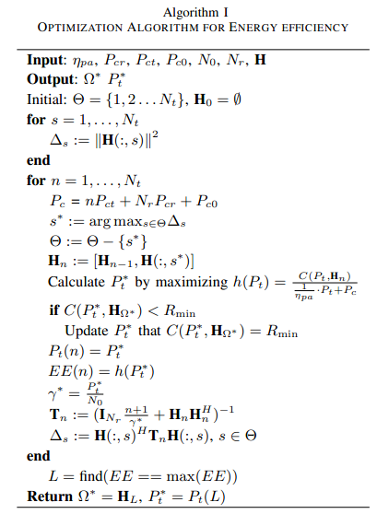
PA and Proposed Algorithm
Main Idea of PA
Proposed Algorithm
Pseudo-concave function: Numerator of EE is concave function and denominator is a convex function of Pt.
Only one optimum: the only optimal Pt is the one leads the derivation of EE to be zero.
Iteration : set the optimum as the initial one for the AS next step.
Remark
Low Complexity: Nt calculations only.
Expansibility : easily extended to handle EE with AS at receiver.
X. Zhou, B. Bo, W. Chen
Iterative AS and PA in Energy Efficient MIMO
IEEE ICC 2014
11

Slide 12
Asymptotic performance analysis
Theorem 2
For high and low SNR regimes, the antenna selection process is independent with the transmission power.
Similar to QR
In particular
High SNR regimes: , where
Low SNR regimes: , where
Remark
The joint iteration is decoupled, thus a better performance and complexity reduction.
Provide us with some insights.
X. Zhou, B. Bo, W. Chen
Iterative AS and PA in Energy Efficient MIMO
IEEE ICC 2014
12

Slide 13
Outline
Background & Problem Formulation
An iterative approach
Simulation results
Conclusions
X. Zhou, B. Bo, W. Chen
Iterative AS and PA in Energy Efficient MIMO
IEEE ICC 2014
13

Slide 14
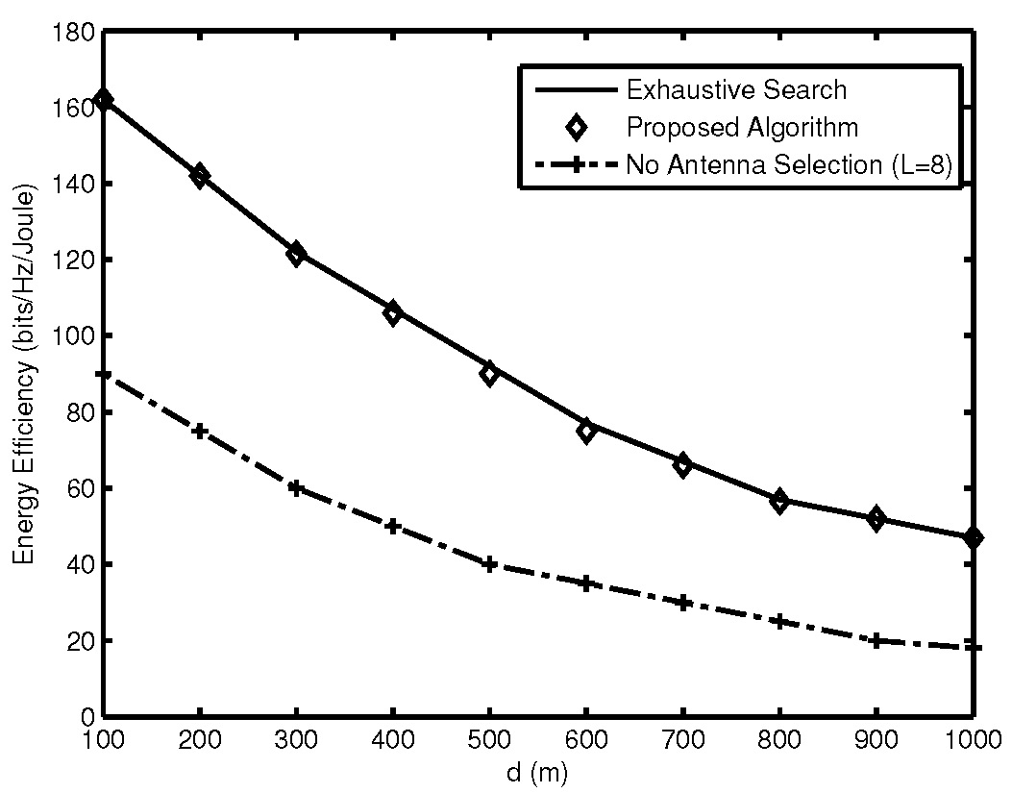
Simulation results (1/3)
Near-optimal
Significant Gain
Figure: Energy efficiency VS. the transmission distance
X. Zhou, B. Bo, W. Chen
Iterative AS and PA in Energy Efficient MIMO
IEEE ICC 2014
14

Slide 15
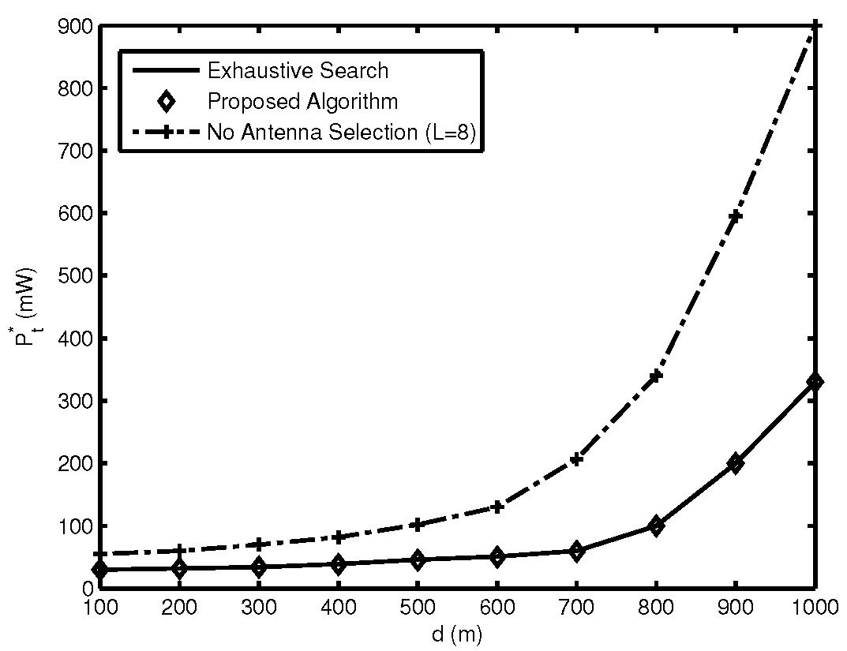
Simulation results (2/3)
Figure: Optimal transmission power VS. the transmission distance.
X. Zhou, B. Bo, W. Chen
Iterative AS and PA in Energy Efficient MIMO
IEEE ICC 2014
15

Slide 16
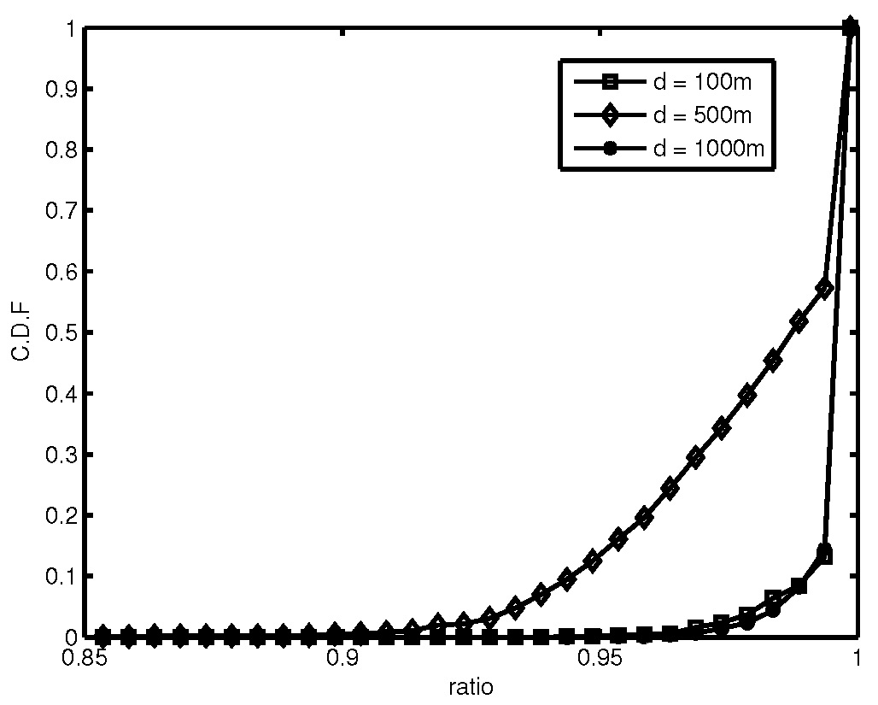
Simulation results (3/3)
Figure: CDF of the ratio between the EE of ES and the EE of the proposed algorithm
X. Zhou, B. Bo, W. Chen
Iterative AS and PA in Energy Efficient MIMO
IEEE ICC 2014
16

Slide 17
Outline
Background & Problem Formulation
An iterative approach
Simulation results
Conclusions
X. Zhou, B. Bo, W. Chen
Iterative AS and PA in Energy Efficient MIMO
IEEE ICC 2014
17

Slide 18
Conclusions
Our proposed iterative algorithm enjoys a low complexity and achieves the near-optimal performance in all the SNR regimes.
A better performance is achieved in high and low SNR regimes.
Our algorithm is capable of simultaneously improving EE and reducing the transmission power.
Our work helps to design future energy efficient wireless communication systems.
Thank you very much!
All comments are welcomed ;-)
X. Zhou, B. Bo, W. Chen
Iterative AS and PA in Energy Efficient MIMO
IEEE ICC 2014
18

