Slide 1
Energy Efficient relay Antenna selection
For AF MIMO Two-way relay channels
Xingyu Zhou
Bo Bai
Wei Chen
Is there a promising way?
Tsinghua National Laboratory for Information Science and Technology (TNList)
Department of Electronic Engineering
Tsinghua University
IEEE International Communications Conference 2015
X. Zhou, B. Bo, W. Chen
Energy Efficient AS for AF MIMO Two-way
IEEE ICC 2015

Slide 2
Outline
Background & Problem Formulation
An iterative approach
Simulation results
Conclusions
X. Zhou, B. Bo, W. Chen
Energy Efficient AS for AF MIMO Two-way
IEEE ICC 2015
2

Slide 3
Outline
Background & Problem Formulation
An iterative approach
Simulation results
Conclusions
X. Zhou, B. Bo, W. Chen
Energy Efficient AS for AF MIMO Two-way
IEEE ICC 2015
3

Slide 4
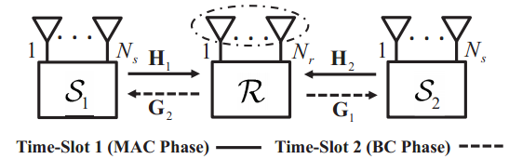
Two-way MIMO Relay
Is there a promising way?
Advantages & Disadvantages
Higher spectral efficiency
Improved reliability
Better coverage
Costly multiple RF chains
High complexity of SP
Especially on the relay
X. Zhou, B. Bo, W. Chen
Energy Efficient AS for AF MIMO Two-way
IEEE ICC 2015
4

Slide 5
Antenna Selection (AS)
RF
RF
Received
RF
Amplify and
Forward
RF
Transmitted
AS
AS
Signal
Energy efficient MIMO with AS?
Signal
RF
RF
Energy Efficient MIMO
Limitations of Suboptimal Methods
Suboptimal Methods
H.Park ’12
Urgent and Important.
Number of RF chains is given and fixed.
Optimal Method
Low Complexity
Features
NOT Energy Efficient.
Only Transmission power is considered
Exhaustive Search
J.-C Chen ‘12
Holistic power model. [S. Cui ’04]
Near-Optimal
Complexity Prohibitive
Capacity maximization only.
Energy efficiency maximization. [D. Feng ’13]
J.Leithon ‘12
Definition:
X. Zhou, B. Bo, W. Chen
Energy Efficient AS for AF MIMO Two-way
IEEE ICC 2015
IEEE ICC 2014
5

Slide 6
Energy Efficient MIMO with AS
RF
RF
Received
RF
Amplify and
Forward
Transmitted
RF
AS
SW
AS
Signal
Signal
Energy efficient AS for Two-way AF MIMO?
RF
RF
Features
Previous Work
X. Zhou ’ICC 14 : p2p MIMO
Number of active RF chains is dynamical
Optimization of RF and AS simultaneously
X. Zhou ’GlobalSIP14: one-way relay
EE maximization
X. Zhou, B. Bo, W. Chen
Energy Efficient AS for AF MIMO Two-way
X. Zhou, B. Bo, W. Chen
IEEE ICC 2015
6

Slide 7

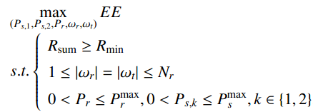

Problem Formulation
How to solve it efficiently ?
Features
Holistic power model
Our problem
Performance metric:
X. Zhou, B. Bo, W. Chen
Energy Efficient AS for AF MIMO Two-way
X. Zhou, B. Bo, W. Chen
IEEE ICC 2015
7

Slide 8
Outline
Background & Problem Formulation
An iterative approach
Simulation results
Conclusions
X. Zhou, B. Bo, W. Chen
Energy Efficient AS for AF MIMO Two-way
IEEE ICC 2015
8

Slide 9





Core idea
Our problem
Proposed Algorithm
AS at the nth step
Theorem 1
Greedy Selection
Theorem 1

Optimize the power for the nth step
Proposition 1
Fractional
Programming
X. Zhou, B. Bo, W. Chen
Energy Efficient AS for AF MIMO Two-way
IEEE ICC 2015
9

Slide 10




Antenna selection process
Theorem 1
With the relay antenna selection and given transmission power, the EE of AF MIMO TWRC
under the holistic power model is given by the following iterative equation:
effect of circuit power
EE increment when is selected
where
Main Idea of AS
At each step, select the antenna pair at the relay that brings the largest contribution to the energy efficiency.
It can be equivalent to this problem :
X. Zhou, B. Bo, W. Chen
Energy Efficient AS for AF MIMO Two-way
IEEE ICC 2015
10

Slide 11




Power Adaptation
Proposition 1
Main Idea of PA
An optimization problem is pseudo-concave when is concave and
is convex. It can be related to the following parametric problem
The maximum value can be achieved if and only if and satisfy
The root can be efficiently found by the Dinkelbach method.
Main Idea of Power Adaptation
Remark
Transform a non-convex optimization problem into parametric convex optimization problem
It can be solved with a superlinear convergence rate.
X. Zhou, B. Bo, W. Chen
Energy Efficient AS for AF MIMO Two-way
IEEE ICC 2015
11

Slide 12
Outline
Background & Problem Formulation
An iterative approach
Simulation results
Conclusions
X. Zhou, B. Bo, W. Chen
Energy Efficient AS for AF MIMO Two-way
IEEE ICC 2015
12

Slide 13
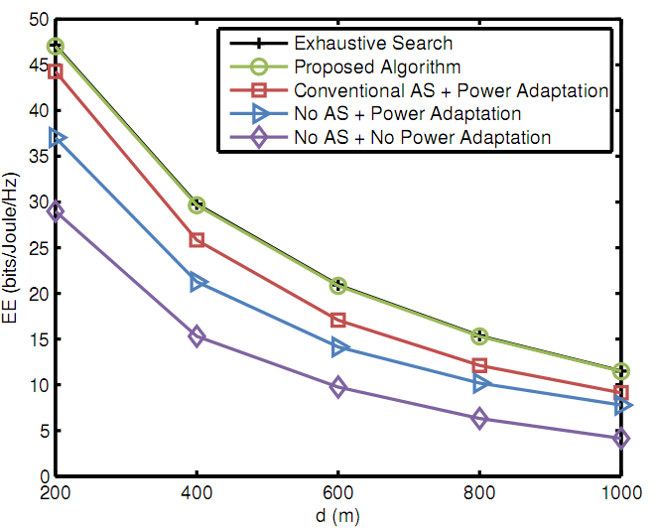
Simulation results (1/3)
Near-optimal
Significant Gain
Figure: Energy efficiency VS. the transmission distance
X. Zhou, B. Bo, W. Chen
Energy Efficient AS for AF MIMO Two-way
IEEE ICC 2015
13

Slide 14
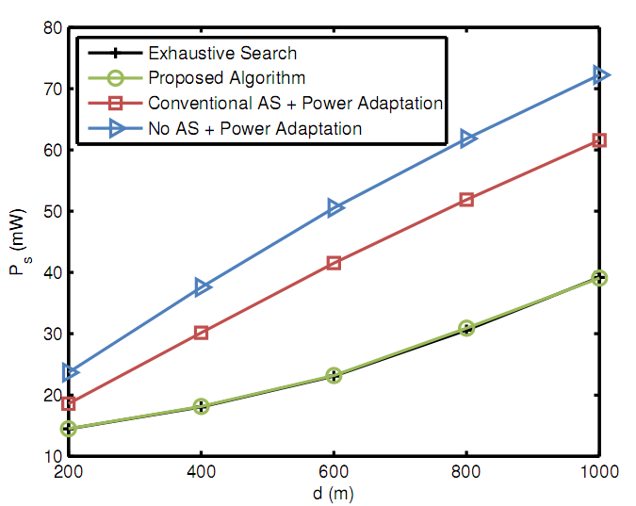
Simulation results (2/3)
Figure: Optimal transmission power VS. the transmission distance.
X. Zhou, B. Bo, W. Chen
Energy Efficient AS for AF MIMO Two-way
IEEE ICC 2015
14

Slide 15
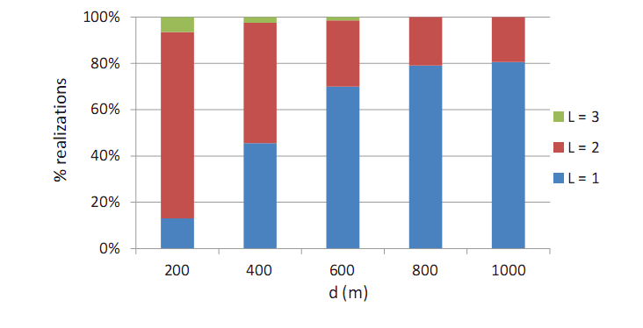
Simulation results (3/3)
Figure: Statistical results for the optimal number of active RF chains
V.S. the distance when achieving the maximum EE
X. Zhou, B. Bo, W. Chen
Energy Efficient AS for AF MIMO Two-way
IEEE ICC 2015
15

Slide 16
Outline
Background & Problem Formulation
An iterative approach
Simulation results
Conclusions
X. Zhou, B. Bo, W. Chen
Energy Efficient AS for AF MIMO Two-way
IEEE ICC 2015
16

Slide 17
Conclusions
Our proposed iterative algorithm enjoys a low complexity and achieves the near-optimal performance in all transmission distances.
Our algorithm is capable of simultaneously improving EE and reducing the transmission power.
Our work helps to design future energy efficient wireless communication systems.
Thank you very much!
All comments are welcomed ;-)
X. Zhou, B. Bo, W. Chen
Energy Efficient AS for AF MIMO Two-way
IEEE ICC 2015
17

