Slide 1
Section 5 and 6

Slide 2
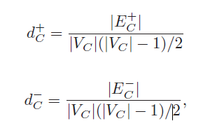

The size of communities(ie. θ) is usually not less than 4
Intra-Connection
(internal edges)
|C| = 4
|C| = 5
Inter-Connection
(external edges)
(The number of intra-Connection)
(The number of inter-Connection)
Community Formation Condition:

Slide 3
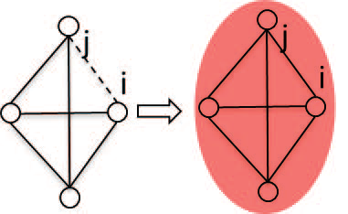
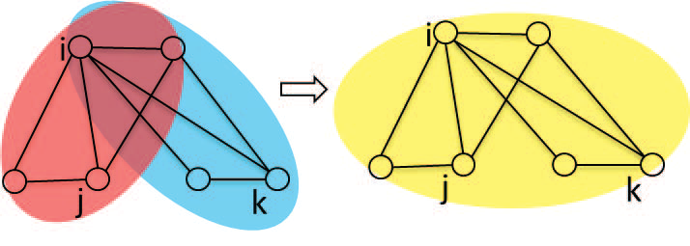
Basic community creation. Whenever a new edge eij
appears, node i always tries to build a new community
Ctemp based on the common neighbors between i
and j
Community merging. Sometimes, the new community
Ctemp may share substructures (i.e., overlap) with other
existing communities, In this case,
the two communities shall be merged into a bigger one.

Slide 4
Bridge Node Self-Recommending
A normal node may become a bridge node or vice versa after the update
When two nodes i and j encounter, they shall update
their bridging centrality(ie.Weighted) by exchanging information
if node i is the only node shared by two communities C ∈ Cti
and C’∈ Ctj , and has not yet been detected as a bridge,
it will identify itself as a bridge node.
C
C’
i
j
Otherwise, node i will recommend itself as a candidate of bridge node
between C and C’ by sending a recommendation packet
to each encountered neighbor in C

Slide 5
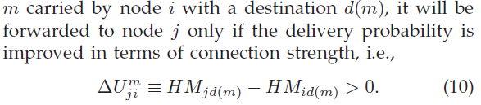
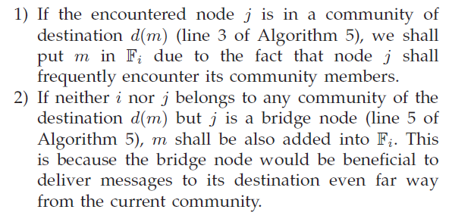
6 CONNECTION STRENGTH AWARE ROUTING
When two nodes encounter, since their contact duration is limited and unexpected
(代表哪些message該被送出)
當node i,j相遇時,若j的delivery probability比i高,才把message傳給j.
j和destination在同一個community,要傳.
i,j都不在destination的community內,但j是bridge node,要傳.

Slide 6
Message Copy Control
more copies generated for a message,the higher delivery performance could be achieved.
=> Overhead 提升
To balance the tradeoff between the delivery performanceand overhead,
we propose an inter-community multi-copy and intra-community single-copy mechanism.
Right after forwarding m to the encountered node j, node i will delete m from its buffer if j shares a common community with message m’s destination d(m)
M
M
M

Slide 7
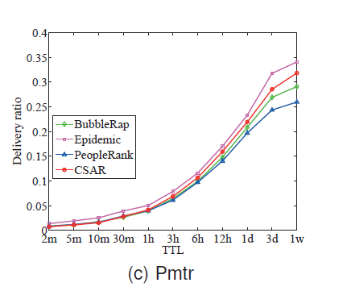
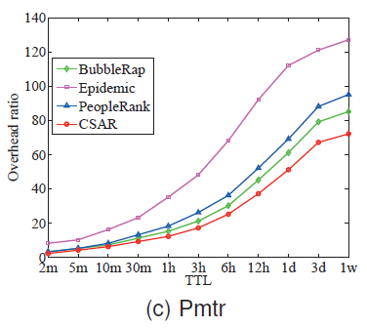
Pmtr

