Slide 1
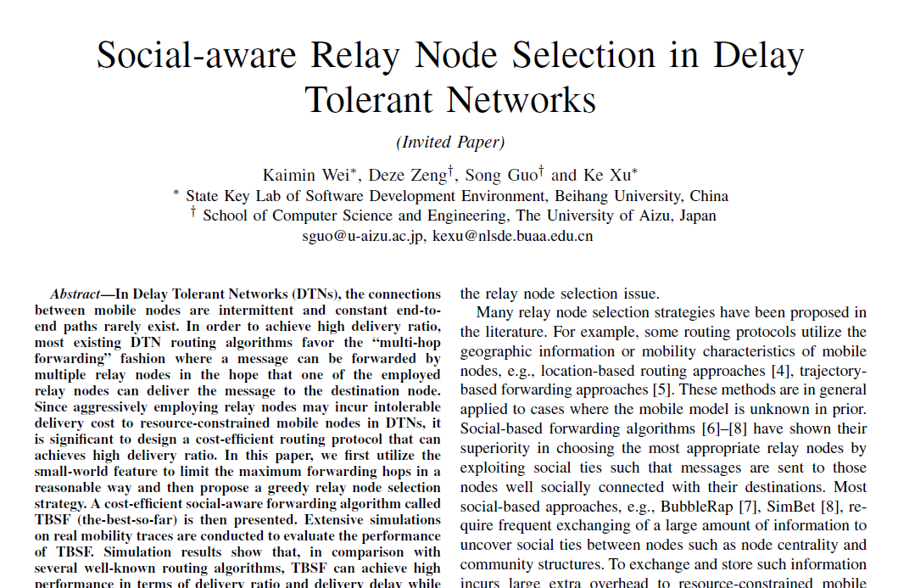

Slide 2
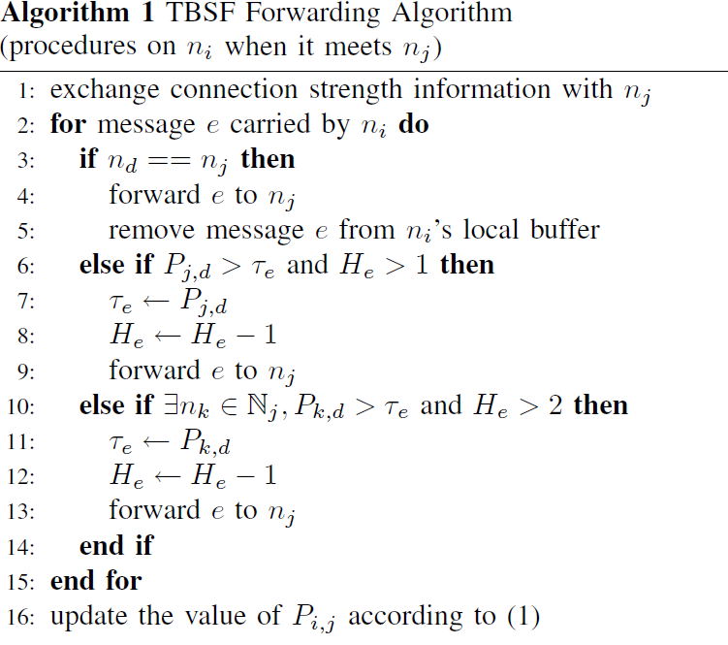


TBFS Algorithm(cont.)
=1
=100
P
=4
=1
Message e
=5
Message e
P
=50
other
=100
=4
P
=20
other
=100
Delivery Probability
Other nodes
FinalRecipient

Slide 3
Infocom2006
Pmtr
Group.movementModel = RandomWaypoint
Group.router = DecisionEngineRouter
Group.bufferSize = 3M
Group.nrofInterfaces = 1
Group.interface1 = btInterface
Group.speed = 0, 0.1
Group.nrofHosts = 98
Group.groupID = n
Events.nrof = 2
Events1.class = ExternalEventsQueue
Events2.class = MessageEventGenerator
ExternalEvents.nrofPreload = 500
Events1.filePath = ee/haggle6-infocom6.csv
Events2.interval = 30,40
Events2.hosts = 0,98
Events2.prefix = Y
Events2.size = 25k
Group.movementModel = RandomWaypoint
Group.router = DecisionEngineRouter
Group.bufferSize = 3M
Group.nrofInterfaces = 1
Group.interface1 = btInterface
Group.speed = 0, 0.1
Group.nrofHosts = 49
Group.groupID = n
Events.nrof = 2
Events1.class = ExternalEventsQueue
Events2.class = MessageEventGenerator
ExternalEvents.nrofPreload = 500
Events1.filePath = ee/pmtr-dirconn.txt
Events2.interval = 30,40
Events2.hosts = 0,49
Events2.prefix = Y
Events2.size = 25k

Slide 4
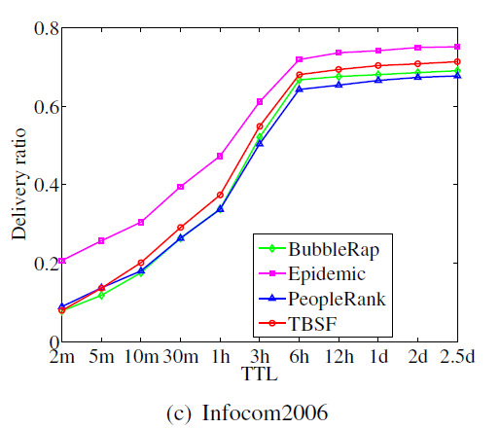
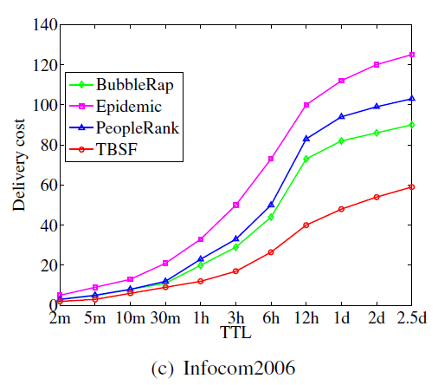
0.7
Infocom2006

Slide 5
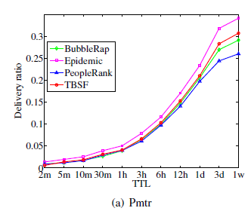
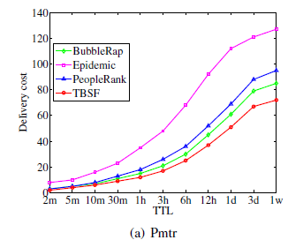
Pmtr

