Slide 1
Infocom2006
程式 DefaultSetting | 我的程式 (BubbleRap) | 家熯的程式 (BubbleRap) | 學長的程式 (BubbleRap)
Paper (98個nodes) | X | X | NO
學長 (65個nodes) | NO | NO | OK

Slide 2
Scenario.name = simbet_D01%%Group.router%%%
Scenario.simulateConnections = false
Scenario.updateInterval = 1
Scenario.endTime = 259200
Scenario.nrofHostGroups = 1
btInterface.type = SimpleBroadcastInterface
btInterface.transmitSpeed = 250k
btInterface.transmitRange = 10
###################################
Group.movementModel = RandomWaypoint
Group.router = DecisionEngineRouter
#Group.router = SimbetRouter
#Group.router = DirectDeliveryRouter
Group.bufferSize = 3M
Group.nrofInterfaces = 1
Group.interface1 = btInterface
Group.speed = 0, 0.1
Group.nrofHosts = 98
Group.groupID = n
#Group.msgTtl = [5000]
Events.nrof = 2
Events1.class = ExternalEventsQueue
Events2.class = MessageEventGenerator
ExternalEvents.nrofPreload = 500
#Events1.filePath = ee/filter-mitfrom9to2-stamp.txt
Events1.filePath = ee/haggle6-infocom6.csv
Events2.interval = 30,40
Events2.hosts = 0,98
Events2.prefix = Y
Events2.size = 25k
98個Nodes

Slide 3
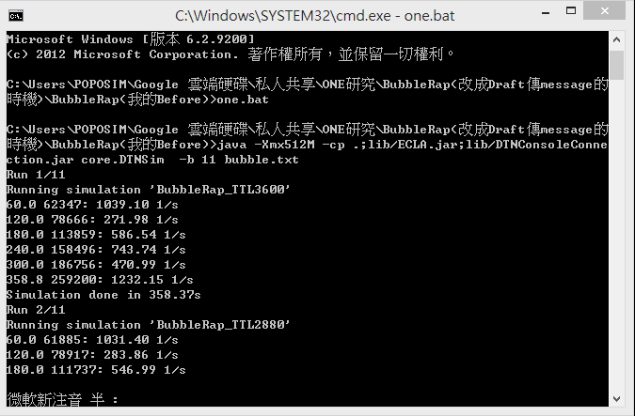
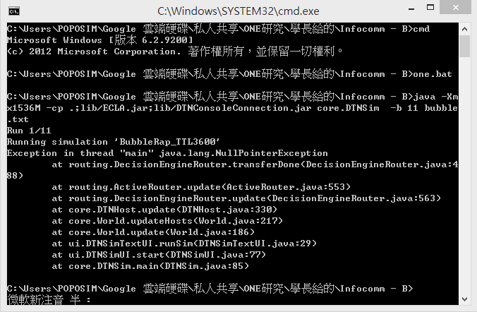
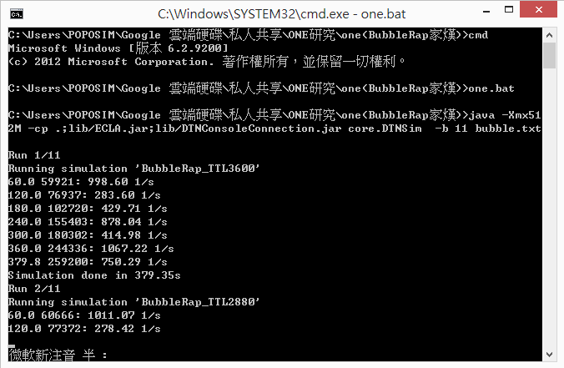
我的BubbleRap(Cost最高達300多)
學長的BubbleRap(不正常)
家熯的BubbleRap(Cost最高達300多)
98個Nodes

Slide 4
Scenario.name = simbet_D01%%Group.router%%%
Scenario.simulateConnections = false
Scenario.updateInterval = 1
Scenario.endTime = 259200
Scenario.nrofHostGroups = 1
btInterface.type = SimpleBroadcastInterface
btInterface.transmitSpeed = 250k
btInterface.transmitRange = 10
###################################
Group.movementModel = RandomWaypoint
Group.router = DecisionEngineRouter
#Group.router = SimbetRouter
#Group.router = DirectDeliveryRouter
Group.bufferSize = 50M
Group.nrofInterfaces = 1
Group.interface1 = btInterface
Group.speed = 0, 0.1
Group.nrofHosts = 65
Group.groupID = n
#Group.msgTtl = [5000]
Events.nrof = 2
Events1.class = ExternalEventsQueue
Events2.class = MessageEventGenerator
ExternalEvents.nrofPreload = 500
#Events1.filePath = ee/haggle6-infocom6.csv
Events1.filePath = ee/infocom2006_65-sorted-dirconn.txt
Events2.interval = 30,40
Events2.hosts = 0,65
Events2.prefix = Y
Events2.size = 1k
65個Nodes

Slide 5
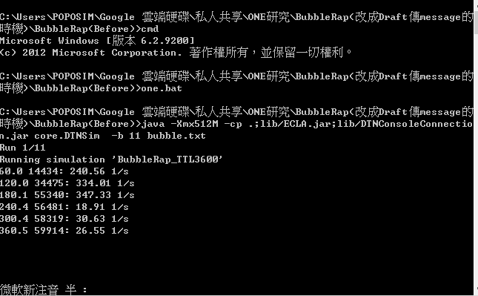
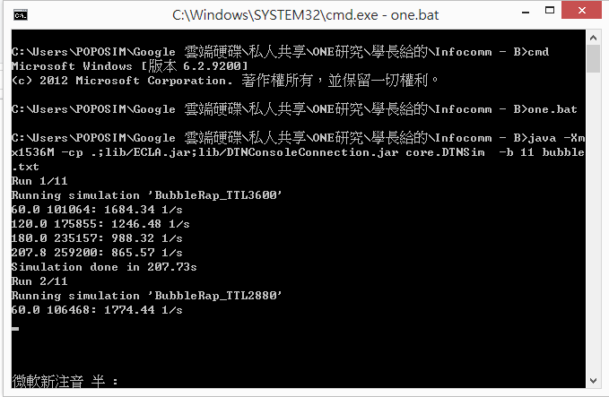
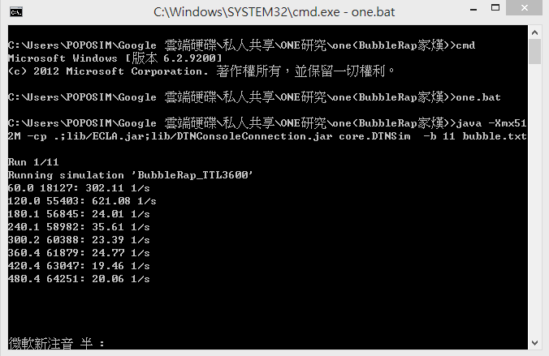
我的BubbleRap(失敗)
學長的BubbleRap(正常)
家熯的BubbleRap(失敗)
65個Nodes

Slide 6
 | 我 | 家熯 | 學長
DistributedBubbleRap | 279行 | 279行 | 523行
KCLiqueCommunityDetection | 223行 | 223行 | 222行
DecisionEngineRouter | 488行 | 716行 | 895行

