Slide 1
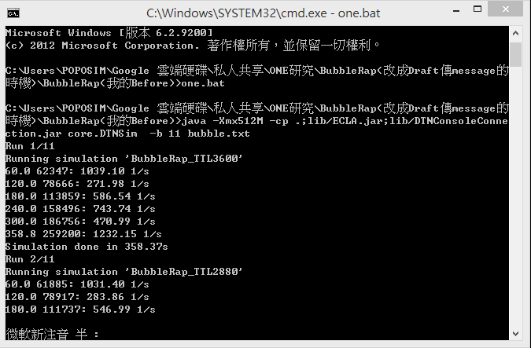
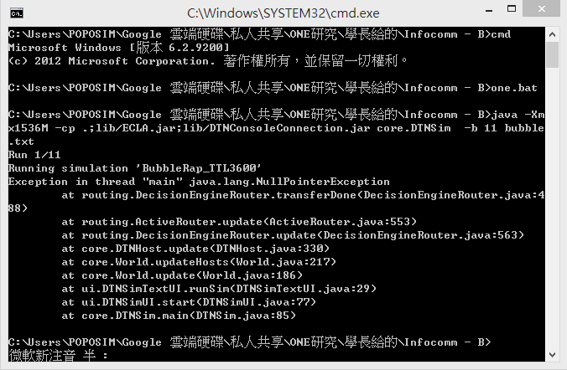
infocom2006-98nodes
我的BubbleRap(Cost最高達300多)
學長的BubbleRap(不能執行)
但可以執行infocom2006-65nodes

Slide 2
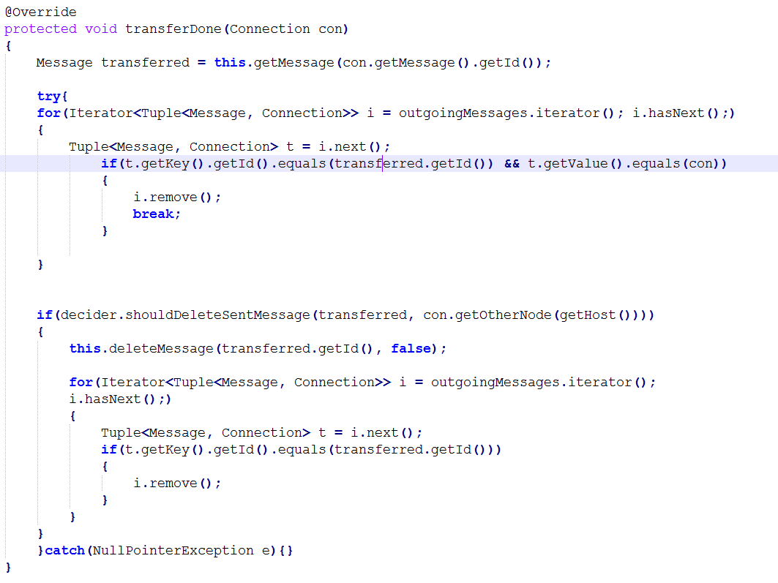
DecisionEngineRouter

Slide 3
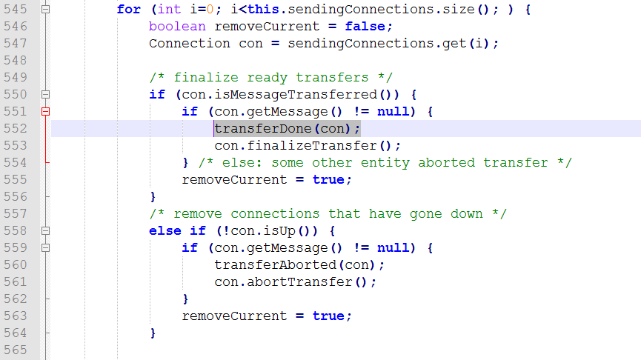
at routing.DecisionEngineRouter.transferDone(DecisionEngineRouter.java:335)
at routing.ActiveRouter.update(ActiveRouter.java:552)
at routing.DecisionEngineRouter.update(DecisionEngineRouter.java:369)
at core.DTNHost.update(DTNHost.java:330)
at core.World.updateHosts(World.java:217)
at core.World.update(World.java:186)
at ui.DTNSimTextUI.runSim(DTNSimTextUI.java:29)
at ui.DTNSimUI.start(DTNSimUI.java:77)
at core.DTNSim.main(DTNSim.java:85)
ActiveRouter

Slide 4
DecisionEngineRouter
con.getMessage().getId()==Y44

Slide 5
DecisionEngineRouter
this.getMessage(Y44) == null

Slide 6

MessageRouter

Slide 7
The messages this router is carrying
Y202
Y71
Y200
Y74
Y206
Y205
Y72
Y107
Y79
Y105
Y101
Y186
Y181
Y182
Y189
Y62
Y64
Y65
Y176
Y175
Y172
Y228
Y3
Y4
Y227
Y1
Y226
Y225
Y8
Y223
問題點
Y234
Y132
Y232
Y130
Y239
Y17
Y13
Y122
Y125
Y98
Y95
Y96
Y91
Y93
Y92
Y121
Y109
Y252
Y114
Y253
Y89
Y118
Y87
Y116
Y85
Y84
Y83
Y82
Y198
Y39
Y191
Y192
Y37
Y31
Y199
Y30
Y149
Y240
Y145
Y243
Y141
Y190
Y29
Y143
Y22
Y21
Y23
Y26
Y25
Y28
Y27
Y20
Y137
Y138
Y231
Y133
Y134
Y131
Y5
Y221
Y6
Y220
Y56
Y54
Y162
Y167
Y166
Y168
Y218
Y215
Y214
Y41
Y216
Y210
Y213
Y212
Y47
Y48
Y43
Y46
Y158
Y157
Y156
Y208
Y209
Y159
Y196
Y197
Y33
Y32
Connection上的message id為 Y44
但Router內的message不存在Y44
?

Slide 8
infocom2006-98nodes
我的BubbleRap(Cost最高達300多)
學長的BubbleRap(不能執行)

Slide 9
修改one最原始版本
在CWindowCentrality.java
getGobalCentrality
getLocalCentrality
各別加入try...catch(NullPointerException e)...
在DecisionEngineRouter.java
transferredDone
加入try...catch(NullPointerException e)...
createNewMessage
加入m.setTtl(this.msgTtl);

Slide 10
infocom2006-98nodes

Slide 11
Message stats for scenario BubbleRap_TTL3600sim_time: 259200.0000
created: 7518
started: 2452775
relayed: 2429791
aborted: 22980
dropped: 2388148
removed: 36063
delivered: 2408
delivery_prob: 0.3203
deliverycost: 323.1965
每個node的relayed數量(每個都很多)
n62=>15158
n67=>23587
n40=>19812
n4=>19895
n66=>28548
n47=>29025
n42=>35927
n71=>23907
n56=>20255
n9=>33019
n15=>40081
n33=>29801
n6=>5575
n76=>42067
n37=>27163
n36=>27461
n49=>37327
n60=>19355
n51=>32104
n38=>25541
n12=>47013
n88=>34497
n86=>28888
n20=>6604
n74=>33392
n21=>25670
n89=>34207
n87=>21058
n69=>25889
n77=>35595
n28=>17754
n78=>30087
n27=>26777
n58=>18924
n17=>1926
n83=>21898
n26=>9430
n97=>12040
n14=>32045
n92=>34374
n94=>20684
n19=>4208
n80=>37545
n53=>22845
n55=>32616
n23=>19402
n79=>29848
n25=>20797
n90=>31559
n31=>28650
n81=>40964
n18=>1934
n63=>25972
n59=>35191
n48=>16906
n85=>25140
n1=>26493
n46=>25716
n73=>36970
n65=>47469
n5=>32497
n45=>26320
n54=>21770
n68=>12078
n52=>33811
n22=>8805
n0=>29366
n10=>5040
n24=>34093
n95=>20562
n41=>19473
n44=>30340
n39=>19087
n29=>25885
n75=>42227
n82=>6371
n13=>39246
n30=>35225
n32=>15787
n84=>12773
n34=>24943
n96=>8056
n93=>12380
n43=>18816
n11=>6852
n7=>6896
n3=>11932
n64=>19053
n91=>20926
n50=>34487
n8=>16504
n35=>17796
n57=>28046
n70=>29844
n61=>18276
n2=>42409
n72=>37125
n16=>40011
Cost = relayed / created
Prob = delivered / created

