Slide 1
The messages this router is carrying
Y202
Y71
Y200
Y74
Y206
Y205
Y72
Y107
Y79
Y105
Y101
Y186
Y181
Y182
Y189
Y62
Y64
Y65
Y176
Y175
Y172
Y228
Y3
Y4
Y227
Y1
Y226
Y225
Y8
Y223
問題點
Y234
Y132
Y232
Y130
Y239
Y17
Y13
Y122
Y125
Y98
Y95
Y96
Y91
Y93
Y92
Y121
Y109
Y252
Y114
Y253
Y89
Y118
Y87
Y116
Y85
Y84
Y83
Y82
Y198
Y39
Y191
Y192
Y37
Y31
Y199
Y30
Y149
Y240
Y145
Y243
Y141
Y190
Y29
Y143
Y22
Y21
Y23
Y26
Y25
Y28
Y27
Y20
Y137
Y138
Y231
Y133
Y134
Y131
Y5
Y221
Y6
Y220
Y56
Y54
Y162
Y167
Y166
Y168
Y218
Y215
Y214
Y41
Y216
Y210
Y213
Y212
Y47
Y48
Y43
Y46
Y158
Y157
Y156
Y208
Y209
Y159
Y196
Y197
Y33
Y32
Connection上的message id為 Y44
但Router內的message不存在Y44
“共120個message”

Slide 2
Scenario.endTime = 259200
Group.movementModel = RandomWaypoint
Group.router = DecisionEngineRouter
#Group.router = SimbetRouter
#Group.router = DirectDeliveryRouter
Group.bufferSize = 3M
Group.nrofInterfaces = 1
Group.interface1 = btInterface
Group.speed = 0, 0.1
Group.nrofHosts = 98
Group.groupID = n
#Group.msgTtl = [5000]
Events.nrof = 2
Events1.class = ExternalEventsQueue
Events2.class = MessageEventGenerator
ExternalEvents.nrofPreload = 500
#Events1.filePath = ee/filter-mitfrom9to2-stamp.txt
Events1.filePath = ee/haggle6-infocom6.csv
Events2.interval = 30,40
Events2.hosts = 0,98
Events2.prefix = Y
Events2.size = 25k
原設定3M/25K = 120
所以每個router只能carrying 120個message
由於產生message的速度(每30~40秒產生一個message)比消耗buffer內的message速度還快,
例: message的TTL尚存,未達刪除message標準..等等
因此buffer來不及清出空間放新的message,
而造成connection上有message id,但實際上一開始產生message後並沒有存入buffer內,
因此當transferredDone時,要去buffer內找message,卻造成NullPointerException
259200秒/30秒 = 8640(一個router最多一次carrying的message量)
若以一個message為25k計,buffer size至少要設為216M

Slide 3
解決方法: 加大buffer size,縮小message size,
避免buffer overload
Scenario.endTime = 259200 Group.movementModel = RandomWaypoint
Group.router = DecisionEngineRouter
#Group.router = SimbetRouter
#Group.router = DirectDeliveryRouter
Group.bufferSize = 50M
Group.nrofInterfaces = 1
Group.interface1 = btInterface
Group.speed = 0, 0.1
Group.nrofHosts = 98
Group.groupID = n
#Group.msgTtl = [5000]
Events.nrof = 2
Events1.class = ExternalEventsQueue
Events2.class = MessageEventGenerator
ExternalEvents.nrofPreload = 500
Events1.filePath = ee/haggle6-infocom6.csv
Events2.interval = 30,40
Events2.hosts = 0,98
Events2.prefix = Y
Events2.size = 1k

Slide 4
昱仁學長的程式

Slide 5
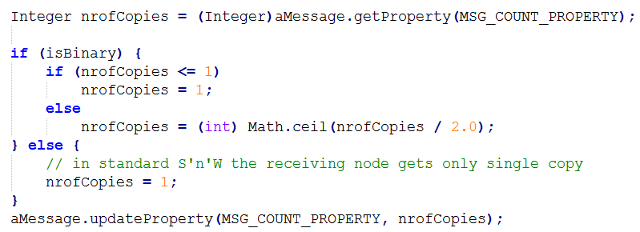
DecisionEngineRouter.messageTransferred

