Slide 1
Time:7652 DecisionEengineR-transferDone-NULL:Y4
Time:7652 DecisionEengineR-transferDone-From:n67
Time:7652 DecisionEengineR-transferDone-To:n79

Slide 2
Group.bufferSize = 3M
Group.nrofInterfaces = 1
Group.interface1 = btInterface
Group.speed = 0, 0.1
Group.nrofHosts = 98
Group.groupID = n
Events.nrof = 2
Events1.class = ExternalEventsQueue
Events2.class = MessageEventGenerator
ExternalEvents.nrofPreload = 500
Events1.filePath = ee/haggle6-infocom6.csv
Events2.interval = 259
Events2.hosts = 0,98
Events2.prefix = Y
Events2.size = 25k
每個MessageBuffer(MessageRouter.messages)只能放120個Message

Slide 3
Time:7374.0 MessageRouter-receiveMessage Y4 from n95 to n67
(n67收到message Y4)
Time:7415.0 DecisionEngineRouter-findConnectionsForNewMessage:Y4 from n67 to n84
(n67送出message Y4給n84)
….
Time:7649.0 ActiveRouter-makeRoomForMessage-n67
(n67 message太多(120個),要清理空間)
Time:7649.0 MessageRouter-deleteMessage Y4 from n67
(n67 把oldest message(Y4)從messages移除)
….
Time:7651.0 ActiveRouter-tryMessagesForConnected:Y4 from n67
(DecisionEngineRouter-update時,從outgoing messages挑出<Y4,n79>發送message)
Time:7651.0 MessageRouter-receiveMessage Y4 from n67 to n79
(n79收到從n67的outgoing messages內送來的message Y4)
Time:7652.0 DecisionEengineR-transferDone-NULL:Y4
Time:7652.0 DecisionEengineR-transferDone-From:n67
Time:7652.0 DecisionEengineR-transferDone-To:n79
問題起因
問題發生點

Slide 4
Time:7374.0 MessageRouter-receiveMessage Y4 from n95 to n67
(n67收到message Y4)
Time:7415.0 DecisionEngineRouter-findConnectionsForNewMessage:Y4 from n67 to n84
(n67送出message Y4給n84)
….
Time:7649.0 ActiveRouter-makeRoomForMessage-n67
(n67 message太多(120個),要清理空間)
Time:7649.0 MessageRouter-deleteMessage Y4 from n67
(n67 把oldest message(Y4)從messages移除)
….
Time:7651.0 ActiveRouter-tryMessagesForConnected:Y4 from n67
(DecisionEngineRouter-update時,從outgoing message挑出<Y4,n79>發送message)
Time:7651.0 MessageRouter-receiveMessage Y4 from n67 to n79
(n79收到從n67的outgoing message內送來的message Y4)
Time:7652.0 DecisionEengineR-transferDone-NULL:Y4
Time:7652.0 DecisionEengineR-transferDone-From:n67
Time:7652.0 DecisionEengineR-transferDone-To:n79
問題起因
問題發生點

Slide 5
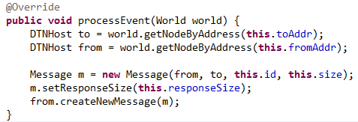
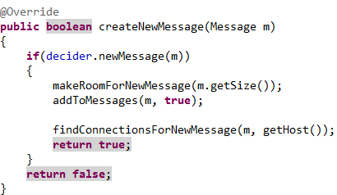

MessageCreateEvent (Sender n67)
在此產生一個new message
DecosionEngineRouter
(Sender)
(Always true)
1
2
3
DistributedBubbleRap

Slide 6

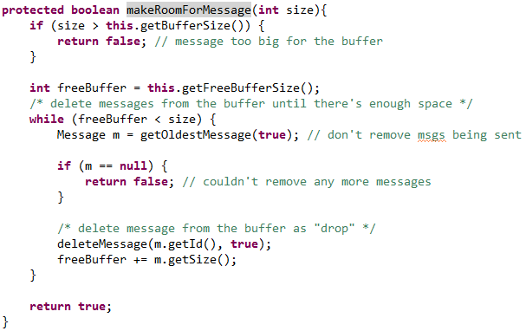
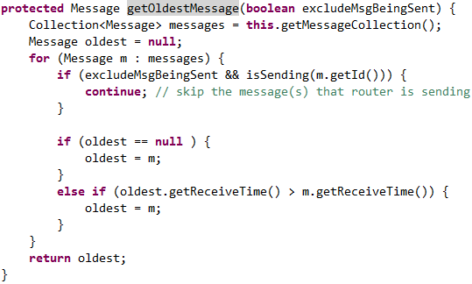
DecosionEngineRouter
(Sender)
ActiveRouter
Sender
(Always true)
1
2
3
size = 25k
freeBuffer = 0k
清理buffer (刪最舊的message)
oldest :Y4
回傳最舊的
message
120個
Messages
… | … | … | Y4

Slide 7
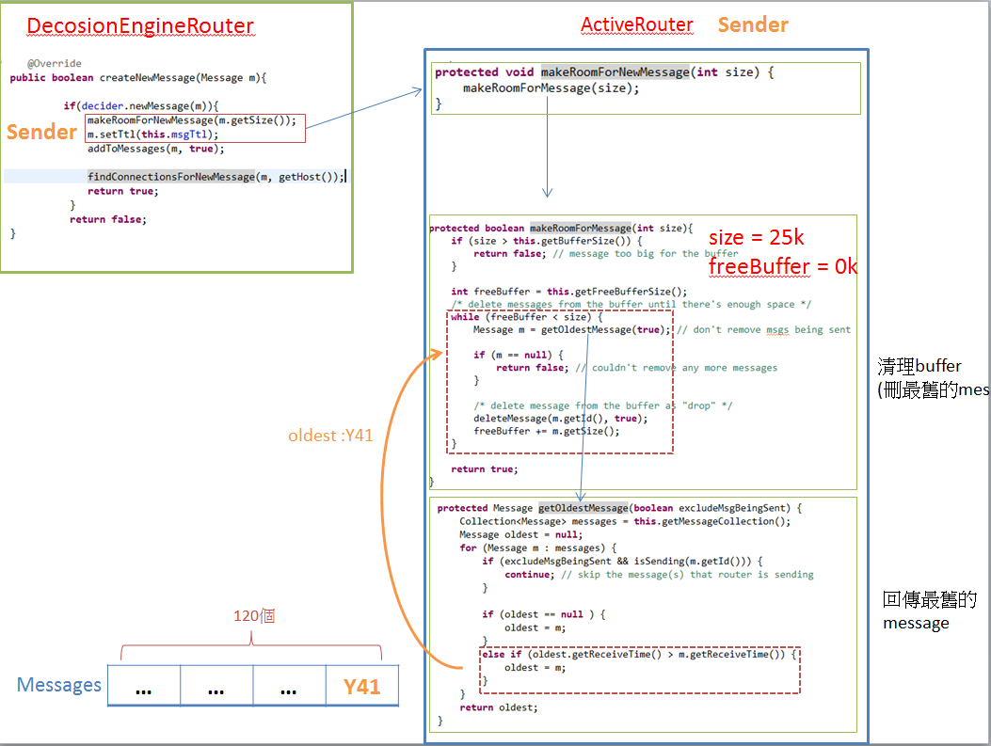
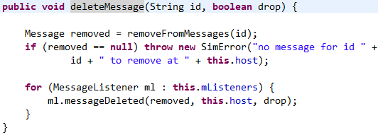

MessageRouter
Sender
(上一頁的縮圖)
Remove Y4 from messages
120個
Messages
… | … | … | Y4
放入new message

Slide 8
Time:7374.0 MessageRouter-receiveMessage Y4 from n95 to n67
(n67收到message Y4)
Time:7415.0 DecisionEngineRouter-findConnectionsForNewMessage:Y4 from n67 to n84
(n67送出message Y4給n84)
….
Time:7649.0 ActiveRouter-makeRoomForMessage-n67
(n67 message太多(120個),要清理空間)
Time:7649.0 MessageRouter-deleteMessage Y4 from n67
(n67 把oldest message(Y4)從messages移除)
….
Time:7651.0 ActiveRouter-tryMessagesForConnected:Y4 from n67
(DecisionEngineRouter-update時,從outgoing messages挑出<Y4,n79>發送message)
Time:7651.0 MessageRouter-receiveMessage Y4 from n67 to n79
(n79收到從n67的outgoing message內送來的message Y4)
Time:7652.0 DecisionEengineR-transferDone-NULL:Y4
Time:7652.0 DecisionEengineR-transferDone-From:n67
Time:7652.0 DecisionEengineR-transferDone-To:n79
問題起因
問題發生點

Slide 9
為什麼n67的outgoing messages內的<Y4,n79>沒被刪除?

Slide 10
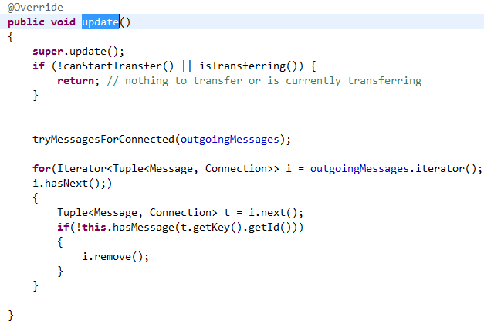
Outgoing messages刪除的時間點
update
ChangedConnection(Connection down)
transferDone
N67做update時,先執行的是tryMessagesForConnection,
然後才是刪outgoing message

Slide 11
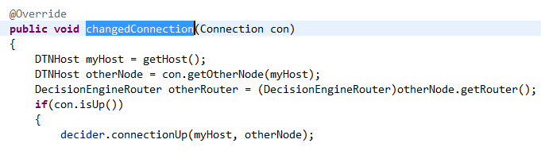
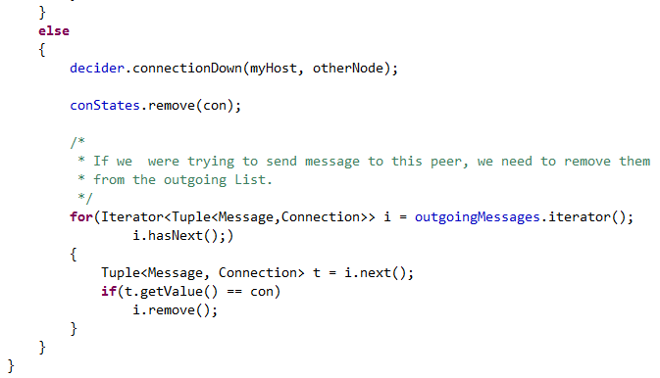
Outgoing messages刪除的時間點
update
changedConnection(Connection down)
transferDone
….
“7867.00 CONN 79 67 down”
Time:7652.0 DecisionEengineR-transferDone-NULL:Y4
transferDone發生NullPointer的時間點比Connection Down早

Slide 12
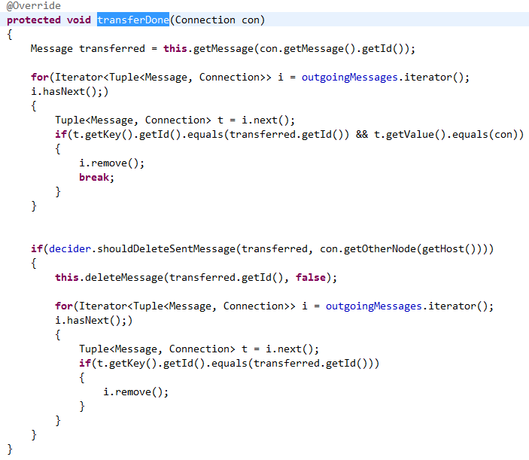
Outgoing messages刪除的時間點
update
changedConnection(Connection down)
transferDone
到messages內取Y4
Null
從outgoing messages內刪除 (沒問題)
Null pointer
從messages內刪除 (NullPointerException)
outgoing
messages
… | … | … | Y4
OK
Messages
… | … | … | …
NULL

Slide 13

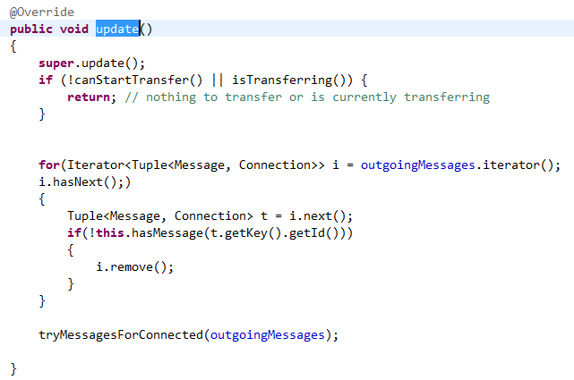
解決方法 :
DecisionEngineRouter
(前)
(後)
從outgoing messages送msg出去前,先確認messages內的msg是否還在

Slide 14
Infocom2006- 98 nodes

Slide 15
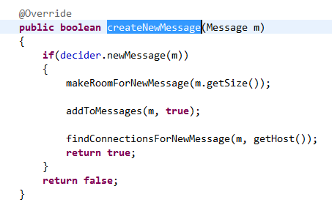
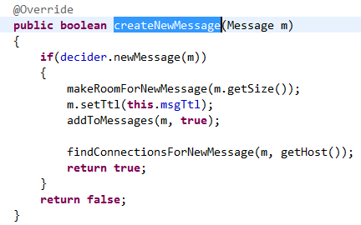
解決方法 :
DecisionEngineRouter
(前)
(後)

Slide 16
98 | 2min |  | 5 |  | 10 |  | 30 |  | 1H |  | 3H |  | 6H |  | 12H |  | 1D |  | 2D |  | 2.5D
TTL | 2 |  | 5 |  | 10 |  | 30 |  | 60 |  | 180 |  | 360 |  | 720 |  | 1440 |  | 2880 |  | 3600
delivery_ratio | 0.04 |  | 0.076 |  | 0.117 |  | 0.209 |  | 0.277 |  | 0.482 |  | 0.652 |  | 0.783 |  | 0.677 |  | 0.548 |  | 0.518
total_cost | 1.643 |  | 2.63 |  | 4.003 |  | 6.913 |  | 9.71 |  | 18.206 |  | 27.871 |  | 131.785 |  | 974.912 |  | 1470.78 |  | 1594.156

