Slide 1
CreateNewMessage
1. Scenario 1 當Messages(Buffer)尚有空間
2. Scenario 2 當Messages(Buffer) 空間已滿
修改程式
1.修改前
2.修改後
SprayAndWait
1.程式說明
2.執行結果

Slide 2
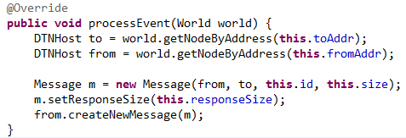
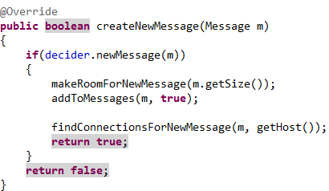

MessageCreateEvent (Sender)
在此產生一個New message
(NewM)
DecosionEngineRouter
(Sender)
(Always true)
DistributedBubbleRap

Slide 3
Scenario 1
當Messages(Buffer)尚有空間

Slide 4
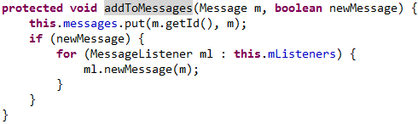
MessageRouter
(Sender)
DecosionEngineRouter
(Sender)
(Always true)
1
2
新增New message到Messages(Buffer)
Messages (Buffer)
oldestM | Free | Free | Free
Messages (Buffer)
oldestM | NewM | Free | Free

Slide 5
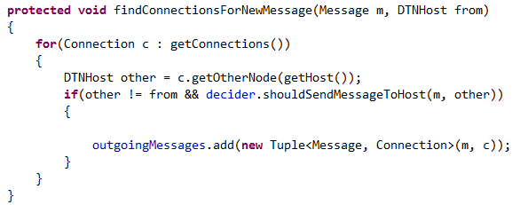
DecosionEngineRouter
(Sender)
DecosionEngineRouter
(Sender)
(Always true)
1
2
新增New message到outgoingMessages
outgoing
messages
… | oldestM | … | Free
outgoing
messages
… | oldestM | … | NewM

Slide 6
A
B
outgoing
messages
… | oldestM | … | NewM
Messages (Buffer)
oldestM | NewM | Free | Free

Slide 7
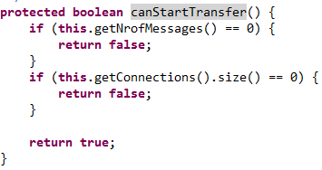
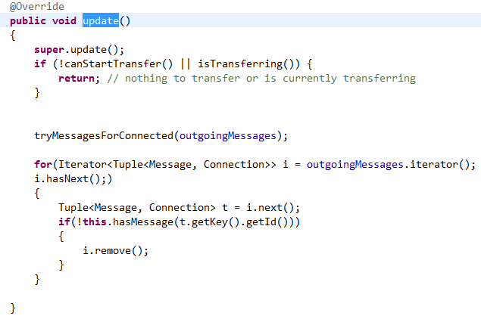
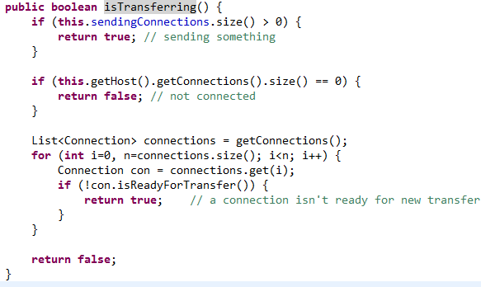
ActiveRouter
(Sender)
DecosionEngineRouter
(Sender)
確認message和connection數量不為零
確認自己沒有在跟別人傳message

Slide 8
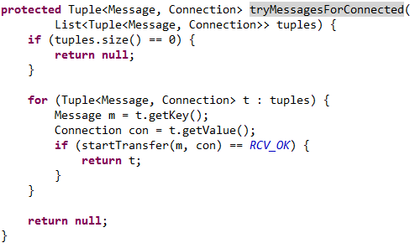
ActiveRouter
(Sender)
DecosionEngineRouter
(Sender)
開始傳outgoingMessages

Slide 9
NewM
oldestM
A
B
outgoing
messages
… | oldestM | … | NewM
Messages (Buffer)
oldestM | NewM | Free | Free

Slide 10
NewM
oldestM
A
B
outgoing
messages
… | oldestM | … | NewM
Messages (Buffer)
oldestM | NewM | Free | Free

Slide 11
NewM oldestM
A
B
outgoing
messages
… | oldestM | … | NewM
Messages (Buffer)
oldestM | NewM | Free | Free

Slide 12
TransferDone

Slide 13
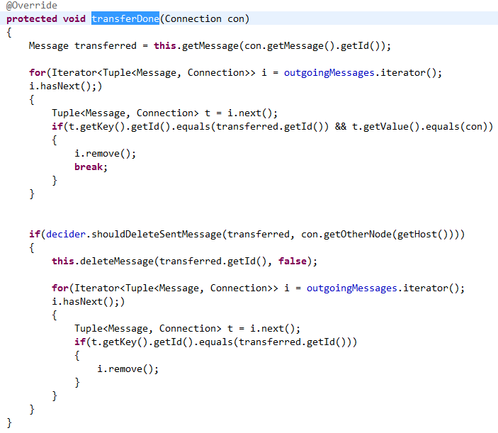
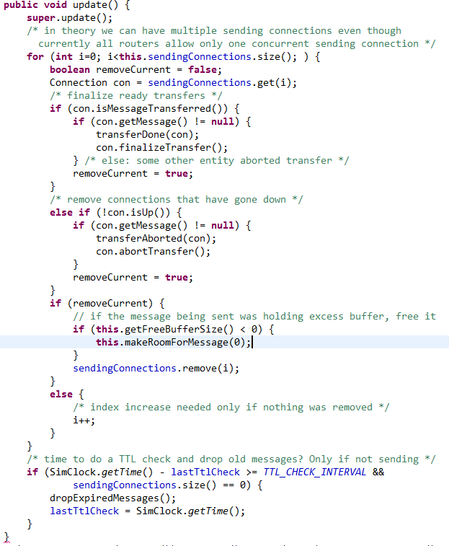
(Sender)
DecosionEngineRouter
(Sender)
ActiveRouter
到Messages(Buffer)內
找剛剛傳完的message
Messages (Buffer)
oldestM | NewM | Free | Free
OldestM
NewM

Slide 14
(Sender)
DecosionEngineRouter
(Sender)
ActiveRouter
把傳完的message從outgoingMessages刪除

Slide 15
NewM oldestM
A
B
outgoing
messages
… | oldestM | … | NewM
Messages (Buffer)
oldestM | NewM | Free | Free

Slide 16
NewM oldestM
A
B
outgoing
messages
… | Free | … | Free
Messages (Buffer)
oldestM | NewM | Free | Free

Slide 17
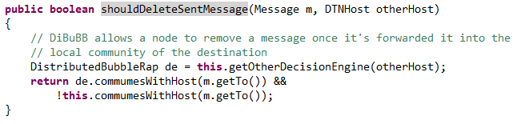
(Sender)
DecosionEngineRouter
(Sender)
ActiveRouter
把傳完的message從outgoingMessages刪除
如果目的地是在對方的群內,且不在我的群內

Slide 18
(Sender)
DecosionEngineRouter
(Sender)
ActiveRouter
把傳完的message從outgoingMessages刪除
把message從Messages(Buffer)內刪除

Slide 19
NewM oldestM
A
B
outgoing
messages
… | Free | … | Free
Messages (Buffer)
oldestM | NewM | Free | Free

Slide 20
NewM oldestM
A
B
outgoing
messages
… | Free | … | Free
Messages (Buffer)
Free | NewM | Free | Free

Slide 21
End 1

Slide 22
Scenario 2
當Messages(Buffer) 空間已滿

Slide 23
MessageCreateEvent (Sender)
在此產生一個New message
(NewM)
DecosionEngineRouter
(Sender)
(Always true)
DistributedBubbleRap

Slide 24

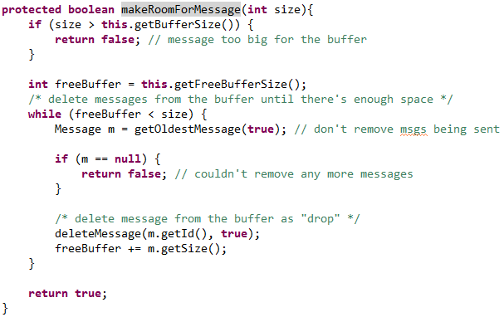
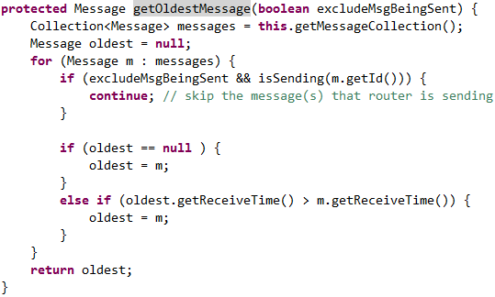
DecosionEngineRouter
(Sender)
ActiveRouter
Sender
(Always true)
1
2
3
清理buffer (刪最舊的message)
OldestM
回傳最舊的
message
Full
Messages (Buffer)
… | … | … | OldestM

Slide 25
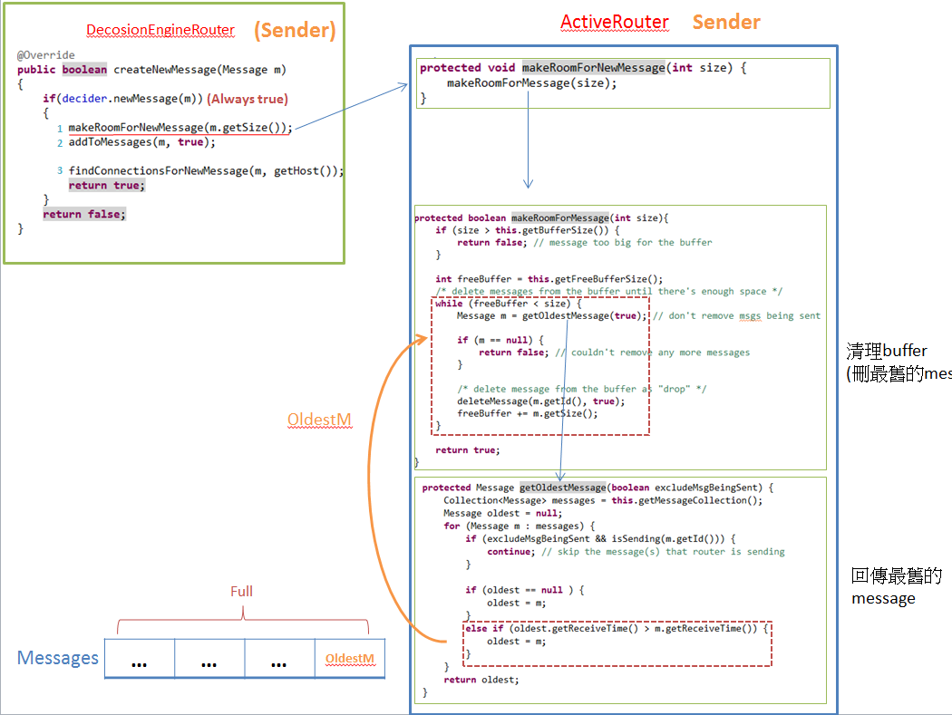
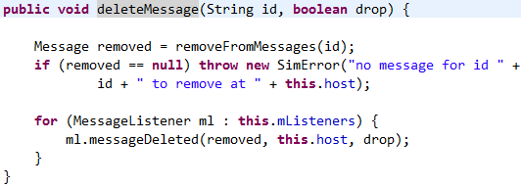

MessageRouter
Sender
(上一頁的縮圖)
Remove OldestM from messages

Slide 26
A
B
outgoing
messages
… | OldestM | … | …
Messages (Buffer)
… | … | … | OldestM

Slide 27
A
B
outgoing
messages
… | OldestM | … | …
Messages (Buffer)
… | … | … | Free

Slide 28
MessageRouter
(Sender)
DecosionEngineRouter
(Sender)
(Always true)
1
2
3
新增New message到Buffer
Messages (Buffer)
… | … | … | Free
Full
Messages (Buffer)
… | … | … | NewM

Slide 29
A
B
outgoing
messages
… | OldestM | … | …
Messages (Buffer)
… | … | … | NewM

Slide 30
DecosionEngineRouter
(Sender)
DecosionEngineRouter
(Sender)
(Always true)
1
2
3
新增New message到outgoingMessages
outgoing
messages
… | OldestM | … | NewM

Slide 31
A
B
outgoing
messages
… | OldestM | … | NewM
Messages (Buffer)
… | … | … | NewM

Slide 32
ActiveRouter
(Sender)
DecosionEngineRouter
(Sender)
確認message和connection數量不為零
確認自己沒有在跟別人傳message

Slide 33
ActiveRouter
(Sender)
DecosionEngineRouter
(Sender)
開始傳outgoingMessages

Slide 34
NewM
oldestM
A
B
outgoing
messages
… | OldestM | … | NewM
Messages (Buffer)
… | … | … | NewM

Slide 35
NewM
oldestM
A
B
outgoing
messages
… | OldestM | … | NewM
Messages (Buffer)
… | … | … | NewM

Slide 36
NewM oldestM
A
B
outgoing
messages
… | OldestM | … | NewM
Messages (Buffer)
… | … | … | NewM

Slide 37
TransferDone

Slide 38
(Sender)
DecosionEngineRouter
(Sender)
ActiveRouter
到Messages(Buffer)內
找剛剛傳完的message
Messages (Buffer)
… | … | … | NewM
NullPointer
NewM
OldestM

Slide 39
(Sender)
DecosionEngineRouter
(Sender)
ActiveRouter
把傳完的message從outgoingMessages刪除

Slide 40
NewM oldestM
A
B
outgoing
messages
… | oldestM | … | NewM
Messages (Buffer)
… | … | … | NewM

Slide 41
NewM oldestM
A
B
outgoing
messages
… | Free | … | Free
Messages (Buffer)
… | … | … | NewM

Slide 42
(Sender)
DecosionEngineRouter
(Sender)
ActiveRouter
到Messages(Buffer)內
找剛剛傳完的message
OldestM
NullPointer

Slide 43
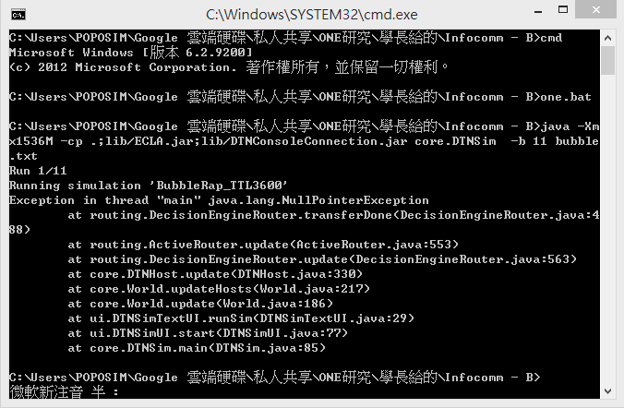

Slide 44
Messages刪除的時間點
CreateNewMessage時,空間不夠,刪最舊的message
TransferDone時,發現對方在目的地的群內
TTL過期
Outgoing messages刪除的時間點
DecisionEngineRouter-update
TransferDone
changedConnection(Connection down)

Slide 45
Messages刪除的時間點
CreateNewMessage時,空間不夠,刪最舊的message
TransferDone時,發現對方在目的地的群內
TTL過期
Outgoing messages刪除的時間點
DecisionEngineRouter-update
TransferDone
changedConnection(Connection down)

Slide 46
ActiveRouter
(Sender)
DecosionEngineRouter
(Sender)
1.開始傳outgoingMessages
outgoing
messages
… | oldestM | … | NewM
Messages (Buffer)
… | … | … | NewM
(不一致)

Slide 47

MessageRouter
(Sender)
DecosionEngineRouter
(Sender)
2.找出Messages(Buffer)中已經被刪除的message,
並將他從outgoingMessages移除
outgoing
messages
… | oldestM | … | NewM
Messages (Buffer)
… | … | … | NewM

Slide 48
修改程式

Slide 49
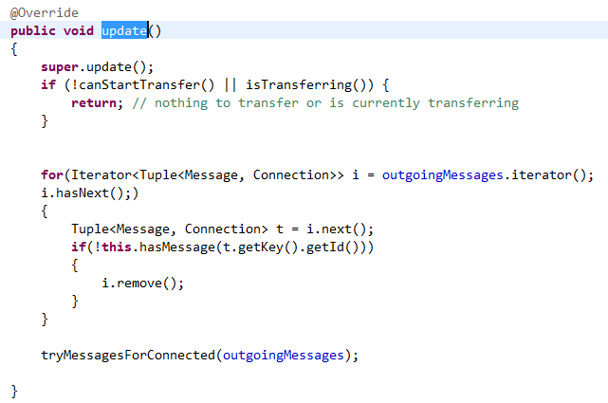
MessageRouter
(Sender)
DecosionEngineRouter
(Sender)
1.找出Messages(Buffer)中已經被刪除的message,
並將他從outgoingMessages移除
outgoing
messages
… | oldestM | … | NewM
Messages (Buffer)
… | … | … | NewM

Slide 50
ActiveRouter
(Sender)
DecosionEngineRouter
(Sender)
2.開始傳outgoingMessages
outgoing
messages
… | … | … | NewM
Messages (Buffer)
… | … | … | NewM
(一致)

Slide 51
98 | 2min |  | 5 |  | 10 |  | 30 |  | 1H |  | 3H |  | 6H |  | 12H |  | 1D |  | 2D |  | 2.5D
TTL | 2 |  | 5 |  | 10 |  | 30 |  | 60 |  | 180 |  | 360 |  | 720 |  | 1440 |  | 2880 |  | 3600
delivery_ratio | 0.04 |  | 0.076 |  | 0.117 |  | 0.209 |  | 0.277 |  | 0.482 |  | 0.652 |  | 0.783 |  | 0.677 |  | 0.548 |  | 0.518
total_cost | 1.643 |  | 2.63 |  | 4.003 |  | 6.913 |  | 9.71 |  | 18.206 |  | 27.871 |  | 131.785 |  | 974.912 |  | 1470.78 |  | 1594.156

Slide 52
SprayAndWait

Slide 53
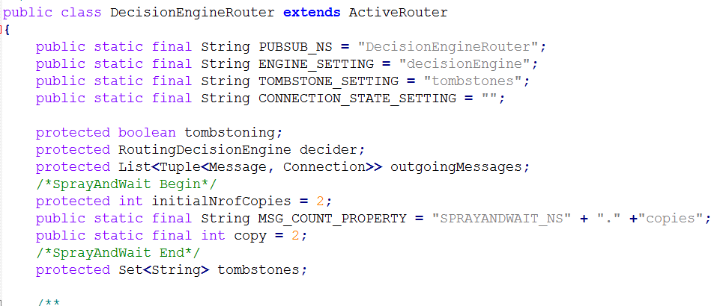
DecosionEngineRouter
每個message只會有2份copies

Slide 54
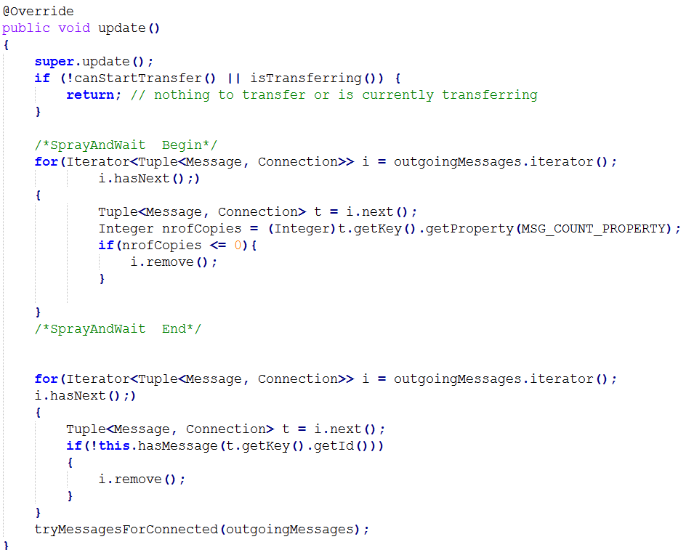
DecosionEngineRouter
Sender
若outgoingMessages內,有某個message的copies數<=0,
則從outgoingMessages移除(不傳給對方)

Slide 55
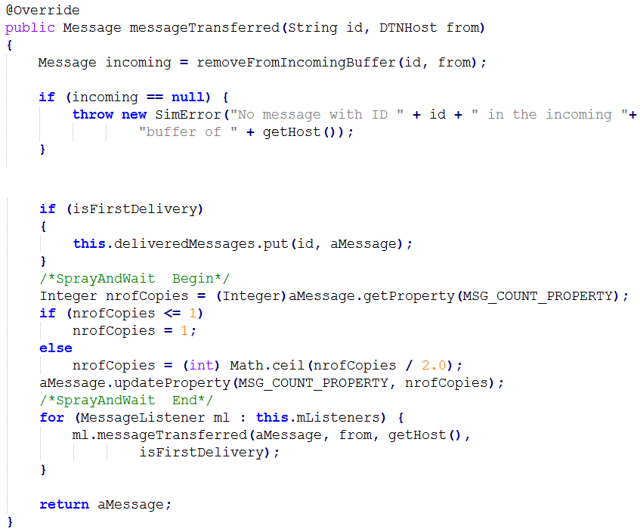
DecosionEngineRouter
Receiver
…
將目前收到的此message之copies數量分一半

Slide 56
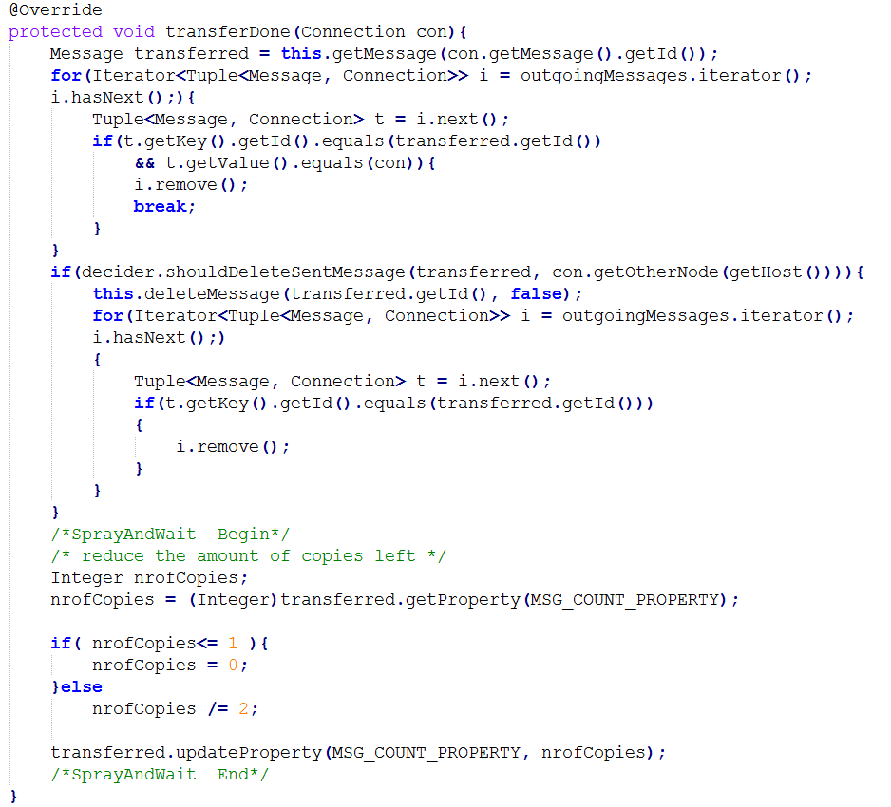
DecosionEngineRouter
Sender
將目前傳出去transferDone的message之copies數量分一半

