Slide 1
BubbleRap

Slide 2
BubbleRap
Global
Local
community
‘GlobalCentrality’
‘LocalCentrality’
connect to A
Msg1
Node A
(from)

Slide 3
FindConnectionsForNewMessage

Slide 4
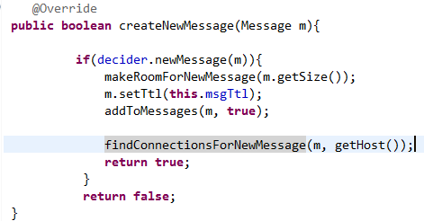
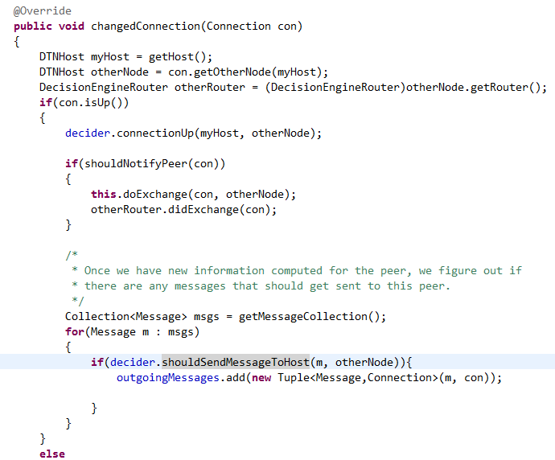
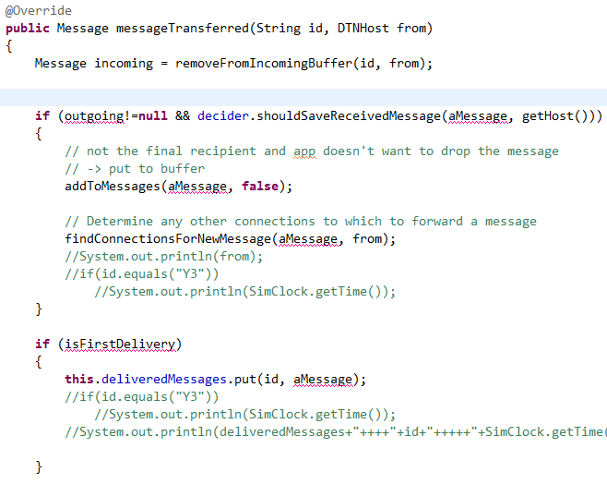
DecosionEngineRouter
DecosionEngineRouter
DecosionEngineRouter
加入outgoingMessages的時間點:
1.CreateNewMessage 2.ConnectionUp 3.MessageTransferred

Slide 5
Should send?

Slide 6
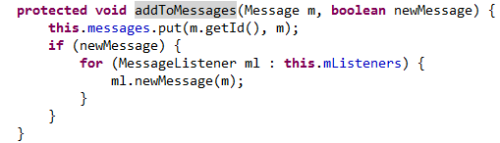
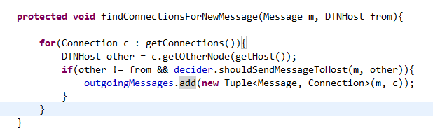
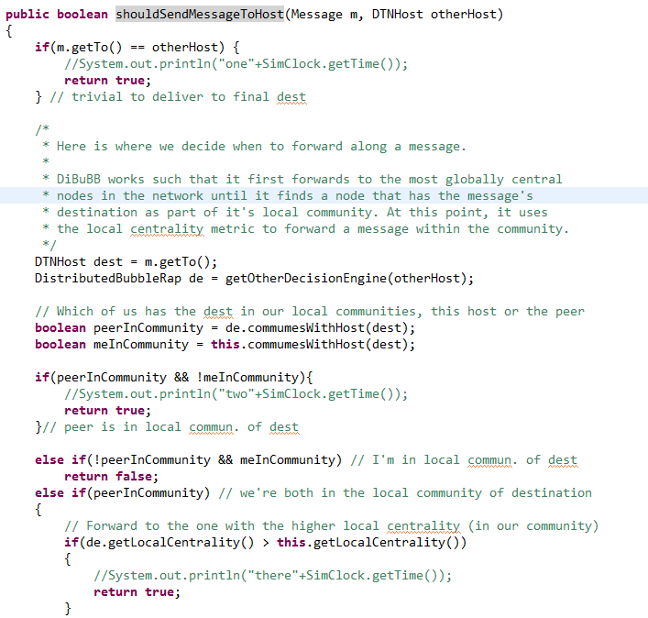
DecosionEngineRouter
Sender
MessageRouter
Sender
DecosionEngineRouter
Sender
DistributedBubbleRap
Sender
Return
(ShouldSendMessageToHost)
若message的目的地: 1.在對方的community內 && 不在我的community內
Return True(要傳,代表加到outgoingmessages)
2.不在對方群內 && 在我的群內
Rtrurn False(不傳)
3.在對方的群內 (&& 在我的群內,代表我跟對方在同一個群內)
3.1若對方的LocalCentrality比我大
Return True(要傳)
4.若對方的GlobalCentrality比我大
Return True(要傳)
否則都Return False(不傳)

Slide 7
tryMessageForConnected

Slide 8
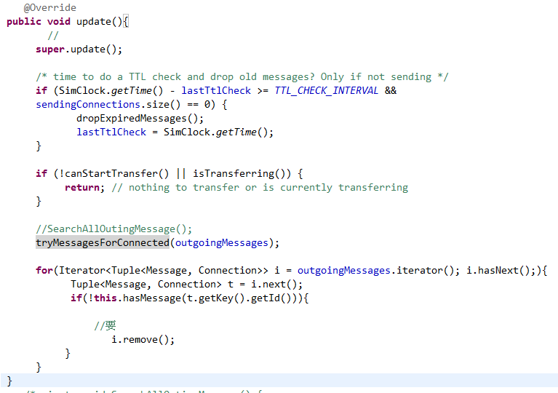
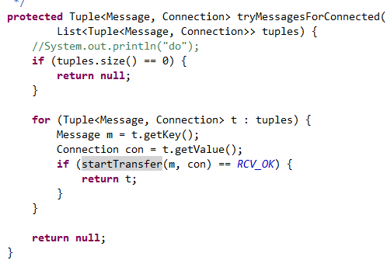
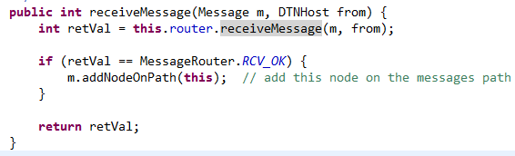
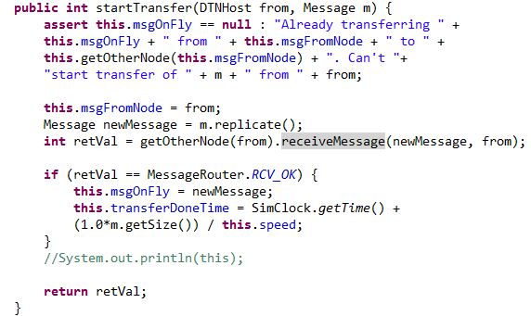
DecisionEngineRouter
Sender
ActiveRouter
Sender
Outgoingmessage
DTNHost
Receiver
CBRConnection
Sender

Slide 9
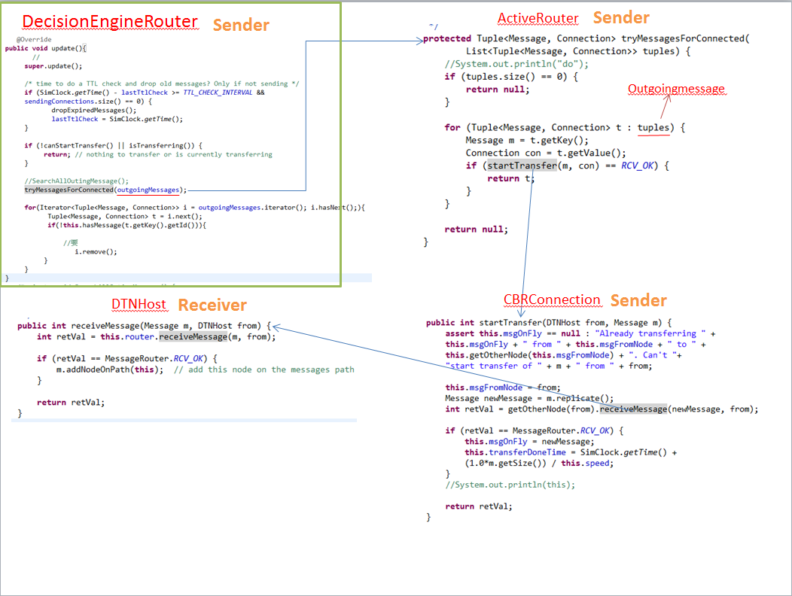
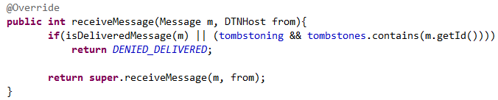
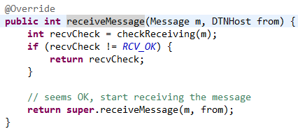
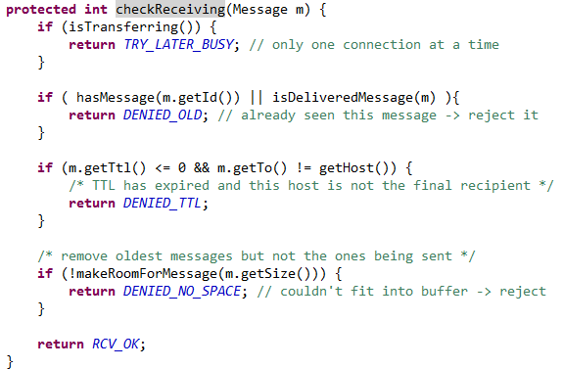
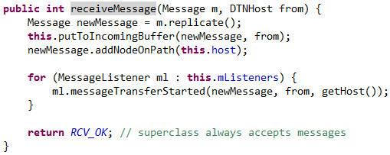
DecisionEngineRouter
Receiver
ActiveRouter
Receiver
(上一頁縮圖)
ActiveRouter
Receiver
MessageRouter
Receiver

Slide 10
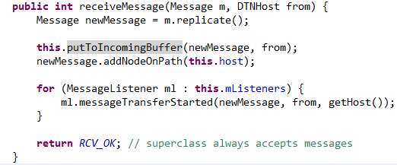
DecisionEngineRouter
Sender
ActiveRouter
Sender
Outgoingmessage
上兩張投影片的簡化版
DTNHost
Receiver
CBRConnection
Sender
MessageRouter
Receiver

Slide 11
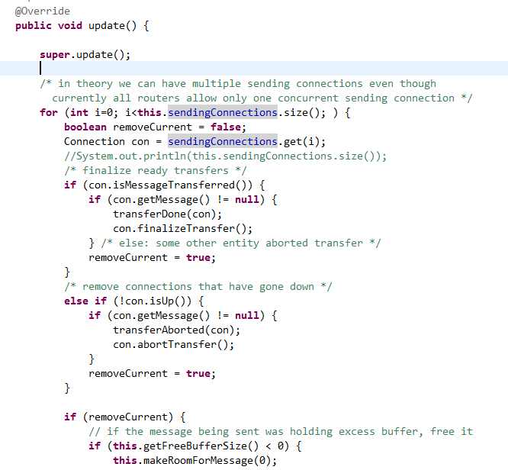
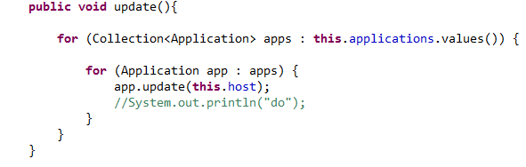
DecisionEngineRouter
Sender
ActiveRouter
Sender
MessageRouter
Sender

Slide 12
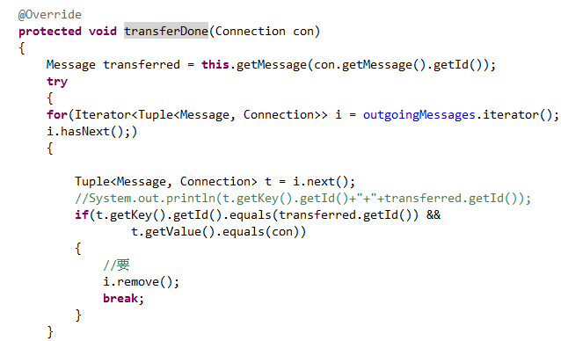
DecisionEngineRouter
Sender
ActiveRouter
Sender
DecosionEngineRouter
Sender

Slide 13
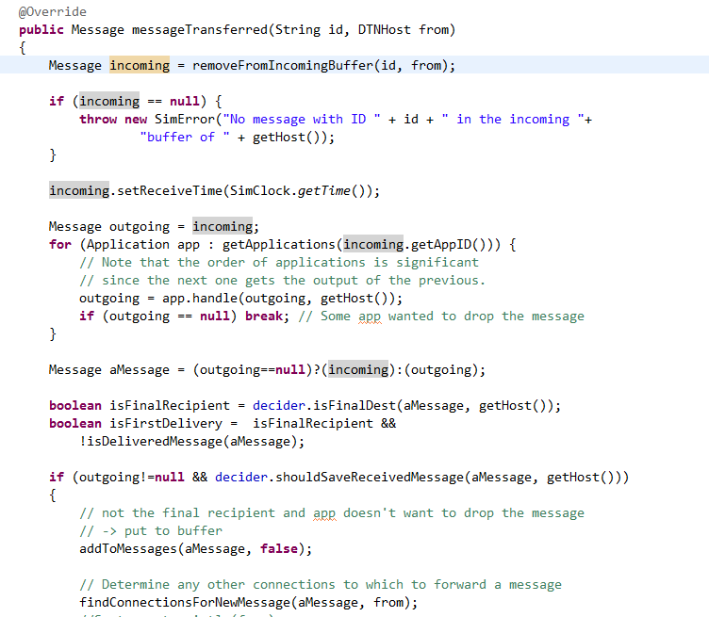
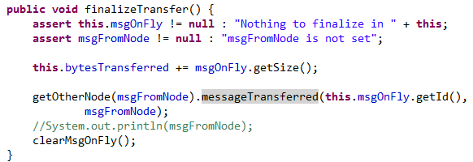
DecosionEngineRouter
Sender
ActiveRouter
Sender
DecosionEngineRouter
Receiver
Connection
Sender
isFinalRecipient判斷是否為此message的目的地
isFirstDelivery判斷”是message的目的地” && “還未接收過此message”

Slide 14

DecisionEngineRouter
續上一頁的DecosionEngineRouter
@Override
public Message messageTransferred(String id, DTNHost from)
{
Message incoming = removeFromIncomingBuffer(id, from);
if (incoming == null) {
throw new SimError("No message with ID " + id + " in the incoming "+
"buffer of " + getHost());
}
incoming.setReceiveTime(SimClock.getTime());
Message outgoing = incoming;
for (Application app : getApplications(incoming.getAppID())) {
// Note that the order of applications is significant
// since the next one gets the output of the previous.
outgoing = app.handle(outgoing, getHost());
if (outgoing == null) break; // Some app wanted to drop the message
}
Message aMessage = (outgoing==null)?(incoming):(outgoing);
boolean isFinalRecipient = decider.isFinalDest(aMessage, getHost());
boolean isFirstDelivery = isFinalRecipient &&
!isDeliveredMessage(aMessage);
if (outgoing!=null && decider.shouldSaveReceivedMessage(aMessage, getHost()))
{
// not the final recipient and app doesn't want to drop the message
// -> put to buffer
addToMessages(aMessage, false);
// Determine any other connections to which to forward a message
findConnectionsForNewMessage(aMessage, from);
}
if (isFirstDelivery)
{
this.deliveredMessages.put(id, aMessage);
}
for (MessageListener ml : this.mListeners) {
ml.messageTransferred(aMessage, from, getHost(),
isFirstDelivery);
}
return aMessage;
}
addToMessages(此message,False(代表不需通知MessageListener))
幫此message找B的community中,其他的connection接收(投影片第6頁)
Msg1
Msg1
Node A
(from)
Node B

Slide 15
Draft傳message的時機

Slide 16
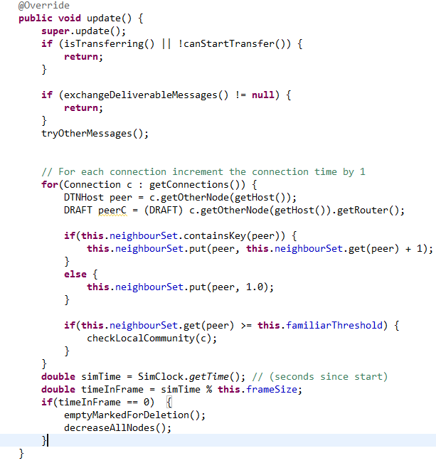
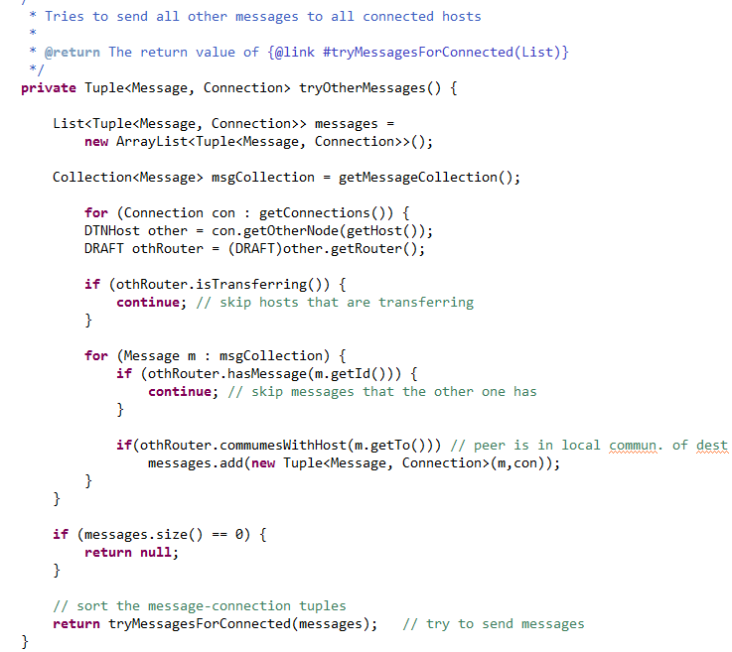
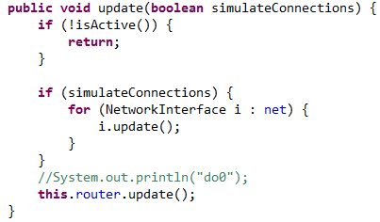
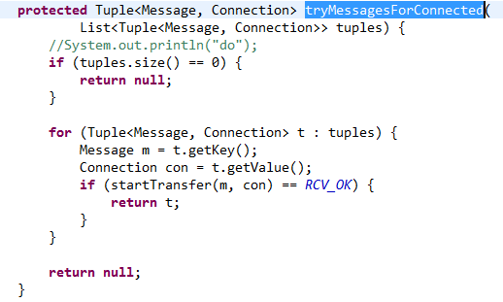
Draft
Draft
DTNHost
For each Connection as con{ If this con is busy
skip this con
For each Message as msg{
If otherRouter has this msg skip this msg
If otherRouter in local community of dest.
messages.add(m,con)
}
} Return tryMessagesForConnected(messages)
ActiveRouter
以下同Epidemic

Slide 17
1/17

Slide 18
DecisionEngineRouter
Draft

Slide 19
原BubbleRap_Update

Slide 20
DecisionEngineRouter
ActiveRouter
Outgoingmessage
DTNHost
CBRConnection
MessageRouter

Slide 21
Draft_Update

Slide 22
Draft
Draft
For each Connection as con{ If this con is busy
skip this con
For each Message as msg{
If otherRouter has this msg skip this msg
If otherRouter in local community of dest.
messages.add(m,con)
}
} Return tryMessagesForConnected(messages)
ActiveRouter
以下同Epidemic

Slide 23
修改BubbleRap_tryMessageForConnected

Slide 24
DecisionEngineRouter
DecisionEngineRouter
DecisionEngineRouter
findConnectionsForNewMessage註解掉
加入outgoingMessages的時間點:
1.CreateNewMessage 2.ConnectionUp 3.MessageTransferred

Slide 25
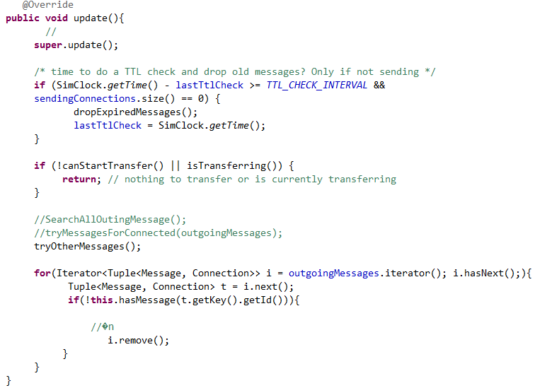
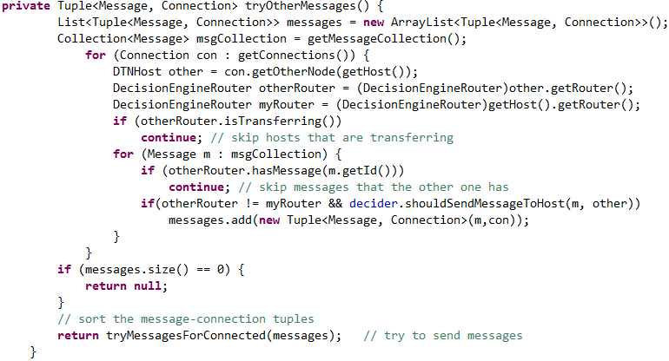
DecisionEngineRouter
DecisionEngineRouter
For each Connection as con{ If this con is busy
skip this con
For each Message as msg{
If otherRouter has this msg skip this msg
If should send message to host
messages.add(m,con)
}
} Return tryMessagesForConnected(messages)

Slide 26
DistributedBubbleRap
(ShouldSendMessageToHost)
若message的目的地: 1.在對方的community內 && 不在我的community內
Return True(要傳,代表加到outgoingmessages)
2.不在對方群內 && 在我的群內
Rtrurn False(不傳)
3.在對方的群內 (&& 在我的群內,代表我跟對方在同一個群內)
3.1若對方的LocalCentrality比我大
Return True(要傳)
4.若對方的GlobalCentrality比我大
Return True(要傳)
否則都Return False(不傳)

