Slide 1
PeopleRank: Social Opportunistic Forwarding

Slide 2
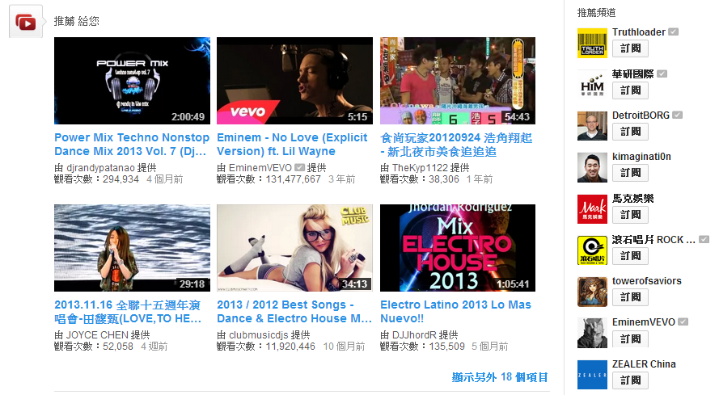
Algorithm
PeopleRank is inspired by the PageRank algorithm employed by Google to rank web pages
people favorites
you may interesting
Fig 1. recommended channel by Youtube

Slide 3
Algorithm (cont.)
Centralized PeopleRank
Distributed PeopleRank

Slide 4
Centralized PeopleRank
important
a person randomly clicking on links will arrive at any particular page
3
important
important
important
2
4
1
Rank value
Rank value
5
Other nodes
important

Slide 5
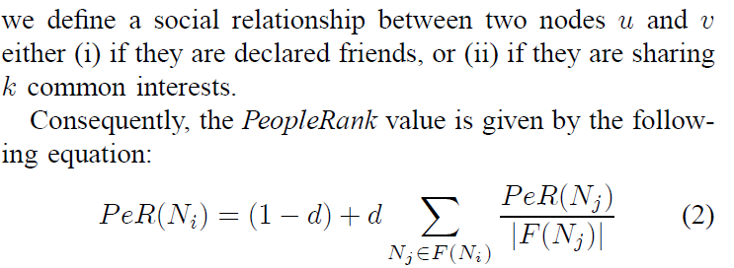
Questions

