Slide 2
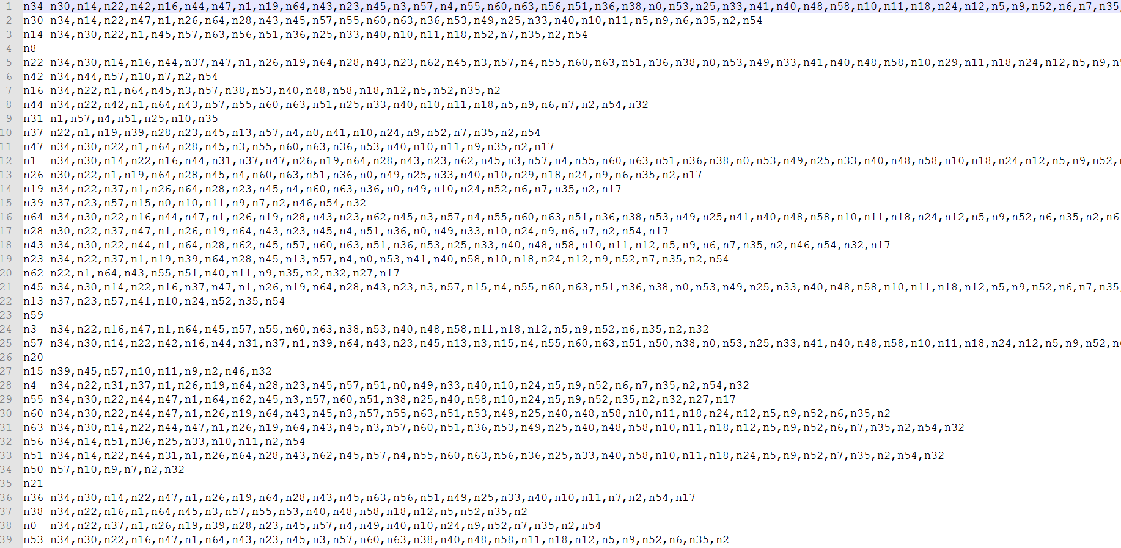
DRAFT(Interesting)
The number of node is 65 (0~64)
Me Friend, Friend, Friend ….

Slide 3
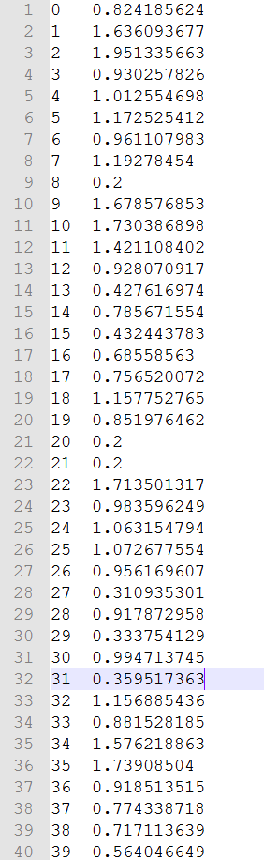
DRAFT(PeopleRankValue)
Me PeopleRank_Value
The number of node is 65 (0~64)

Slide 4
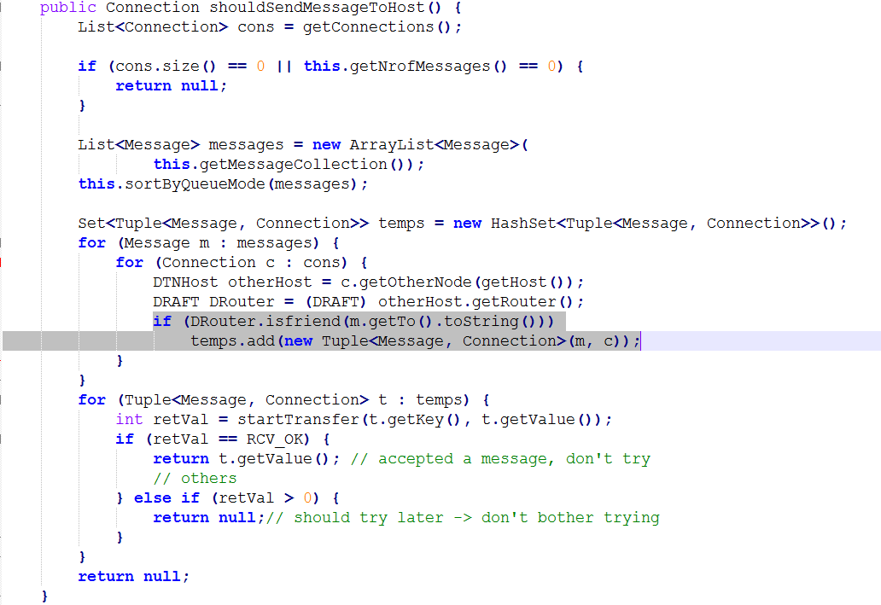
DRAFT(Interesting)

Slide 5
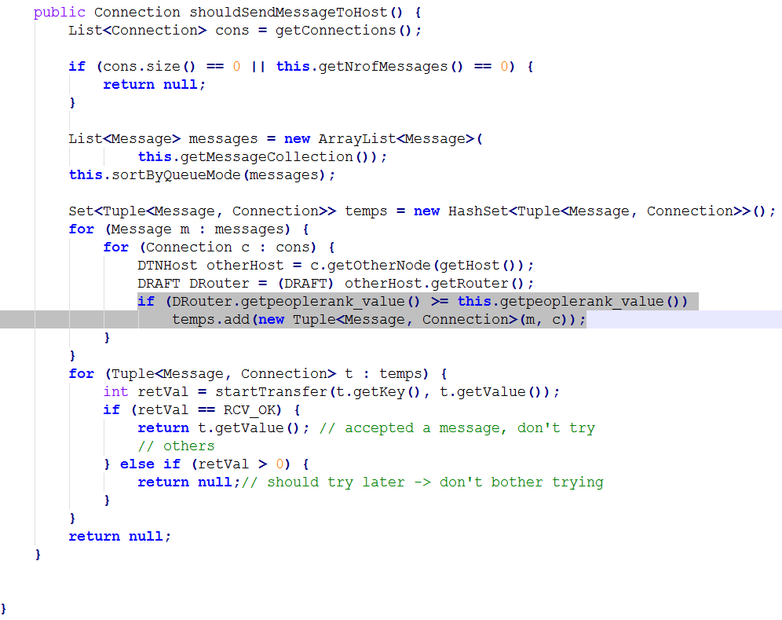
DRAFT(PeopleRankValue)

Slide 6
