Slide 2
The information of contacted connections
Dataset :
INFOCOM 2006
Period : 4 days
Setting : conference
Devices : 63

Slide 3
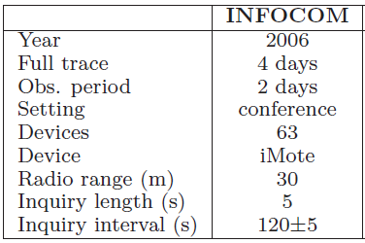
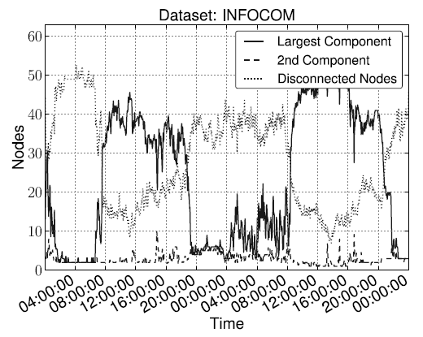
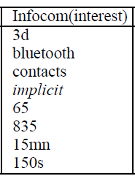
April 24th 0:00 ~ April 26th 0:00

Slide 4
