Slide 2
PMTR
Summary
This dataset contains mobility traces from 44 mobile devices at University of Milano. The data was collected in November 2008.
The experiment lasted for 19 days in November 2008. 49 Pocket Mobile Trace Recorders (PMTRs) were distributed to faculty members, PhD students, and technical staff.
Collection
Recorded data was collected at the end of the experiment. Symmetric contacts, that is contacts recorded by both devices approximately at the same time, were kept for analysis; unidirectional contact records were discarded. This resulted in a collection of 11895 contacts between 44 PMTRs.
Limitation hole
At the end of the experiment, 5 PMTRs (with IDs 5, 8, 15, 30 and 35) had not registered any contacts due to hardware failure.
Only symmetric contact records from other PMTRs were kept. One-sided contact records were discarded.

Slide 3
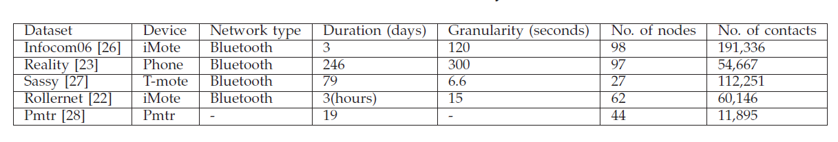
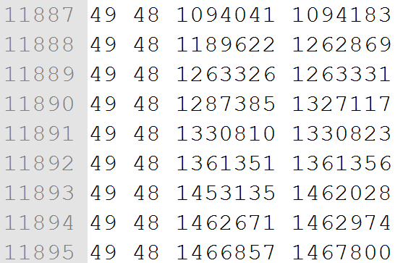
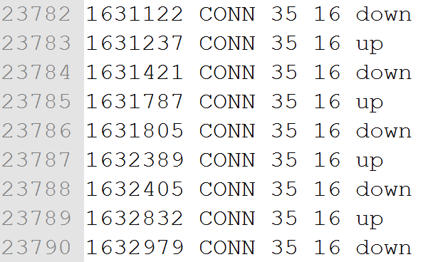
Original file
ONE format

Slide 4
Original file
ONE format
Exclude 5 PMTRs (with IDs 5, 8, 15, 30 and 35)

