Slide 1
PeopleRank : Social Opportunistic Forwarding

Slide 2
Outline
Introduction
Devices Information
The idea
Issue
Prove

Slide 3
Introduction
Environment :
With the emergence of a new generation of powerful mobile devices, novel communication paradigms were possible: ad hoc data transfer between the mobile devices.
Protocol :
WIFI, Bluetooth
Transfer manner :
Hop by hop. A device exchange and forward data in an opportunistic wireless connectivity.
Problem :
A device has to decide whether or not to forward data to an intermediate node that it encounters.
Intermittent connectivity and unpredictable mobility.

Slide 4
Devices Information
Such information includes :
Historical contacts with other devices.
Device mobility patterns
Most relevant to this work, information about the social interaction between the participants.
The following metrics to valuate the efficiency of routing protocols:
Delivery Ratio: the ratio of the number of delivered messages to the number of generated messages.
Overhead Ratio: the average number of forwardings of the same message before it reaches the destination.
Average Delay: the average time for delivering a message to its destination over the network.

Slide 5
The idea
Those latter ones implicitly assume that the opportunistic contacts relate with the social property used to design the algorithms.
We introduce an opportunistic forwarding algorithm that uses PeopleRank which ranks the “importance” of a node in the social graph.

Slide 6
Issue
PeopleRank identifies the most popular nodes (in a social context) to forward the message to, given that popular nodes are more likely to meet other nodes in the Networks.

Slide 7
Prove
Using social interaction between people for forwarding has already been proven to reduce the number of message replicas (cost) while increasing the likelihood of a message to reach its destination (success rate).
In the following, we present and compare different methods that use additional information such as historical contact or social patterns to make “better” forwarding decisions.

Slide 8
Global knowledge V.S. Partial knowledge
Global knowledge :
network topology can make for very efficient routing and forwarding decisions.
Partial knowledge :
Collecting and exchanging topology information in opportunistic networks is cumbersome because of their intermittent connectivity and unpredictable mobility.
Routing schemes for such networks typically rely on and on prediction of future contacts which results in degraded routing performance.
While opportunistic contact information is changing constantly, the links and nodes in a social network remain rather stable.
The idea of this paper is to use this more stable social information to augment available partial contact information in order to provide efficient data routing in opportunistic networks.

Slide 9
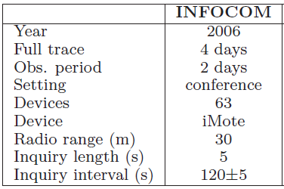
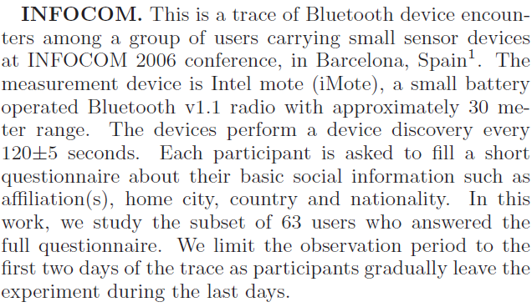
Data Sets

Slide 10
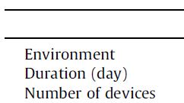
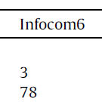
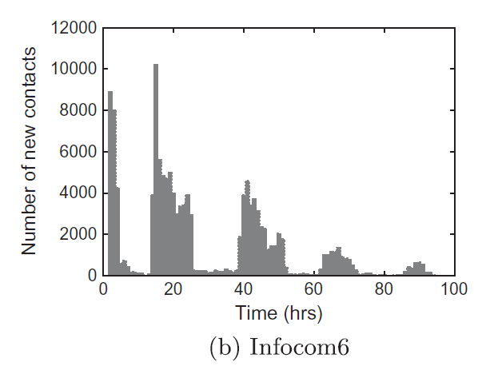
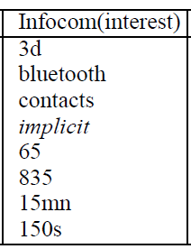
INFOCOM2006

Slide 11
The information of contacted connections
Dataset :
INFOCOM 2006
Period : 4 days
Setting : conference
Devices : 63

Slide 12
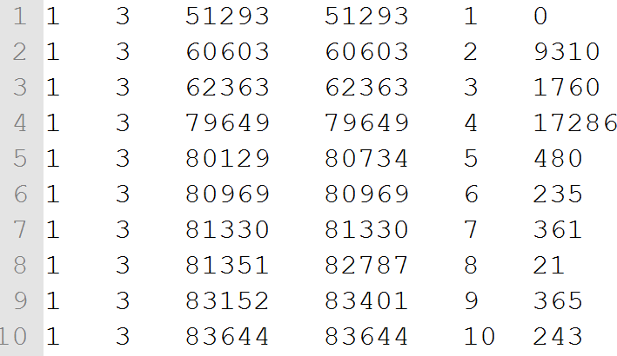
"contacts.Exp6.dat"
ID1
ID2
Star
End
No.
Pre time –current time

Slide 13
Social relationship between two nodes
(i) if they are declared friends
(ii) if they are sharing k common interests.
Social graph generation
The techniques we described thus far are suitable for centralized implementations where the social graph is known a-priori.
We describe the distributed version of our algorithm in the next section.

Slide 14
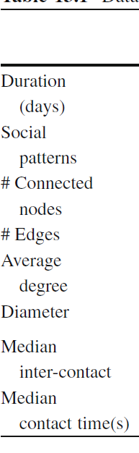
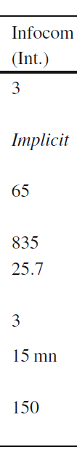
Building a social relationships between each device
Total edges = (Node*Average degree)/2
Total edges = 65*25.7/2 = 835.25
Define a social relationship between two nodes u and v if they are sharing 2 common interests.
Total degree = 1676
Edges = 838
Average degree = 25.7846

Slide 15
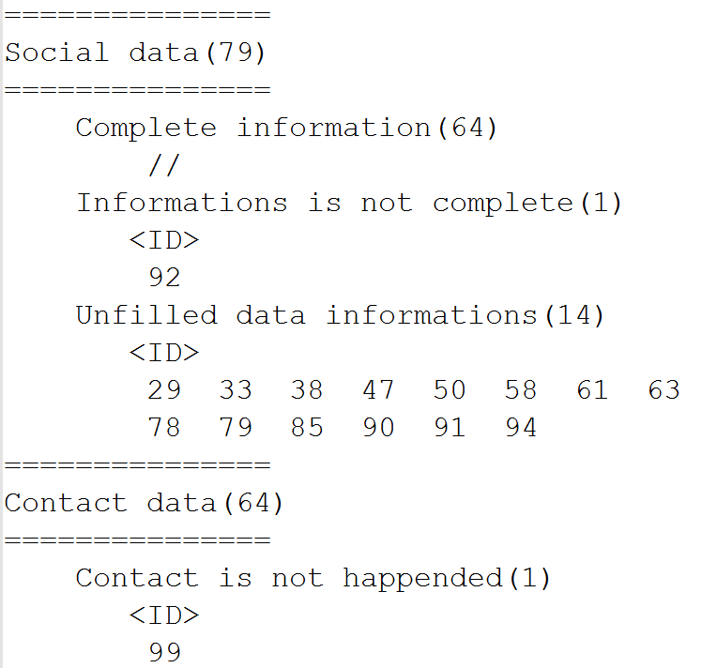
Selected devices

Slide 16
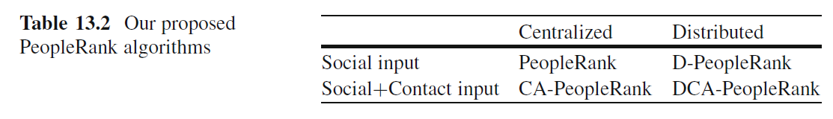
Centralized PeopleRank

Slide 17
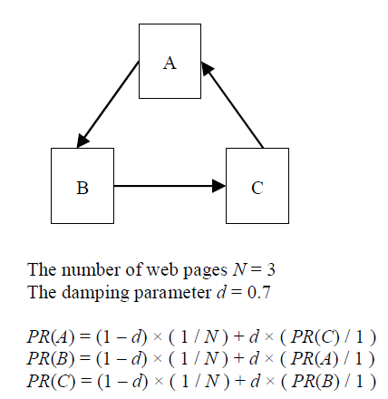
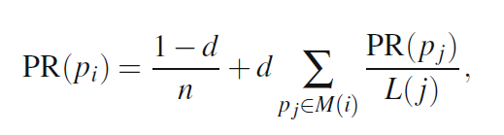
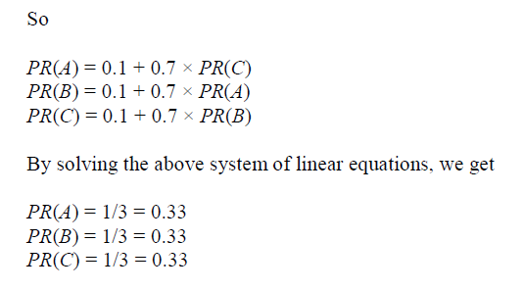
PageRank

Slide 18
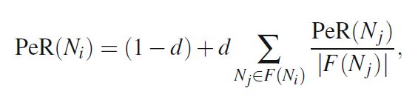
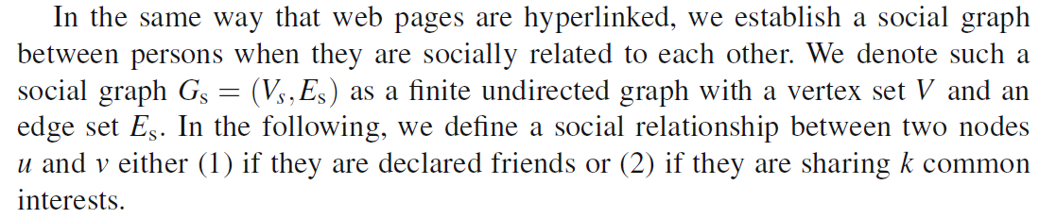
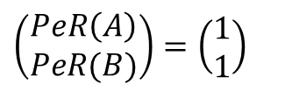
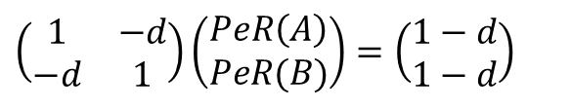
PeopleRank
A
B
PeR(A) = (1-d) + d * (PeR(B)/1)
PeR(B) = (1-d) + d * (PeR(A)/1)
$$\left(\begin{matrix}1 & −d \\ −d & 1\end{matrix}\right)\left(\begin{aligned}PeR\left(A\right) \\ PeR(B)\end{aligned}\right)=\left(\begin{aligned}1−d \\ 1−d\end{aligned}\right)$$
The number of nodes N = 2
The dumping factor is d
$$\left(\begin{aligned}PeR\left(A\right) \\ PeR(B)\end{aligned}\right)=\left(\begin{aligned}1 \\ 1\end{aligned}\right)$$

Slide 19
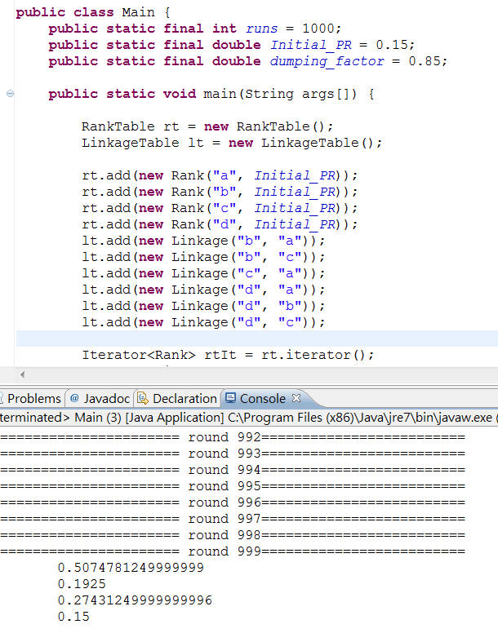
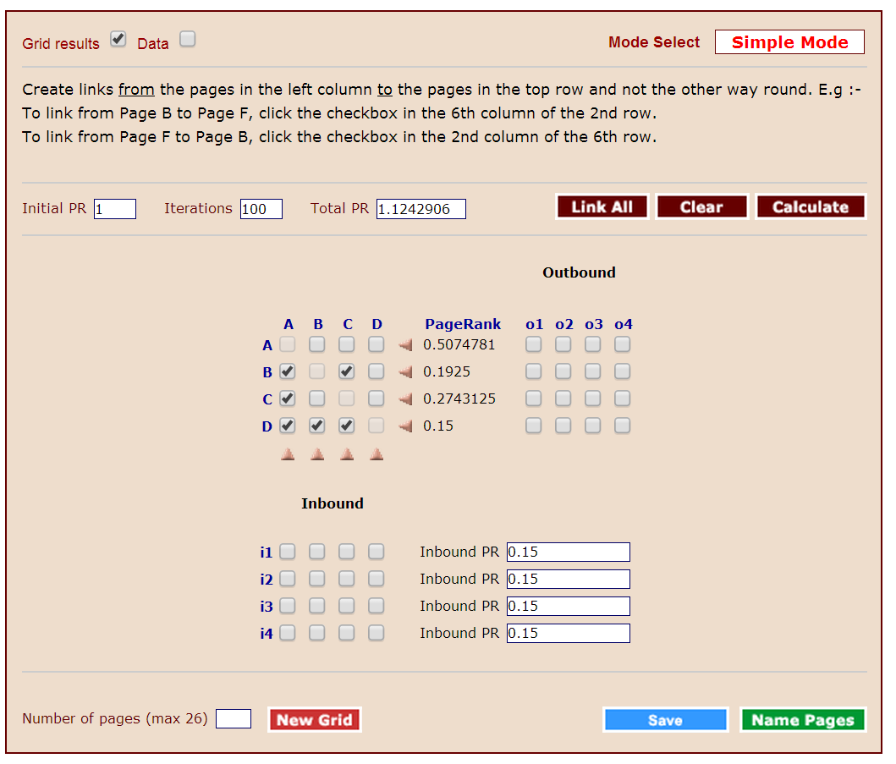
First calculate each node’s people rank value by
Testing the correctness of the program
pagerank-pc-master.zip, get it from GitHub.

Slide 20
Distributed PeopleRank

Slide 21
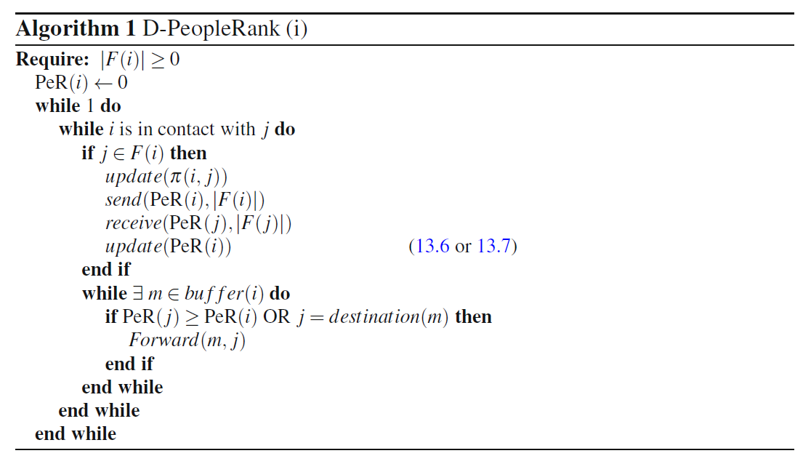
Algorithm
(13.6) – for the D-PeopleRank
(13.7) – for the DCA-PeopleRank

Slide 22
Evaluation Results for PeopleRank
Comparison to social algorithms
centrality
degree
Comparison to contact-based algorithms
Last Contact
Destination Last contact
Frequency
Spray & wait
Wait destination

Slide 23
The information of contacted connections
10H
14.5H
13H
10.5H

