Slide 1
Integrated Plots
For the wind-battery manuscript

Slide 2

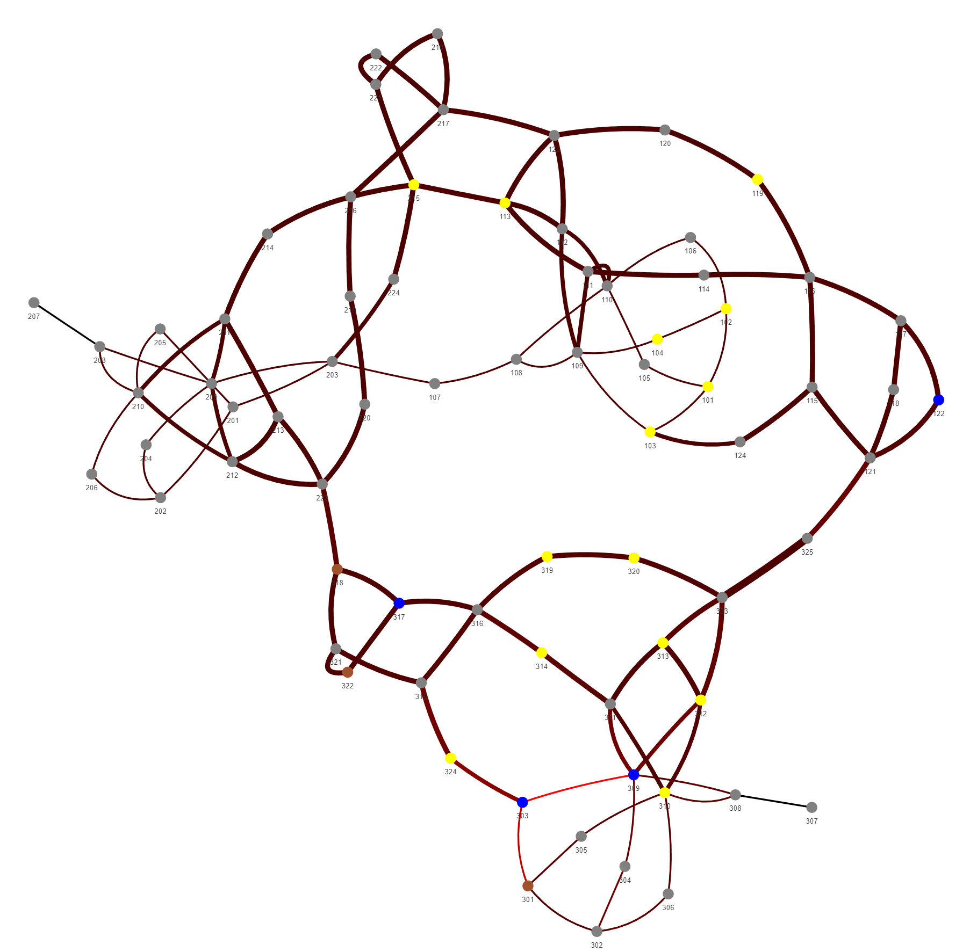
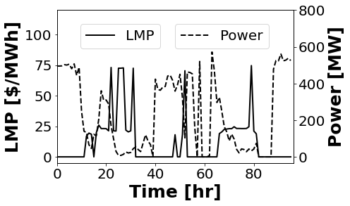
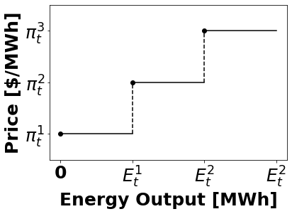
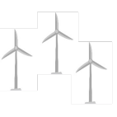




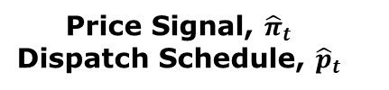

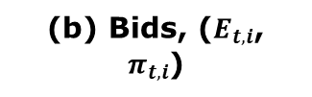

(c) PCM
(e) Electric Grid
(d) Market Outcomes
(b) Bids, ($E_{t,i}$, $π_{t,i}$)
303_WIND_1
Price Signal, ${\hat{π}}_{t}$
Dispatch Schedule, ${\hat{p}}_{t}$
$$p_{t,i}$$
$$p_{t,i}^{s}$$
$$p_{t,i}^{d}$$
Wind Farm
$$p_{t,i}^{w}$$
Battery
Storage
$$p_{t,i}^{c}$$
(a) Wind-Battery IES

Slide 3
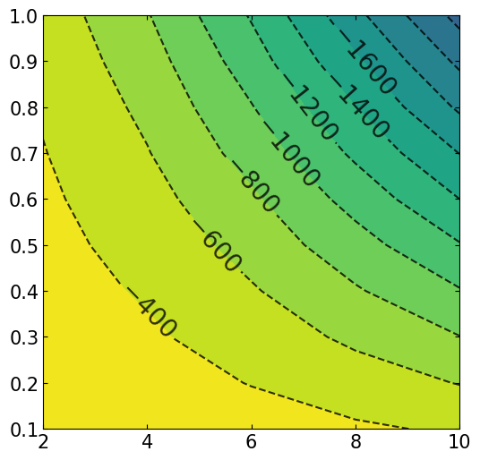
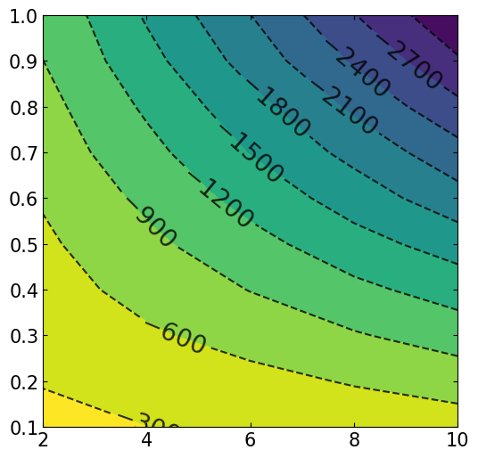
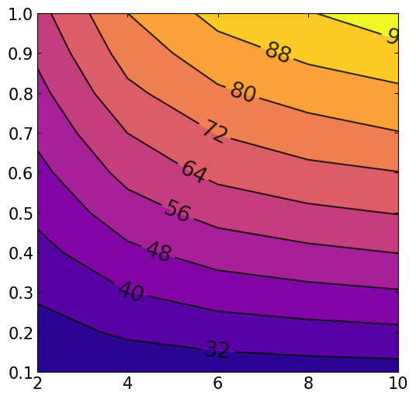
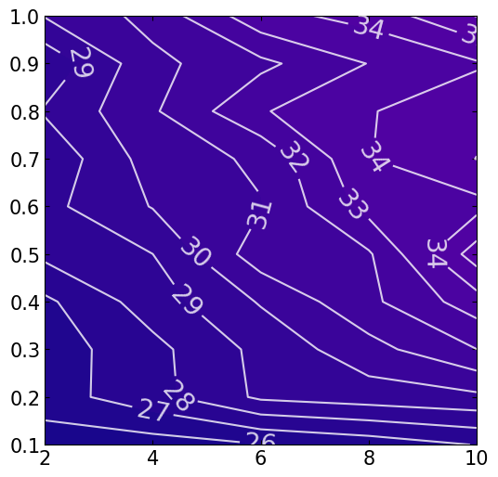

(a) NPV, PT
(b) NPV, MO
${\overline{P}}^{b}/{\overline{P}}^{w}$ [MW/MW]
(c) ER, PT
(d) ER, MO
Battery Capacity [hr]

Slide 4
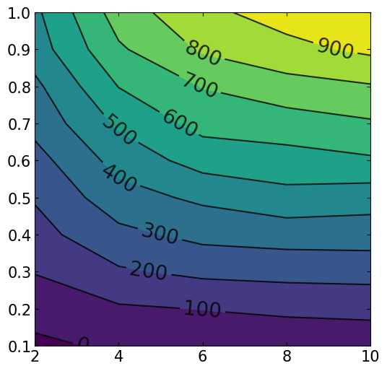
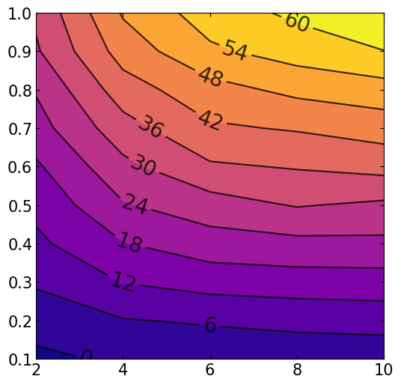

(a) NPV, Difference
(a) ER, Difference
${\overline{P}}^{b}/{\overline{P}}^{w}$ [MW/MW]
Battery Capacity [hr]

Slide 5
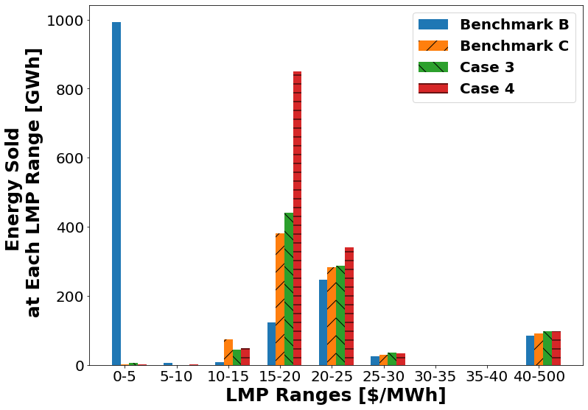
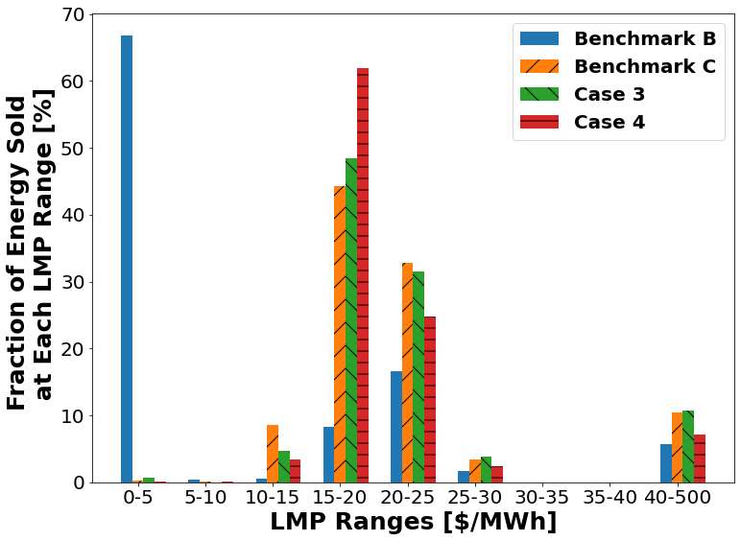
(a)
(b)

