Slide 1
An Analysis of the Queueing Delays and Throughput of the TCP BBR Congestion Control in NS-3
Xinkai Xiong
Examiner: Markus Hidell
Supervisor: Marco Chiesa

Slide 2
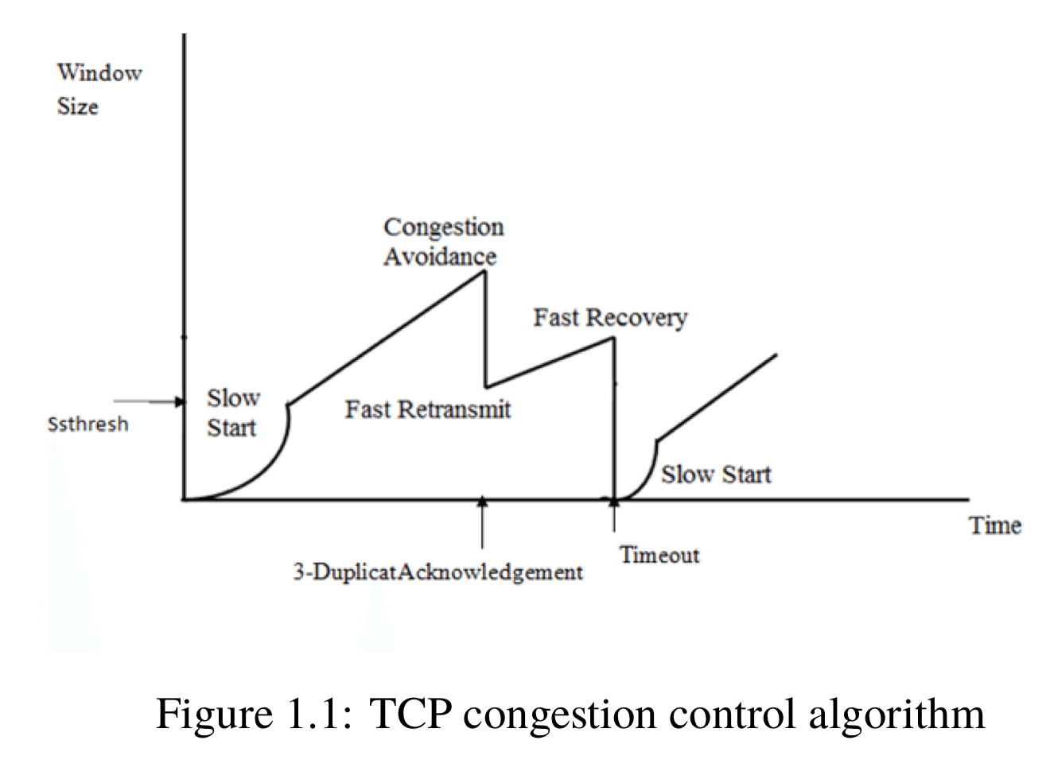
Introduction
Traditional TCP congestion control algorithm (loss-based)
Slow start phase: exponential increment
Congestion avoidance phase: additive increment
Fast retramsmit: after 3 duplicated Acknowledgement, retramsit immediately
Fast Recovery: ssthresh reduce to half of the current window size, set cwnd = ssthresh
Notes:
Every time an ACK is received, the congestion window is increased by one packet, doubling the congestion window by each RTT. Once the congestion window reaches ssthresh, it enters congestion avoidance phase. The congestion window will increase by one packet with each RTT. After 3 duplicated ACKs, which denotes a loss of a packet, TCP uses fast retransmit algorithm to retransmit the missing packet immediately. Then it enters fast recovery phase, the congestion window and ssthresh are set to half of the current congestion window. If a new ACK is received which means the missing packet is retransmitted successfully, TCP exits fast recovery, and enters congestion avoidance phase.

Slide 3
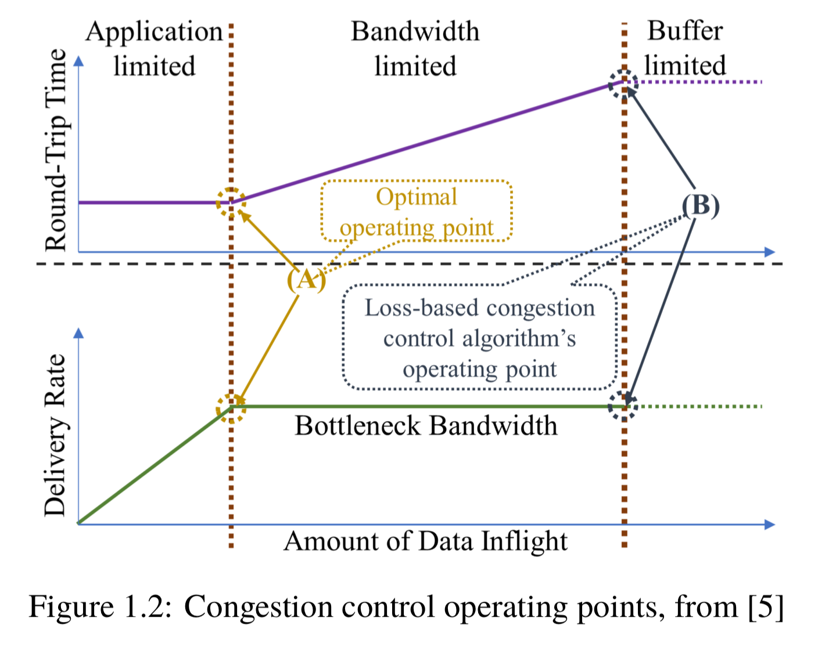
Loss-based congestion control algorithm operates when the congestion happens
BBR operates before the congestion happens

Slide 4
Background
TCP NewReno: a modification of TCP’s fast recovery algorithm
ACKx: ACK that sender received in fast recovery
PKTy: the packet with the largest sequence number that had been sent by the sender when receiving ACKx
If ACKx is not the acknowledgment of PKTy, then it’s a partial ACK; If not, it’s a recovery ACK.
The sender exits fast recovery and enters congestion avoidance only when receiving the recovery ACK, i.e. all lost packets are retransmitted and the ACKs are received.
Notes:
We noted the ACK that sender received in fast recovery as ACKx, and noted the packet with the largest sequence number that had been sent by the sender when receiving ACKx as PKTy. If ACKx is not the acknowledgment of PKTy, then it is a partial ACK; If not, it is a recovery ACK. Partial ACKs are used in TCP NewReno to avoid halving the congestion window too aggresively.
TCP New Reno deals with the single packet loss as same as TCP Reno, but when multiple packets are dropped in the same period, the sender exits fast recovery and enters congestion avoidance only when receiving the recovery ACK, i.e. all lost packets are retransmitted and the ACKs are received.

Slide 5
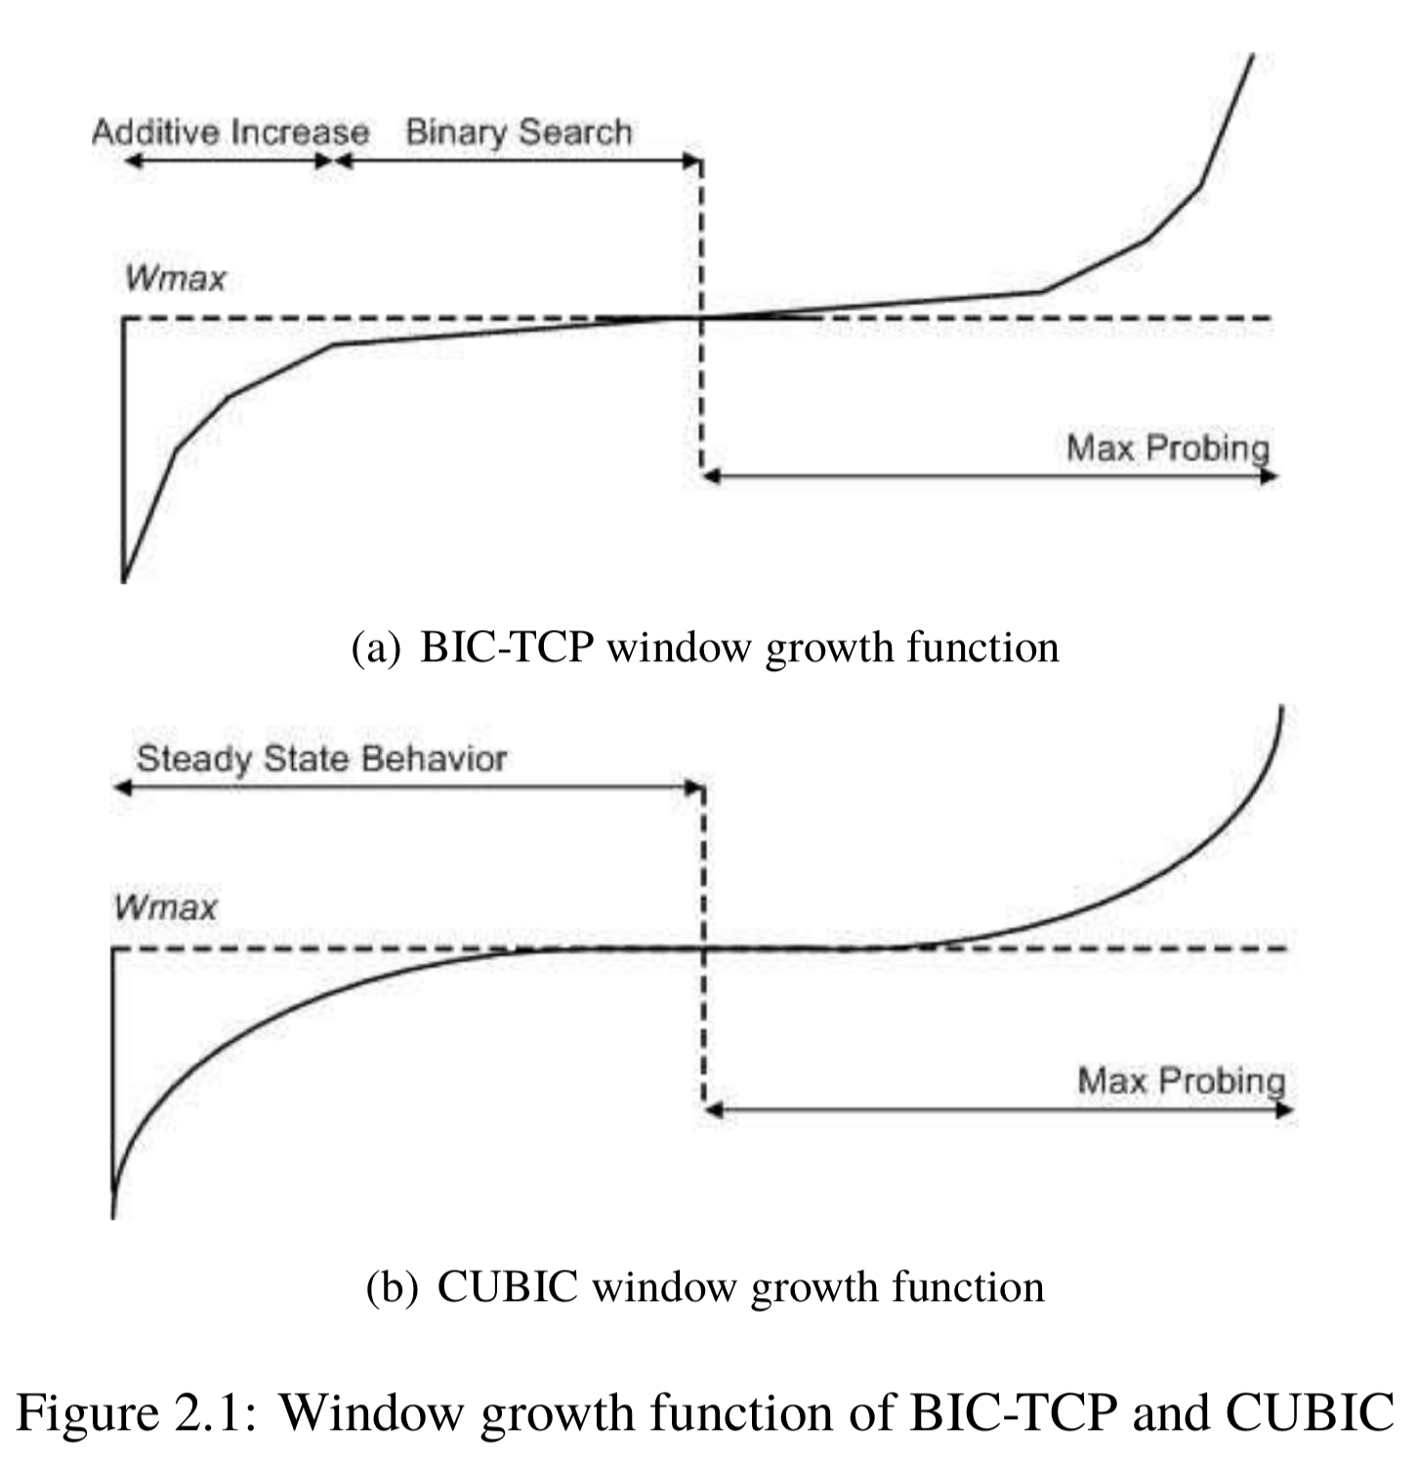
BIC-TCP & CUBIC
BIC-TCP (Binary Increase Congestion Control) : using a binary search to set cwnd
BIC-TCP supports RTT fairness, TCP friendliness, and scalability
CUBIC: the next version of BIC-TCP, using a cubic function as the window growth function
CUBIC is less aggressive, the window growth is independent of RTT, improves RTT fairness and TCP friendliness
Notes:
BIC-TCP is a congestion control designed for fast long-distance network. In Max Probing, it uses a window growth function that is symmetrical with the Additive Increase and Binary Search phases.
The key feature of CUBIC is that its window growth depends only on the time between two consecutive congestion events, so the window growth is independent of RTT since the function is deﬁned in real-time. This allows CUBIC to perform good RTT fairness and TCP friendliness.

Slide 6
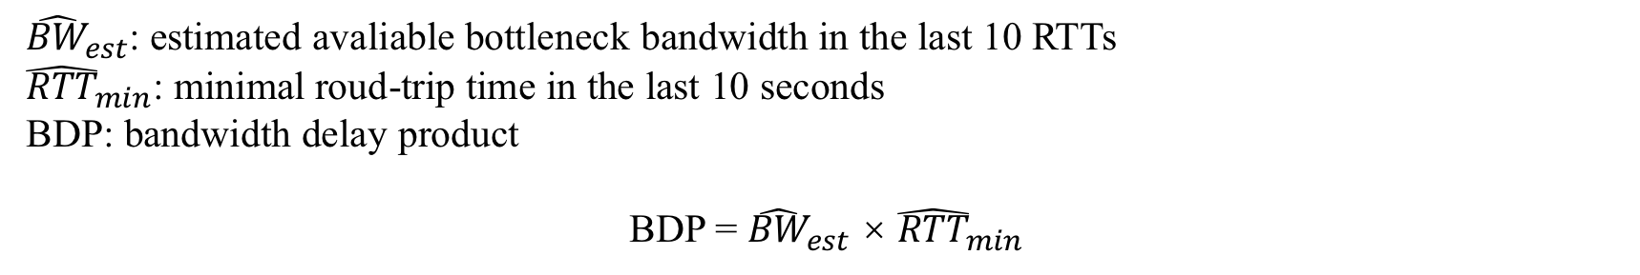
BBR (Bottleneck Bandwidth and Round-trip propagation time)
BBR does not use packet loss as the siginal of congestion
BBR aims to achieve higher throughput and lower latency
${\hat{BW}}_{est}$: estimated avaliable bottleneck bandwidth in the last 10 RTTs
${\hat{RTT}}_{min}$: minimal roud-trip time in the last 10 seconds
BDP: bandwidth delay product
BDP = ${\hat{BW}}_{est}$ × ${\hat{RTT}}_{min}$
BBR set the pacing_rate and congestion window on ACKs:
pacing_rate = pacing_gain × ${\hat{BW}}_{est}$
cwnd = cwnd_gain × BDP
Notes:
BDP determines the amount of data that can be in transit in the network.

Slide 7
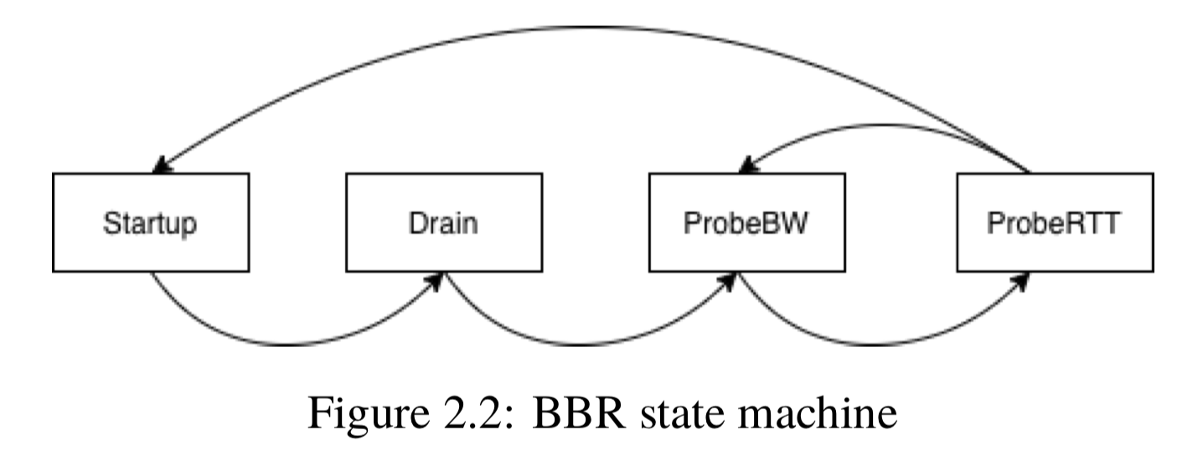
Startup: BBR doubles its sending rate every RTT
pacing_gain = cwnd_gain = 2/ln2 ≈ 2.89
Drain : BBR reduces the amount of excess data once the inflight = BDP holds
pacing_gain = ln2/2 ≈ 0.34
ProbeBW: BBR probes for more bandwidth
gain_cycle: [1.25, 0.75, 1, 1, 1, 1, 1, 1]
cwnd_gain = 2
ProbeRTT: the sender limits its amount of inflight data to 4 packets for max(RTT, 200ms) to measure
RTT_{min}
Notes:
reciprocal

Slide 8
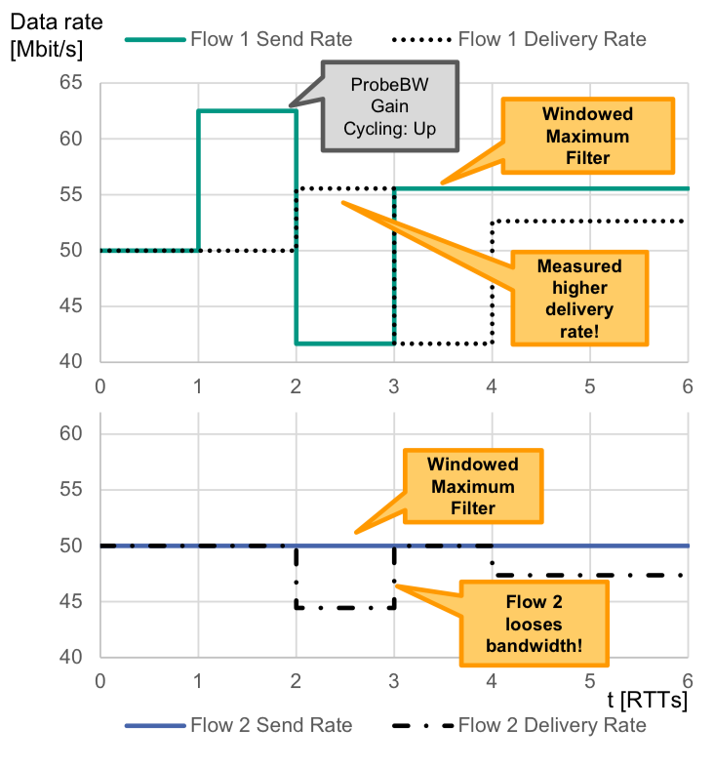
Problem
BBR overestimates the available bandwidth on the bottleneck when there are multiple flows in the network
Simple example with 2 flows:
Bottleneck 100 Mbps
Both flows send at 50 Mbps initially
Large queuing delay when buffer is large
Massive packet loss when buffer is small
source: https://datatracker.ietf.org/meeting/100/materials/slides-100-iccrg-a-quick-bbr-update-bbr-in-shallow-buffers
Notes:
100*62.5/(62.5+50)=55.5
100*55.5/(55.5+50)=52.5

Slide 9
Purpose
Adjust overestimated available bandwidth
Reduce the additional queuing delay
Avoid packet loss

Slide 10
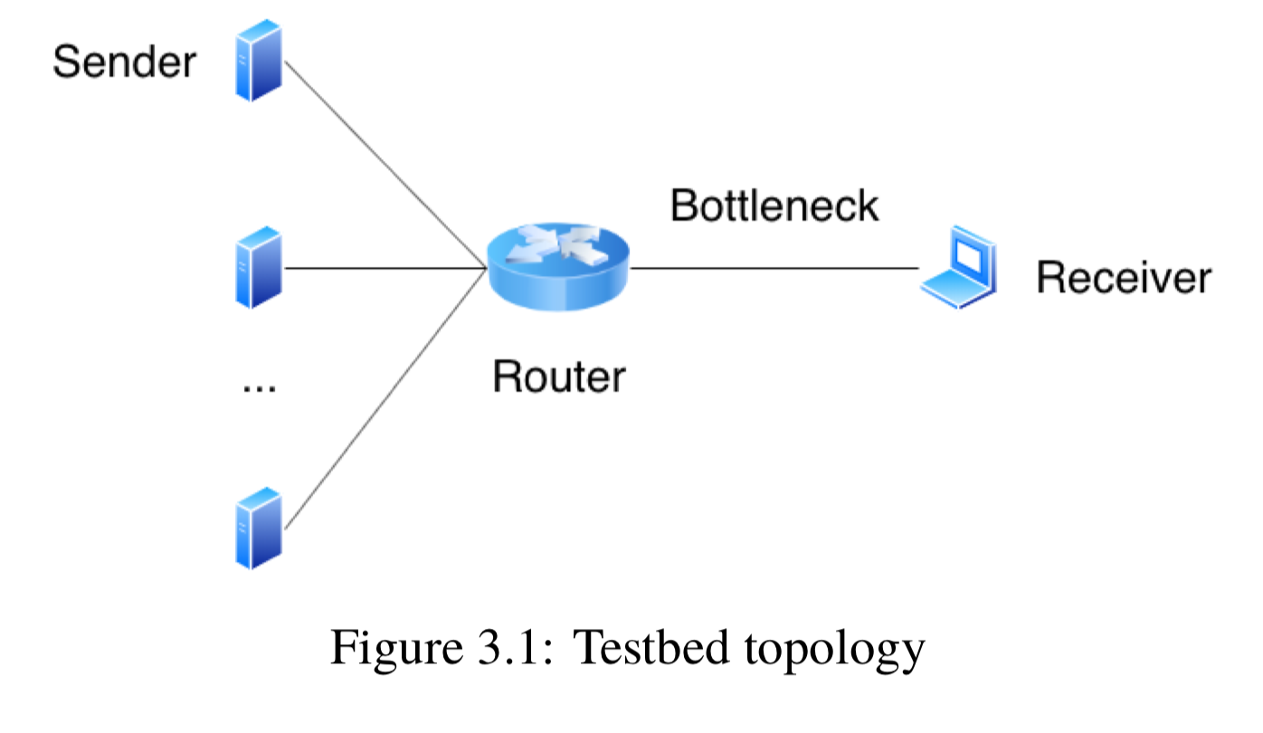
Methods
Testbed
Simulations are running on ns-3 (version 3.27)
Each sender has same sending rate
Each link has same RTT_{min}
Each flow starts 3 seconds after the previous one
Each simulation is run for 5 times for 90 seconds

Slide 11
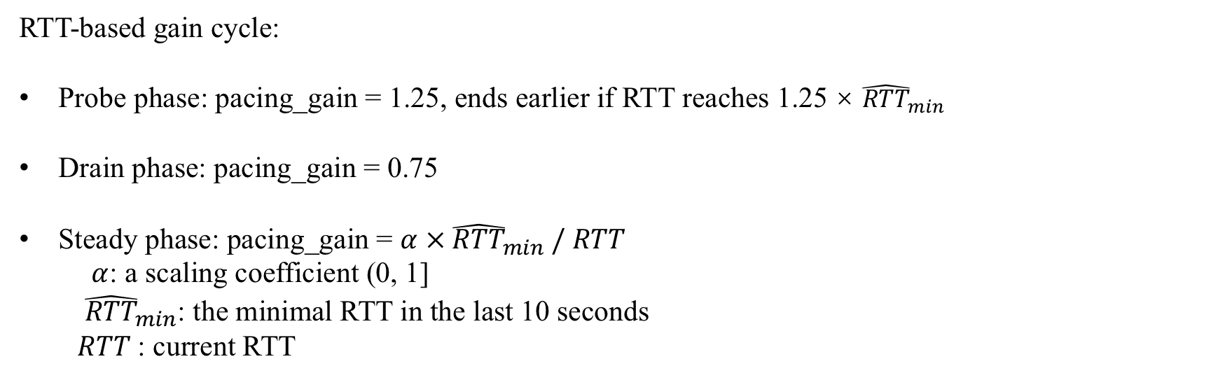
Our improvement
RTT-based gain cycle:
Probe phase: pacing_gain = 1.25, ends earlier if RTT reaches 1.25 × ${\hat{RTT}}_{min}$
Drain phase: pacing_gain = 0.75
Steady phase: pacing_gain = $α × {\hat{RTT}}_{min} \text{/} RTT$
$α$: a scaling coefficient (0, 1]
${\hat{RTT}}_{min}$: the minimal RTT in the last 10 seconds
$RTT$: current RTT
BBR overestimates bandwidth
Queue
RTT
RTT_{min}/RTT
RTT
Queue
sending rate
pacing_gain

Slide 12
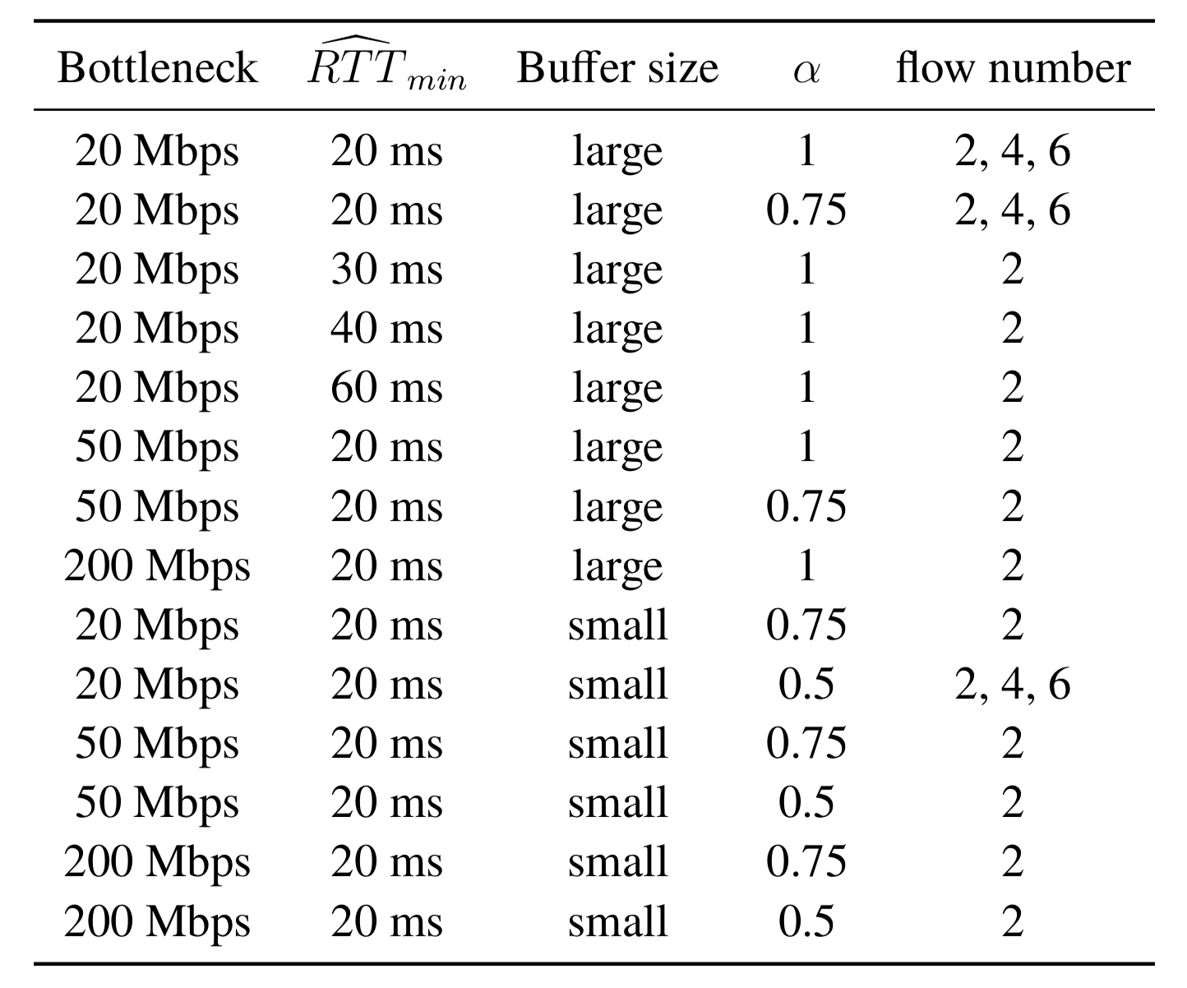
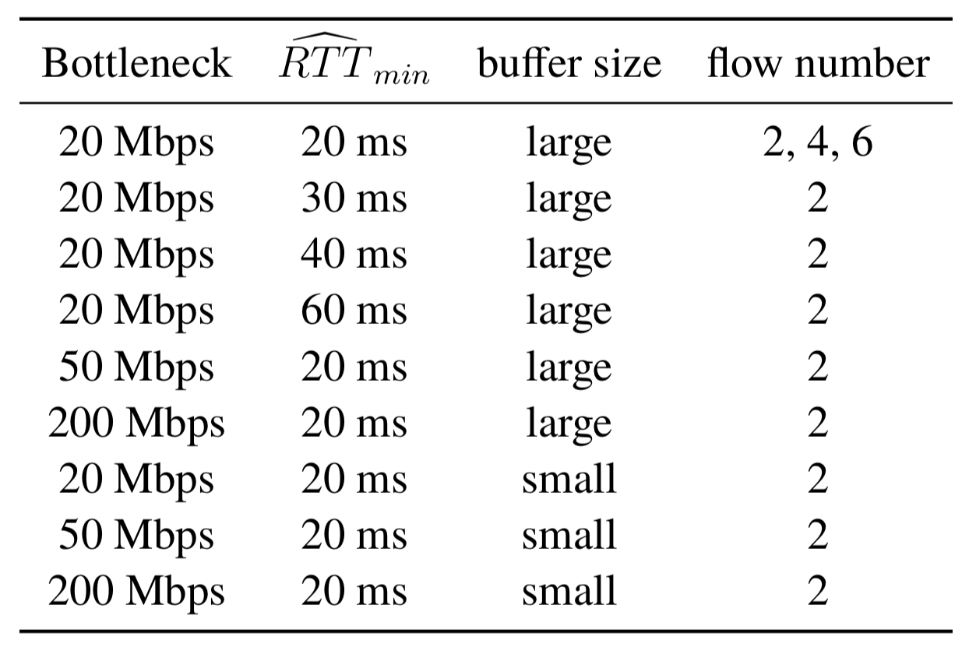
Simulation setup
Large buffer: 80×BDP
Small buffer: 0.8×BDP
Packet size: 1KB
Setup for improved BBR
Setup for original BBR

Slide 13
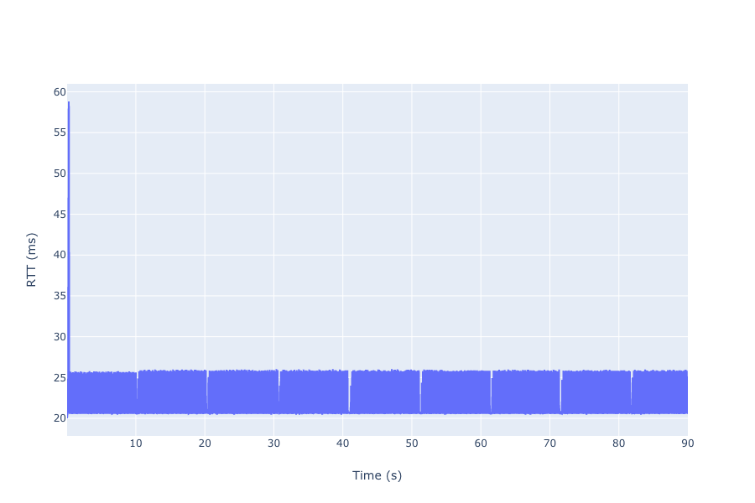
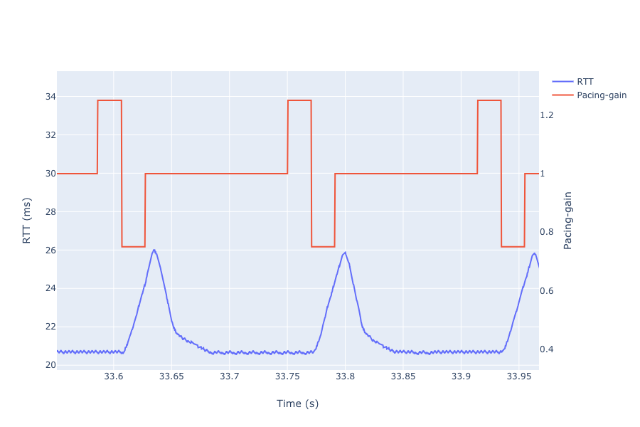
Results
Original BBR’s behavior
Single original BBR flow, BBR works as intended
bottleneck = 20 Mbps, RTT_{min} = 20 ms

Slide 14
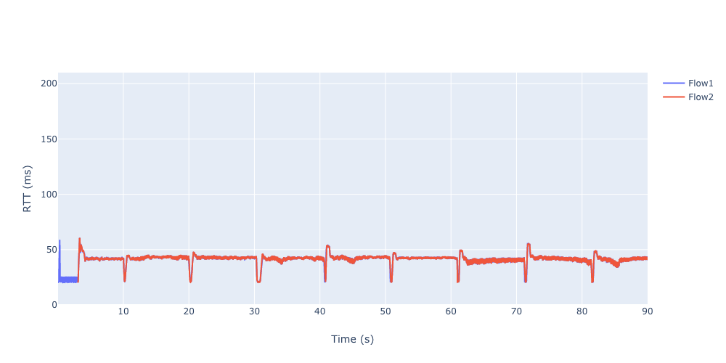
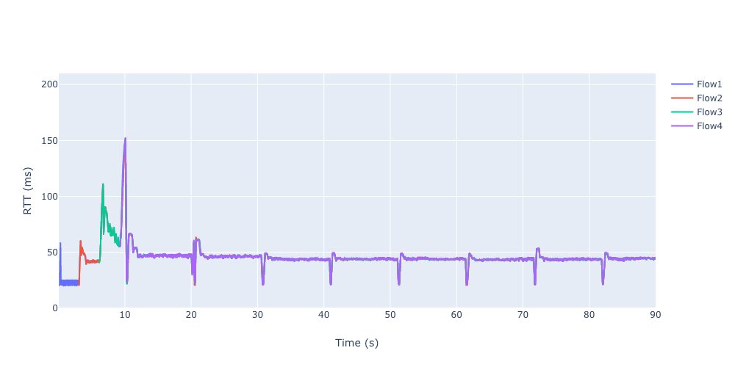
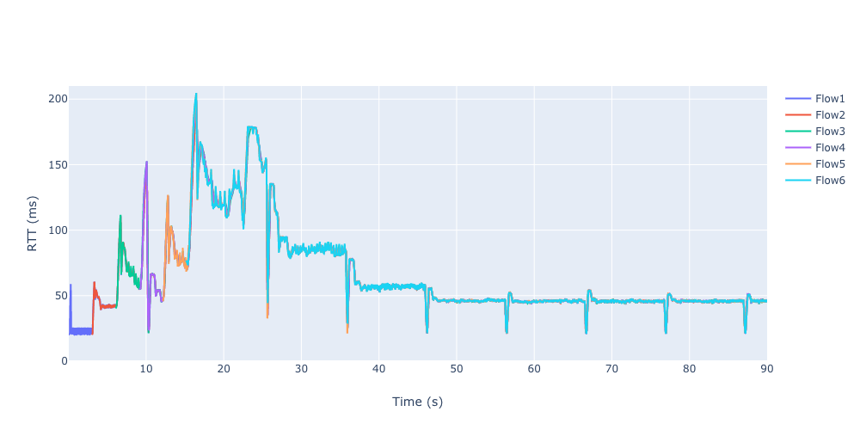
Large buffer
Multiple original BBR flows overload the bottleneck, RTTs steady at around (2~2.5)×RTT_{min}
bottleneck = 20 Mbps, RTT_{min} = 20 ms
2 flows
4 flows
6 flows

Slide 15
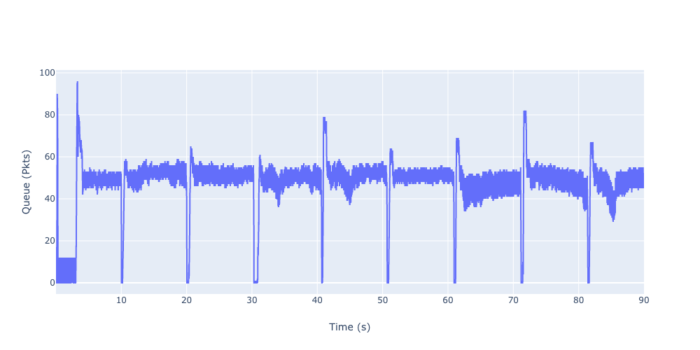
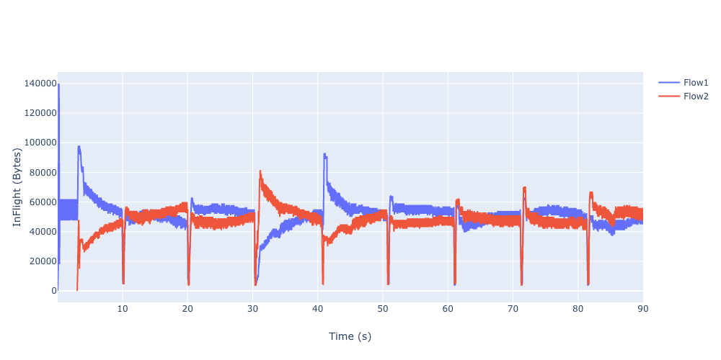
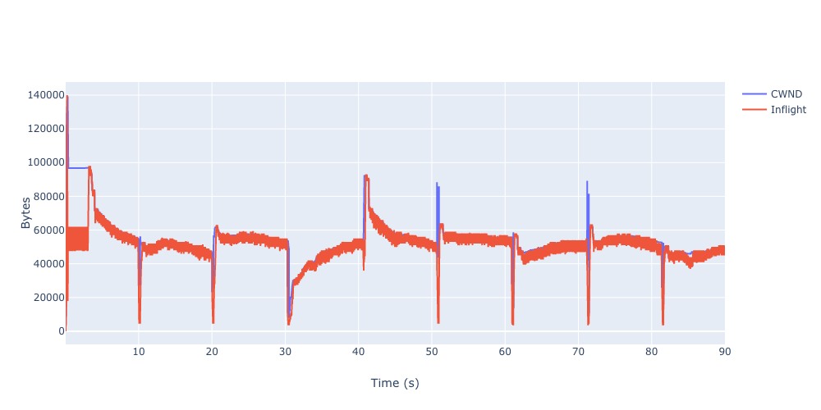
The queue is built in ProbeBW state, the inflight and CWND overlap and stay at 2×BDP (50000 B)
2 original BBR flows, bottleneck = 20 Mbps, RTT_{min} = 20 ms
Queue
Inflight
CWND and inflight of Flow 1

Slide 16
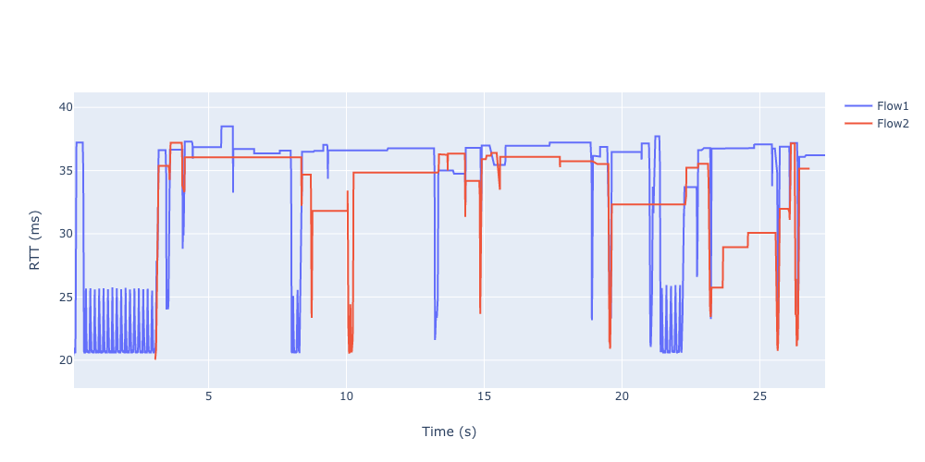
Small buffer
2 original BBR flows, the 2nd flow stops after 25s (unexpected behaviour)
bottleneck = 20 Mbps, RTT_{min} = 20 ms

Slide 17
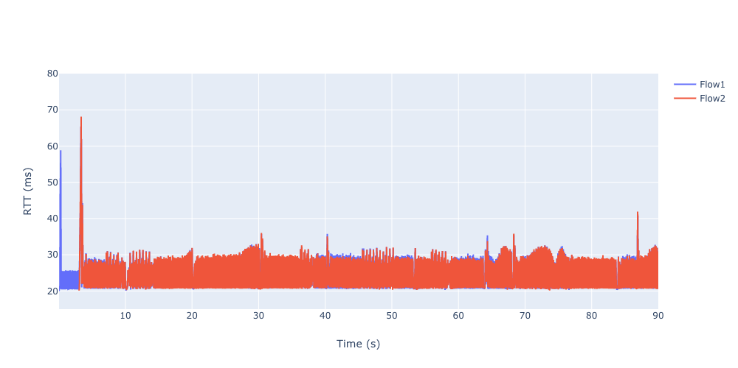
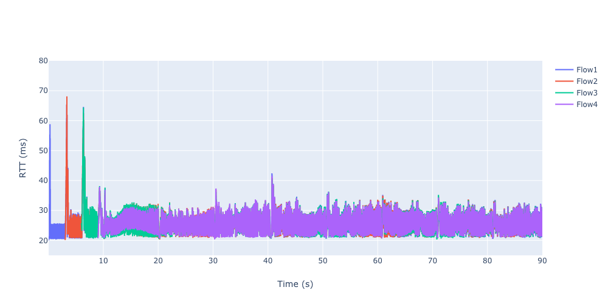
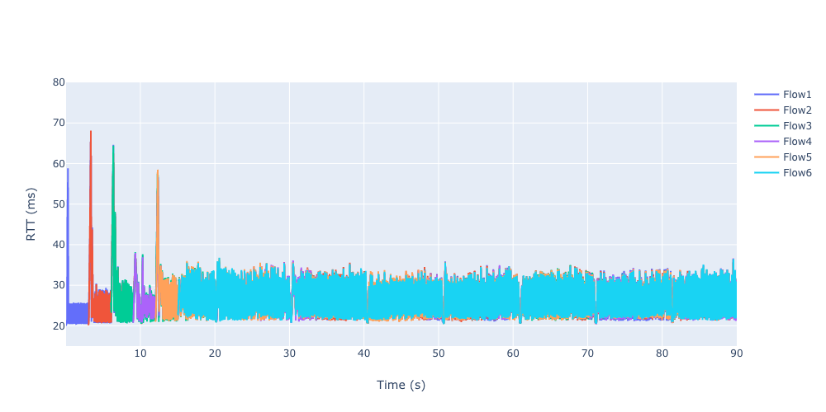
Improved BBR’s performance
Multiple improved BBR flows, RTT is not steady but much smaller compared with the original BBR
bottleneck = 20 Mbps, RTT_{min} = 20 ms, α = 1, large buffer
2 flows
4 flows
6 flows

Slide 18
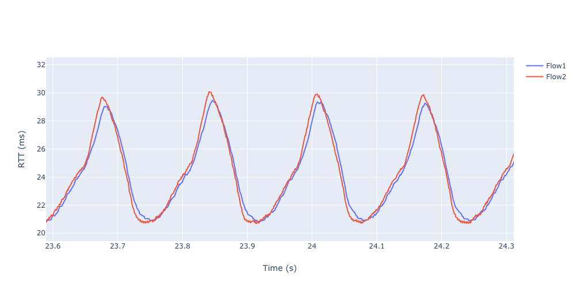
ProbeBW phase (zoomed) of 2 improved BBR flows, RTT-based gain_cycle helps drain the queue
bottleneck = 20 Mbps, RTT_{min} = 20 ms, α = 1, large buffer

Slide 19
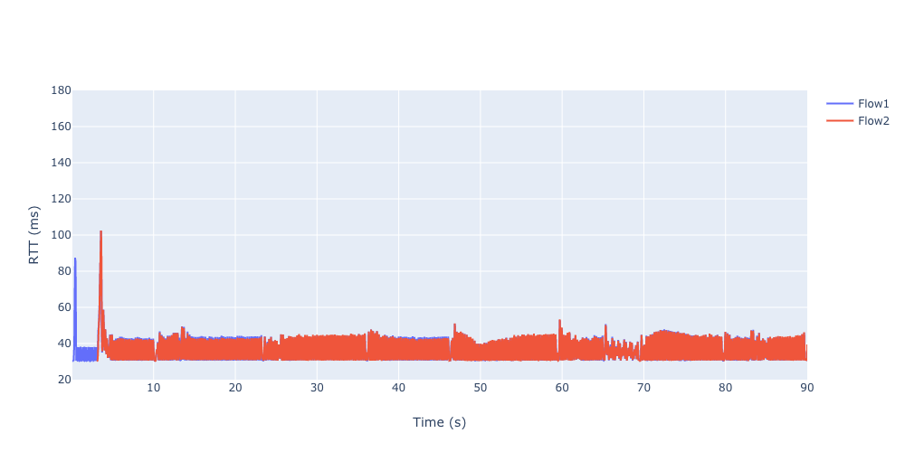
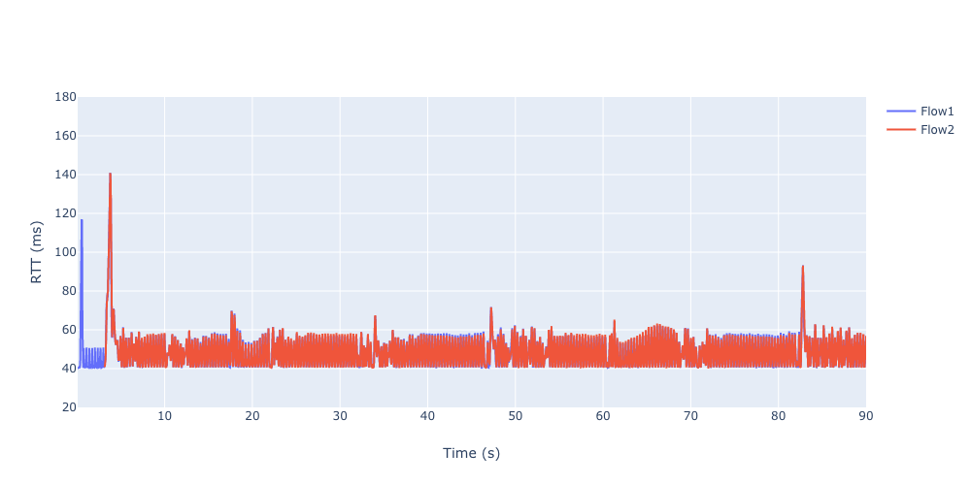
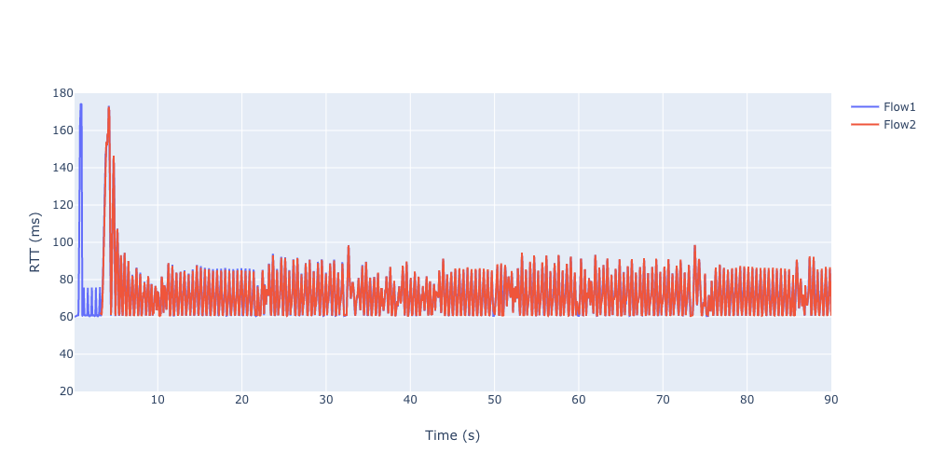
Large buffer
2 improved BBR ﬂows, with different RTT_{min} and bottlenecks, still works
bottleneck = 20 Mbps, α = 1
30 ms
40 ms
60 ms

Slide 20
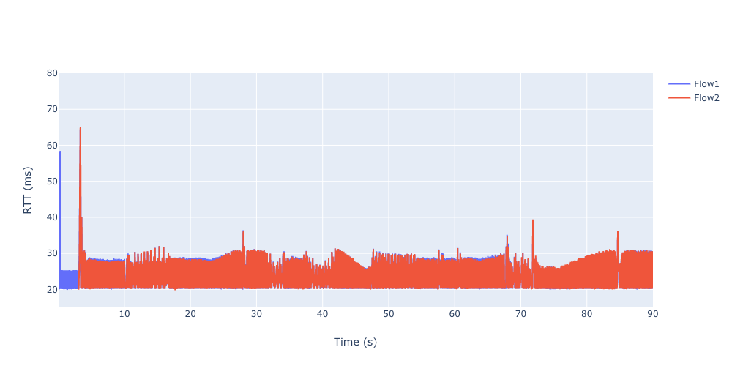
Cont’d
bottleneck = 20 Mbps, α = 1
20 Mbps
50 Mbps
200 Mbps

Slide 21
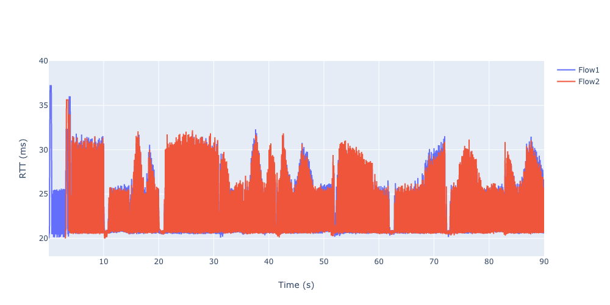
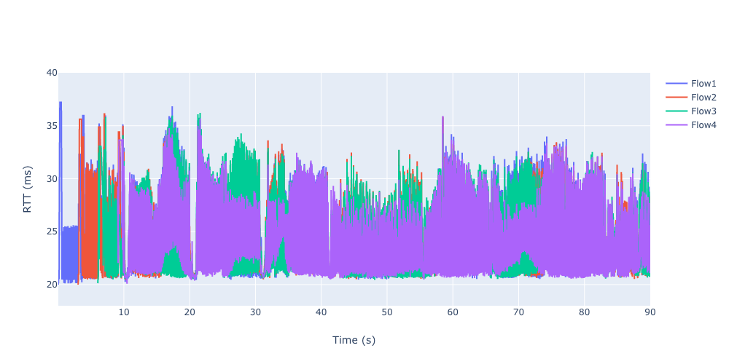
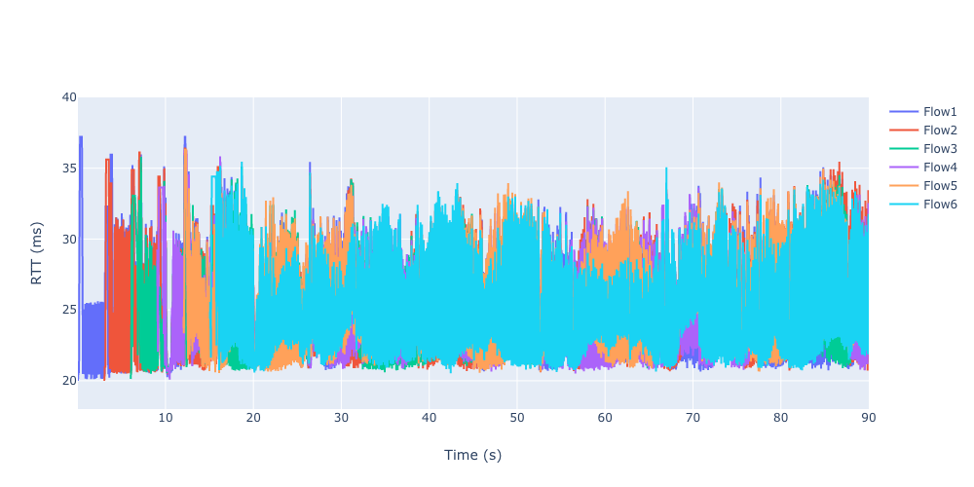
Small buffer
RTT is unstable but still less than 2×RTT_{min} (40 ms)
bottleneck = 20 Mbps, RTT_{min} = 20 ms, α = 0.5
2 flows
4 flows
6 flows

Slide 22
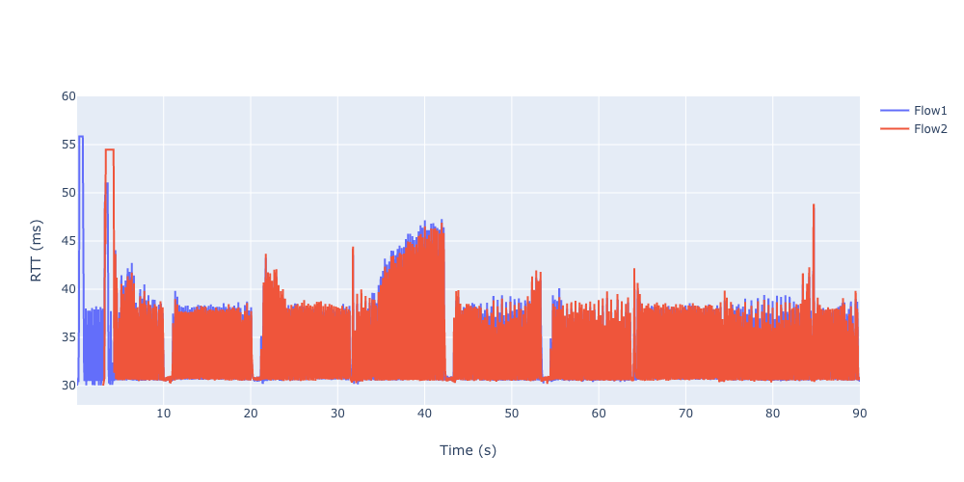
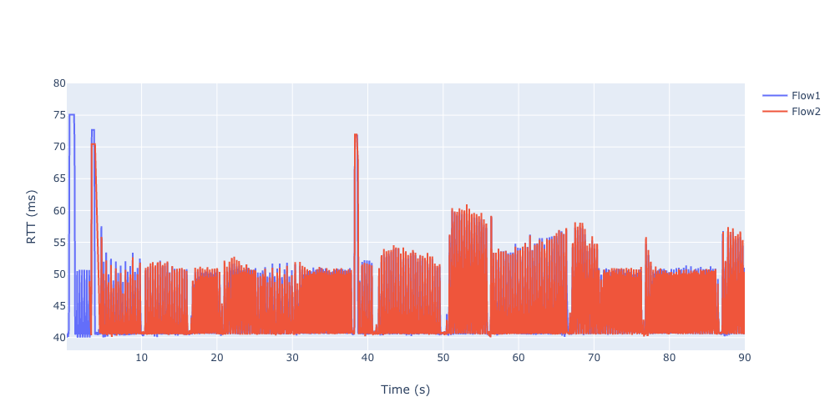
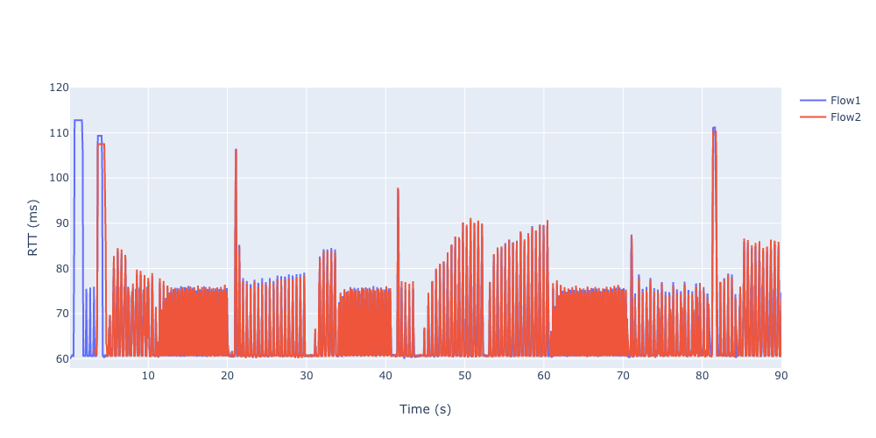
2 improved BBR ﬂows, bottleneck = 20 Mbps, α = 0.5
Comparison of different RTT_{min}
30 ms
40 ms
60 ms

Slide 23
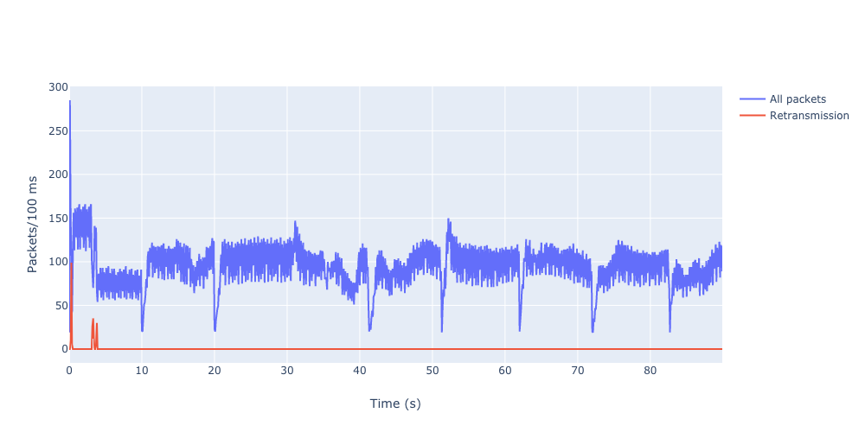
Retransmission only happens at Startup state since the pacing_gain is 2.89 while the buffer is 0.8×BDP
The 1st flow’s retransmission of 2 improved BBR ﬂows, RTT_{min} = 20 ms, α = 0.5

Slide 24
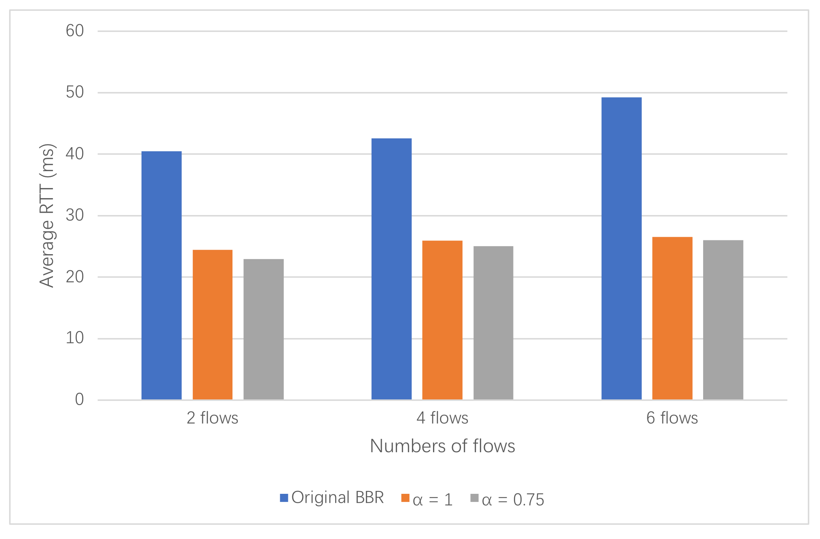
Comparison between original BBR and our improved BBR
Average RTT of improved BBR is close to the RTT_{min} and almost half of the original BBR
bottleneck = 20 Mbps, RTT_{min} = 20 ms, large buﬀer

Slide 25
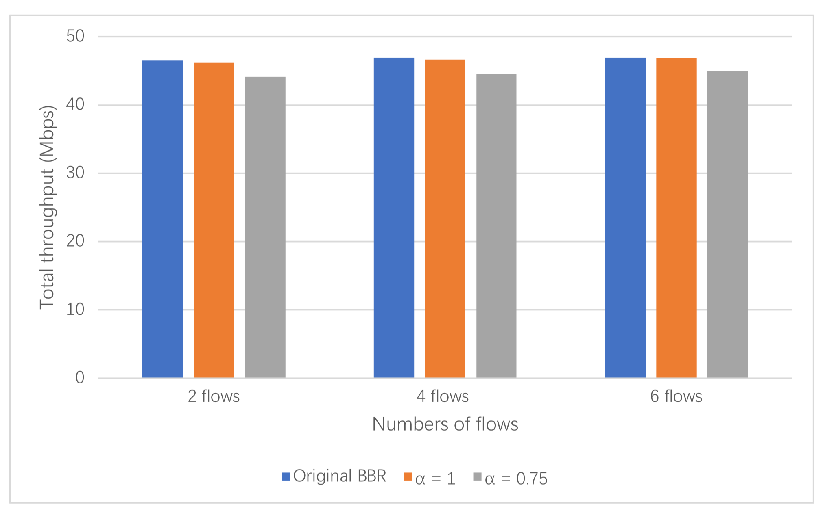
Total throughput of improved BBR is very close to the original BBR
bottleneck = 50 Mbps, RTT_{min} = 20 ms, large buﬀer

Slide 26
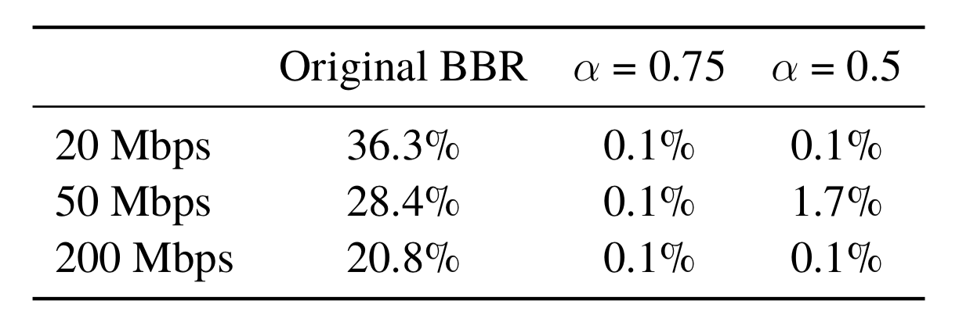
Retransmission rate is very high with the original BBR because BBR ignores congestions and overestimate the available bandwidth
The improved BBR reduces the retransmission rate massively (only happens in Startup)
RTT_{min} = 20 ms, comparison of diﬀerent bottleneck, small buﬀer

Slide 27
Conclusion
Single BBR flow works as intended
Our improved BBR can significantly reduce the additional queuing delay at a very small cost of total throughput
When the buffer is small, our improved BBR can greatly reduce the retransmission rate, avoid massive packet loss (less than 0.1%)

Slide 28
Limitations
The experiments are running on NS-3 instead of real machines, the behavior of BBR on NS-3 could be slightly diﬀerent from on the real machine in certain scenarios.
The implementation of BBR on NS-3 haven’t been updated since 2018, there were some unexpected behaviors possibly caused by bugs in the original BBR codes

Slide 29
Future Work
Try more scenarios
Simulations with more complicated topologies
Use inflight to control the pacing rate

