Slide 1


Slide 2
An Example of Multi-Stage Recommendation System
Necessity of each stage and actual candidate size scale is dependent on the specific task.
Source 1
ANN Search
Source 2
Text Search
Business Rules
Collaborative
...
Safety Filters
Source 3
Deep Learning & GBDT
Sourcing Pass
Recall Layer
Integrity Layer
Precision Layer
Recommendations
Millions of Candidates
(extremely high recall)
Millions → Thousands
Thousands → Hundreds
Hundreds → Dozens
Dozens
Personalization & context signals may be applied throughout all stages
User Profile & History
Situational, Conversational & Other Context

Slide 3
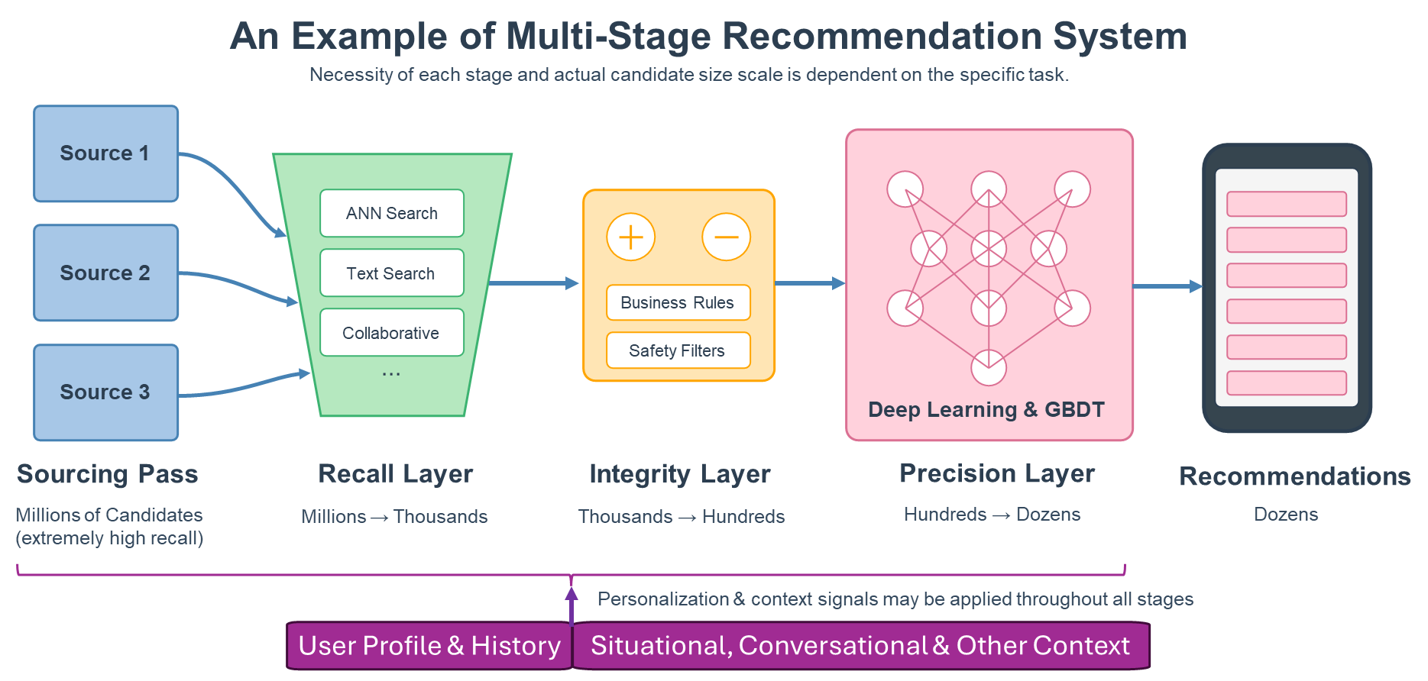

Slide 4
Multi-Modal Fusion Strategies
Early Fusion
Image
Image
f₁
Modality features are
Encoder
+
Main Model
ŷ
immediately combined
Text
Text
f₂
after encoding
Encoder
Intermediate Fusion
Features are fused at a
deeper stage after
Image
Image
f₁
Image
modality-specific processing
Encoder
Subnet
+
Main Model
ŷ
Text
Text
f₂
Text
Encoder
Subnet
Late Fusion
Each modality processed
separately, outputs
Image
Image Encoder + Processing + Model
ŷ₁
combined at the end
(Complete Pipeline)
Lightweight
Decision Layer
ŷ
Text
Text Encoder + Processing + Model
ŷ₂
(Complete Pipeline)
potential convenient modality signals to mitigate missing cross-modal correlations at the decision layer

Slide 5
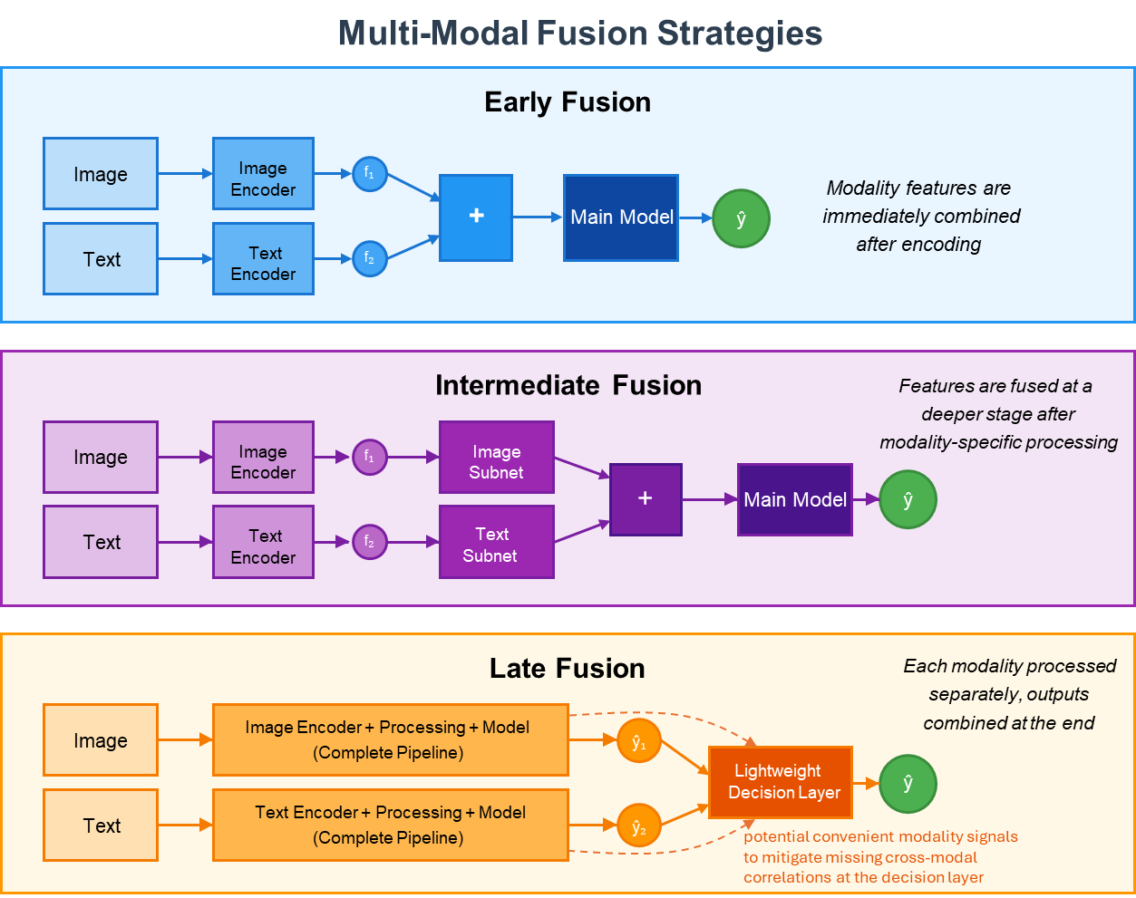

Slide 6
Multi-Modal Recommendation System Architecture
Multi-modal fusion happens offline to pre-compute multi-modal embeddings for retrieval purpose. For example,
Fusing video and video text catalog as the final video embedding.
Fusing product catalog and product image/video data as the final product embedding.
Fusing user profile, preference and historical activities as user embedding.
Fused embeddings are saved in large-scale distributed vector DBs with indexing (e.g., FAISS, ScaNN).
Pre-indexed Data
Data Ingestion & Storage Layer
Real-time Data
Real-time Data
Pre-Indexed Data
Current User Activity
Context Signals
Trending Content
Text Data
User Profiles
Historical User Activities
Multi-Modal Fusion
Session Events & Behaviors
Time, Location, Device
Popular & Time-Sensitive Items
Items & Metadata
Demographics & Preferences
Past Interactions & Behaviors
Stream Processing
Real-Time Indexing
Multimedia Data
Distributed Storage & Indexing
Kafka/Kinesis Event Processing, Real-time Analytics
Fast Access Structures
Images, Videos, Audios,
Catalog & Meta Data
Document DB, Temporal DB, Graph DB $⇒$ Vector DBs (FAISS, ScaNN)
Real-Time Analytics
Query Analytics
Context Analytics
Real-Time
Activity Analytics
Modality analytics are optional depending on model capabilities.
Strong models can ingest various modalities and perform in-depth inference without additional help, e.g., strong LLMs.
Analytics signals could benefit lesser model performance.
Query Modality Processing
Situational Context
(Location, Time, Screen Content)
Short-Term Interest Tracking
Entity/Intent Detection
Session Context
(Conversation & On-Going Activities)
Short-Term Behavior Patterns
Caching mechanisms (e.g., on-server cache, distributed cache) enables efficient data fetching with lower latency.
Query Expansion
Caching
Staged Recommendation Pipeline
Sourcing Layer
Multi-modal fusion might happen inside Recall Layer and / or Precision Layer, depending on the design.
Recall Layer (ANN Search, Text Search, Collaborative Filter)
Multi-Modal Fusion
Millions → Thousands
Integrity Layer (Business Rules, Safety Rules)
Thousands → Hundreds
Precision Layer (Deep Learning, GBDT)
Multi-Modal Fusion
Hundreds → Dozens
feedback for dynamically adjusting the recommendation pipeline
Serving & Feedback Layer
Logging, Feedback & NRT Analytics
Runtime Experiments
Real-Time Serving Infrastructure
User Interactions

Slide 7
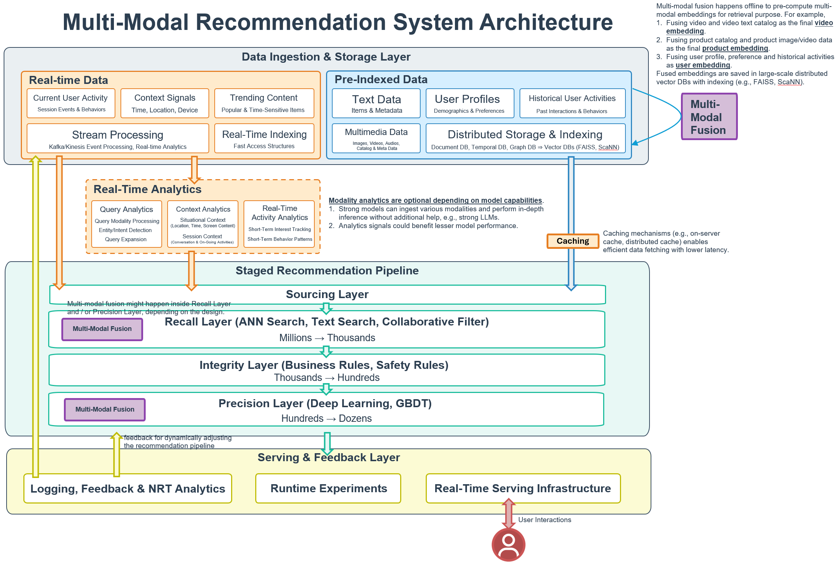

Slide 8
Self-Improving ML/AI System with Closed Feedback Learning Loop
Runtime Model
Serving search results,
recommendations, ads, et.
User Interaction
(real-time predictions)
(strict latency constraints)
Engagement with results
Business Guardrails
(rules, constraints, etc.)
Loging interactions,
Including explicit feedback
(such as thumbs up/down, ratings, surveys, etc.)
Updating runtime model on a regular basis (more frequent, e.g., daily)
Runtime Model
Training Pipeline
Extracting session interaction sequences
Data Storage
Complete interaction logs
Reinforcement Learning
Generates learning signals (labels)
Extracting session interaction sequences
and preference pairs
Deep Reward Model
Updating reward model on a periodic basis (less frequent, e.g., weekly)
Reward Model
Training Pipeline
(label creation)
(offline, no latency constraint)
Supervised Preference Learning
Teacher-Student Relationship
Reward model (teacher): Creates learning signals with hindsight
Runtime model (student): Applies learning in real scenarios to predict the future

Slide 9
Self-Improving ML/AI System with Closed Feedback Learning Loop
Runtime Model
User Interaction
(real-time predictions)
Validated models
Serving search results,
Engagement with results
Continuous
recommendations, ads, etc.
(strict latency constraints)
Model Version
Policy
Management
Direct feedback
Runtime Model
constraints
(validation & deployment)
Training Pipeline
Model updates
Explicit Feedback
Reinforcement Learning
Logging interactions
(ratings, reports, surveys)
Feature importance
Business
Generates learning
information flow
Guardrails
signals (labels)
(rules & constraints)
Deep Reward Model
Historical data
Data Storage
Batch/Periodic
(label creation)
Complete interaction logs
(offline, no latency constraint)
Raw data
Updating reward model
on a periodic basis
Reward Model
Training pairs
Preference Pair
Training Pipeline
Extraction
Supervised Preference Learning
Teacher-Student Relationship
Information Asymmetry of Hindsight
Reward model (teacher): Creates learning signals from historical outcomes
Reward model: Complete historical data with full session context
Runtime model (student): Applies learning to make predictions in real scenarios
Runtime model: Historical data + partial real-time data from current session

Slide 10
Positional Encoding Frequencies in Transformer
1.0
Lower dimensions (e.g., dim=0) have low frequencies - capture long-range position relationships
Mid-range dimensions (e.g., dim=16) have medium frequencies
Higher dimensions (e.g., dim=48) have high frequencies - capture fine-grained local positions
0.5
dim=0
Value
0.0
dim=4
dim=16
dim=48
-0.5
-1.0
0
20
40
60
80
100
120
Position

Slide 11
