Slide 1
Optimal Decision Tree
Xinlong Li

Slide 2
Outline
- Widely used algorithm for generating decision tree
- ID3
- C4.5
- CART
- Local optimal decision tree
- Post Prune
- Cross-validation
- The efforts of Finding the Global Optimal decision tree
- T2, T3, T3C
- OCT

Slide 3


ID3 Algorithm
- Entropy Ent(D) is a measure of the amount of uncertainty in the data set D
where
- k is the set of classes in D
- p_{k} is the proportion of the number of elements in class k
- Information gain Gain(D,a) is the measure of the difference in entropy from before to after the D is split on an feature a. In other words, how much uncertainty in D was reduced after splitting set D on feature a.
where
- V is the number of values in feature a
- D^{v} is the number of samples which have value v in feature a

Slide 4
ID3 Algorithm
- ID3 uses a greedy strategy by selecting the locally best feature, which has the largest information gain, to split the dataset on each iteration
- ID3 is harder to use on numerical data than on categorical data
- ID3 does not guarantee an global optimal solution. It usually converge to a local optima
- ID3 is possible to overfit the training data
- ID3 tends to choose the feature, which has more values, to be the best one

Slide 5


C4.5 Algorithm
- C4.5 is an extension of ID3 algorithm
- C4.5 uses normalized information gain ratio instead of information gain
where
Is the intrinsic value of feature T
- As an improvement, to handle continuous attributes, C4.5 creates a threshold and then splits the list into those whose attribute value is above the threshold and those that are less than or equal to it
- C4.5 prunes trees after creation

Slide 6


CART Algorithm
- Gini impurity is a measure of how often a randomly chosen element from the set T would be incorrectly labeled if it was randomly labeled according to the distribution of labels in the subset.
where
- p_{j} is the fraction of items labeled with class j in the data set T
- Gini gain gini_{split}(T) after splitting on feature a
Where
- N_{i} is the number of samples belonging to the i-th value in feature a
- T_{j} is the subset belonging to the i-th value in feature a

Slide 7
CART Algorithm
- CART selects the locally best feature, which has the smallest Gini gain, to split the dataset on each iteration
- CART generates binary tree
- CART is able to handle both numerical and categorical data
- CART can can overfit the training data, needs pruning trees after generation

Slide 8
Optimal Decision Tree
- Two or more decision trees may represent the same distribution (giving the same classification result). The one with smallest size (with the fewest leaves) is the optimal decision tree
- ID3, C4.5, CART are all top-down induction methods, usually generating locally optimal trees.
- Constructing global optimal binary decision trees is NP-hard
- In financial field where computations are sometimes required to be done virtually online or at least to be conducted very quickly, the speed matter becomes crucial, that is why it is reasonable to apply locally optimal procedures
- Nowadays commercial versions of software capable of producing globally optimal structures are not present on the market

Slide 9
Methods to Stop Splitting
- In CART, Set up a threshold, stop splitting when Gini gain is smaller than this threshold
- Set up a restriction on the minimum number of samples at each terminal leaf
- Cross-validation, usually 10-fold validation is used to compare the quality of different trees
- Get the optimal decision tree through cost-complexity pruning
The above two simple methods usually don’t result in an (local) optimal tree

Slide 10

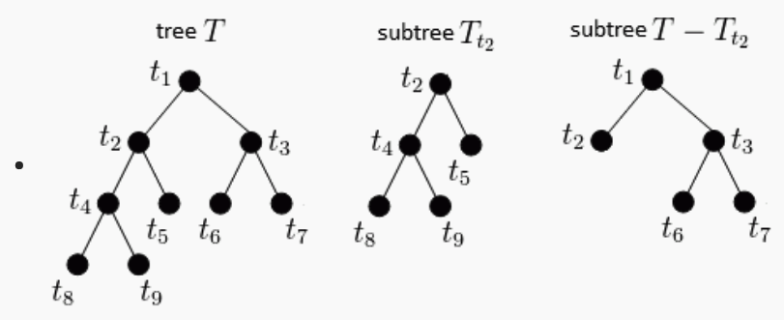
Cost-complexity Function and Cross-validation
- Goal: to minimize the cost-complexity function R_{α}(T):
where:
- R(T) is the training/learning error related to the misclassification rate
-|f(T)| is the size of the tree T or the number of terminal leaves
- The value of α determines which tree is optimal
- We need to find the critical values of α, and determine which value is the best

Slide 11
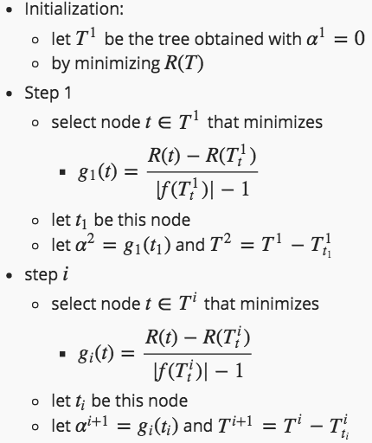
Pruning Algorithm
- After some mathematical derivation, we have following algorithm

Slide 12
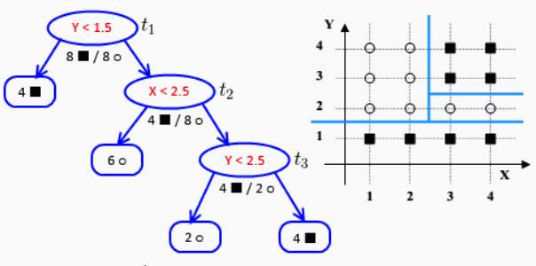
Pruning Algorithm – Example Part 1

Slide 13

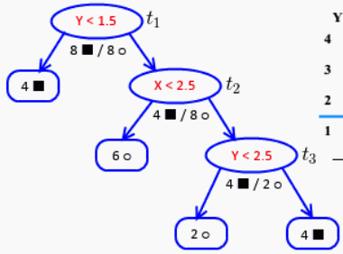

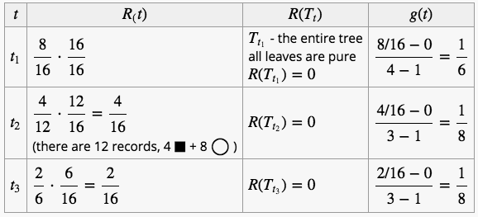

Pruning Algorithm – Example Part 1
- R(t) is training error of node t
- R(t) = r(t) p(t)
- r(t) is the misclassification rate at node t
- p(t) is the proportion of data items reached t
- R(T_{t}) is sum of all training errors over all leaves with root at t
- |f(T_{t})| is the number of leaves to prune
α₁ = 1/8

Slide 14
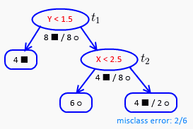
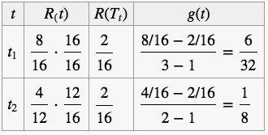
Pruning Algorithm – Example Part 2
- R(t) is training error of node t
- R(t) = r(t) p(t)
- r(t) is the misclassification rate at node t
- p(t) is the proportion of data items reached t
- R(T_{t}) is sum of all training errors over all leaves with root at t
- |f(T_{t})| is the number of leaves to prune
α₂ = 1/8

Slide 15
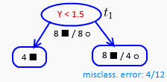

Pruning Algorithm – Example Part 3
- R(t) is training error of node t
- R(t) = r(t) p(t)
- r(t) is the misclassification rate at node t
- p(t) is the proportion of data items reached t
- R(T_{t}) is sum of all training errors over all leaves with root at t
- |f(T_{t})| is the number of leaves to prune
α₃ = 1/4

Slide 16
Pruning Algorithm – Example Part 4
T1
- We now have a series of values:
- α₀ = 0
- α₁ = 1/8
- α₂ = 1/8
- α₃ = 1/4
- By the theorem we want to find tree such T that minimizes the cost-complexity function
- if 0 ≤ α < 1/8, then T1 is the best
- if α = 1/8, then T2 is the best
- if 1/8 < α < 1/4, then T3 is the best
- if α ≥ 1/8, then T3 is the best
- Next we use cross validation to determine which α is the best and thus which tree is the optimal tree
T2
T3

Slide 17
Finding the Global Optima - T3C
- ID3, C4.5, CART are all top-down induction methods. The choice of split cannot be guided by the possible influence of future splits.
- To get global optimal tree, we need to form the entire decision tree in a single step, allowing each split to be determined with full knowledge of all other splits.
- A family of efficient enumeration approaches, called T2, T3 and T3C, which create optimal non-binary decision trees of depths up to 3
- T3C can deal with both categorical and numerical data
- T3C splits a node into more than 2 branches
- T3C generates smaller trees with the same performance compared to C4.5 and C5.0

Slide 18
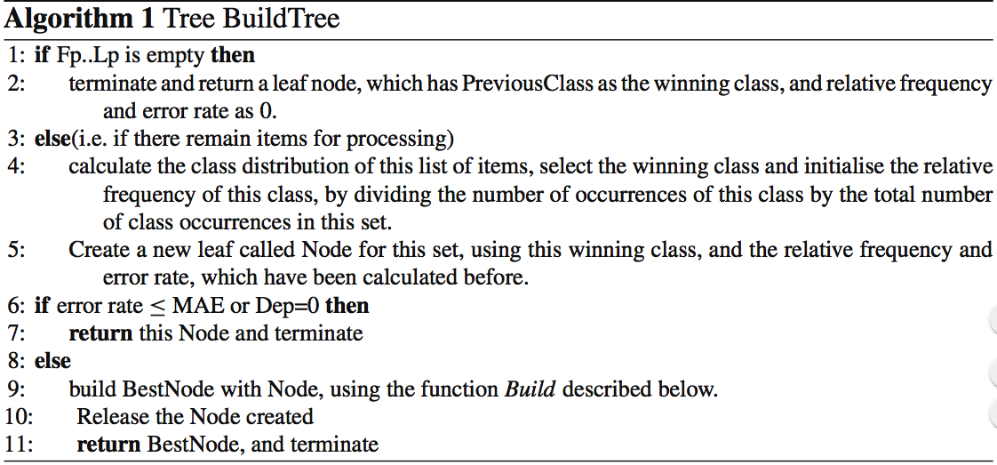
Finding the Global Optima - T3C
- Tree BuildTree (ItemNo Fp, ItemNo Lp, int Dep, ClassNo PreviousClass)

Slide 19
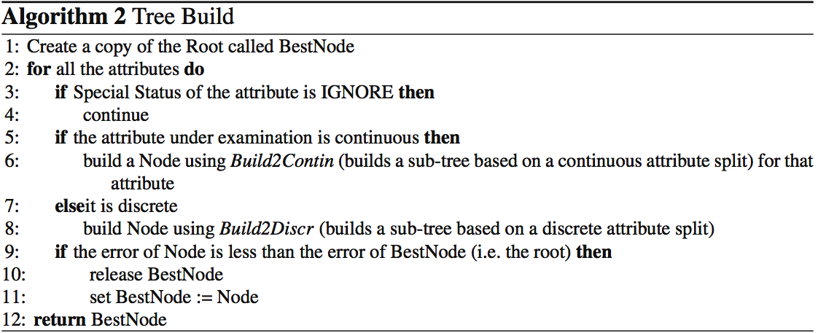
Finding the Global Optima - T3C
- Tree Build (ItemNo Fp, ItemNo Lp, int Dep, Tree Root)

Slide 20
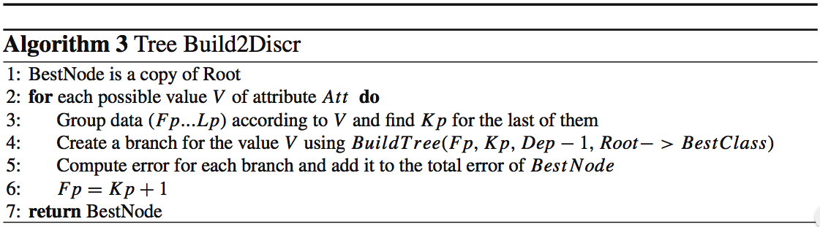
Finding the Global Optima - T3C
- Tree Build2Discr(ItemNo Fp, ItemNo Lp, Attribute Att, int Dep, Tree Root)

Slide 21
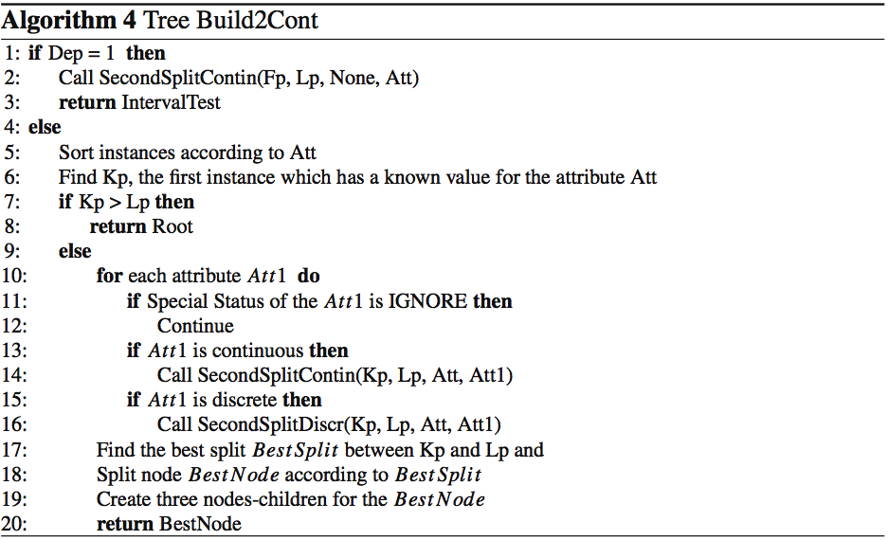
Finding the Global Optima - T3C
-111

Slide 22
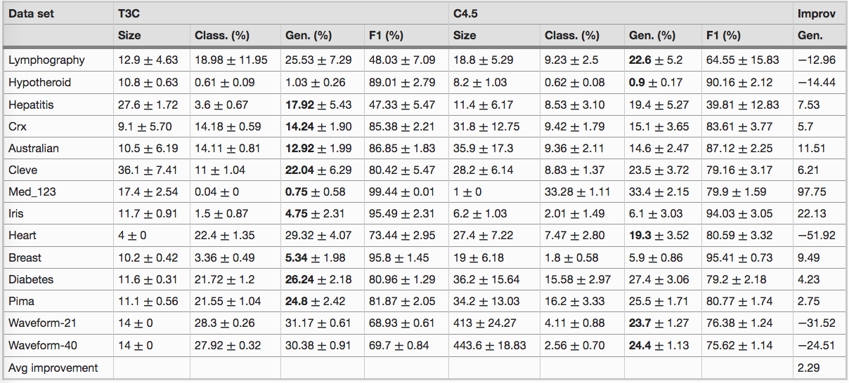
Finding the Global Optima - T3C
- Gen is the number of incorrect instances divided by the total number of instances in the test set

Slide 23
Finding the Global Optima - T3C
- Future work
- T3C does not perform better when the depth is larger than 3. Increasing depth improves classification accuracy
- T3C can be improved by reducing the splitted branches for each node. Reducing splits could improve generalization accuracy

Slide 24
Finding the Global Optima - OCT
- To get global optimal tree, we need to form the entire decision tree in a single step, allowing each split to be determined with full knowledge of all other splits.
- Goal: to minimize the cost-complexity function R_{α}(T):
where:
- R(T) is the training/learning error related to the misclassification rate
- |f(T)| is related to the size of the tree T or the number of terminal leaves
- The OCT method is to change the above optimization problem to a mixed-integer optimization (MIO) problem. By solving the MIO problem, we can get the global optimal tree directly (without post-prune)
- Modern MIO solvers such as Gurobi (Gurobi Optimization Inc 2015b) and CPLEX (IBM ILOG CPLEX 2014) are able to solve linear MIO problems of considerable size

Slide 25
Finding the Global Optima - OCT
- To get global optimal tree, we need to form the entire decision tree in a single step, allowing each split to be determined with full knowledge of all other splits.
- Goal: to minimize the cost-complexity function R_{α}(T):
where:
- |f(T)| is the size of the tree T or the number of terminal leaves
- R(T) is the training/learning error related to the misclassification rate
- The OCT method need to be specify 3 parameters before solving the optimization problem:
- the maximum depth D
- the minimum leaf size N_{min}
- the complexity parameter α

Slide 26

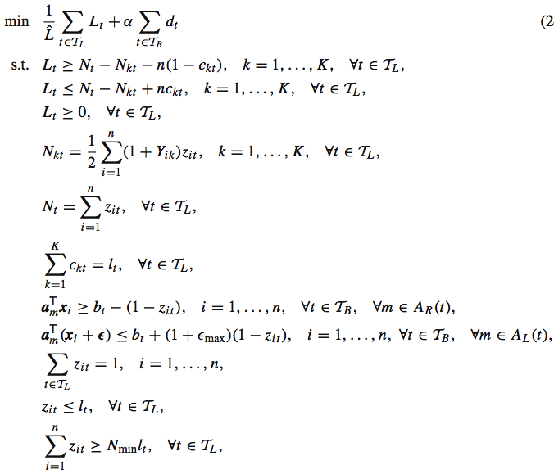
Finding the Global Optima - OCT
-----

Slide 27
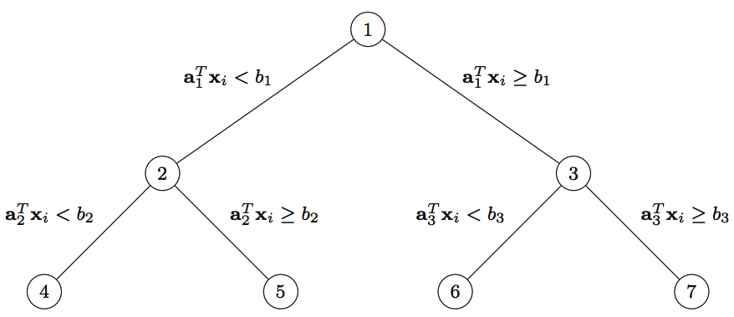
Finding the Global Optima - OCT
- OCT method generates the binary decision tree
- Given a depth D, we can construct the maximal tree of this depth, which has T = 2^{(D+1)} −1 nodes.
- x_{i} is the value of i-th feature (categorical or numerical)
- OCT assume without loss of generality that the values for each dimension across the training data are normalized to the 0–1 interval, meaning 0<=x_{i}<=1

Slide 28
Finding the Global Optima - OCT
- If node 2 does not apply a split (by some judgment), set a=b=0. There will be no split from node 2 to node 4, 5 because 0 cannot smaller than 0.
- A indicator d_{t} will be set to 0, indicating no split at node 2 (d₂ = 0).
- The number of data points N_{t} in node 4 and 5 will be zero (N₄ = 0, N₅ = 0).
- If node 2 does not apply a split, then node 4 does not either. So d_{t1} is less than d_{t2} if t2 is the parent of t1.

Slide 29

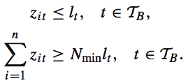
Finding the Global Optima - OCT
- OCT introduces the indicator variables z_{it} = 1 if data point x_{i} is in leaf node t.
- OCT introduces the indicator variables l_{t} = 1 if leaf node t is not empty
- OCT defines a minimum number N_{min} of points at each leaf node

Slide 30

Finding the Global Optima - OCT
- The objective is to minimize the misclassification error. Matrix Y_{ik} is defined
- K is the labels of target classes
- Set N_{kt} to be the number of points of label k in node t, and Nt to be the total number of points in node t.

Slide 31
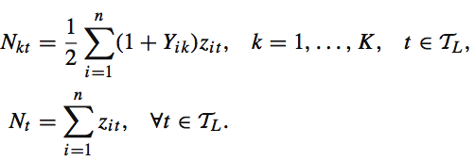
Finding the Global Optima - OCT
- Set N_{kt} to be the number of points of label k in node t, and Nt to be the total number of points in node t.
- The k with largest N_{kt} will be the label of this leaf node t

Slide 32

Finding the Global Optima - OCT
- The misclassification loss in each node, denoted L_{t}, is going to be equal to the number of points in the node minus the number of points of the most common label k

Slide 33

Finding the Global Optima - OCT
- The final objective function will be
- The first term is the (normalized) total misclassification cost
- The second is the total splits when building the tree, which is related to the size of the tree

Slide 34
Finding the Global Optima - OCT
- It can find high-quality solutions in minutes for depths up to 4 for datasets with thousands of points. Beyond this depth or dataset size, the rate of finding solutions is slower, and more time is required
- It need to specify 3 parameters before optimization

Slide 35
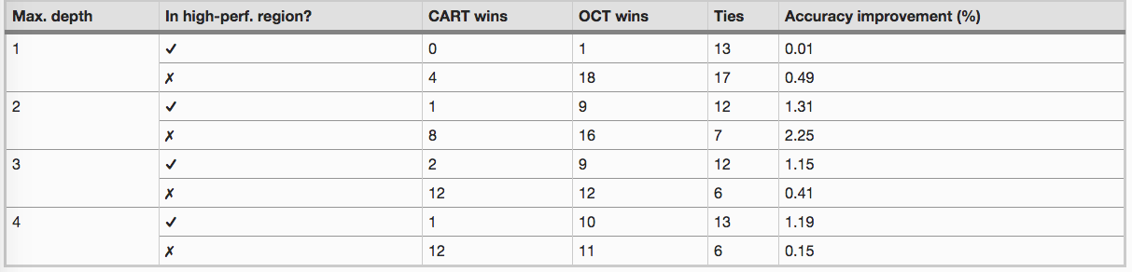
Finding the Global Optima - OCT
- Comparison with post-prune CART

Slide 36
Finding the Global Optima – Other Approach
- linear optimization
- Dynamic programming
- Genetic algorithms
- Stochastic gradient descent
- However, none of these methods have been able to produce certifiably optimal trees in practical times

Slide 37
Thanks

