Slide 1
Predicting Disease Spread
Xinlong Li

Slide 2
Outline
- Understand the features
- Missing values
- Outliers
- Correlation analysis
- Model
- Negative binomial regression
- Random forest
- Regression result

Slide 3

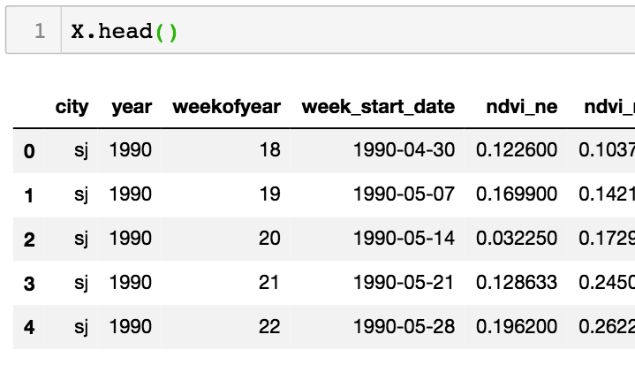
Load the Data

Slide 4
Description about the features
City and date indicators
city – City abbreviations: sj for San Juan and iq for Iquitos week_start_date – Date given in yyyy-mm-dd format
NOAA's GHCN daily climate data weather station measurements station_max_temp_c – Maximum temperature
station_min_temp_c – Minimum temperature
station_avg_temp_c – Average temperature
station_precip_mm – Total precipitation
station_diur_temp_rng_c – Diurnal temperature range
PERSIANN satellite precipitation measurements (0.25x0.25 degree scale) precipitation_amt_mm – Total precipitation

Slide 5
Description about the features
NOAA's NCEP Climate Forecast System Reanalysis measurements (0.5x0.5 degree scale)
reanalysis_sat_precip_amt_mm – Total precipitation reanalysis_dew_point_temp_k – Mean dew point temperature reanalysis_air_temp_k – Mean air temperature reanalysis_relative_humidity_percent – Mean relative humidity reanalysis_specific_humidity_g_per_kg – Mean specific humidity reanalysis_precip_amt_kg_per_m2 – Total precipitation reanalysis_max_air_temp_k – Maximum air temperature reanalysis_min_air_temp_k – Minimum air temperature reanalysis_avg_temp_k – Average air temperature
reanalysis_tdtr_k – Diurnal temperature range
Satellite vegetation - Normalized difference vegetation index (NDVI) - NOAA's CDR Normalized Difference Vegetation Index (0.5x0.5 degree scale) measurements
ndvi_se – Pixel southeast of city centroid
ndvi_sw – Pixel southwest of city centroid
ndvi_ne – Pixel northeast of city centroid
ndvi_nw – Pixel northwest of city centroid

Slide 6
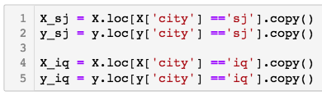
Training San Juan and Iquitos Separately

Slide 7
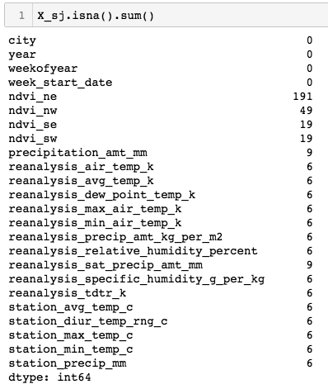
Missing Value

Slide 8
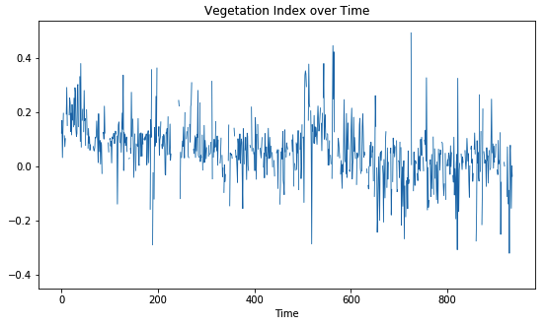

Missing Value

Slide 9
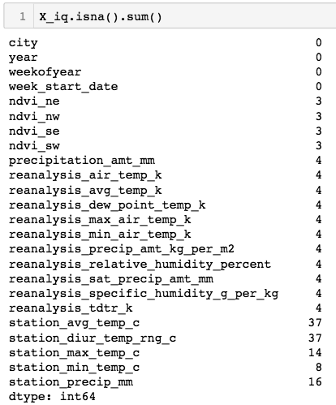
Missing Value

Slide 10
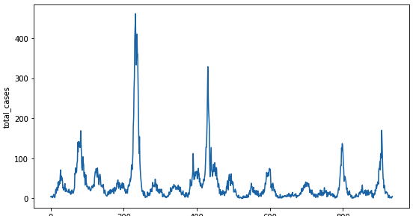
Outliers
Aside from missing values, outliers were also detected, using 3σ as inner outlier limit and 5σ as extreme limit, where σ was the observed standard deviation of the feature. Analysis of these outliers revealed that they were plausible values, and as such, they were not treated for this study

Slide 11

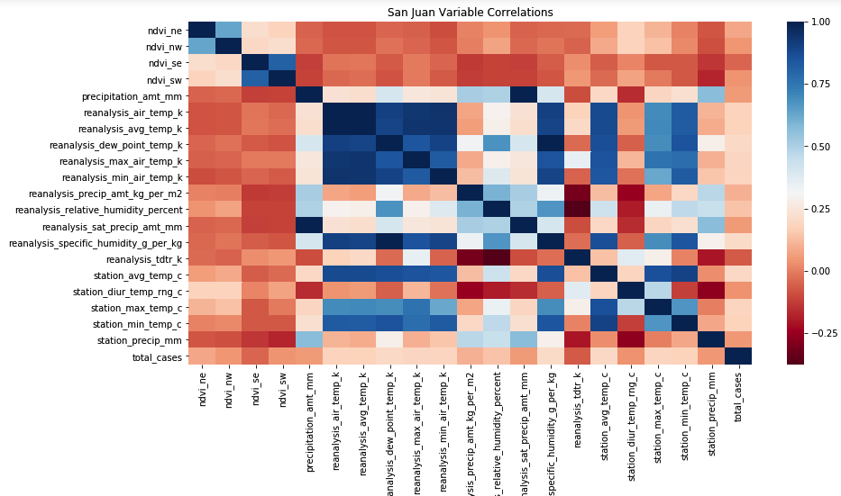
Correlation Analysis

Slide 12
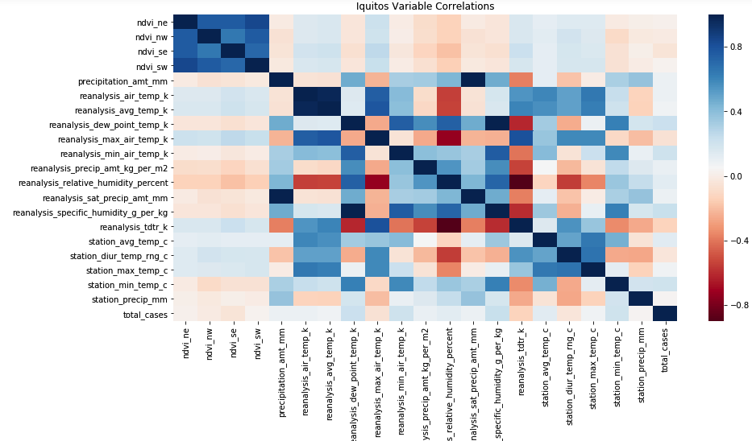
Correlation Analysis

Slide 13
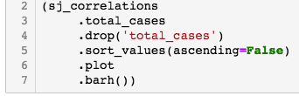
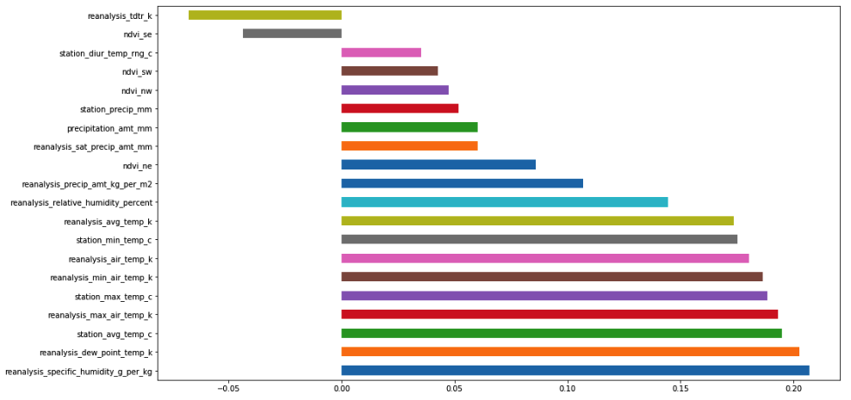
Correlation Analysis

Slide 14
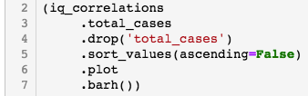
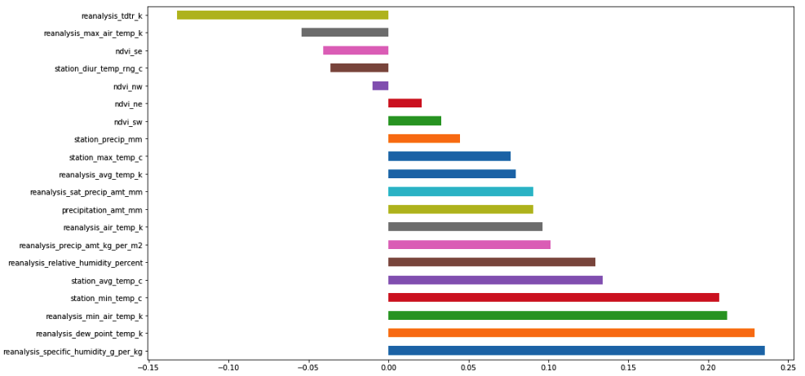
Correlation Analysis

Slide 15
Correlation Analysis
-The wetter the better
-The correlation strengths differ for each city, but it looks like reanalysis_specific_humidity_g_per_kg and reanalysis_dew_point_temp_k are the most strongly correlated with total_cases. This makes sense: we know mosquitos thrive wet climates, the wetter the better!
- Hot and heavy
-As is known, "cold and humid" is not a thing. So it's not surprising that as minimum temperatures, maximum temperatures, and average temperatures rise, the total_cases of dengue fever tend to rise as well.
- Rain
-Interestingly, the precipitation measurements bear little to no correlation to total_cases, despite strong correlations to the humidity measurements

Slide 16
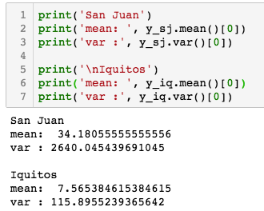
Model – Negative Binomial Regression
variance >> mean
- suggests total_cases can be described by a negative binomial distribution, so we'll use a negative binomial regression.

Slide 17
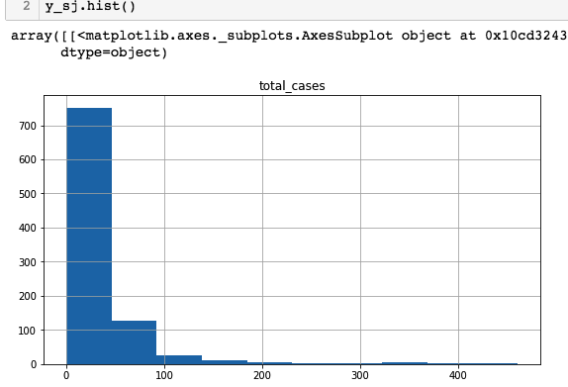
Model – Negative Binomial Regression

Slide 18
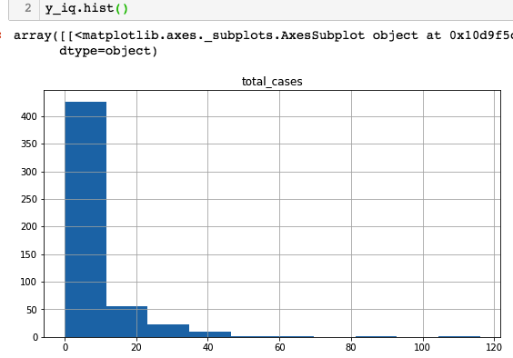
Model – Negative Binomial Regression

Slide 19
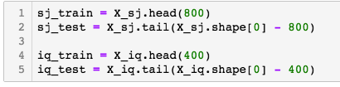
Model – Negative Binomial Regression

Slide 20
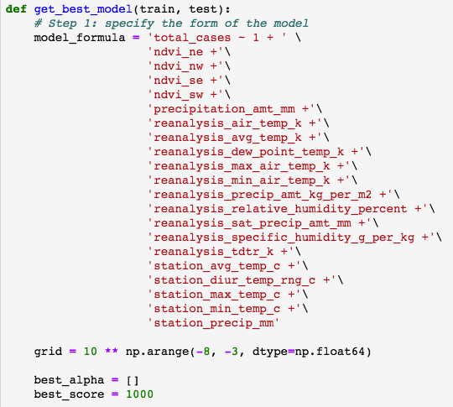
Model – Negative Binomial Regression

Slide 21
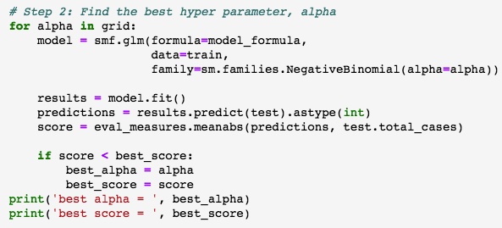
Model – Negative Binomial Regression

Slide 22
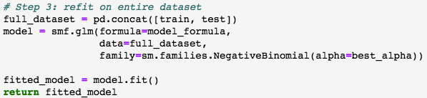
Model – Negative Binomial Regression

Slide 23

Model – Negative Binomial Regression
- Best score for San Juan is 23.3
- Best score for iquitos is 7.0

Slide 24
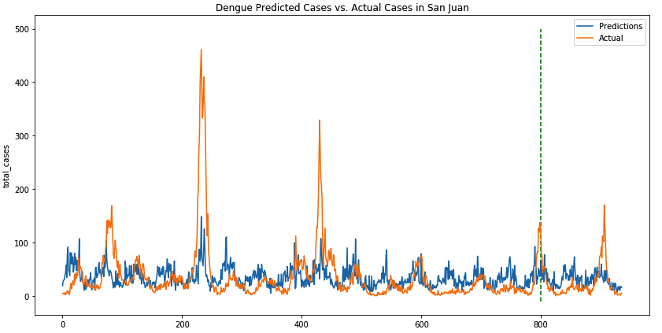
Model – Negative Binomial Regression
Train
Test

Slide 25
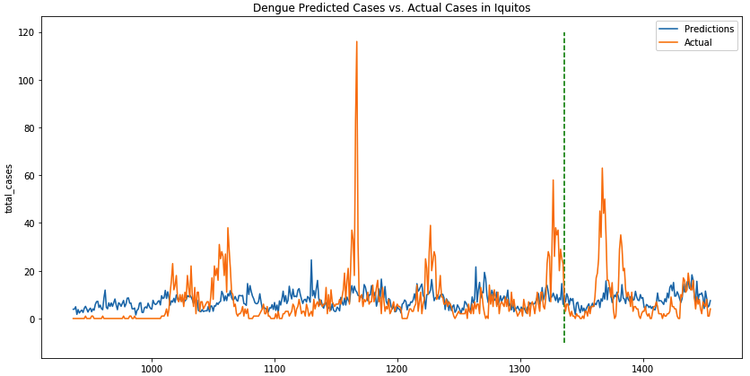
Model – Negative Binomial Regression
Train
Test

Slide 26
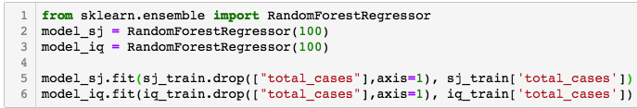
Model – Random Forest
- Best score for San Juan is 12.8
- Best score for iquitos is 3.7

Slide 27
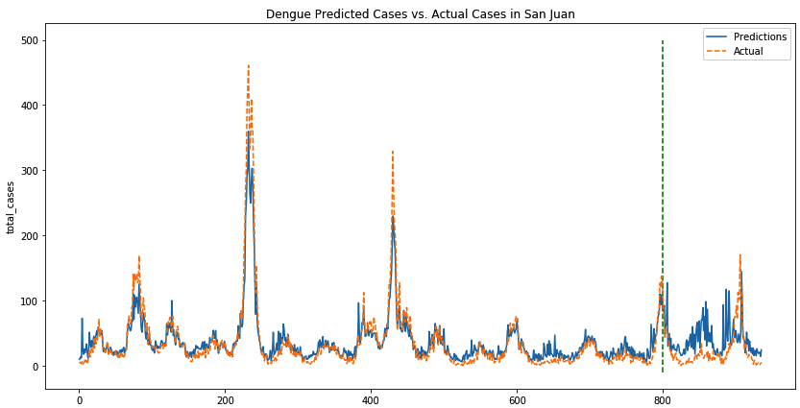
Model – Random Forest
Train
Test

Slide 28
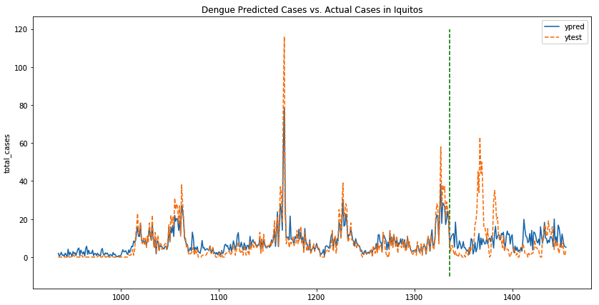
Model – Random Forest
Train
Test

Slide 29
Thanks

Slide 31
Correlation Analysis
- The reanalysis specific humidity and reanalysis dew point temperature were the most strongly correlated with total cases. This supported the assumption that mosquitoes thrive in wet climates, which could lead to more dengue cases.
- Temperature and total dengue cases showed positive correlation, indicating higher cases of dengue during warm weather.
- In general, the precipitation measurements had weak correlation to total cases.

Slide 32
Variable Rescaling
The wide variation in the value ranges resulted from the use of different scale, and necessitated rescaling to avoid biasing the data models. All fields were brought to comparable scales, such as °C for temperature and mm for precipitation.

