Slide 1
House Stark
Amir
Xinly

Slide 2



Introduction
Vanguard Digital Interface Experiment: User Completion and Engagement Analysis
New Website Feature Launch
A/B Test Period: March 15, 2017 – June 20, 2017.
Client Groups:
Control Group: Used the existing feature.
Test Group: Used the new feature.
Test
Session = visit_id
Device = visitor_id

Slide 3

Data Overview
.
Null values
& incorrect values
Merging data sets
Formatting
Final sample
Formatted and standardized the data.
Removed null entries and corrected inaccuracies.
Total: 50,488 clients
Divided into two groups: Test and Control.
Merging digital footprints into one dataset.

Slide 4
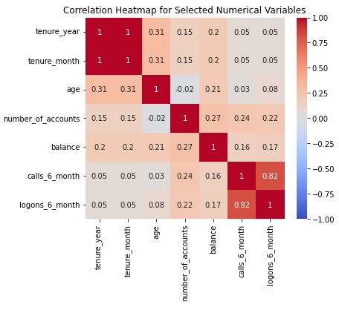
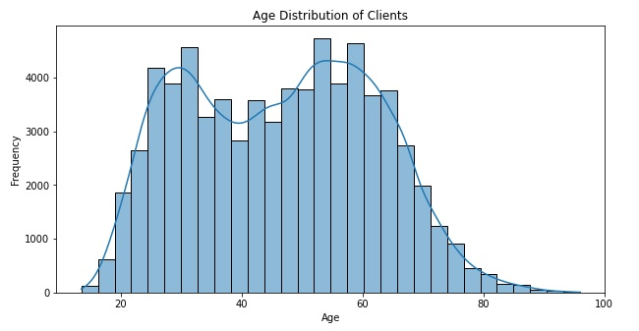
Exploratory data analysis

Slide 5
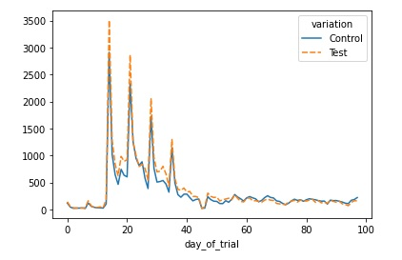
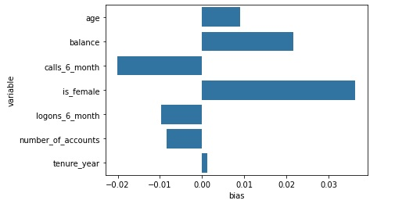
Evaluation of the experiment
Biases
Duration
Overall, the bias is within acceptable limits for the experiment.
No Sample Selection Bias.
Significant rise in user access after the first two weeks.
Noticeable spikes in April, likely due to the U.S. federal income tax filing deadline.

Slide 6
Key performance indicators (KPIs) & Metrics
Completion rate:
The percentage of users who successfully reach the final “confirm” step.
Average time:
Measures the average time users take to move from one step to the next.
Calls vs logins rate:
Measures the average of calls by client for each login.

Slide 7
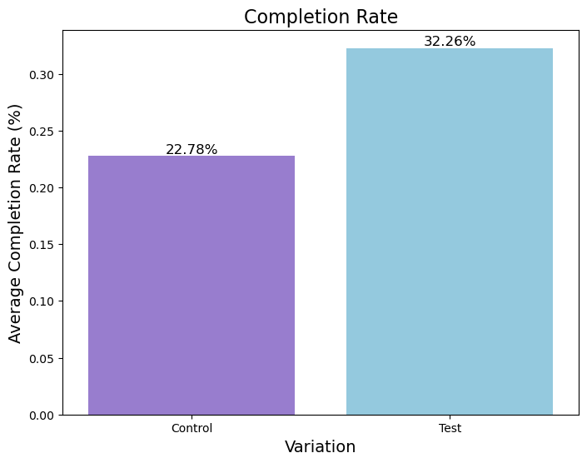
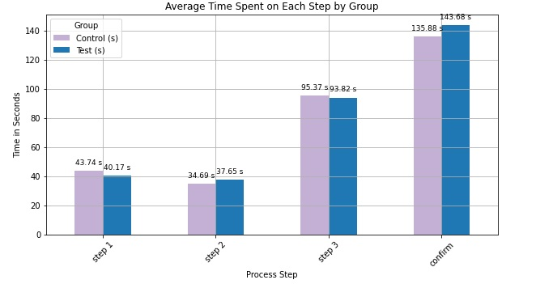


Key Performance Indicators (KPIs) & Metrics
Completion rate
Average time
315 s
309 s
Test
Control

Slide 8
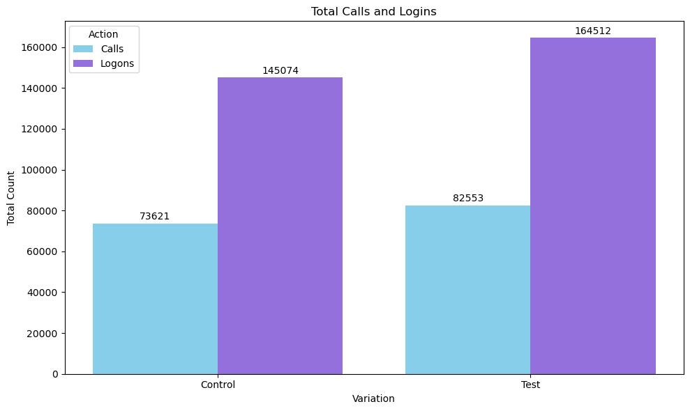
Key Performance Indicators (KPIs) & Metrics
Calls vs logins rate
Test
51% calls
Control
50% calls

Slide 9
Hypothesis Testing

Slide 10
The new feature is expected to motivate more clients to complete the process?
KPI: Completion rate.
Chi-Squared Statistic: 853.289.
P-value: 1.4010802466791885e-187.
H0 : No significant difference in completion rates between the Control and Test groups.
H1 : There is a significant increase in completion rates for the Test group.
There is a statistically significant improvement in completion rates for the Test group compared to the Control group.

Slide 11
Does the new feature reduce time spent on each step?
KPI: Time spent on each step
Average Time per Step:
Control: 77.42 sec Test: 78.33 sec.
Total Time Spent:
Control: 309.68 sec Test: 315.32 sec.
H0: There is no significant difference in the time spent in each step of the process between the control group and the test group .
H1: The new design significantly reduces the time spent in each step of the process compared to the old design.
The average time spent on the new design is significantly different from the old design.

Slide 12
Test group clients will have more interactions (logins and calls), indicating greater engagement and independence?
KPI: Calls vs logins rate.
T-statistic for Calls: 3.4466
P-value: 0.0006
H0: No significant difference in logon-to-call ratio between Control and Test groups.
H1: The Test group shows a higher logon-to-call ratio, indicating greater user independence.
There is a significant difference in the logons to calls ratio between the Test and Control groups.

Slide 13
Challenges & Learnings
Handling multiple sessions per user and ensuring that the completion rate is calculated per session, not just per user.
Selecting the right hypothesis test for comparing completion rates and interaction ratios.
Gaining proficiency with Tableau for data visualization took some time, especially in designing interactive dashboards.

Slide 14
Conclusion
Users may need time to adapt to the new layout, which is expected to reduce the time spent on each step over time.
The new feature increased the completion rate by 10%, surpassing the 5% threshold.
The ratio of logons to calls in the Test group suggests that clients in this group were more independent, relying less on customer support.

Slide 15
Tableau Visualizations
Please click on the link below
https://public.tableau.com/app/profile/xinly.roy/viz/Vanguard_DB/Dash-Demog?publish=yes

Slide 16
THANKS!
Amir
Xinly

