Slide 1
Cluster Growth using the DLA Model
By Tahoe, Ksenia, and Xinmeng

Slide 2
In this presentation:
2D Random Walks
The 1D Diffusion Equation
Diffusion Limited Aggregation Model for Cluster Growth

Slide 3
2D Random Walks

Slide 4
ADD STUFF HERE

Slide 5
Add PLOTS

Slide 6
1D Diffusion Equation Solver

Slide 7






Modelling the Equation
Differential Form
Finite Difference Form
Time dependent diff. eq.
For a box density, later solutions should be Gaussian
Convert to an iterable form
Algebraically manipulate formal derivatives
For our purposes, D=2 and stability is guaranteed by

Slide 8

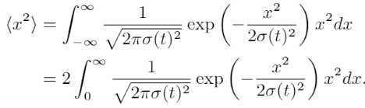


Variance of a Gaussian – Quick Proof
Expectation values are of the form:
Thus, after using the fact that we are dealing with an even function
After a change of variable
Finally, after integrating by parts:

Slide 9
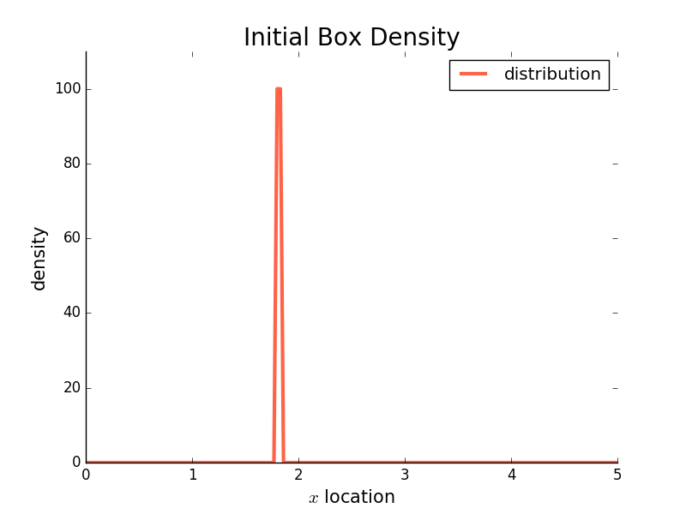
Initial Distribution
Important to put the box density far from the edges, otherwise you will affect the Gaussian and make it lopsided.

Slide 10
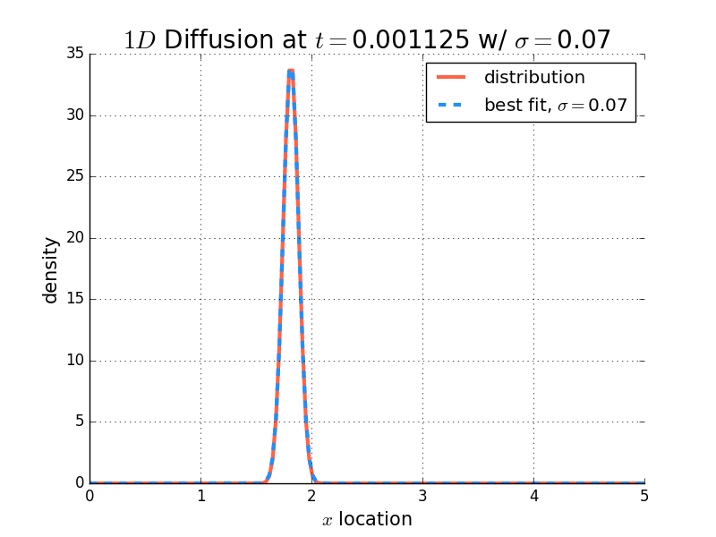
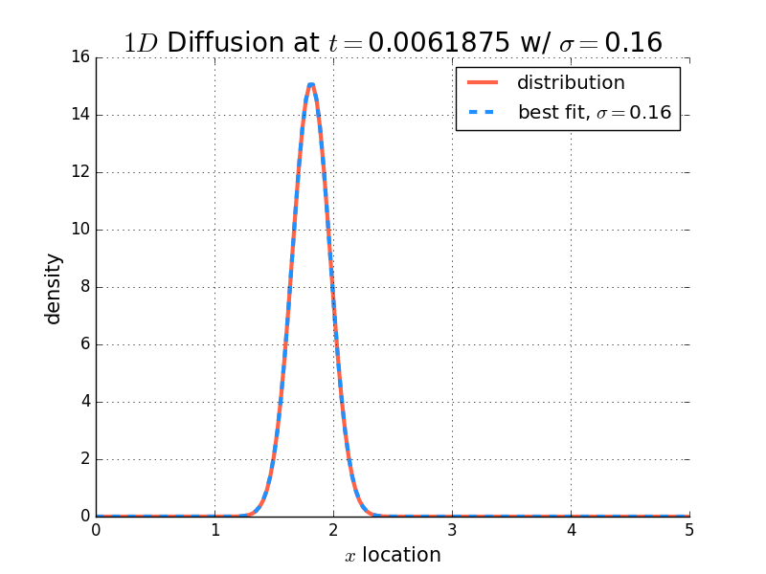
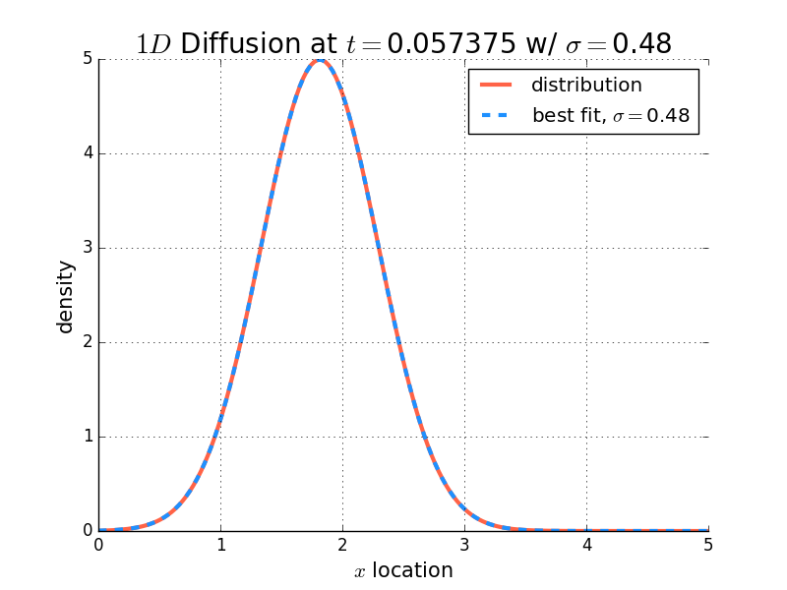
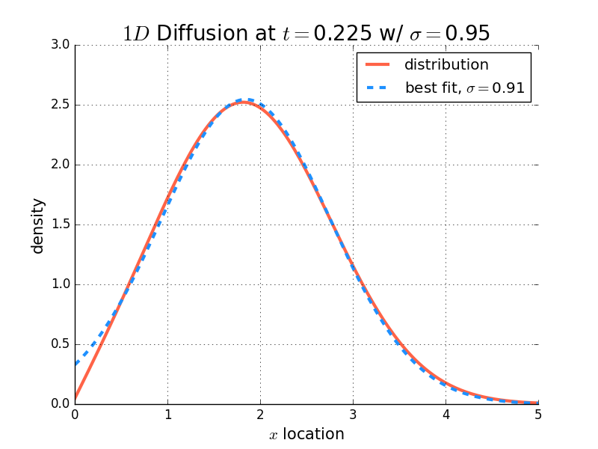

Four Evolutions in Time
A sigma fit was performed for each time snapshot, and they match very well with the expected:
Note: Edge effects distorting the fit at later times.

Slide 11
Cluster Growth using DLA

Slide 12
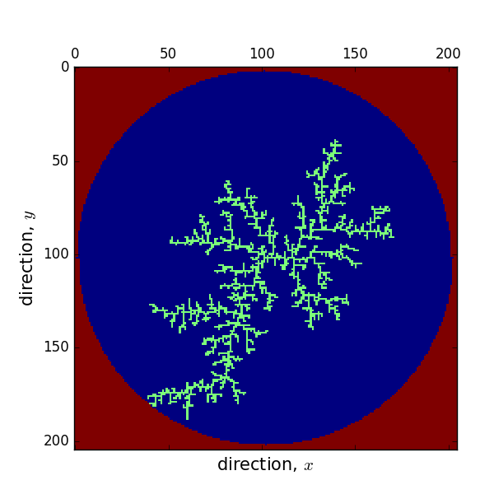

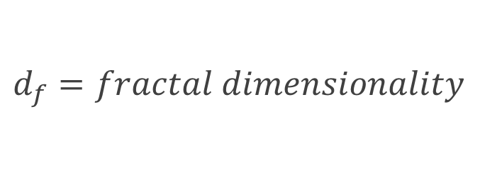
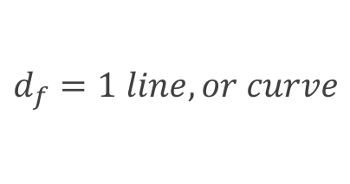
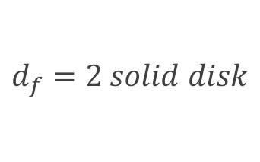
DLA Cluster
Many large open spaces, irregular perimeter
$$\text{m}\text{(}\text{r}\text{)}\sim r^{d_{f}}$$
$$d_{f}=fractal dimensionality$$
$$d_{f}=1 line, or curve$$
$$d_{f}=2 solid disk$$

Slide 13
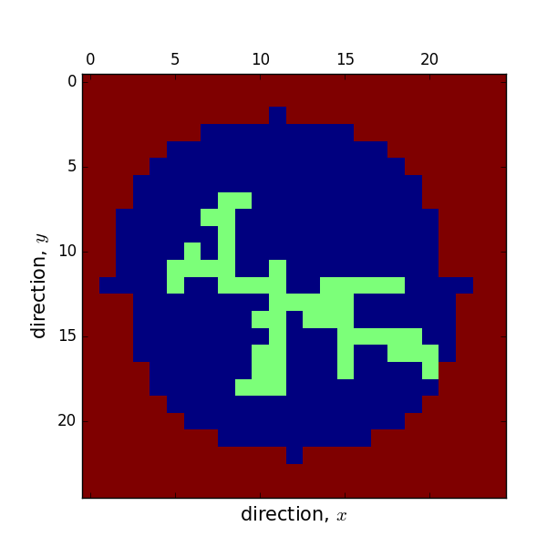
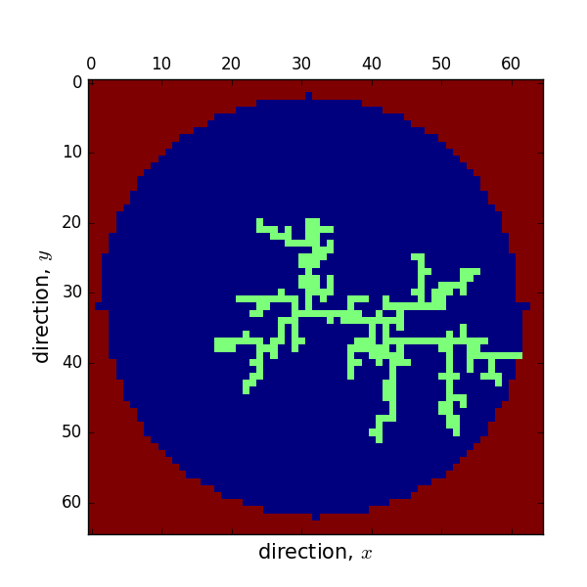
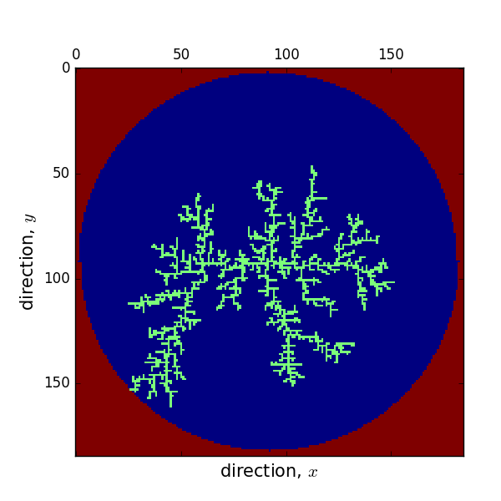

Slide 14
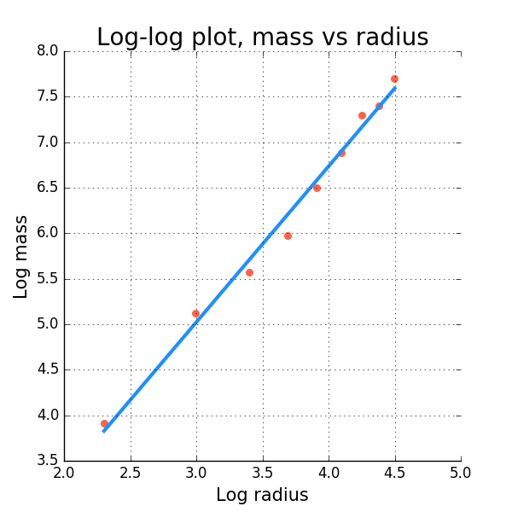


Fractal dimensionality
$$\log{m=d_{f}log⁡(r)}$$
In 10 runs fractal dimensionality:
2.067, 1.653, 1.877, 1.833, 1.607, 1.832,1.782, 1.712, 1.843, 1.862
$$d_{f}=\text{1.712}$$
mean=1.807

Slide 15
Thank you for your time!

