Slide 1

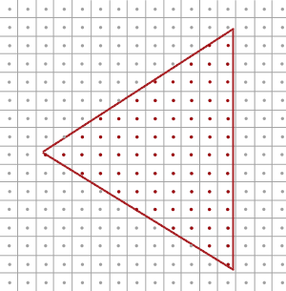
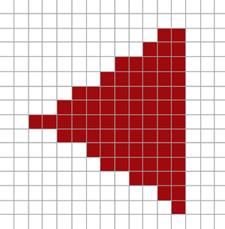
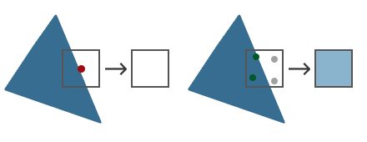
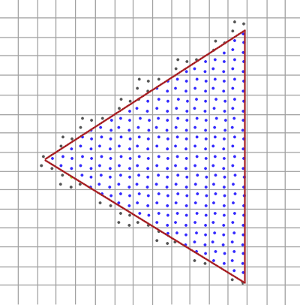
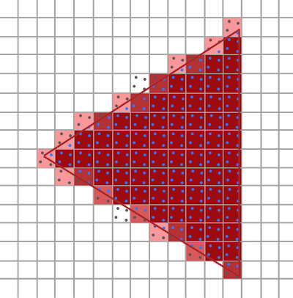
抗锯齿(Anti Aliasing)
超采样抗锯齿(Super Sample Anti-aliasing, SSAA)技术：
使用比正常分辨率更高的分辨率（即超采样）来渲染场景，当图像输出在帧缓冲中更新时，分辨率会被下采样(Downsample)至正常的分辨率。这些额外的分辨率会被用来防止锯齿边缘的产生。
多重采样(Multisampling)
每个像素的中心包含有一个采样点(Sample Point)，它会被用来决定这个三角形是否遮盖了某个像素
多重采样所做的正是将单一的采样点变为多个采样点
采样点的数量可以是任意的，更多的采样点能带来更精确的遮盖率
glfwWindowHint(GLFW_SAMPLES, 4);
glEnable(GL_MULTISAMPLE);

Slide 2
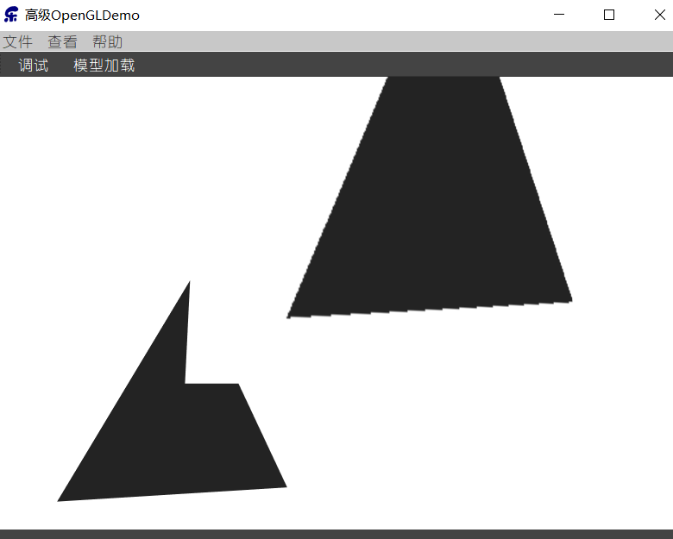
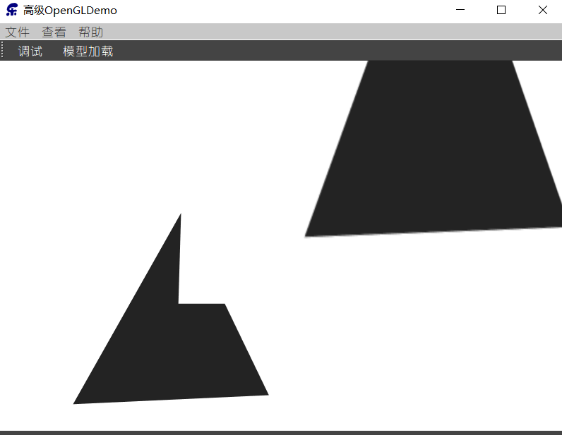
离屏MSAA
如果想要使用自己的帧缓冲来进行离屏渲染，那么就必须要自己动手生成多重采样缓冲：
将纹理渲染到multiSamples帧缓冲
将multiSamples帧缓冲中的纹理赋值给另一个自定义帧缓冲
使用另一个自定帧缓冲中的纹理附件作为mesh的纹理，进行绘制
// configure MSAA framebuffer // --------------------------
unsigned int framebuffer;
glGenFramebuffers(1, &framebuffer);
glBindFramebuffer(GL_FRAMEBUFFER, framebuffer);
// create a multisampled color attachment texture
unsigned int textureColorBufferMultiSampled;
glGenTextures(1, &textureColorBufferMultiSampled);
glBindTexture(GL_TEXTURE_2D_MULTISAMPLE, textureColorBufferMultiSampled);
glTexImage2DMultisample(GL_TEXTURE_2D_MULTISAMPLE, 4, GL_RGB, SCR_WIDTH, SCR_HEIGHT, GL_TRUE);
glBindTexture(GL_TEXTURE_2D_MULTISAMPLE, 0);
glFramebufferTexture2D(GL_FRAMEBUFFER, GL_COLOR_ATTACHMENT0, GL_TEXTURE_2D_MULTISAMPLE, textureColorBufferMultiSampled, 0);
// create a (also multisampled) renderbuffer object for depth and stencil attachments
unsigned int rbo;
glGenRenderbuffers(1, &rbo);
glBindRenderbuffer(GL_RENDERBUFFER, rbo);
glRenderbufferStorageMultisample(GL_RENDERBUFFER, 4, GL_DEPTH24_STENCIL8, SCR_WIDTH, SCR_HEIGHT);
glBindRenderbuffer(GL_RENDERBUFFER, 0);
glFramebufferRenderbuffer(GL_FRAMEBUFFER, GL_DEPTH_STENCIL_ATTACHMENT, GL_RENDERBUFFER, rbo);
// configure second post-processing framebuffer
unsigned int intermediateFBO;
glGenFramebuffers(1, &intermediateFBO);
glBindFramebuffer(GL_FRAMEBUFFER, intermediateFBO);
// create a color attachment texture
unsigned int screenTexture; glGenTextures(1, &screenTexture);
glBindTexture(GL_TEXTURE_2D, screenTexture);
glTexImage2D(GL_TEXTURE_2D, 0, GL_RGB, SCR_WIDTH, SCR_HEIGHT, 0, GL_RGB, GL_UNSIGNED_BYTE, NULL);
glTexParameteri(GL_TEXTURE_2D, GL_TEXTURE_MIN_FILTER, GL_LINEAR);
glTexParameteri(GL_TEXTURE_2D, GL_TEXTURE_MAG_FILTER, GL_LINEAR);
glFramebufferTexture2D(GL_FRAMEBUFFER, GL_COLOR_ATTACHMENT0, GL_TEXTURE_2D, screenTexture, 0);

Slide 3
// 1. draw scene as normal in multisampled buffers
glBindFramebuffer(GL_FRAMEBUFFER, framebuffer);
glClearColor(0.1f, 0.1f, 0.1f, 1.0f);
glClear(GL_COLOR_BUFFER_BIT | GL_DEPTH_BUFFER_BIT);
glEnable(GL_DEPTH_TEST);
// set transformation matrices
shader.use();
shader.setMat4("projection", projection);
shader.setMat4("view", camera.GetViewMatrix());
shader.setMat4("model", glm::mat4(1.0f));
glBindVertexArray(cubeVAO);
glDrawArrays(GL_TRIANGLES, 0, 36);
// 2. now blit multisampled buffer(s) to normal colorbuffer of intermediate FBO. Image is stored in screenTexture
glBindFramebuffer(GL_READ_FRAMEBUFFER, framebuffer);
glBindFramebuffer(GL_DRAW_FRAMEBUFFER, intermediateFBO);
glBlitFramebuffer(0, 0, SCR_WIDTH, SCR_HEIGHT, 0, 0, SCR_WIDTH, SCR_HEIGHT, GL_COLOR_BUFFER_BIT, GL_NEAREST);
// 3. now render quad with scene's visuals as its texture image
glBindFramebuffer(GL_FRAMEBUFFER, 0);
glClearColor(1.0f, 1.0f, 1.0f, 1.0f);
glClear(GL_COLOR_BUFFER_BIT);
glDisable(GL_DEPTH_TEST);
// draw Screen quad
screenShader.use();
glBindVertexArray(quadVAO);
glActiveTexture(GL_TEXTURE0);
glBindTexture(GL_TEXTURE_2D, screenTexture); // use the now resolved color attachment as the quad's texture
glDrawArrays(GL_TRIANGLES, 0, 6);
将纹理渲染到multiSamples帧缓冲
将multiSamples帧缓冲中的纹理赋值给另一个自定义帧缓冲
使用另一个自定帧缓冲中的纹理附件作为mesh的纹理，进行绘制
#version 330 core out vec4 FragColor;
in vec2 TexCoords;
uniform sampler2D screenTexture;
void main() {
vec3 col = texture(screenTexture, TexCoords).rgb;
float grayscale = 0.2126 * col.r + 0.7152 * col.g + 0.0722 * col.b;
FragColor = vec4(vec3(grayscale), 1.0);
}

