Slide 1
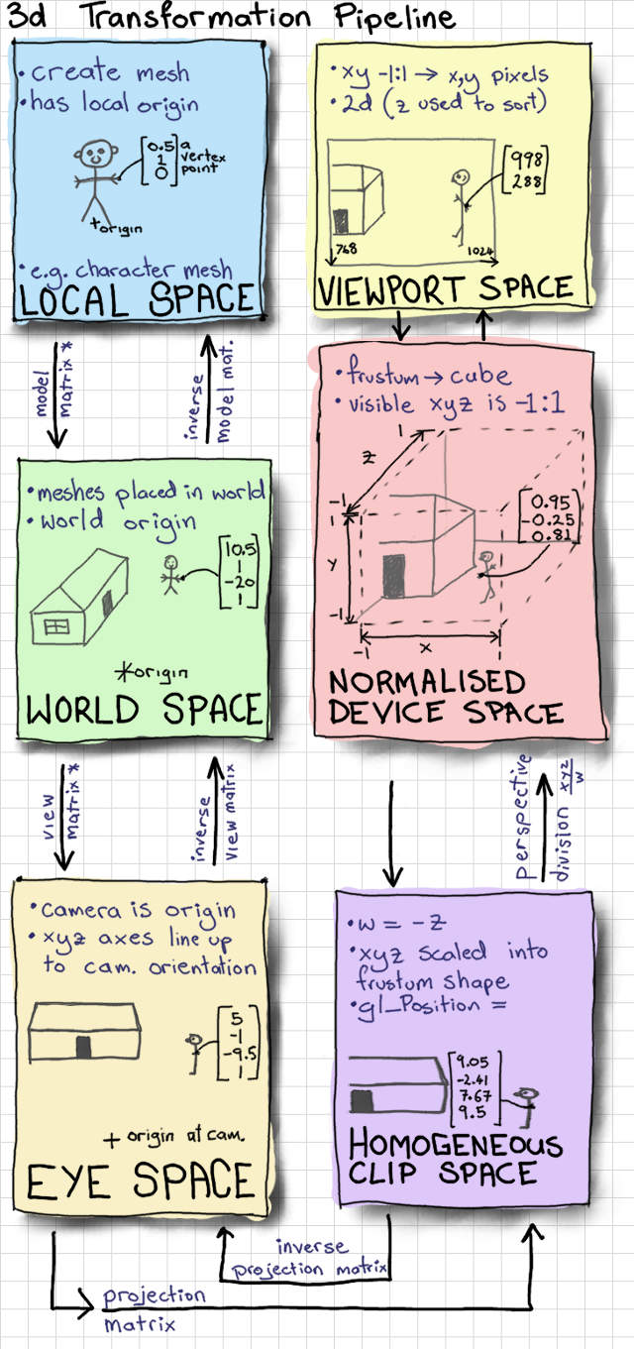
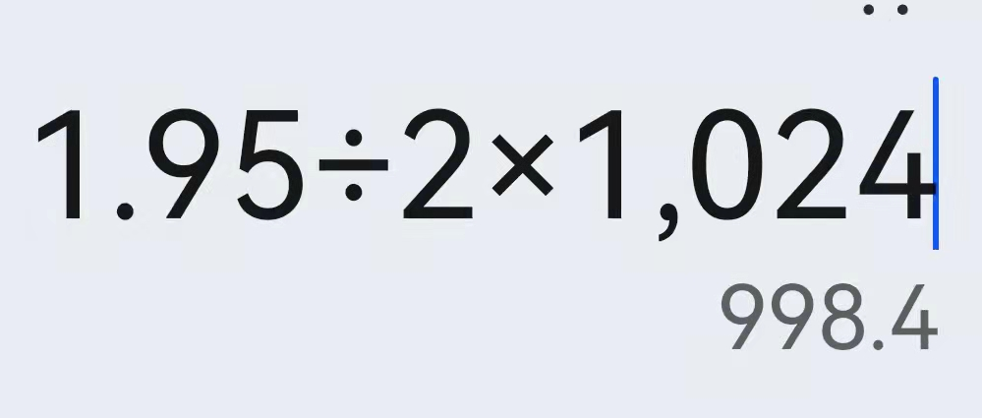
通过鼠标选择模型（理论基础）
网站地址：Mouse Picking with Ray Casting - Anton's OpenGL 4 Tutorials (antongerdelan.net)
float x = (2.0f * mouse_x) / width - 1.0f;
float y = 1.0f - (2.0f * mouse_y) / height;
glReadPixels - OpenGL 4 Reference Pages (khronos.org)
void glReadPixels( | GLint x,
 | GLint y,
 | GLsizei width,
 | GLsizei height,
 | GLenum format,
 | GLenum type,
 | void * data);
GL_DEPTH_COMPONENT
Specify the dimensions of the pixel rectangle. width and height of one correspond to a single pixel.
glReadPixels(
(int)mouse_x,
600-(int)mouse_y,
1,
1,
GL_DEPTH_COMPONENT,
GL_FLOAT,
&mouse_z
);
float z=2.0*mouse_z-1.0f;
//float w = (2.0 * near * far) / (far + near - z * (far - near));
float w=near*far/(near*winZ-far*mouse_z+far);

Slide 2
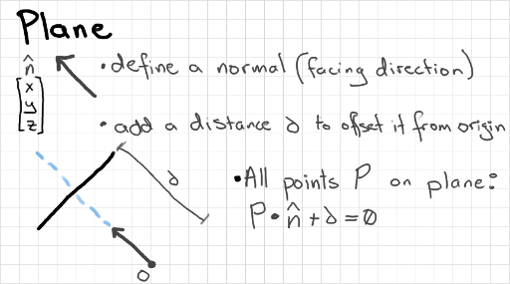
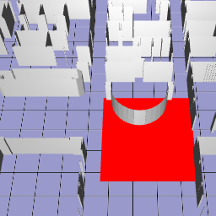
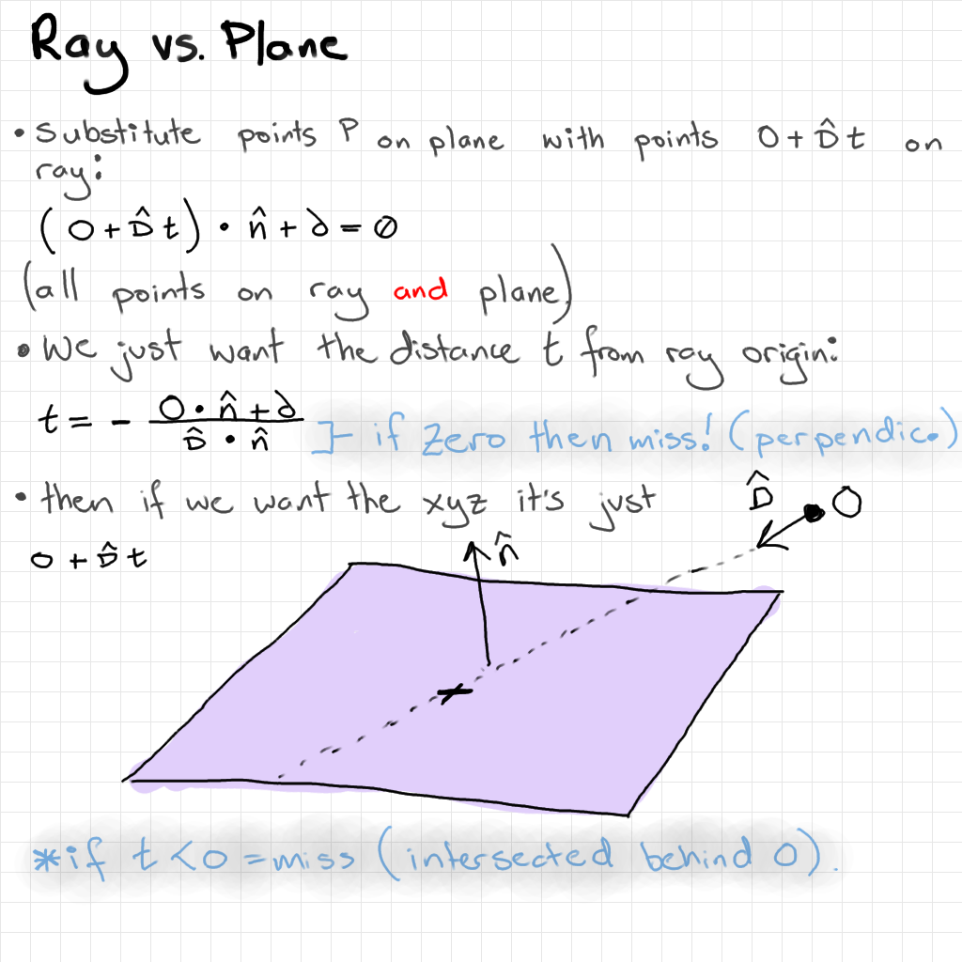
I do 2 ray-plane intersections to get the top-left and bottom-right corners of the box in xyz world coordinates.

Slide 3
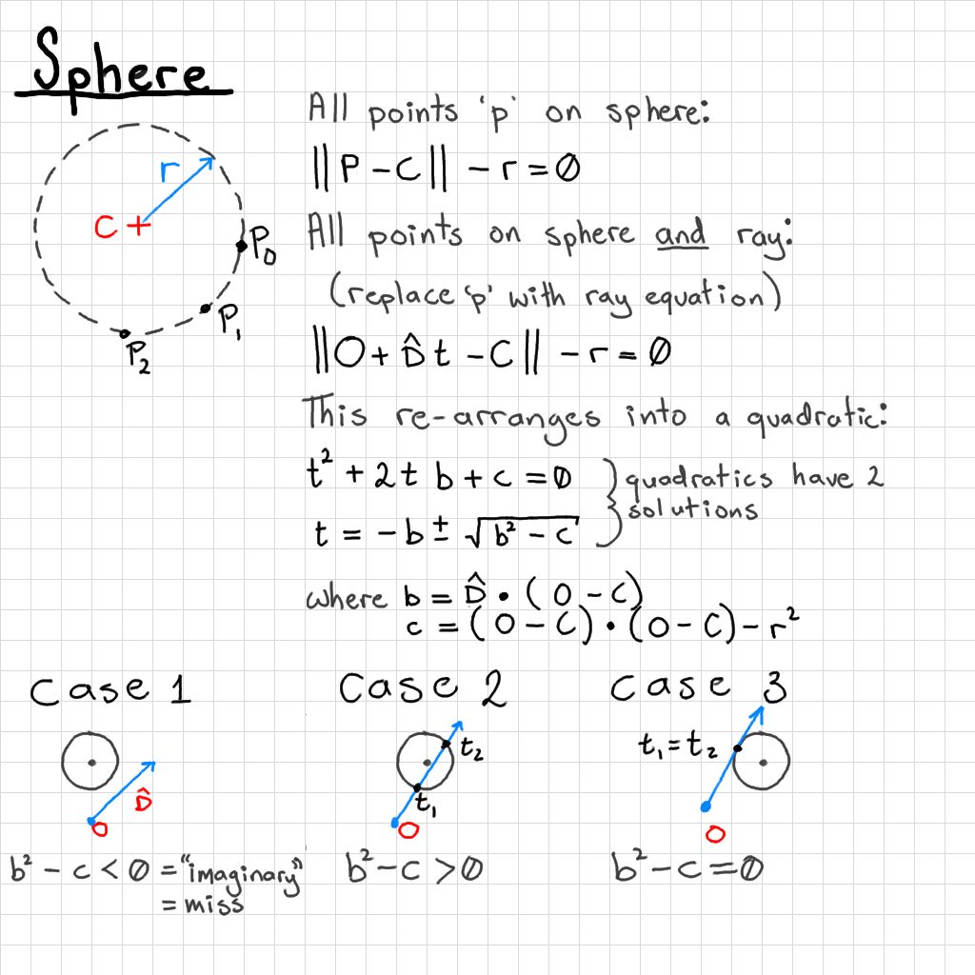

Slide 4
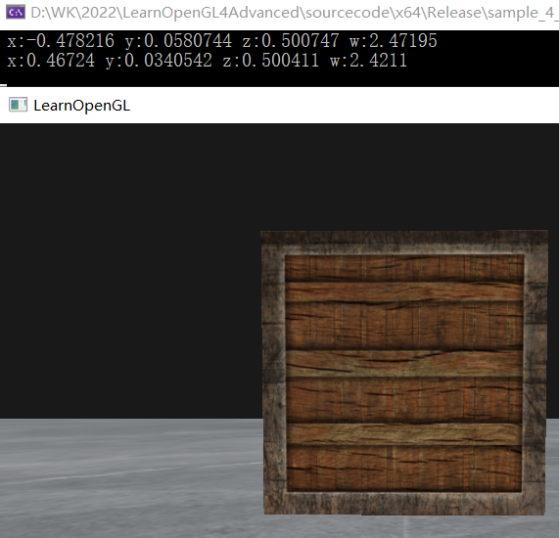
鼠标拾取
通过点击鼠标右键，击中的世界坐标。
glfwSetMouseButtonCallback(window, mouseClick_callback);
… …
void mouseClick_callback(GLFWwindow* window, int button, int action, int mods){
if ((action== GLFW_PRESS) && (button== GLFW_MOUSE_BUTTON_RIGHT)) {
double winX, winY;
float winZ;
glfwGetCursorPos(window, &winX, &winY);
glReadPixels(
(int)winX,
(int)SCR_HEIGHT - (int)winY
, 1, 1
, GL_DEPTH_COMPONENT, GL_FLOAT
, &winZ);
float x = (2.0f * winX) / SCR_WIDTH - 1.0f;
float y = 1.0f - (2.0f * winY) / SCR_HEIGHT;
float z = winZ * 2.0 - 1.0f;
//有像素被点中
if (winZ < 1.0f) {
//float w = (2.0 * _near * _far) / (_far + _near - z * (_far - _near));
float w= _near*_far/(_near*winZ-_far*winZ+_far);
glm::vec4 wolrdPostion(x, y, z, 1);
wolrdPostion *= w;
wolrdPostion = glm::inverse(view) * glm::inverse(projection) * wolrdPostion;
cout << " x:" << wolrdPostion.r
<< " y:" << wolrdPostion.y
<< " z:" << wolrdPostion.z
<< " w:" << w << endl;
}
else {
cout << "没有像素被选中" << endl;;
}
}
}

