Slide 1
摄像机控制调整
目前的操作器，更适合第一人称视角的游戏，不适合模型控制。
void mouseClick_callback(GLFWwindow* window, int button, int action, int mods){
double winX, winY;
float winZ;
glfwGetCursorPos(window, &winX, &winY);
if ((action == GLFW_PRESS) && (button == GLFW_MOUSE_BUTTON_LEFT))
{
lastX = winX;
lastY = winY;
LeftButtonHolding = true; //只有按下鼠标右键时，才会改变摄像机角度
}else
LeftButtonHolding = false;
…
}
基于点击的位置进行旋转
void mouse_callback(GLFWwindow* window, double xposIn, double yposIn)
{
if (!LeftButtonHolding) return;
float xpos = static_cast<float>(xposIn);
float ypos = static_cast<float>(yposIn);
float xoffset = xpos - lastX;
float yoffset = lastY - ypos; // reversed since y-coordinates go from bottom to top
lastX = xpos;
lastY = ypos;
camera.ProcessMouseMovement(xoffset, yoffset);
}

Slide 2
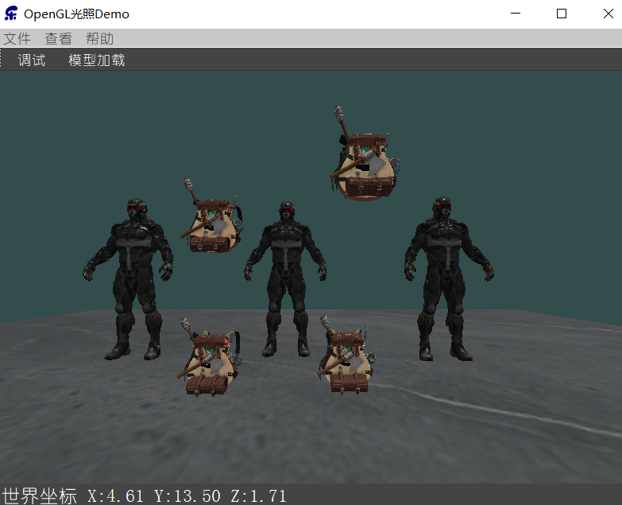
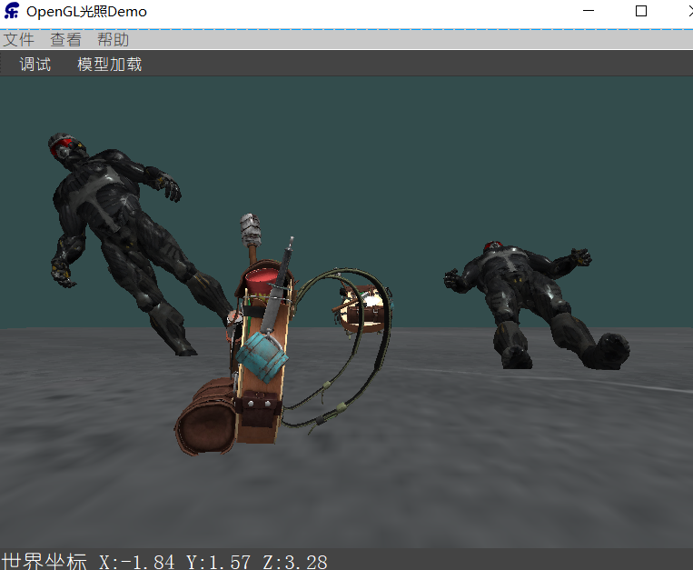
多模型加载
struct ModelInfo {
Model* model;
glm::vec3 worldPos;
float pitch;
float yaw;
float roll;
bool isSelected;
string name;
};
map<string, ModelInfo> _Models;
多模型加载：
Model Zhang3 = Model("../resources/backpack/backpack.obj");
_Models["zhang3"]= ModelInfo{ &Zhang3,glm::vec3(-3,0,0),0.0,0.0,0.0,false,"Zhang3" };
Model Li4 = Model("../resources/backpack/backpack.obj");
_Models["Li4"] = ModelInfo{ &Li4,glm::vec3(3,0,0),0.0,0.0,0.0,false,"Li4" };
绘制模型：
map<string, ModelInfo>::iterator _modelsIter;
for (_modelsIter = _Models.begin(); _modelsIter != _Models.end(); _modelsIter++)
{
model = glm::mat4(1.0f);
model = glm::translate(model, _modelsIter->second.worldPos);
model = glm::rotate(model, _modelsIter->second.pitch,glm::vec3(1.0f,0.0f,0.0f));
model = glm::rotate(model, _modelsIter->second.yaw, glm::vec3(0.0f, 1.0f, 0.0f));
model = glm::rotate(model, _modelsIter->second.roll, glm::vec3(0.0f, 0.0f, 1.0f));
shader.setMat4("model",model);
_modelsIter->second.model->Draw(shader);
}
glm::vec3 worldPosFromViewPort(int winX, int winY) {
float winZ;
glReadPixels(winX,(int)SCR_HEIGHT - winY, 1, 1, GL_DEPTH_COMPONENT, GL_FLOAT, &winZ);
float x = (2.0f * (float)winX) / SCR_WIDTH - 1.0f;
float y = 1.0f - (2.0f * (float)winY) / SCR_HEIGHT;
float z = winZ * 2.0f - 1.0f;
//有像素被点中
//float w = (2.0 * _near * _far) / (_far + _near - z * (_far - _near));
float w = _near * _far / (_near * winZ - _far * winZ + _far);
glm::vec4 wolrdPostion(x, y, z, 1);
wolrdPostion *= w;
wolrdPostion = glm::inverse(view) * glm::inverse(projection) * wolrdPostion;
return wolrdPostion;
}
从窗口坐标到世界坐标

Slide 3
点击选择模型
void mouseClick_callback(GLFWwindow* window, int button, int action, int mods) {
double winX, winY;
glfwGetCursorPos(window, &winX, &winY);
……
if ((action == GLFW_PRESS) && (button == GLFW_MOUSE_BUTTON_RIGHT)) {
RightButtonHolding = true;
glm::vec3 wolrdPostion = worldPosFromViewPort((int)winX,(int)winY);
for (map<string, ModelInfo>::iterator _modelsIter = _Models.begin();
_modelsIter != _Models.end(); _modelsIter++)
{
float _distance = glm::distance(_modelsIter->second.worldPos, glm::vec3(wolrdPostion));
if (_distance < 2.5) {
cout << _modelsIter->first << "模型被选中..." << endl;
_modelsIter->second.isSelected = true;
break;
}
else
_modelsIter->second.isSelected = false;
}
}
else
RightButtonHolding = false;
}
void mouse_callback(GLFWwindow* window, double xposIn, double yposIn)
{
if (LeftButtonHolding) {
... ...
}
if (RightButtonHolding) {
for (map<string, ModelInfo>::iterator _modelsIter = _Models.begin();
_modelsIter != _Models.end(); _modelsIter++)
{
if (_modelsIter->second.isSelected) {
_modelsIter->second.worldPos = worldPosFromViewPort((int)xposIn,(int)yposIn);
break;
}
}
}
}
将视口坐标，转换为世界坐标，赋给拖动中的模型

Slide 4
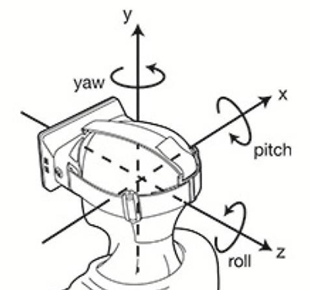
旋转
struct ModelInfo {
Model* model;
glm::vec3 worldPos;
float pitch;
float yaw;
float roll;
bool isSelected;
string name;
};
map<string, ModelInfo> _Models;

