Slide 1
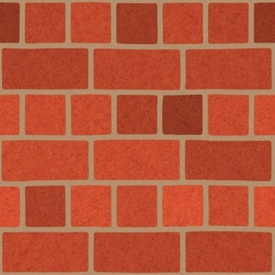
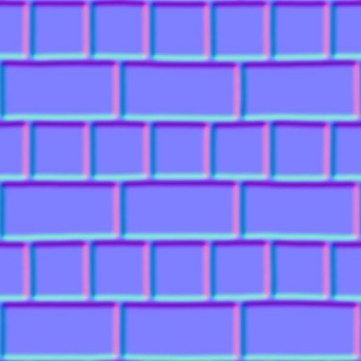
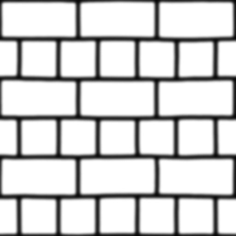
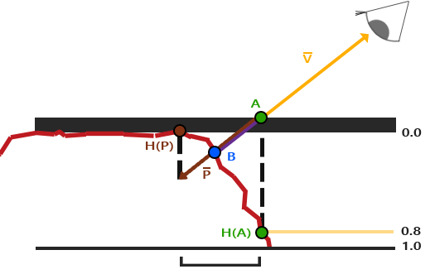
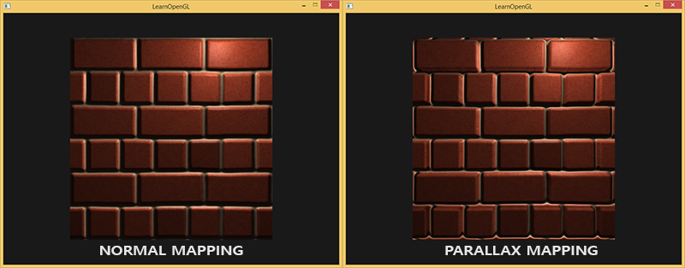
视差映射(Parallax Mapping)
法线贴图
高度贴图
#version 330 core
layout (location = 0) in vec3 aPos;
layout (location = 1) in vec3 aNormal;
layout (location = 2) in vec2 aTexCoords;
layout (location = 3) in vec3 aTangent;
layout (location = 4) in vec3 aBitangent;
out VS_OUT {
vec3 FragPos;
vec2 TexCoords;
vec3 TangentLightPos;
vec3 TangentViewPos;
vec3 TangentFragPos;
} vs_out;
uniform mat4 projection;
uniform mat4 view;
uniform mat4 model;
uniform vec3 lightPos;
uniform vec3 viewPos;
void main() {
gl_Position = projection * view * model * vec4(aPos, 1.0);
vs_out.FragPos = vec3(model * vec4(aPos, 1.0));
vs_out.TexCoords = aTexCoords;
vec3 T = normalize(mat3(model) * aTangent);
vec3 B = normalize(mat3(model) * aBitangent);
vec3 N = normalize(mat3(model) * aNormal);
mat3 TBN = transpose(mat3(T, B, N));
vs_out.TangentLightPos = TBN * lightPos;
vs_out.TangentViewPos = TBN * viewPos;
vs_out.TangentFragPos = TBN * vs_out.FragPos;
}
由于法线贴图通常是从高度贴图生成的，因此将法线贴图与高度贴图一起使用可确保照明与置换保持一致。
视差贴图在片段着色器中实现。在片段着色器中，需要计算片段到View的向量V，因此我们需要纹理空间中的Light的位置、View的位置和片段位置。

Slide 2
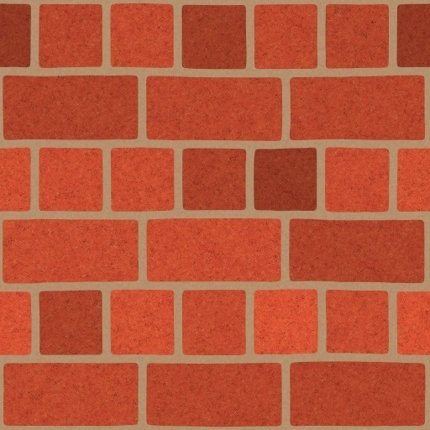
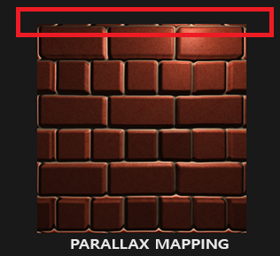
#version 330 core
out vec4 FragColor;
in VS_OUT {
vec3 FragPos;
vec2 TexCoords;
vec3 TangentLightPos;
vec3 TangentViewPos;
vec3 TangentFragPos;
} fs_in;
uniform sampler2D diffuseMap;
uniform sampler2D normalMap;
uniform sampler2D depthMap;
uniform float heightScale;
vec2 ParallaxMapping(vec2 texCoords, vec3 viewDir) {
float height = texture(depthMap, texCoords).r;
return texCoords - viewDir.xy * (height * heightScale);
}
void main() {
// offset texture coordinates with Parallax Mapping
vec3 viewDir = normalize(fs_in.TangentViewPos - fs_in.TangentFragPos);
vec2 texCoords = fs_in.TexCoords;
texCoords = ParallaxMapping(fs_in.TexCoords, viewDir);
if(texCoords.x > 1.0 || texCoords.y > 1.0 || texCoords.x < 0.0 || texCoords.y < 0.0)
discard;
// obtain normal from normal map
vec3 normal = texture(normalMap, texCoords).rgb;
normal = normalize(normal * 2.0 - 1.0);
// get diffuse color
vec3 color = texture(diffuseMap, texCoords).rgb;
// ambient
vec3 ambient = 0.1 * color;
// diffuse
vec3 lightDir = normalize(fs_in.TangentLightPos - fs_in.TangentFragPos);
float diff = max(dot(lightDir, normal), 0.0);
vec3 diffuse = diff * color;
// specular
vec3 reflectDir = reflect(-lightDir, normal);
vec3 halfwayDir = normalize(lightDir + viewDir);
float spec = pow(max(dot(normal, halfwayDir), 0.0), 32.0);
vec3 specular = vec3(0.2) * spec;
FragColor = vec4(ambient + diffuse + specular, 1.0);
}
viewDir.xy / viewDir.z

Slide 3
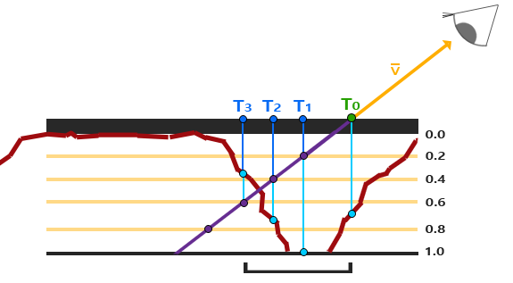
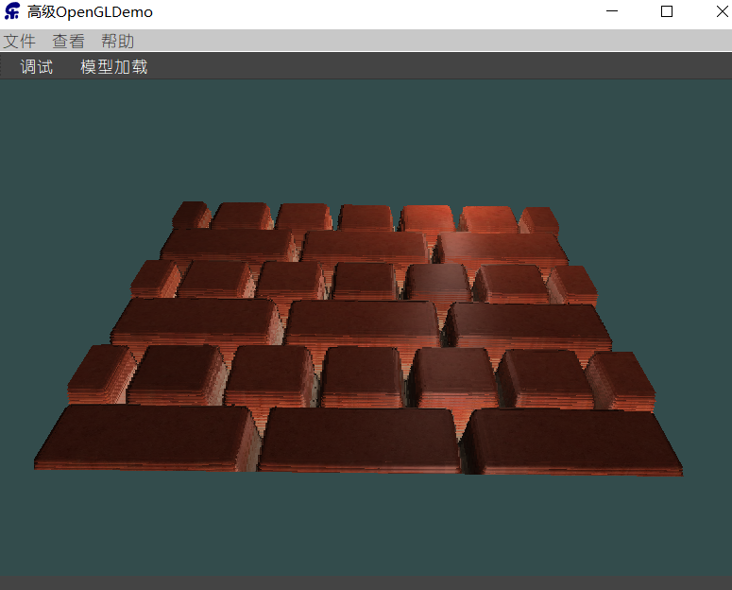
陡峭视差映射(Steep Parallax Mapping)
直到找到小于当前层深度值的采样深度值
是视差映射的扩展，但不是使用一个样本而是多个样本来确定向量。即使在陡峭的高度变化的情况下，它也能得到更好的结果，原因在于该技术通过增加采样的数量提高了精确性。
vec2 ParallaxMapping(vec2 texCoords, vec3 viewDir) {
// number of depth layers
const float minLayers = 8;
const float maxLayers = 32;
float numLayers = mix(maxLayers, minLayers, abs(dot(vec3(0.0, 0.0, 1.0), viewDir)));
// calculate the size of each layer
float layerDepth = 1.0 / numLayers;
// depth of current layer
float currentLayerDepth = 0.0;
// the amount to shift the texture coordinates per layer (from vector P)
vec2 P = viewDir.xy / viewDir.z * heightScale;
vec2 deltaTexCoords = P / numLayers;
// get initial values
vec2 currentTexCoords = texCoords;
float currentDepthMapValue = texture(depthMap, currentTexCoords).r;
while(currentLayerDepth < currentDepthMapValue) {
// shift texture coordinates along direction of P
currentTexCoords -= deltaTexCoords;
// get depthmap value at current texture coordinates
currentDepthMapValue = texture(depthMap, currentTexCoords).r;
// get depth of next layer
currentLayerDepth += layerDepth;
}
return currentTexCoords;
}

Slide 4
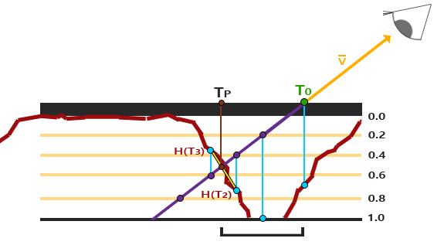
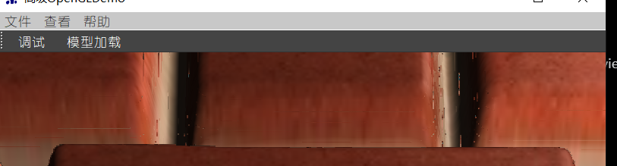







视差遮蔽映射(Parallax Occlusion Mapping)
在触碰之前和之后，在深度层之间进行线性插值
vec2 ParallaxMapping(vec2 texCoords, vec3 viewDir) {
// number of depth layers
const float minLayers = 8;
const float maxLayers = 32;
float numLayers = mix(maxLayers, minLayers, abs(dot(vec3(0.0, 0.0, 1.0), viewDir)));
// calculate the size of each layer
float layerDepth = 1.0 / numLayers;
// depth of current layer
float currentLayerDepth = 0.0;
// the amount to shift the texture coordinates per layer (from vector P)
vec2 P = viewDir.xy / viewDir.z * heightScale;
vec2 deltaTexCoords = P / numLayers;
// get initial values
vec2 currentTexCoords = texCoords;
float currentDepthMapValue = texture(depthMap, currentTexCoords).r; while(currentLayerDepth < currentDepthMapValue) {
// shift texture coordinates along direction of P
currentTexCoords -= deltaTexCoords;
// get depthmap value at current texture coordinates
currentDepthMapValue = texture(depthMap, currentTexCoords).r;
// get depth of next layer
currentLayerDepth += layerDepth;
} // get texture coordinates before collision (reverse operations)
vec2 prevTexCoords = currentTexCoords + deltaTexCoords;
// get depth after and before collision for linear interpolation
float afterDepth = currentDepthMapValue - currentLayerDepth;
float beforeDepth = texture(depthMap, prevTexCoords).r - currentLayerDepth + layerDepth;
// interpolation of texture coordinates
float weight = afterDepth / (afterDepth - beforeDepth);
vec2 finalTexCoords = prevTexCoords * weight + currentTexCoords * (1.0 - weight);
return finalTexCoords;
}

