Slide 1
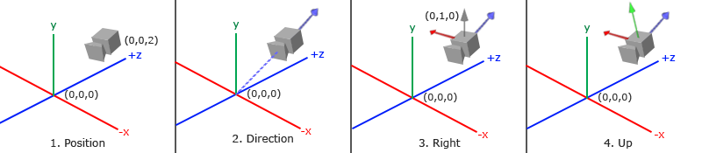
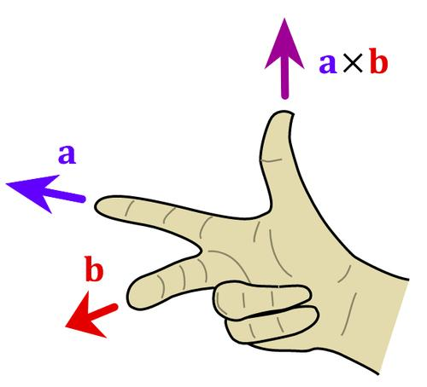
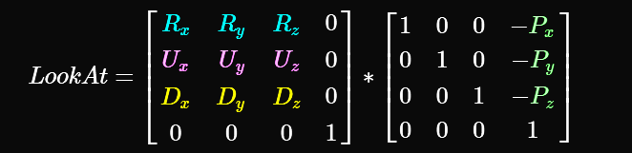
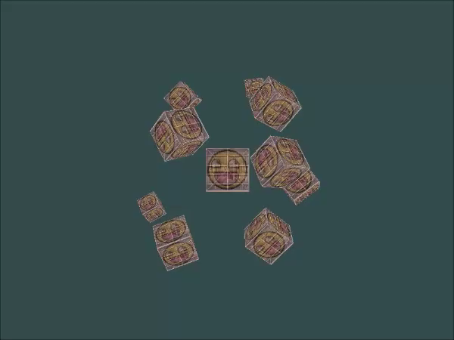

摄像机(Camera)
OpenGL本身没有摄像机(Camera)的定义，但我们可以通过把场景中的所有物体往相反方向移动的方式来模拟出摄像机，产生一种我们在移动的感觉。
以相机位置为原点，创建具有3个垂直单位轴的坐标系
方向向量并不是最好的名字，因为它实际上指向相反的方向
//1、摄像机位置P
glm::vec3 cameraPos = glm::vec3(0.0f, 0.0f, 3.0f);
//2、摄像机方向D
glm::vec3 cameraTarget = glm::vec3(0.0f, 0.0f, 0.0f);
glm::vec3 cameraDirection = glm::normalize(cameraPos - cameraTarget);
//3、右轴R
glm::vec3 up = glm::vec3(0.0f, 1.0f, 0.0f);
glm::vec3 cameraRight = glm::normalize(glm::cross(up, cameraDirection));
//4、上轴U
glm::vec3 cameraUp = glm::cross(cameraDirection, cameraRight);
我们只需要指定一个摄像机位置、一个目标位置和一个表示世界空间上的上方向向量的向量。
glm::mat4 view;
view = glm::lookAt(glm::vec3(0.0f, 0.0f, 3.0f), glm::vec3(0.0f, 0.0f, 0.0f), glm::vec3(0.0f, 1.0f, 0.0f));
const float radius = 10.0f;
float camX = sin(glfwGetTime()) * radius;
float camZ = cos(glfwGetTime()) * radius;
glm::mat4 view;
view = glm::lookAt(glm::vec3(camX, 0.0, camZ), glm::vec3(0.0, 0.0, 0.0), glm::vec3(0.0, 1.0, 0.0));

Slide 2

摄像机(Camera)移动
总是盯着一点看，看久了还是很乏味！希望能任意的拍摄。
在程序顶部定义一些摄像机变量非常有用：
glm::vec3 cameraPos = glm::vec3(0.0f, 0.0f, 3.0f);
glm::vec3 cameraFront = glm::vec3(0.0f, 0.0f, -1.0f);
glm::vec3 cameraUp = glm::vec3(0.0f, 1.0f, 0.0f);
view = glm::lookAt(cameraPos, cameraPos + cameraFront, cameraUp);
void processInput(GLFWwindow *window) {
...
const float cameraSpeed = 0.05f; // adjust accordingly
if (glfwGetKey(window, GLFW_KEY_W) == GLFW_PRESS)
cameraPos += cameraSpeed * cameraFront;
if (glfwGetKey(window, GLFW_KEY_S) == GLFW_PRESS)
cameraPos -= cameraSpeed * cameraFront;
if (glfwGetKey(window, GLFW_KEY_A) == GLFW_PRESS)
cameraPos -= glm::normalize(glm::cross(cameraFront, cameraUp)) * cameraSpeed;
if (glfwGetKey(window, GLFW_KEY_D) == GLFW_PRESS)
cameraPos += glm::normalize(glm::cross(cameraFront, cameraUp)) * cameraSpeed;
}
移动速度
目前还有个小问题，不同性能的机器，移动速度不同。
float deltaTime = 0.0f; // 距离上一帧的时间间隔
float lastFrame = 0.0f; // 上一帧发生的时间
float currentFrame = glfwGetTime();
deltaTime = currentFrame - lastFrame;
lastFrame = currentFrame;
void processInput(GLFWwindow *window) {
float cameraSpeed = 2.5f * deltaTime;
[...]
}

Slide 3
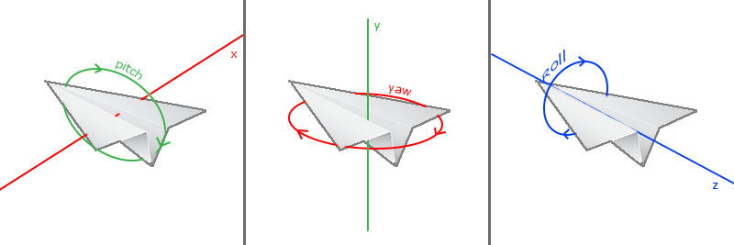
旋转
为了能够改变视角，我们需要根据鼠标的输入改变cameraFront向量
欧拉角(Euler Angle)：俯仰角(Pitch)、偏航角(Yaw)和滚转角(Roll)：
glfwSetCursorPosCallback(window, mouse_callback);
…
void mouse_callback(GLFWwindow* window, double xpos, double ypos) {
if (firstMouse) { lastX = xpos; lastY = ypos; firstMouse = false; }
float xoffset = xpos - lastX;
float yoffset = lastY - ypos;
lastX = xpos;
lastY = ypos;
float sensitivity = 0.1f;
xoffset *= sensitivity;
yoffset *= sensitivity;
yaw += xoffset;
pitch += yoffset;
if(pitch > 89.0f) pitch = 89.0f;
if(pitch < -89.0f) pitch = -89.0f;
glm::vec3 direction;
direction.x = cos(glm::radians(yaw)) * cos(glm::radians(pitch));
direction.y = sin(glm::radians(pitch));
direction.z = sin(glm::radians(yaw)) * cos(glm::radians(pitch));
cameraFront = glm::normalize(direction);
}
bool firstMouse = true;
float yaw = -90.0f;
float pitch = 0.0f;
float lastX = 800.0f / 2.0;
float lastY = 600.0 / 2.0;
缩放
视野(Field of View)或fov定义了可以看到场景中多大的范围。当视野变小时，场景投影出来的空间就会减小，产生放大(Zoom In)了的感觉。我们会使用鼠标的滚轮来放大。
glfwSetScrollCallback(window, scroll_callback);
…
void scroll_callback(GLFWwindow* window, double xoffset, double yoffset) {
fov -= (float)yoffset;
if (fov < 1.0f) fov = 1.0f;
if (fov > 45.0f) fov = 45.0f;
}

Slide 4
Camera封装
void processInput(GLFWwindow *window) {
…
if (glfwGetKey(window, GLFW_KEY_W) == GLFW_PRESS)
camera.ProcessKeyboard(FORWARD, deltaTime);
if (glfwGetKey(window, GLFW_KEY_S) == GLFW_PRESS)
camera.ProcessKeyboard(BACKWARD, deltaTime);
if (glfwGetKey(window, GLFW_KEY_A) == GLFW_PRESS)
camera.ProcessKeyboard(LEFT, deltaTime);
if (glfwGetKey(window, GLFW_KEY_D) == GLFW_PRESS)
camera.ProcessKeyboard(RIGHT, deltaTime);
}
void mouse_callback(GLFWwindow* window, double xposIn, double yposIn) {
float xpos = static_cast<float>(xposIn);
float ypos = static_cast<float>(yposIn);
if (firstMouse) {
lastX = xpos;
lastY = ypos;
firstMouse = false;
}
float xoffset = xpos - lastX;
float yoffset = lastY - ypos;
lastX = xpos;
lastY = ypos;
camera.ProcessMouseMovement(xoffset, yoffset);
}
void scroll_callback(GLFWwindow* window, double xoffset, double yoffset) {
camera.ProcessMouseScroll(static_cast<float>(yoffset));
}

Slide 5
练习
看看是否能够修改摄像机类，使得其能够变成一个真正的FPS摄像机（也就是说不能够随意飞行）；你只能够呆在xz平面上：参考解答
试着创建自己的LookAt函数，其中需要手动创建一个我们在一开始讨论的观察矩阵。用你的函数实现来替换LookAt函数，看看它是否还能一样地工作：参考解答
void ProcessKeyboard(Camera_Movement direction, float deltaTime) {
float velocity = MovementSpeed * deltaTime;
if (direction == FORWARD)
Position += Front * velocity;
if (direction == BACKWARD)
Position -= Front * velocity;
if (direction == LEFT)
Position -= Right * velocity;
if (direction == RIGHT)
Position += Right * velocity;
Position.y = 0.0f;
}
glm::mat4 calculate_lookAt_matrix(glm::vec3 position, glm::vec3 target, glm::vec3 worldUp) {
// 1. 位置 = 已知
// 2. 计算方向
glm::vec3 zaxis = glm::normalize(position - target);
// 3. 获取右轴
glm::vec3 xaxis = glm::normalize(glm::cross(glm::normalize(worldUp), zaxis));
// 4. 计算向上的向量
glm::vec3 yaxis = glm::cross(zaxis, xaxis);
// 创建位移和旋转矩阵
// 在GLM中，采用[col][row] 方式
glm::mat4 translation = glm::mat4(1.0f); // 初始化为4X4单位矩阵
translation[3][0] = -position.x; // 第四列第一行
translation[3][1] = -position.y;
translation[3][2] = -position.z;
glm::mat4 rotation = glm::mat4(1.0f);
rotation[0][0] = xaxis.x; // 第一列，第一行
rotation[1][0] = xaxis.y;
rotation[2][0] = xaxis.z;
rotation[0][1] = yaxis.x; // 第一列，第二行
rotation[1][1] = yaxis.y;
rotation[2][1] = yaxis.z;
rotation[0][2] = zaxis.x; // 第一列，第三行
rotation[1][2] = zaxis.y;
rotation[2][2] = zaxis.z;
return rotation * translation; // (先位移再旋转)
}
// 使用我们自定义的函数替换 glm::lookAt
// view = glm::lookAt(glm::vec3(camX, 0.0f, camZ), glm::vec3(0.0f, 0.0f, 0.0f), glm::vec3(0.0f, 1.0f, 0.0f));
view = calculate_lookAt_matrix(glm::vec3(camX, 0.0f, camZ),
glm::vec3(0.0f, 0.0f, 0.0f),
glm::vec3(0.0f, 1.0f, 0.0f));

