Slide 1
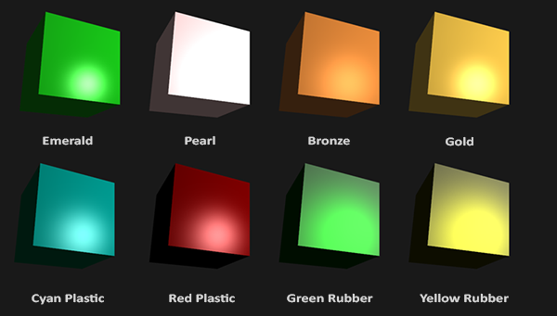
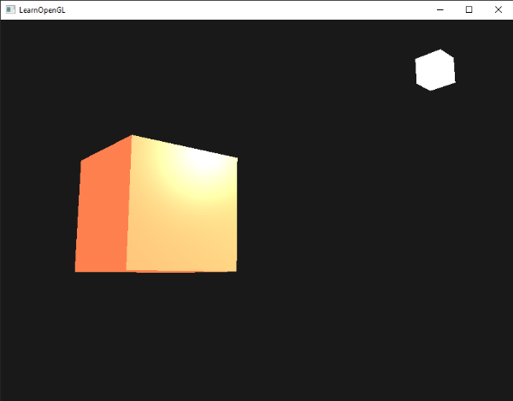
材质
在OpenGL中模拟多种类型的物体，必须为每种物体分别定义一个材质(Material)属性
#version 330 core
struct Material {
vec3 ambient;
vec3 diffuse;
vec3 specular;
float shininess;
};
uniform Material material;
主要用于替代前面的objectColor
在现实世界里，每个物体会对光产生不同的反应
ourShader.setVec3("material.ambient", 1.0f, 0.5f, 0.31f);
ourShader.setVec3("material.diffuse", 1.0f, 0.5f, 0.31f);
ourShader.setVec3("material.specular", 0.5f, 0.5f, 0.5f);
ourShader.setFloat("material.shininess", 32.0f);
void main() {
// ambient
vec3 ambient = lightColor * material.ambient;
// diffuse
vec3 norm = normalize(Normal);
vec3 lightDir = normalize(lightPos - FragPos);
float diff = max(dot(norm, lightDir), 0.0);
vec3 diffuse = lightColor * (diff * material.diffuse);
// specular
vec3 viewDir = normalize(viewPos - FragPos);
vec3 reflectDir = reflect(-lightDir, norm);
float spec = pow(max(dot(viewDir, reflectDir), 0.0), material.shininess);
vec3 specular = lightColor * (spec * material.specular);
vec3 result = ambient + diffuse + specular;
FragColor = vec4(result, 1.0);
}
这个物体太亮了。物体过亮的原因是环境光、漫反射和镜面光这三个颜色对任何一个光源都会去全力反射。

Slide 2
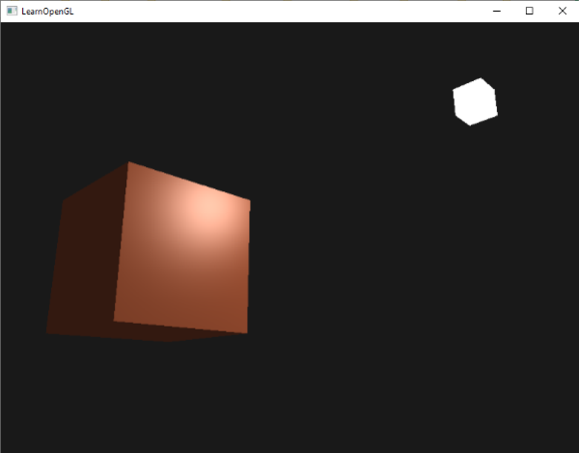
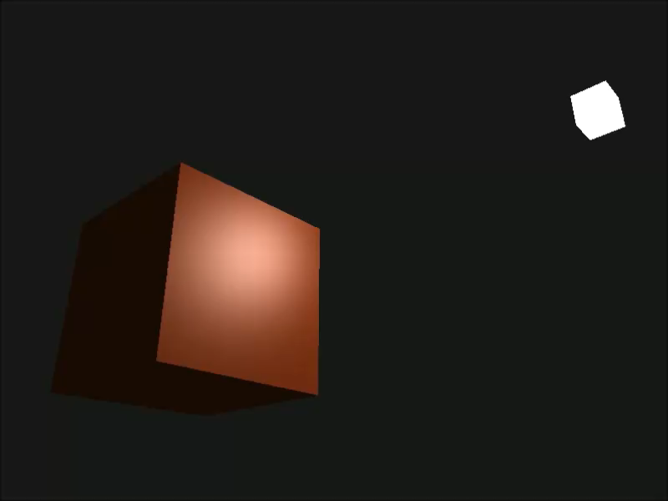
光的属性
如果我们假设lightColor是vec3(1.0)，代码会看起来像这样：
vec3 ambient = vec3(1.0) * material.ambient;
vec3 diffuse = vec3(1.0) * (diff * material.diffuse);
vec3 specular = vec3(1.0) * (spec * material.specular);
可是环境光分量实际上不应该对最终的颜色有这么大的影响（将光源的环境光强度设置为一个小一点的值），用同样的方式修改光源的漫反射和镜面光强度
struct Light {
vec3 position;
vec3 ambient;
vec3 diffuse;
vec3 specular;
};
uniform Light light;
vec3 ambient = light.ambient * material.ambient;
vec3 diffuse = light.diffuse * (diff * material.diffuse);
vec3 specular = light.specular * (spec * material.specular);
ourShader.setVec3("light.ambient", 0.2f, 0.2f, 0.2f);
ourShader.setVec3("light.diffuse", 0.5f, 0.5f, 0.5f); // darken diffuse light a bit
ourShader.setVec3("light.specular", 1.0f, 1.0f, 1.0f);
根据时间改变颜色：
glm::vec3 lightColor;
lightColor.x = sin(glfwGetTime() * 2.0f);
lightColor.y = sin(glfwGetTime() * 0.7f);
lightColor.z = sin(glfwGetTime() * 1.3f);
glm::vec3 diffuseColor = lightColor * glm::vec3(0.5f);
glm::vec3 ambientColor = diffuseColor * glm::vec3(0.2f);
ourShader.setVec3("light.ambient", ambientColor);
ourShader.setVec3("light.diffuse", diffuseColor);

Slide 3
练习
你能像教程一开始那样，定义相应的材质来模拟现实世界的物体吗？参考解答，我做的是青色塑料(Cyan Plastic)的箱子。
// 光源属性
ourShader.setVec3("light.ambient", 1.0f, 1.0f, 1.0f);
ourShader.setVec3("light.diffuse", 1.0f, 1.0f, 1.0f);
ourShader.setVec3("light.specular", 1.0f, 1.0f, 1.0f);
// 材料属性
ourShader.setVec3("material.ambient", 0.0f, 0.1f, 0.06f);
ourShader.setVec3("material.diffuse", 0.0f, 0.50980392f, 0.50980392f);
ourShader.setVec3("material.specular", 0.50196078f, 0.50196078f, 0.50196078f);
ourShader.setFloat("material.shininess", 32.0f);

