Slide 1
多光源
创建一个包含六个光源的场景。我们将模拟一个类似太阳的定向光(Directional Light)光源，四个分散在场景中的点光源(Point Light)，以及一个手电筒(Flashlight)。
out vec4 FragColor;
void main() {
// 定义一个用于输出的变量
vec3 output = vec3(0.0);
// 自定义一个定向光的函数，并调用它
output += someFunctionToCalculateDirectionalLight();
// 定义一个点光源的函数，并调用它
for(int i = 0; i < nr_of_point_lights; i++)
output += someFunctionToCalculatePointLight();
// 定义一个聚光的函数，并调用它
output += someFunctionToCalculateSpotLight();
FragColor = vec4(output, 1.0);
}
定向光
struct DirLight {
vec3 direction;
vec3 ambient;
vec3 diffuse;
vec3 specular;
};
uniform DirLight dirLight;
// directional light
ourShader.setVec3("dirLight.direction", -0.2f, -1.0f, -0.3f);
ourShader.setVec3("dirLight.ambient", 0.05f, 0.05f, 0.05f);
ourShader.setVec3("dirLight.diffuse", 0.4f, 0.4f, 0.4f);
ourShader.setVec3("dirLight.specular", 0.5f, 0.5f, 0.5f);
vec3 CalcDirLight(DirLight light, vec3 normal, vec3 viewDir) {
vec3 lightDir = normalize(-light.direction);
// diffuse shading
float diff = max(dot(normal, lightDir), 0.0);
// specular shading
vec3 reflectDir = reflect(-lightDir, normal);
float spec = pow(max(dot(viewDir, reflectDir), 0.0), material.shininess);
// combine results
vec3 ambient = light.ambient * vec3(texture(material.diffuse, TexCoords));
vec3 diffuse = light.diffuse * diff * vec3(texture(material.diffuse, TexCoords));
vec3 specular = light.specular * spec * vec3(texture(material.specular, TexCoords));
return (ambient + diffuse + specular);
}

Slide 2
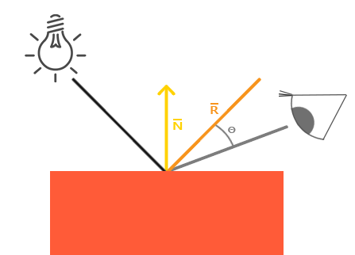
点光源
struct PointLight {
vec3 position;
float constant;
float linear;
float quadratic;
vec3 ambient;
vec3 diffuse;
vec3 specular;
};
#define NR_POINT_LIGHTS 4
uniform PointLight pointLights[NR_POINT_LIGHTS];
vec3 CalcPointLight(PointLight light, vec3 normal, vec3 fragPos, vec3 viewDir) {
vec3 lightDir = normalize(light.position - fragPos);
// diffuse shading
float diff = max(dot(normal, lightDir), 0.0);
// specular shading
vec3 reflectDir = reflect(-lightDir, normal);
float spec = pow(max(dot(viewDir, reflectDir), 0.0), material.shininess);
// attenuation
float distance = length(light.position - fragPos);
float attenuation = 1.0/(light.constant+light.linear*distance+light.quadratic*(distance*distance));
// combine results
vec3 ambient = light.ambient * vec3(texture(material.diffuse, TexCoords));
vec3 diffuse = light.diffuse * diff * vec3(texture(material.diffuse, TexCoords));
vec3 specular = light.specular * spec * vec3(texture(material.specular, TexCoords));
ambient *= attenuation;
diffuse *= attenuation;
specular *= attenuation;
return (ambient + diffuse + specular);
}
glm::vec3 pointLightPositions[] = {
glm::vec3( 0.7f, 0.2f, 2.0f),
glm::vec3( 2.3f, -3.3f, -4.0f),
glm::vec3(-4.0f, 2.0f, -12.0f),
glm::vec3( 0.0f, 0.0f, -3.0f)
};
// point light 1
ourShader.setVec3("pointLights[0].position", pointLightPositions[0]);
ourShader.setVec3("pointLights[0].ambient", 0.05f, 0.05f, 0.05f);
ourShader.setVec3("pointLights[0].diffuse", 0.8f, 0.8f, 0.8f);
ourShader.setVec3("pointLights[0].specular", 1.0f, 1.0f, 1.0f);
ourShader.setFloat("pointLights[0].constant", 1.0f);
ourShader.setFloat("pointLights[0].linear", 0.09f);
ourShader.setFloat("pointLights[0].quadratic", 0.032f);
// point light 2
…
// point light 3
…
// point light 4
…

Slide 3
聚光
// calculates the color when using a spot light.
vec3 CalcSpotLight(SpotLight light, vec3 normal, vec3 fragPos, vec3 viewDir) {
vec3 lightDir = normalize(light.position - fragPos);
// diffuse shading
float diff = max(dot(normal, lightDir), 0.0);
// specular shading
vec3 reflectDir = reflect(-lightDir, normal);
float spec = pow(max(dot(viewDir, reflectDir), 0.0), material.shininess);
// attenuation
float distance = length(light.position - fragPos);
float attenuation =
1.0 / (light.constant + light.linear * distance + light.quadratic * (distance * distance));
// spotlight intensity
float theta = dot(lightDir, normalize(-light.direction));
float epsilon = light.cutOff - light.outerCutOff;
float intensity = clamp((theta - light.outerCutOff) / epsilon, 0.0, 1.0);
// combine results
vec3 ambient = light.ambient * vec3(texture(material.diffuse, TexCoords));
vec3 diffuse = light.diffuse * diff * vec3(texture(material.diffuse, TexCoords));
vec3 specular = light.specular * spec * vec3(texture(material.specular, TexCoords));
ambient *= attenuation * intensity;
diffuse *= attenuation * intensity;
specular *= attenuation * intensity;
return (ambient + diffuse + specular);
}
// spotLight
lightingShader.setVec3("spotLight.position", camera.Position); lightingShader.setVec3("spotLight.direction", camera.Front); lightingShader.setVec3("spotLight.ambient", 0.0f, 0.0f, 0.0f);
…
lightingShader.setFloat("spotLight.cutOff", glm::cos(glm::radians(12.5f)));
lightingShader.setFloat("spotLight.outerCutOff", glm::cos(glm::radians(15.0f)));
合并结果
void main() {
// properties
vec3 norm = normalize(Normal);
vec3 viewDir = normalize(viewPos - FragPos);
// phase 1: Directional lighting
vec3 result = CalcDirLight(dirLight, norm, viewDir);
// phase 2: Point lights
for(int i = 0; i < NR_POINT_LIGHTS; i++)
result += CalcPointLight(pointLights[i], norm, FragPos, viewDir);
// phase 3: Spot light
result += CalcSpotLight(spotLight, norm, FragPos, viewDir);
FragColor = vec4(result, 1.0);
}

Slide 4
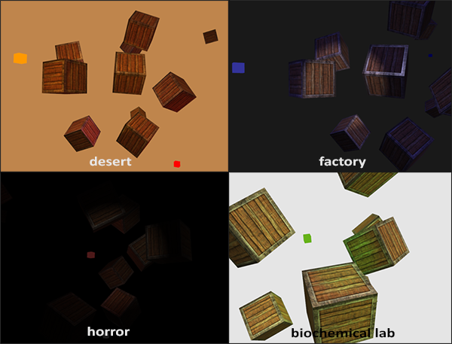
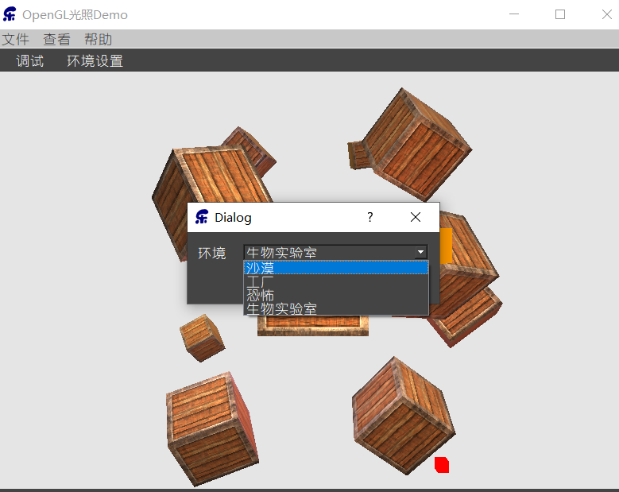
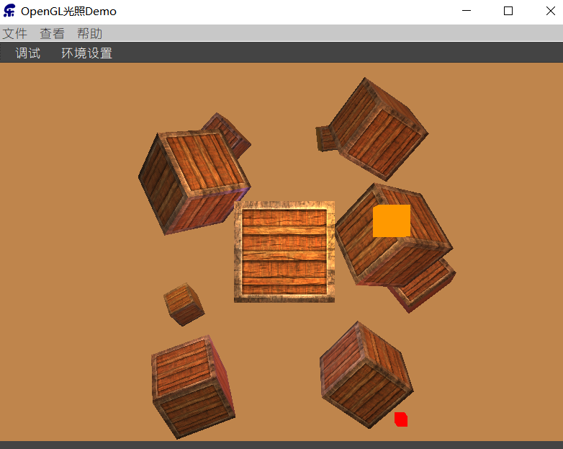
练习
你能通过调节光照属性变量，（大概地）重现最后一张图片上不同的氛围吗？参考解答

