Slide 1
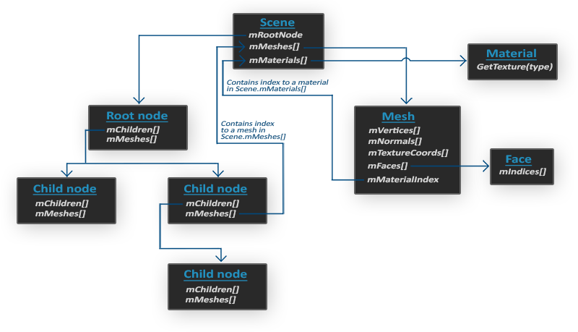
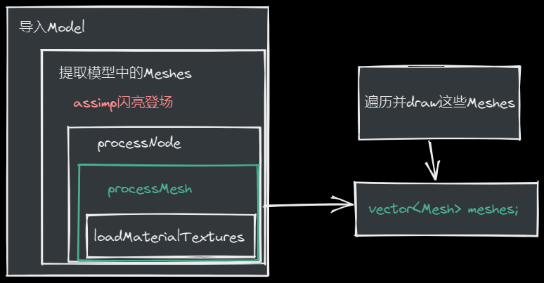
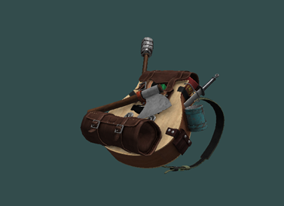
Model
#include <assimp/Importer.hpp>
#include <assimp/scene.h>
#include <assimp/postprocess.h>
编译器版本需要与Assimp编译的版本一致
class Model {
public:
Model(char *path) {
loadModel(path);
}
void Draw(Shader &shader);
private:
// model data
vector<Mesh> meshes;
string directory;
void loadModel(string path);
void processNode(aiNode *node, const aiScene *scene);
Mesh processMesh(aiMesh *mesh, const aiScene *scene);
vector<Texture> loadMaterialTextures(aiMaterial *mat, aiTextureType type, string typeName);
};
通过Assimp加载模型，将其转换为多个网格（Mesh）对象
void Draw(Shader &shader) {
for(unsigned int i = 0; i < meshes.size(); i++)
meshes[i].Draw(shader);
}
一旦有了场景对象，就可以从加载的模型中访问我们需要的所有数据
void loadModel(string path) {
Assimp::Importer import;
const aiScene *scene = import.ReadFile(path, aiProcess_Triangulate | aiProcess_FlipUVs);
if(!scene || scene->mFlags & AI_SCENE_FLAGS_INCOMPLETE || !scene->mRootNode) {
qDebug() << "ERROR::ASSIMP::" << import.GetErrorString() ;
return;
}
directory = path.substr(0, path.find_last_of('/'));
processNode(scene->mRootNode, scene);
}
aiProcess_Triangulate : 告诉Assimp，如果模型（不完全）由三角形组成，它应该首先将模型的所有基本形状转换为三角形
返回从0位置开始，到最后一个’/’
（从path里去除了文件名）
aiProcess_GenNormals: 如果模型不包含法线向量，则为每个顶点创建法线向量。
aiProcess_SplitLargeMeshes: 将大网格拆分为更小的子网格，如果渲染具有允许的最大顶点数，并且只能处理更小的网格，这将非常有用。
aiProcess_OptimizeMeshes: 相反，尝试将多个网格连接到一个更大的网格中，以减少需要优化的绘图需求。
更多后期处理选项

Slide 2
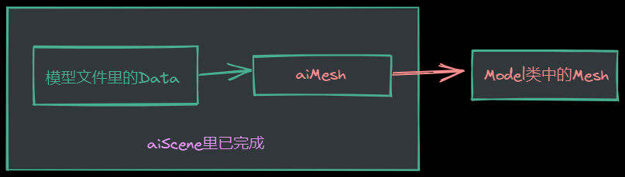
Assimp里的结构：每个节点包含一组网格索引，每个索引指向场景对象中的特定网格
void processNode(aiNode *node, const aiScene *scene) {
// process all the node's meshes (if any)
for(unsigned int i = 0; i < node->mNumMeshes; i++) {
aiMesh *mesh = scene->mMeshes[node->mMeshes[i]];
meshes.push_back(processMesh(mesh, scene));
}
// then do the same for each of its children
for(unsigned int i = 0; i < node->mNumChildren; i++) {
processNode(node->mChildren[i], scene);
}
}
将Assimp的数据解析到上一节中创建的Mesh类中：
Mesh processMesh(aiMesh *mesh, const aiScene *scene) {
vector<Vertex> vertices;
vector<unsigned int> indices;
vector<Texture> textures;
for(unsigned int i = 0; i < mesh->mNumVertices; i++) {
Vertex vertex;
// 处理顶点位置、法线和纹理坐标
[...]
vertices.push_back(vertex);
}
// 处理索引
[...]
// 处理材质
if(mesh->mMaterialIndex >= 0) {
[...]
}
return Mesh(vertices, indices, textures);
}
glm::vec3 vector;
vector.x = mesh->mVertices[i].x;
vector.y = mesh->mVertices[i].y;
vector.z = mesh->mVertices[i].z;
vertex.Position = vector;
vector.x = mesh->mNormals[i].x;
vector.y = mesh->mNormals[i].y;
vector.z = mesh->mNormals[i].z;
vertex.Normal = vector;
if(mesh->mTextureCoords[0]) // 有纹理坐标？
{
glm::vec2 vec;
vec.x = mesh->mTextureCoords[0][i].x;
vec.y = mesh->mTextureCoords[0][i].y; vertex.TexCoords = vec;
} else
vertex.TexCoords = glm::vec2(0.0f, 0.0f);

Slide 3
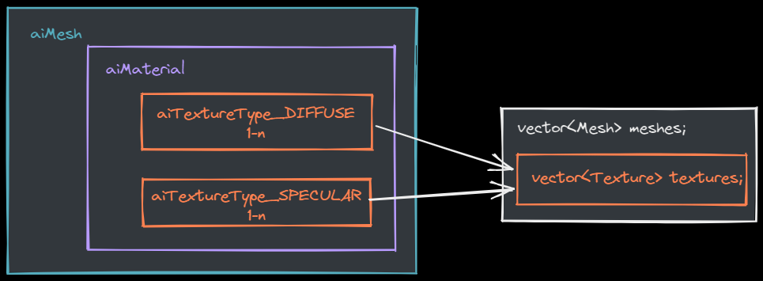


for(unsigned int i = 0; i < mesh->mNumFaces; i++) {
aiFace face = mesh->mFaces[i];
for(unsigned int j = 0; j < face.mNumIndices; j++)
indices.push_back(face.mIndices[j]);
}
索引
材质纹理
if(mesh->mMaterialIndex >= 0) {
aiMaterial *material = scene->mMaterials[mesh->mMaterialIndex];
vector<Texture> diffuseMaps =
loadMaterialTextures(material, aiTextureType_DIFFUSE, "texture_diffuse");
textures.insert(textures.end(), diffuseMaps.begin(), diffuseMaps.end());
vector<Texture> specularMaps =
loadMaterialTextures(material, aiTextureType_SPECULAR, "texture_specular");
textures.insert(textures.end(), specularMaps.begin(), specularMaps.end());
}
vector<Texture> loadMaterialTextures(aiMaterial *mat, aiTextureType type, string typeName) {
vector<Texture> textures;
for(unsigned int i = 0; i < mat->GetTextureCount(type); i++) {
aiString str;
mat->GetTexture(type, i, &str);
Texture texture;
texture.id = TextureFromFile(str.C_Str(), directory);
texture.type = typeName;
texture.path = str.C_Str();
textures.push_back(texture);
}
return textures;
}
unsigned int Model::TextureFromFile(const char *path, const string &directory){
string filename = string(path);
filename = directory + '/' + filename;
unsigned int textureID;
glGenTextures(1, &textureID);
int width, height, nrComponents;
unsigned char *data = stbi_load(filename.c_str(), &width, &height, &nrComponents, 0);
……
return textureID;
}

Slide 4
重大优化
大多数场景都会在多个网格中重用部分纹理
struct Texture {
unsigned int id;
string type;
string path;
// we store the path of the texture to compare with other textures
};
class Model {
public:
// model data
vector<Texture> textures_loaded;
… …
}
vector<Texture> loadMaterialTextures(aiMaterial *mat, aiTextureType type, string typeName) {
vector<Texture> textures;
for(unsigned int i = 0; i < mat->GetTextureCount(type); i++) {
aiString str;
mat->GetTexture(type, i, &str);
bool skip = false;
for(unsigned int j = 0; j < textures_loaded.size(); j++) {
if(std::strcmp(textures_loaded[j].path.data(), str.C_Str()) == 0) {
textures.push_back(textures_loaded[j]);
skip = true;
break;
}
}
if(!skip) {
// if texture hasn't been loaded already, load it
Texture texture;
texture.id = TextureFromFile(str.C_Str(), directory);
texture.type = typeName;
texture.path = str.C_Str();
textures.push_back(texture);
textures_loaded.push_back(texture); // add to loaded textures
}
}
return textures;
}

