Slide 1


Final Project Presentation
Group #9
Project L: What makes a playlist popular?

Slide 2
Problem Statement
what will make a playlist popular
The aim of project was to work with the public dataset on AIcrowd develop a predictive model for the popularity for a Spotify playlist.
The popularity of a playlist is defined by the number of followers.

Slide 3
Data Collection
Data Source:
We work with the open data set and data collected from Spotify API.
Data Acquisition Method:
We downloaded the open data set from AIcrowd and collected the complementary data from Spotify API using spotipy library.

Slide 4
Data Description
Playlists Data Set:
Contains information about playlists, such as name, collaborative, etc. Each playlist is associated with multiple tracks, and thus multiple artists and multiple albums.
Tracks Data Set:
Contains distinct tracks information extracted, each track is associated with multiple playlists, and usually (but not always) one single artist and one single album.
The position information of the track in each playlist are also recorded.
Artists Data Set:
Contains distinct artists information extracted, each artist is associated with multiple tracks, multiple albums, and multiple playlists.
Original Data
The original data sets contain 1,000,000 playlists, which are stored in multiple json files. We extract two further data sets for distinct tracks, and artists based on the original data set.

Slide 5
Extended Features
Tracks Data Set:
Collected audio features from Spotify API:
danceability, energy, key, loudness, mode, speechiness, acousticness, instrumentalness, liveness, valence, tempo, time_signature
Artists Data Set:
Collected artist features from Spotify API:
popularity, followers, genres, tracks, albums
Spotify API
Spotipy
Notes:
According to our observation, the original data set from AIcrowd is kind of limited, and we would like to get more data from other sources. We found that Spotify provides an open API, and with a lightweight Python library called Spotipy, we can get access to more data provided by the Spotify platform. We collected more features for artists and tracks based on the Spotify API.
Since we speculate that playlist popularity should be related to the tracks and the artists of these tracks in the playlist, we extract audio features for the tracks and information for the artists.

Slide 6
EDA
Distribution of the response variableeeee1e
Scatterplot for continuous features 3451678
Boxplot for catogorical featureseeeeeeeee1
WordCloud for text featureseeeeeeeee1eee1
Scatterplot for transformed datetimeeee1111
Scatterplot for fetched mean artist features 1
Wordcloud for text artist features2223e
Notes:
In the exploratory data analysis, we generated a lot of graphs to visualize possible relationship among the variables. Here are some of the plots we have created.

Slide 7
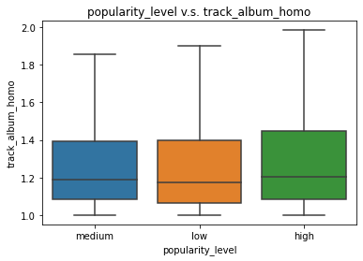
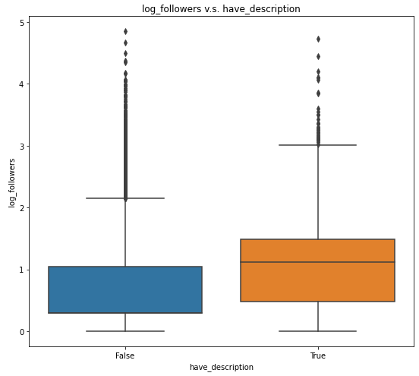
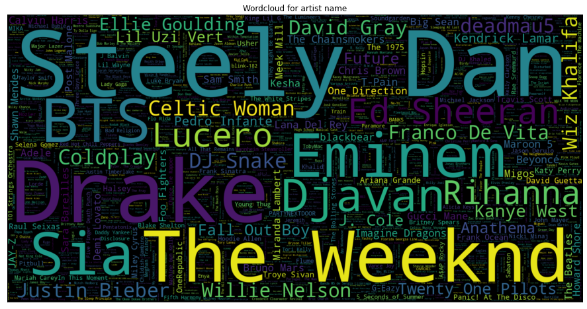
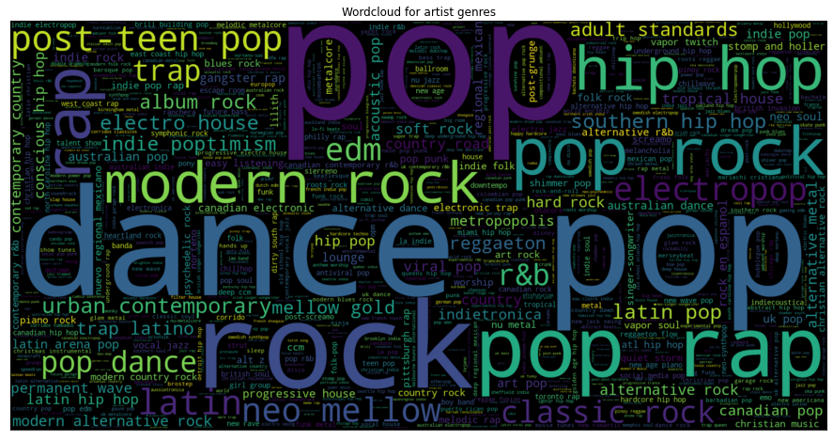
Notes:
We made the number of followers into a categorical variable with levels low, medium and high, and we generated a new feature that represents the similarity between tracks in the playlists. The top left boxplot with outliers removed shows a slight difference, probably implying that a more homogenous playlist corresponds to a higher popularity.
The second boxplot shows that playlists with description provided has an higher average number of followers than playlists without description. This is good feature to be included in the prediction model.
The two words clouds are built based on the show up frequencies of the artists and the genres. We can see that some artists and genres show up way more often than others, and we are thus inspired to do more feature engineering related to artists and genre later.

Slide 8
Imbalanced Data
We found that the playlist data set is highly imbalanced in terms of number of followers.
We define playlists with more than 10 followers as the minority and less than or equal to 10 followers as the majority.
For the majority, we downsampled them, making a final dataset with 25% playlists as the minority.

Slide 9
Feature Engineering
Features Based on Playlist Description
cluster: 10 Clusters based on existing playlist descriptions;
has_description.
Averaged Album and Artist information of each Track:
track_artist_homo: ratio of num_tracks to num_artists;
track_album_homo: ratio of num_tracks to num_albums.
Averaged Audio features of each Track
Averaged the audio feature values of tracks within each playlist collected from Spotify API.
Genres Scores based on artists’ genres

Slide 10
Feature Engineering
# Column Non-Null Count Dtype
--- ------ -------------- -----
0 duration_s 21069 non-null float64
1 num_edits 21069 non-null int64
2 num_artists 21069 non-null int64
3 num_albums 21069 non-null int64
4 num_tracks 21069 non-null int64
5 num_followers 21069 non-null int64
6 popularity_level 21069 non-null category
7 have_description 21069 non-null bool
8 log_followers 21069 non-null float64
9 artist_popularity 21069 non-null float64
10 artist_followers 21069 non-null float64
11 track_album_homo 21069 non-null float64
12 track_artist_homo 21069 non-null float64
13 danceability 21069 non-null float64
14 energy 21069 non-null float64
15 key 21069 non-null float64
16 loudness 21069 non-null float64
17 mode 21069 non-null float64
18 speechiness 21069 non-null float64
19 acousticness 21069 non-null float64
20 instrumentalness 21069 non-null float64
21 liveness 21069 non-null float64
22 valence 21069 non-null float64
23 tempo 21069 non-null float64
24 time_signature 21069 non-null float64
25 modified_at_FROMNOW 21069 non-null float64
26 genres_score_album 21069 non-null int64
27 genres_score_alternative 21069 non-null int64
28 genres_score_art 21069 non-null int64
29 genres_score_atl 21069 non-null int64
30 genres_score_australian 21069 non-null int64
31 genres_score_blues 21069 non-null int64
32 genres_score_canadian 21069 non-null int64
33 genres_score_ccm 21069 non-null int64
34 genres_score_christian 21069 non-null int64
35 genres_score_classic 21069 non-null int64
36 genres_score_coast 21069 non-null int64
37 genres_score_contemporary 21069 non-null int64
38 genres_score_country 21069 non-null int64
39 genres_score_dance 21069 non-null int64
40 genres_score_edm 21069 non-null int64
41 genres_score_electro 21069 non-null int64
42 genres_score_electropop 21069 non-null int64
43 genres_score_folk 21069 non-null int64
44 genres_score_funk 21069 non-null int64
45 genres_score_gangster 21069 non-null int64
46 genres_score_gold 21069 non-null int64
47 genres_score_hip 21069 non-null int64
48 genres_score_holler 21069 non-null int64
49 genres_score_hop 21069 non-null int64
50 genres_score_house 21069 non-null int64
51 genres_score_indie 21069 non-null int64
52 genres_score_jazz 21069 non-null int64
53 genres_score_latin 21069 non-null int64
54 genres_score_mellow 21069 non-null int64
55 genres_score_metal 21069 non-null int64
56 genres_score_modern 21069 non-null int64
57 genres_score_neo 21069 non-null int64
58 genres_score_new 21069 non-null int64
59 genres_score_pop 21069 non-null int64
60 genres_score_post-teen 21069 non-null int64
61 genres_score_punk 21069 non-null int64
62 genres_score_r&b 21069 non-null int64
63 genres_score_rap 21069 non-null int64
64 genres_score_road 21069 non-null int64
65 genres_score_rock 21069 non-null int64
66 genres_score_soft 21069 non-null int64
67 genres_score_soul 21069 non-null int64
68 genres_score_southern 21069 non-null int64
69 genres_score_stomp 21069 non-null int64
70 genres_score_trap 21069 non-null int64
71 genres_score_tropical 21069 non-null int64
72 genres_score_uk 21069 non-null int64
73 genres_score_urban 21069 non-null int64
74 genres_score_wave 21069 non-null int64
75 genres_score_worship 21069 non-null int64
76 cluster 21069 non-null category

Slide 11
Modeling and Evaluation
Model Choices:
Linear Regression: used as baseline model
Random Forest: bagging ensemble method
LightGBM: boosting ensemble method, fast, distributed, high-performance, high-compatibility, uses GOSS to filter data to define a split
XGBoost: boosting ensemble method, fast, paralleled, uses pre-sorted algorithm & histogram-based algorithm for computing the best split.
Notes:
Now Im happy to share about our models and evaluation. First of all, we choose a simple linear model as our baseline. Then we tried 3 different models, random forest, lightgbm and xgboost.

Slide 12
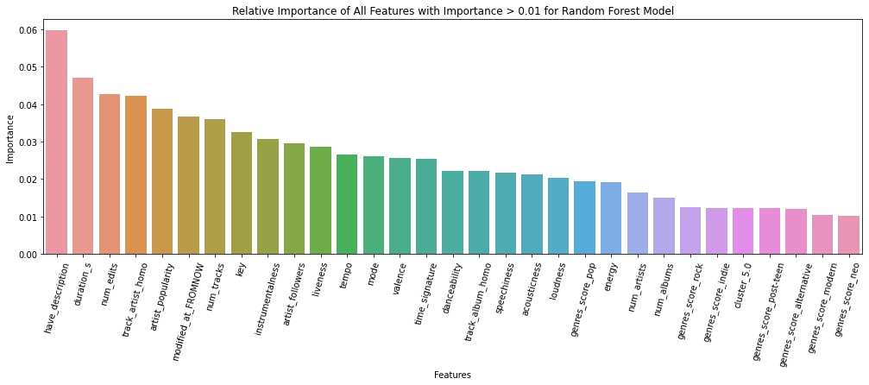


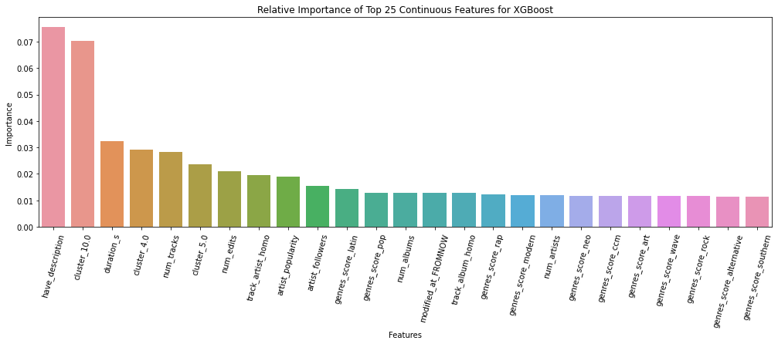

Modeling and Evaluation
Linear Regression:
Random Forest:
LightGBM:
XGBoost:
Notes:
among those 4 models, random forest reached the best r square score. Also, we analyse the feature importance of these models.
we can find that the feature `have_description`,`track_artist_homo`, and `artist popularity` are more important.

Slide 13
Conclusion
The best model is Random Forest,
test R-squared = 0.11648
The random forest model is able to explain about 11.648% of the variation in the response variable, log number of followers.
Poor Performance in Model predictability
Improvement: Data & Model
Features related to Playlist Creators
Predictability v.s Exploration
Better recommendation
Notes:
Even the best model has a really poor performance in predicting the log number of followers of the playlists. There are still much space for improvement, either by getting more informative data and building better models.
We speculate that playlist popularity can be related to playlist creators’ popularity. If we are able to retrieve features related to users who created the playlists, we might be able to improve the performance of the model. However, if this strongly boost model performance, models are less focused on exploring what playlist characteristics make them popular, and perhaps popularity of a playlist does not really depend on its own characteristics but more on the popularity and publicity of the creators, and this might mean that there is much space for Spotify to improve the recommendation system so that playlists created by non-popular users can also get noticed.

Slide 14
Thank you for watching!
CS109A/AC209A 2021: Introduction to Data Science
Group #9 Chelsea Chen, Mengyuan Li, Xinran Tang, Jing Xu

