Slide 1
Exploring Election on Twitter with Crossfilter
Yijia Zhou
Xinran Wang
QMSS4063

Slide 2
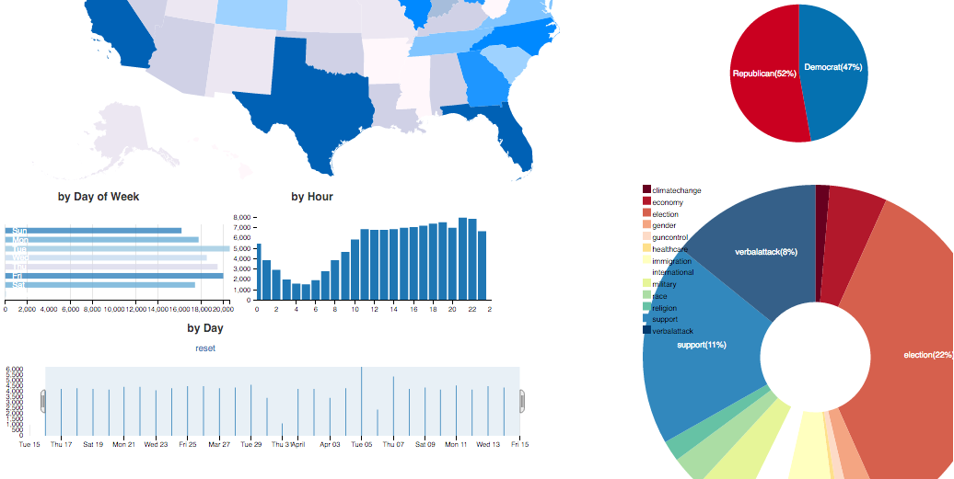
Crossfilter
- dc-js library
- Allows multivariate comparison
- Very fast interaction with coordinated views
- We explore the tweets by candidates, parties, topics, locations and time
Link to online dynamic visualization:
https://xinranwang.shinyapps.io/visfinal (not always load correctly, the github page containing the project is also included)
https://github.com/XinranWa/G4063_Final_Project

Slide 3
Processing tweets
Time period: March 15, 2016 - April 15, 2016
Using summary csv file
Sampling 5000 tweets for each day:
original files take too long to process

Slide 4
Manipulating variables
Topics
13 topics chosen: Military, Economy, Immigration, Health Care, Gun Control, Race, Gender, Climate, Religion, International, Verbal Attack, Election, Support
Location
Use twitter users self-reported location
Substitute major cities with state to obtain more counts

Slide 5
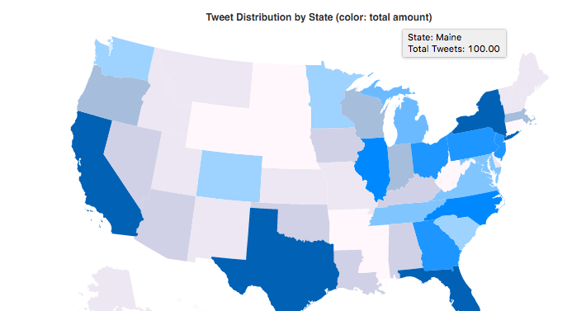
Geo-located Tweets on Map

Slide 6
More interesting to analyze by topics
Support
Keywords
- hash tags of each candidates
- supportive words
feelthebern, alwaystrump, stillsanders
- Trump and Sanders more popular on Twitter

Slide 7
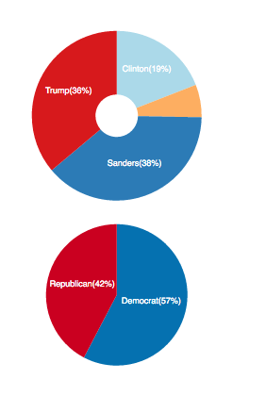
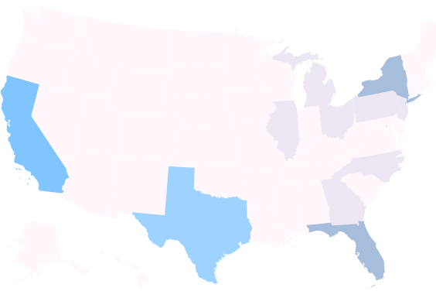
Support

Slide 8
Election
Keywords: 11 major magazines/newspapers
All election related vocabularies
Equal share between two parties
Trump has the largest counts
Peak at April, 5 – Wisconsin Primary

Slide 9
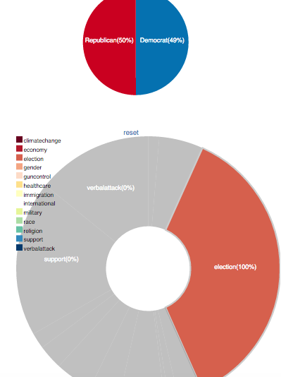
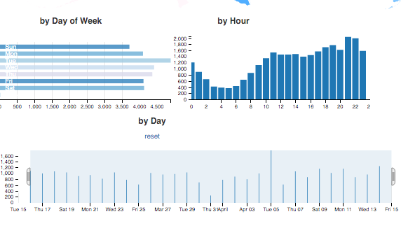
By topic - Election

Slide 10
Verbal Attack
Keywords:
- Idiot, fraud, hell, damn, fucking, sexist, loser
Not always imply negative attitude:
- Damn good, fucking awesome, or just express general feelings
(shown by tweets data chart)

Slide 11
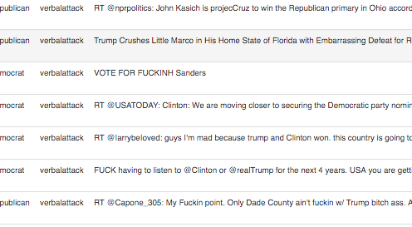
Verbal Attack

