Slide 1


Slide 2
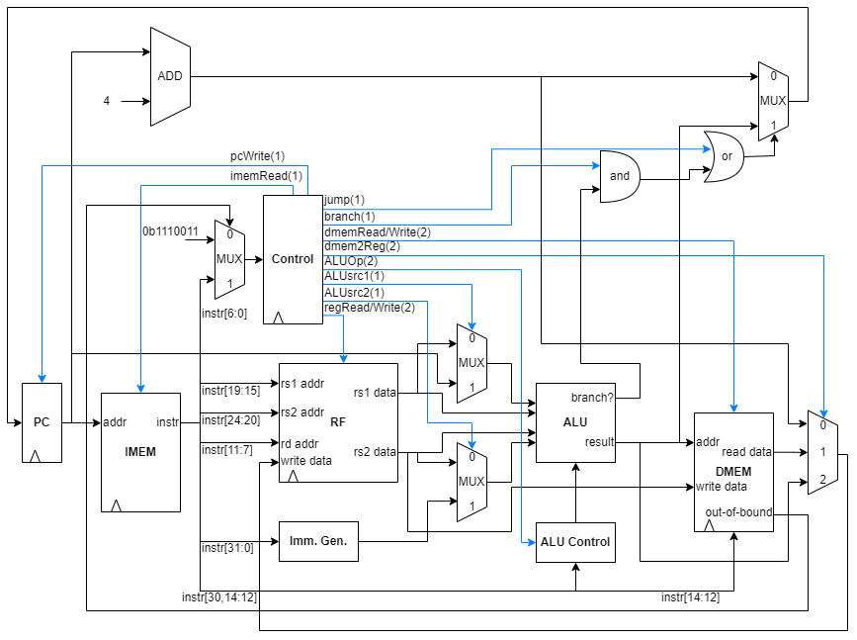
Design Datapath

Slide 3
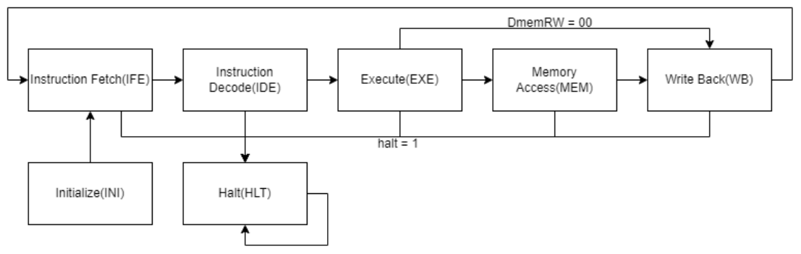
FSM Diagram

Slide 4
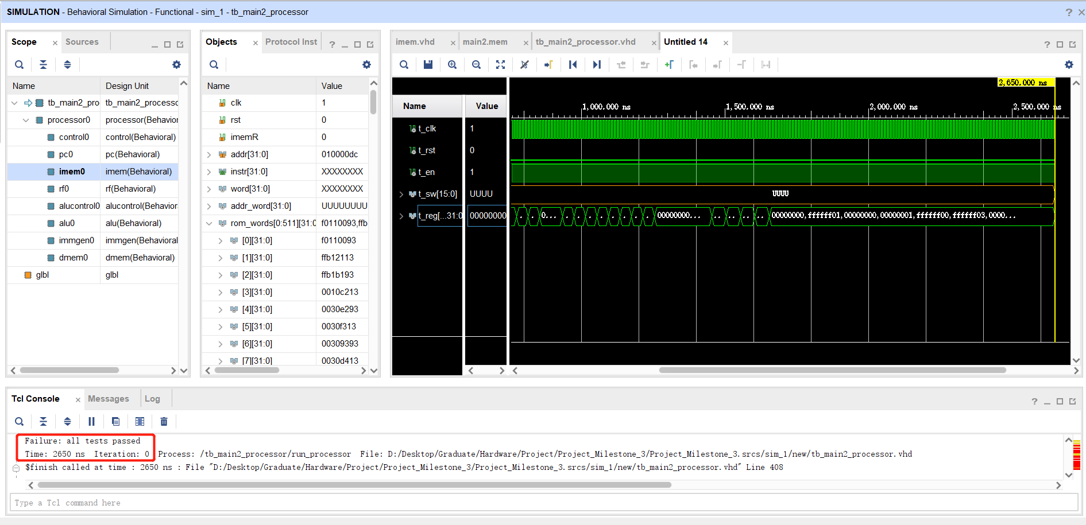
low-level test case 1: tb_main2_processor
tb_main2_processor tested many instructions including ADDI, SLTI, SLTIU, XORI, ORI, ANDI, SLLI, SRLI, SRAI, ADD, SUB, SLL, SLT, SLTU, XOR, SRL, SRA, OR, AND, LUI, AUIPC, ADDI, LUI, SB, SH, SW, LB, LH, LW, LBU, LHU (all required instructions without branch-related instructions)

Slide 5
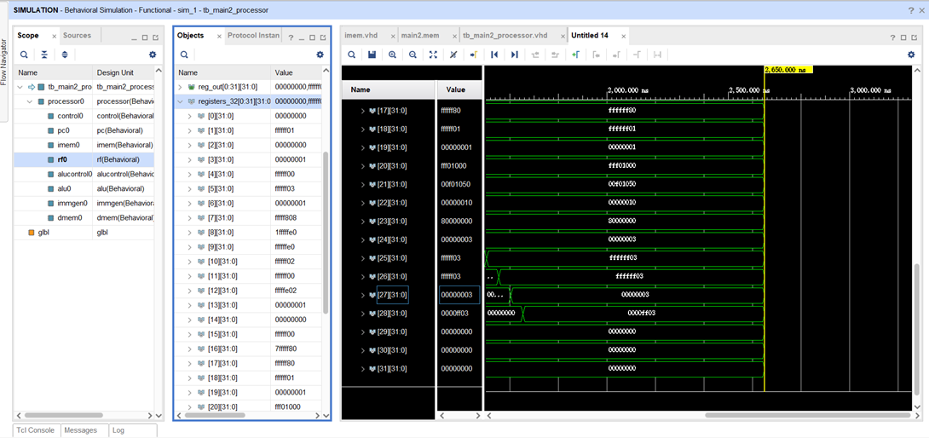
low-level test case 1: tb_main2_processor
After run instructions in main2.mem, the results stored in 32 registers.
They are compared with “correct answers” in the testbench.

Slide 6
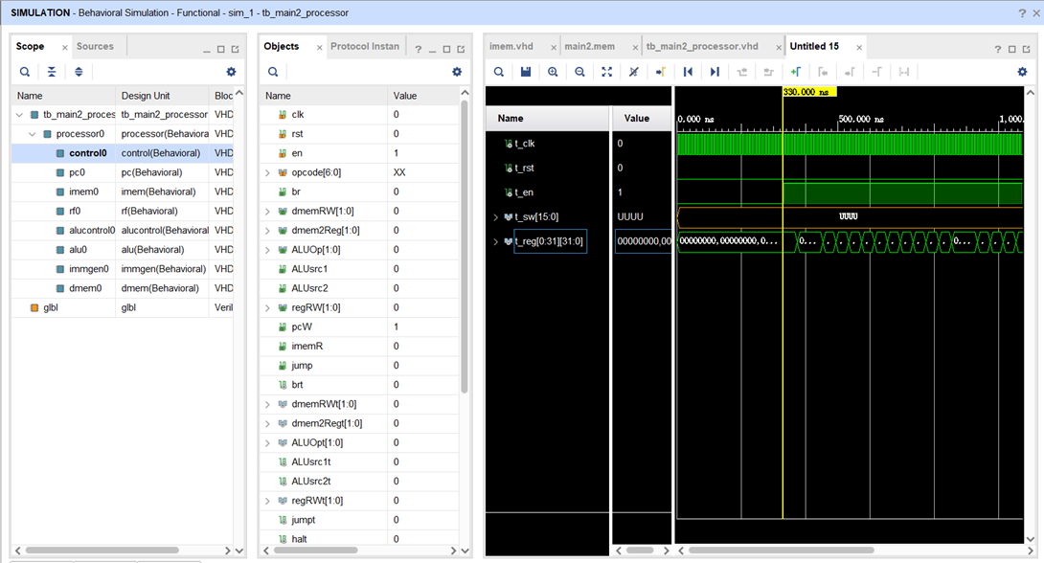
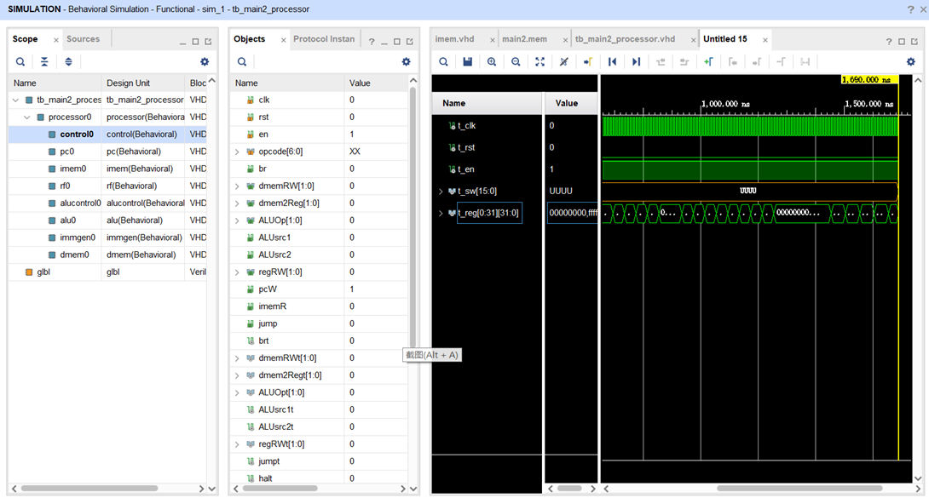
low-level test case 1: tb_main2_processor
Runtime of main2.mem is 1360s (136 clock cycles), for 31 instructions in total.
Each instruction run for 4.39 cycles on average. (4 for instruction without load/store function, 5 for load/store instructions)

Slide 7
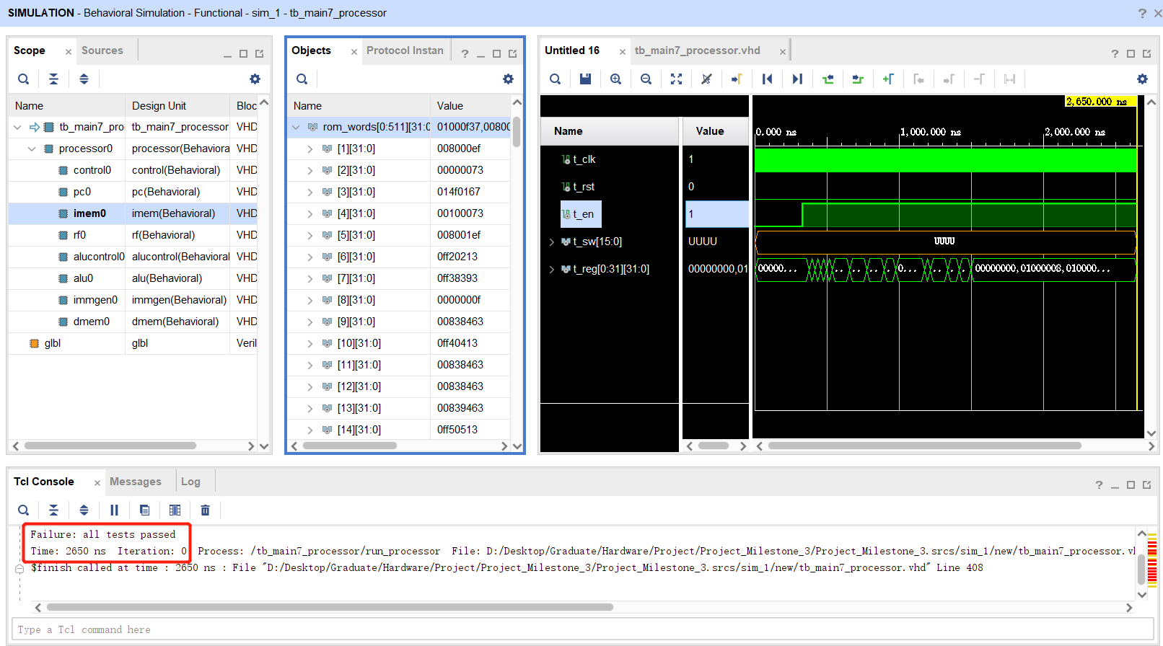
low-level test case 2: tb_main7_processor
tb_main7_processor tested many instructions including LUI, JAL, JALR, BEQ, BNE, BLT, BGE, BLTU, BGEU, ECALL, EBREAK, FENCE

Slide 8
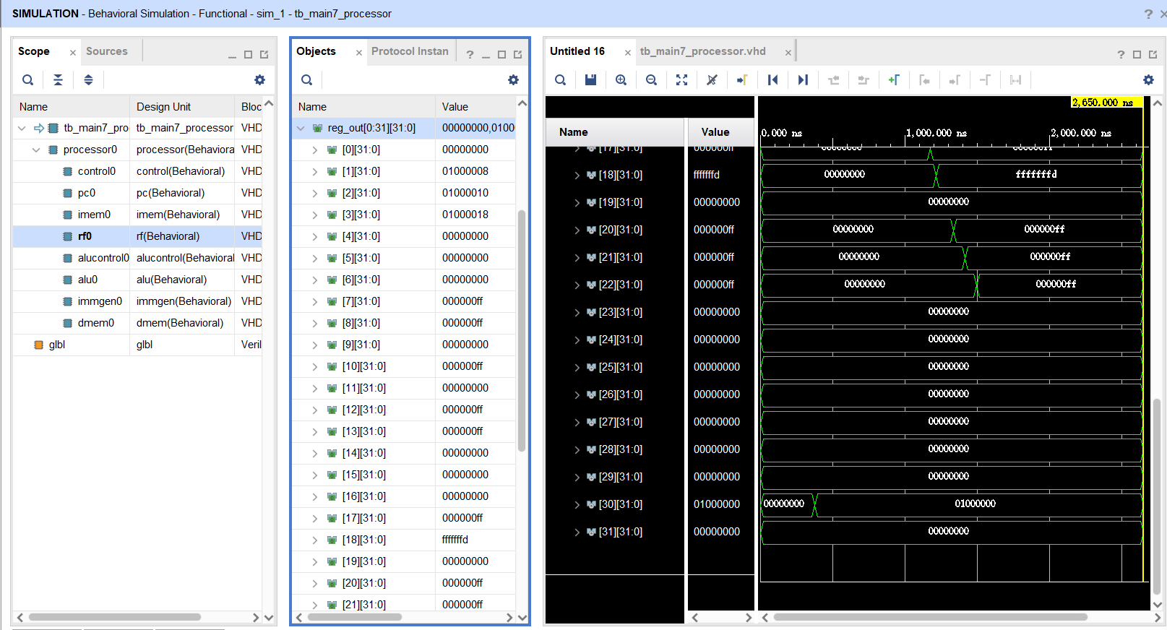
low-level test case 2: tb_main7_processor
After run instructions in main2.mem, the results stored in 32 registers.
They are compared with “correct answers” in the testbench.

Slide 9
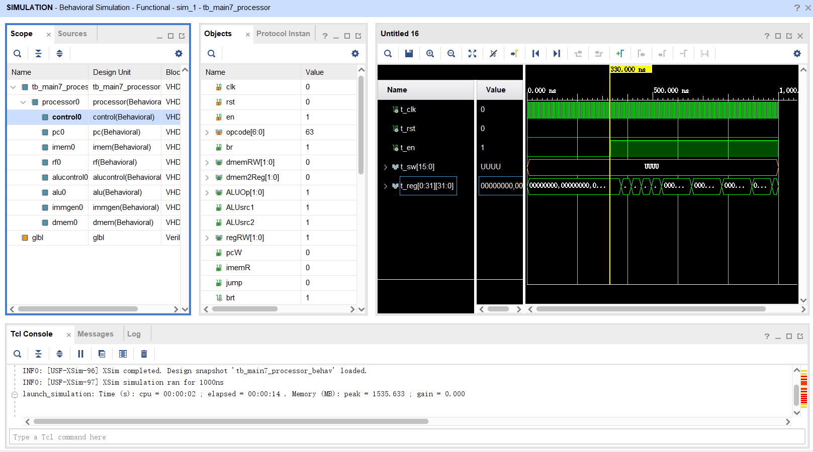
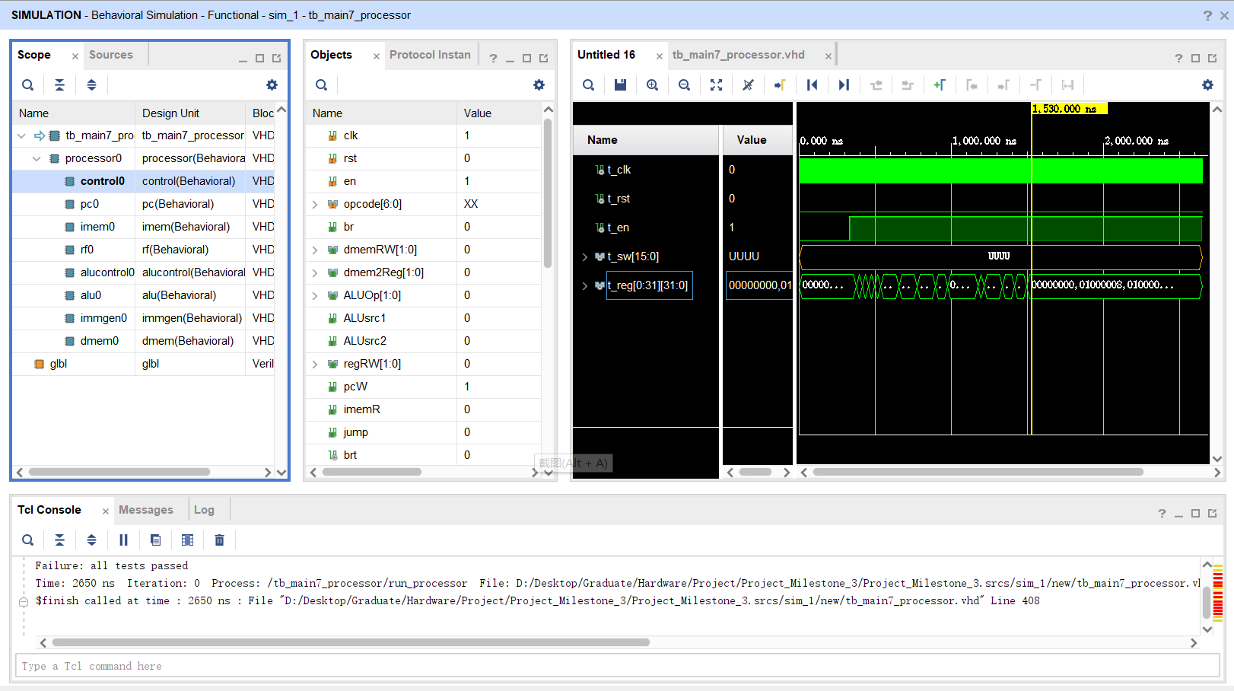
low-level test case 2: tb_main7_processor
Runtime of main7.mem is 1200s (120 clock cycles), for 30 instructions in total.
Each instruction run for 4 cycles on average. (4 for instruction without all load/store function)

Slide 10
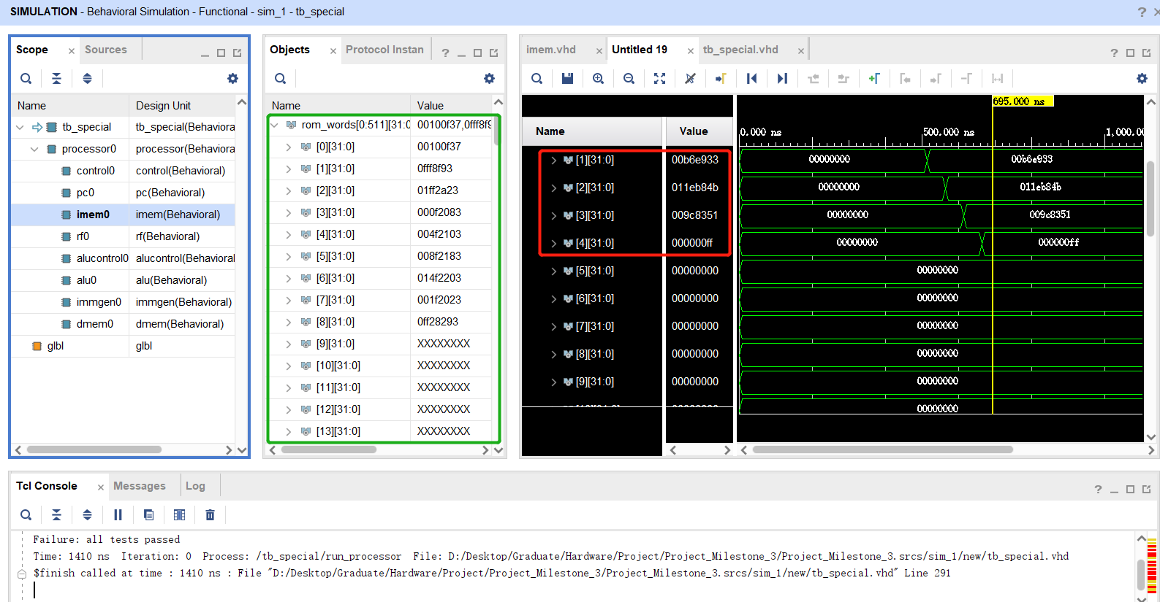
low-level test case 3: tb_special
tb_special tested load and store instructions about some special addresses in data memory. Including the address that stored N numbers of us, the address in which the data will be output to the LED, and the address in which the data is input from Switches.
(Left are the instructions stored in instruction memory, right are the output loaded into registers.

Slide 11
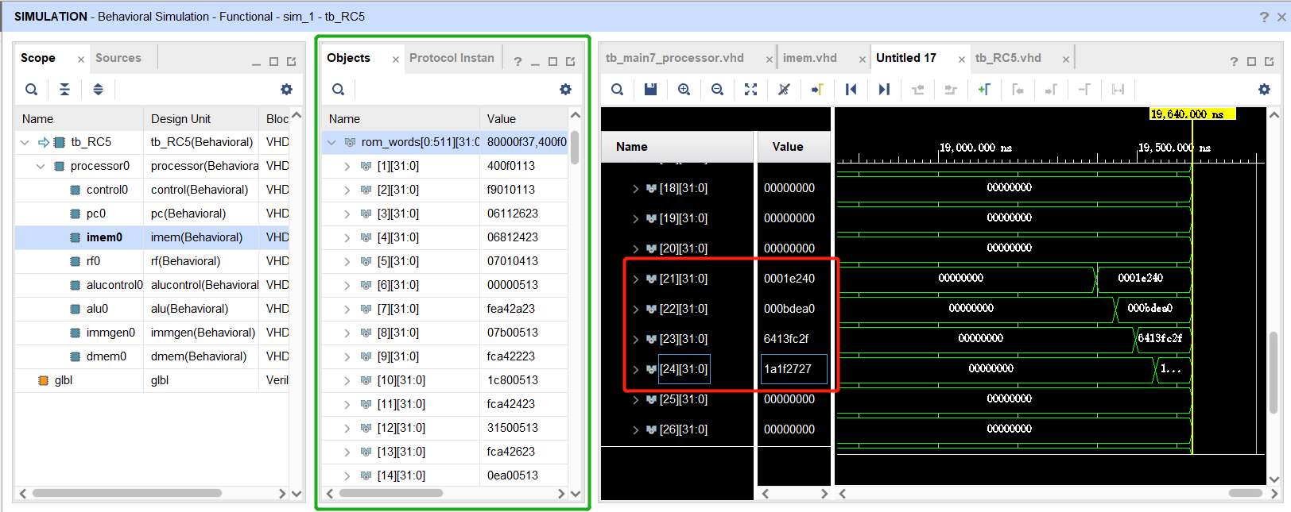
high-level test case 1: tb_RC5
The input plaintexts of RC5 are two numbers: 123456, 777888 (1e240, bdea0 in hex)
The ciphertexts after encoding are: 1679031343, 438249255 (6413fc2f, 1a1f2727 in hex)
Ciphertext results are stored in registers x23, x24; plaintext results gotten from decoding are stored in x21, x22

Slide 12
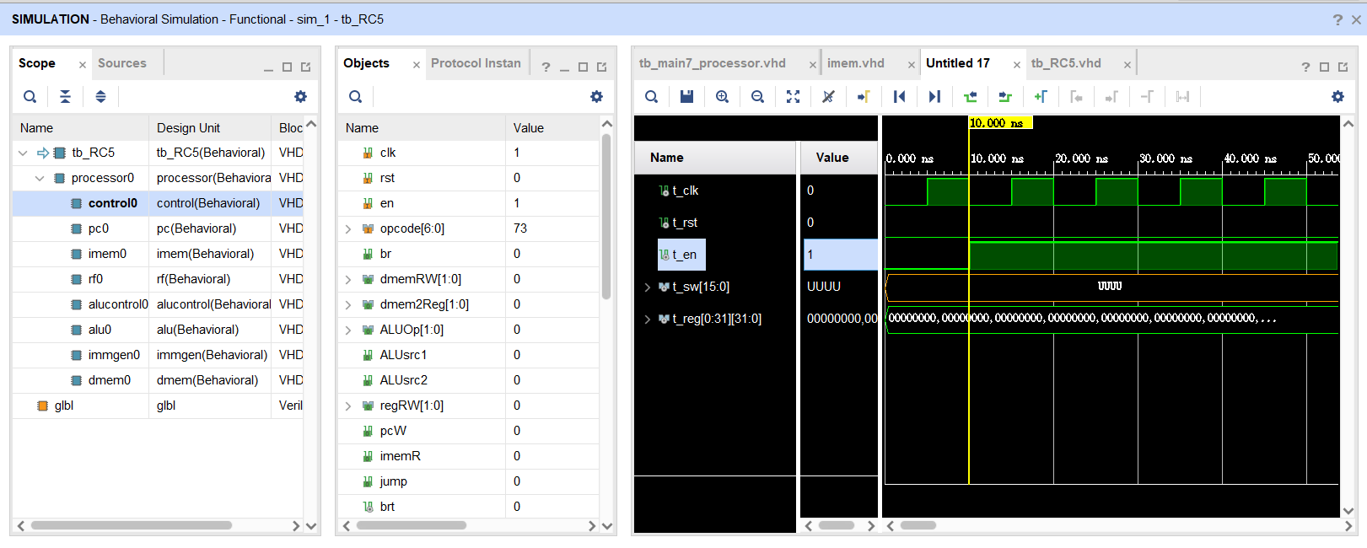
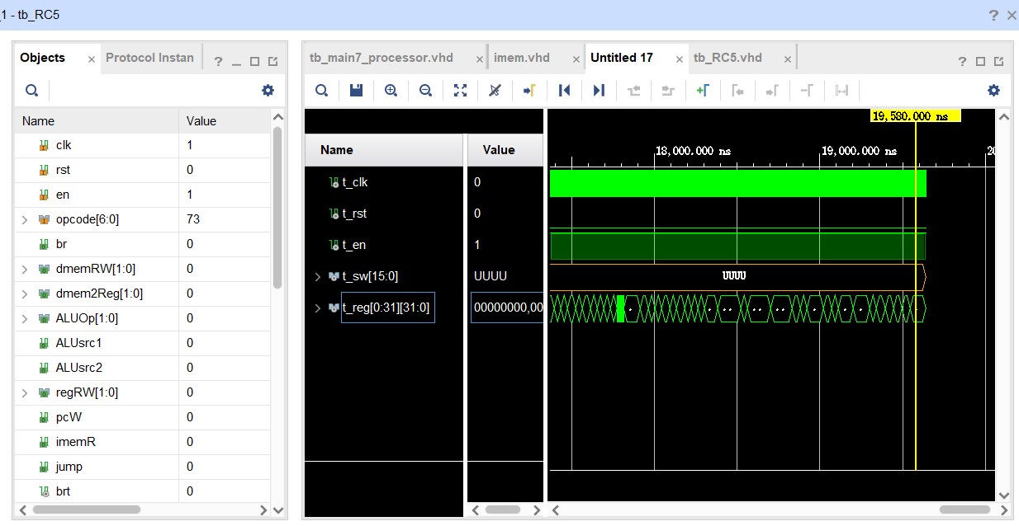
high-level test case 1: tb_RC5
Runtime of RC5_final3.mem is 19570s (1957 clock cycles), for 427 instructions (after counting loop) in total.
Each instruction run for 4.58 cycles on average. (4 for instruction without load/store function, 5 for load/store instructions)

Slide 13
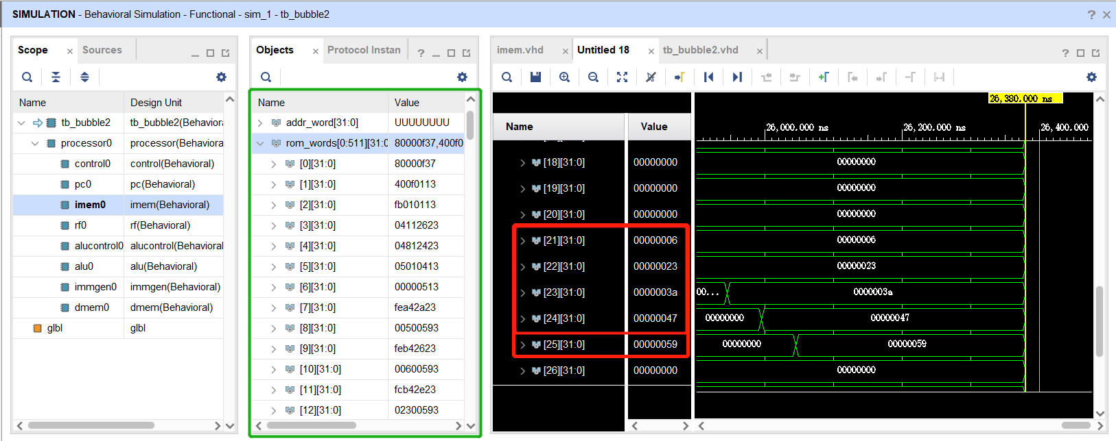
high-level test case 2: tb_bubble2
The input of bubble sort is 5 numbers not in order: 58,89,71,35,6
The output of bubble sort is 5 numbers in order, from small to large (stored in x21 to x25): 6, 35, 58, 71, 89
(6, 23, 3a, 47, 59 in hex)

Slide 14
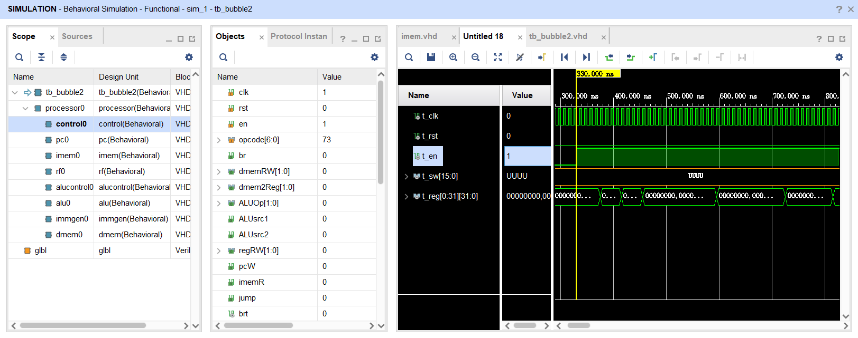
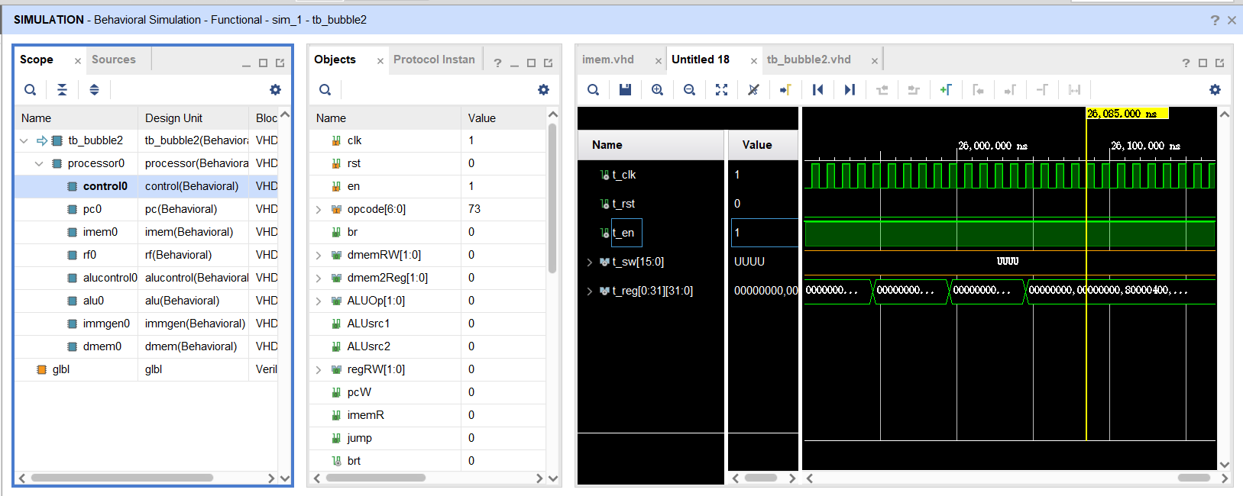
high-level test case 1: tb_bubble2
Runtime of bubble2_new2.mem is 25750s (2575 clock cycles), for 571 instructions (after counting loop) in total.
Each instruction run for 4.51 cycles on average. (4 for instruction without load/store function, 5 for load/store instructions)

Slide 15
performance and area analysis of design
Multi-cycle
Skipping memory stage
Components only active when needed in stage
No unexpected components

Slide 16
optimization and improvement
Use Pipelined Design
Add MAF(multiply-add-fused)
Future Work
Instruction Memory
Control Unit

Slide 17
Thank You!

