Slide 1
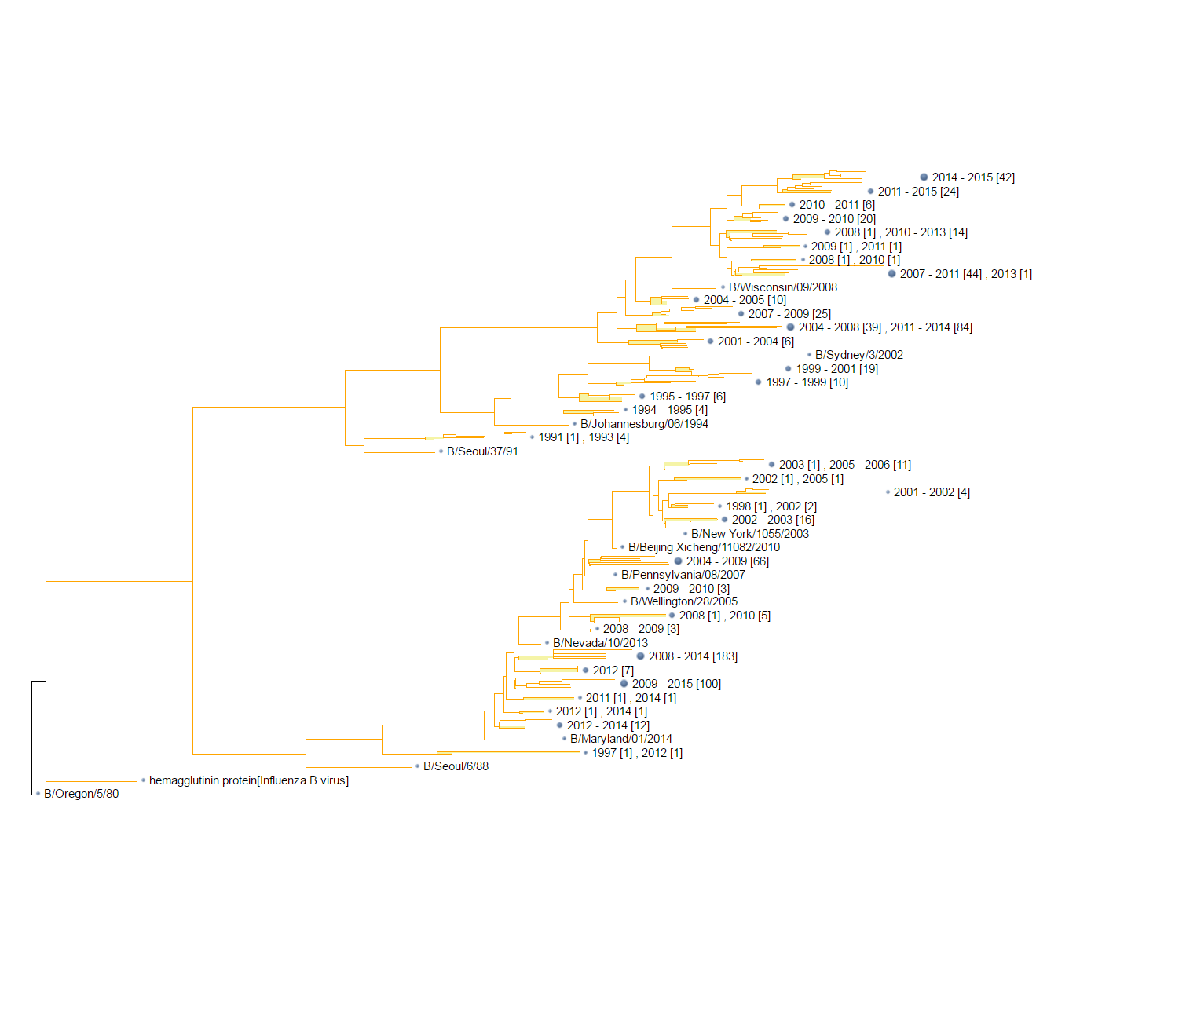
Figure 1. Phylogenetic tree of HA1 sequences of influenza B viruses.
It’s indicated influenza virus B diverging into two lineages co-circulating around the world, named as Yamagata lineage and Victoria lineage.

Slide 2
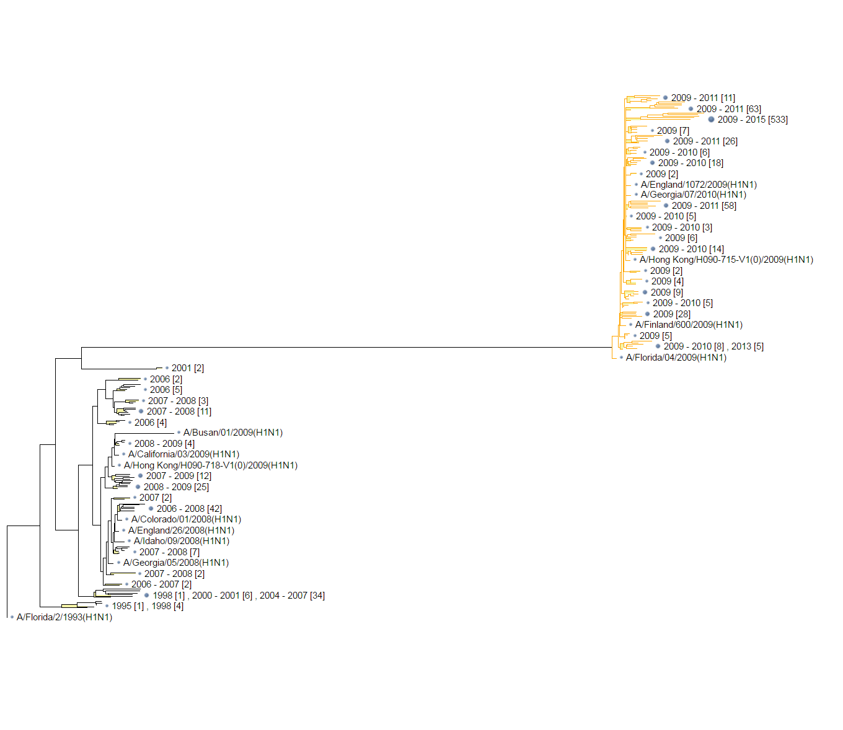
Figure 2. Phylogenetic tree of HA1 sequences of A/H1N1 viruses.
It’s clearly divided into two clusters before and after 2009, when the world swine flu pandemic happened.

Slide 3
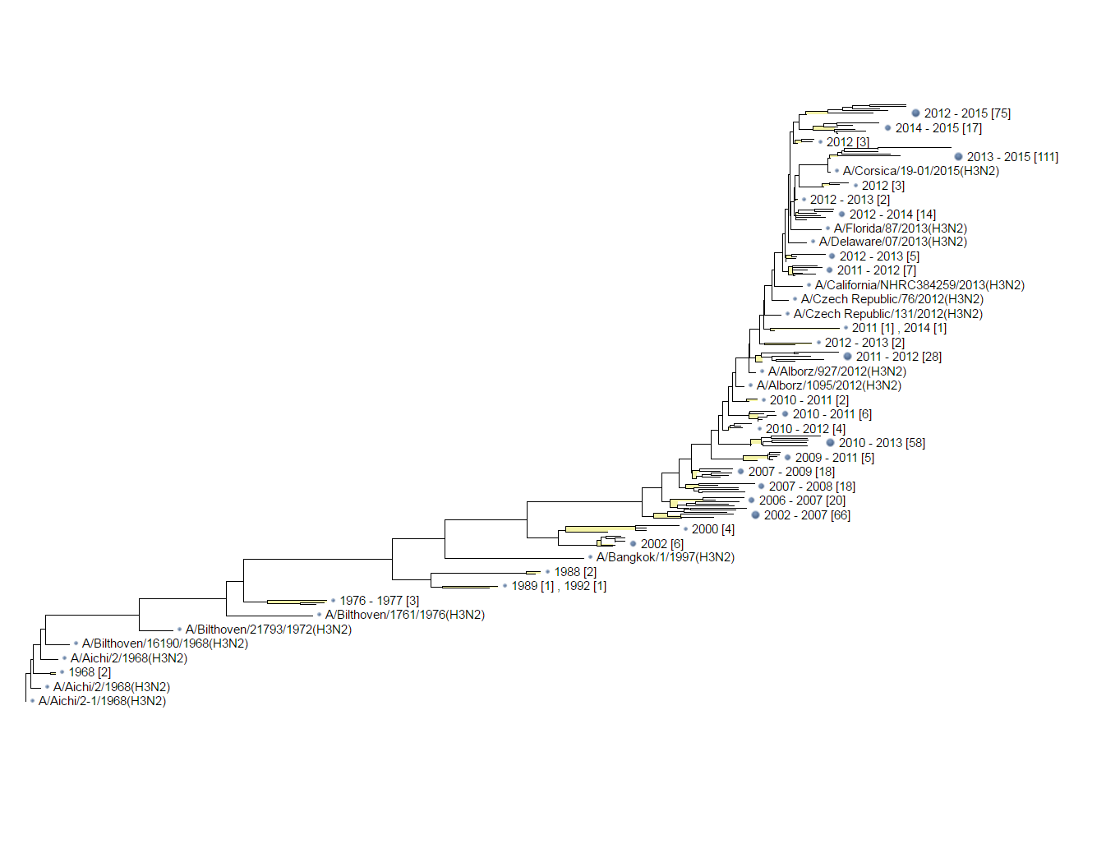
Figure 3. Phylogenetic tree of HA1 sequences of A/H3N2 viruses.
The tree was constructed using 1000 randomly selected sequences, which showed an apparent selecting preference on the evolutionary path of A/H3N2.

Slide 4
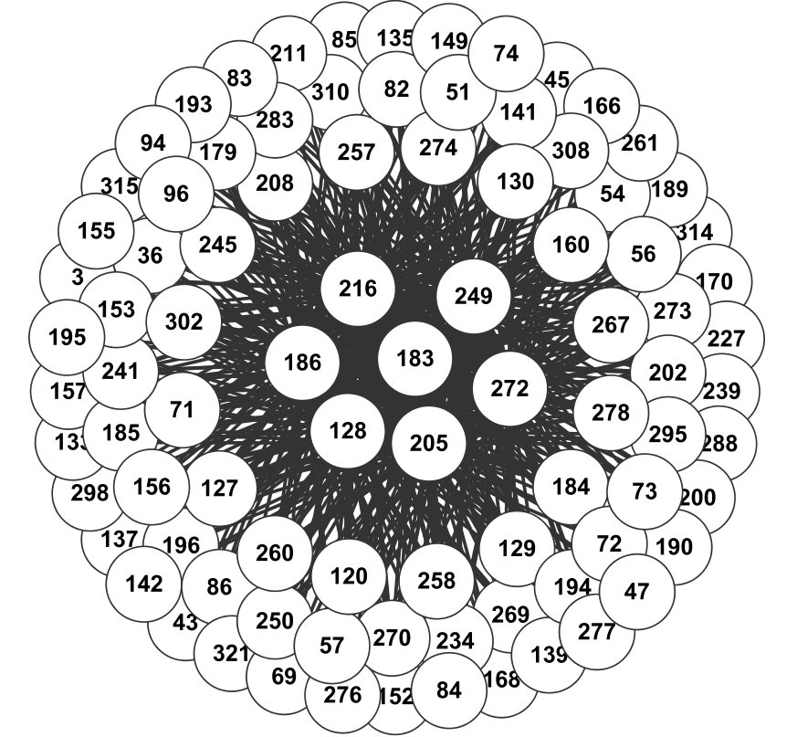
Figure 4. The network representing the rules of co-mutation sites in H1N1 based on sequences from 2008 to 2011.

Slide 5
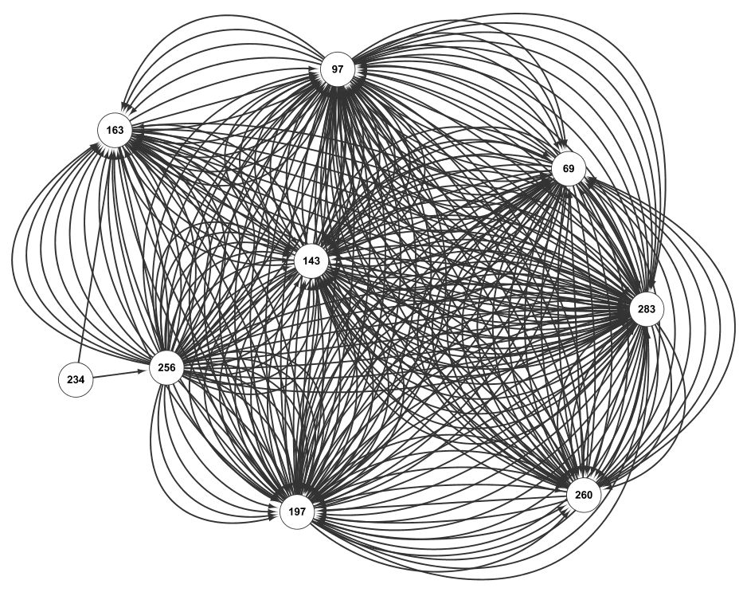
Figure 5. The network representing the rule of co-mutation sites in H1N1 based on sequences from 2011 to 2014.

Slide 6
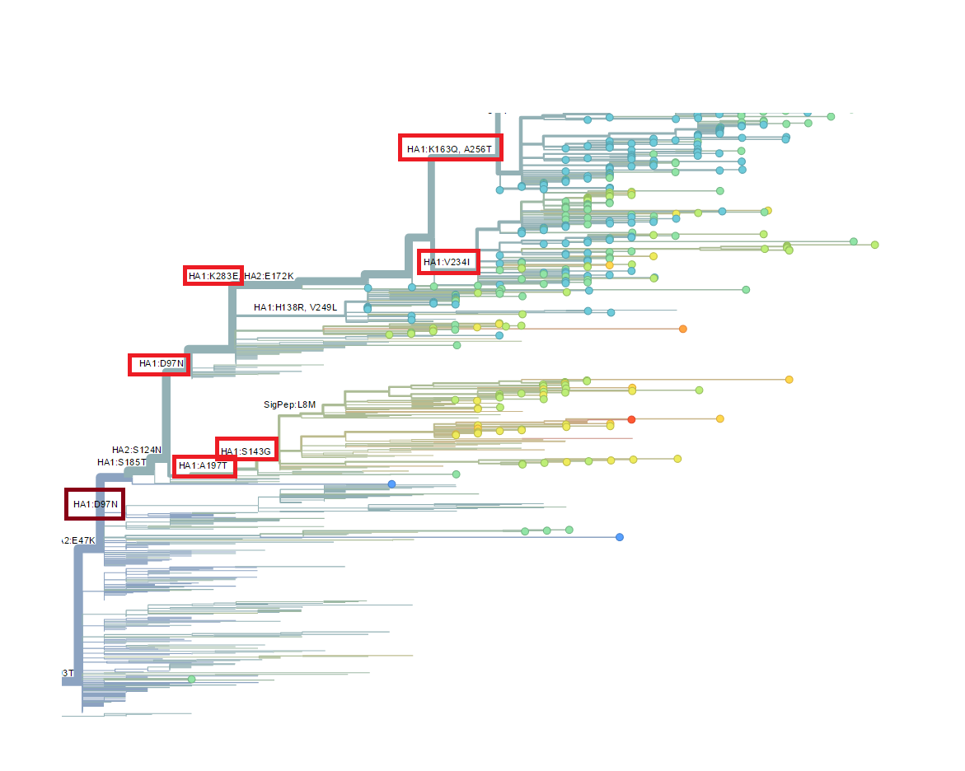
Figure 6. Site mutations predicted by “nextflu”. The red rectangles are used to highlight the overlap with our prediction (Figure 5).

Slide 7
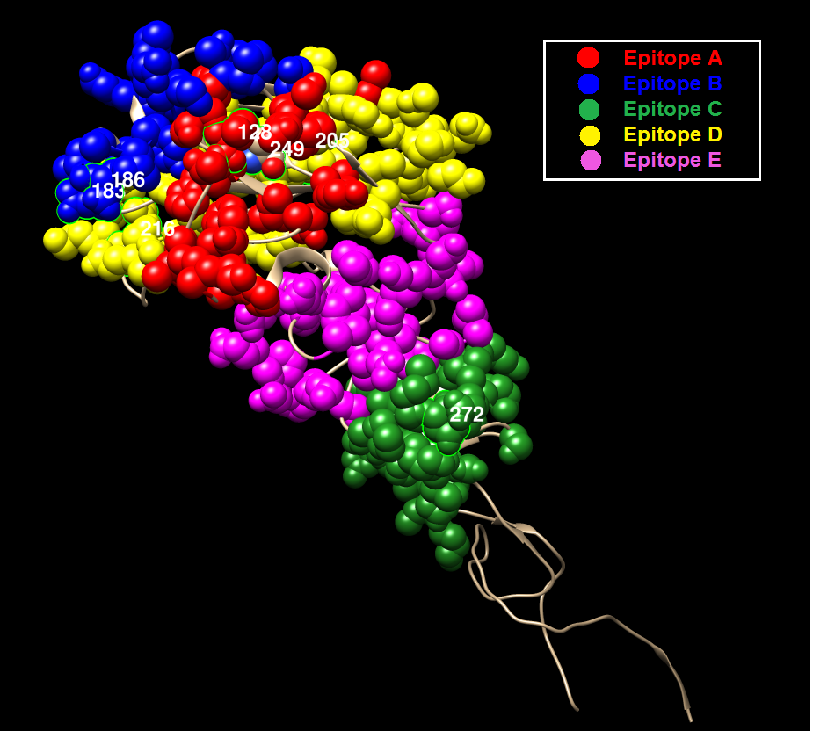
Figure 7. Mapping co-mutation sites on HA1 protein of H1N1 (PDB ID: 4EDB).The red, blue, yellow, magenta and green colors represent the five epitope regions, the tan color denotes non-epitope region, and the co-mutation sites are circled and marked with corresponding numbers (similarly for the following two figures, i.e. Figure 8 and 9).

Slide 8
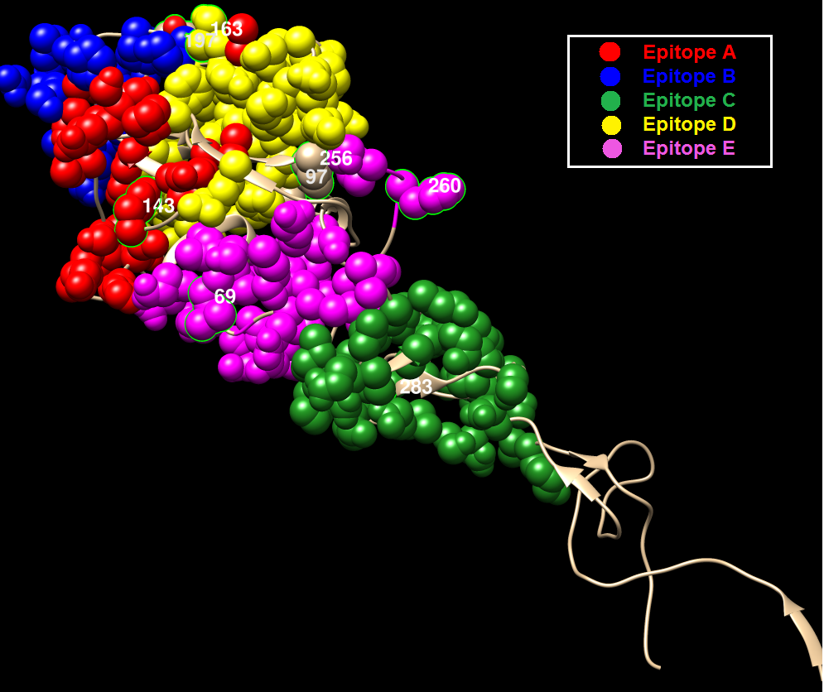
Figure 8. Mapping co-mutation sites on HA1 protein of H1N1 (PDB ID: 4EDB)

Slide 9
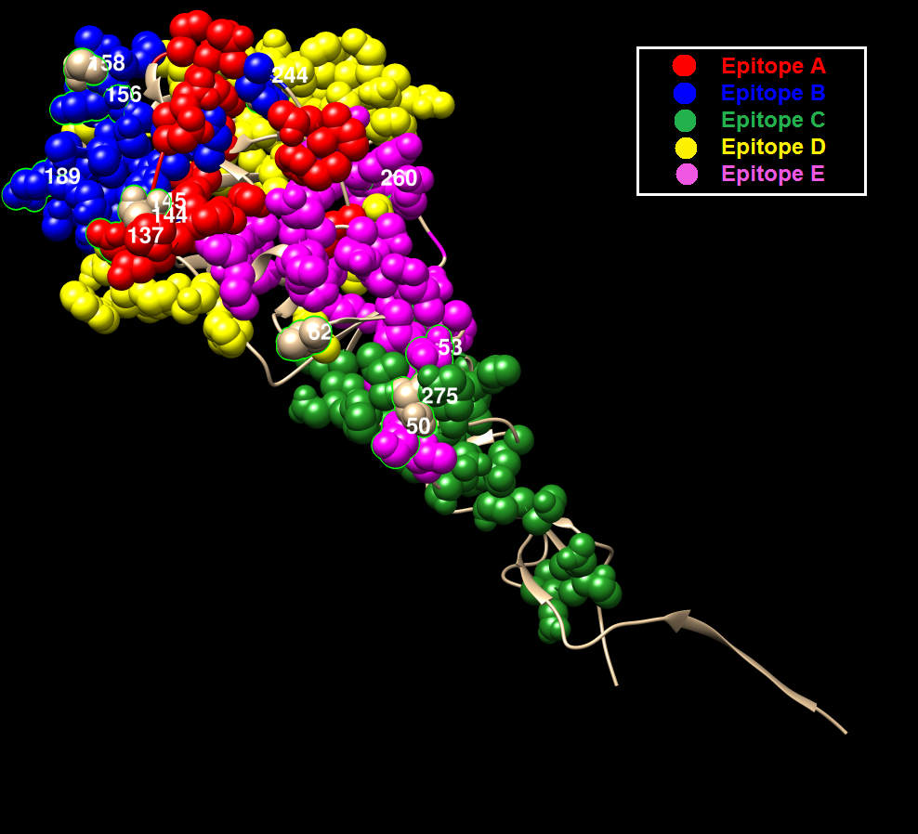
Figure 9. Mapping co-mutation sites on HA1 protein of H3N2 (PDB ID: 2YPG).
All sites are distributed on the five epitope regions, colored as red, blue, green, yellow and magenta for epitope A, B, C, D and E respectively.

Slide 10
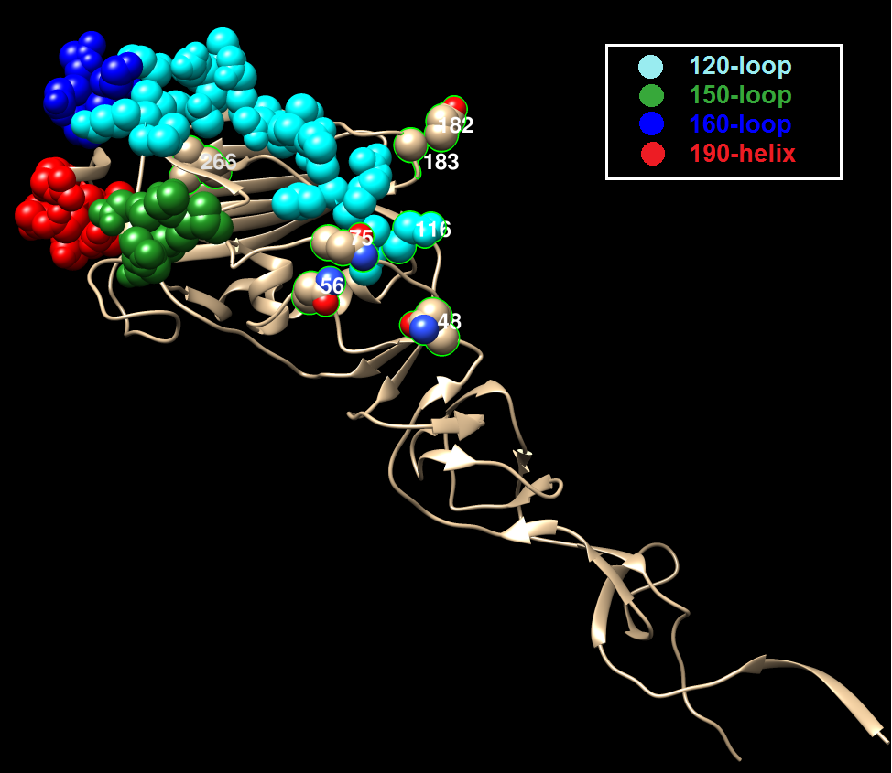
Figure 10. Mapping co-mutation sites detected onto HA1 protein of flu B/Yamagata (PDB ID: 4NRJ), where the red, blue, cyan and green colors represent 120-loop, 150-loop, 160-loop and 190-helix respectively. The four clusters have been found to cause antigenicity variation, together forming a single large antigenic site with overlapping epitopes. The co-mutation sites are circled and marked with corresponding numbers.

Slide 11
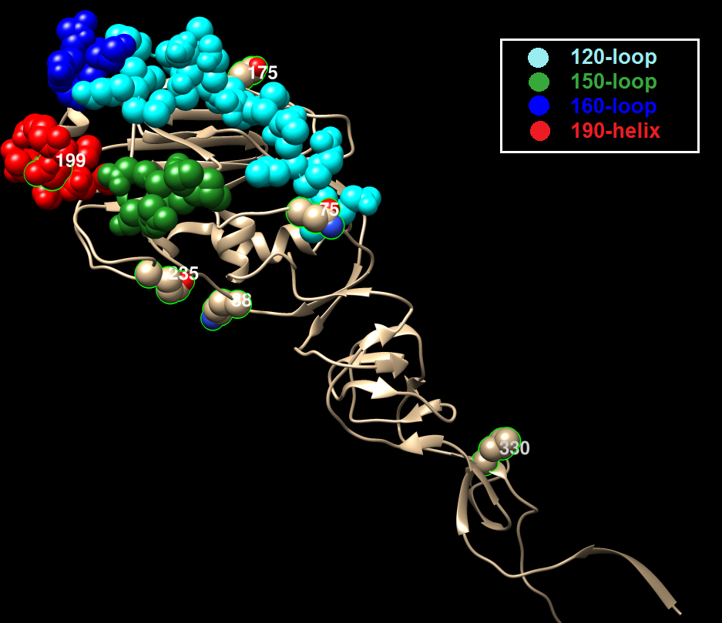
Figure 11. Mapping co-mutation sites detected onto HA1 protein of flu B/Victoria (PDB ID: 4NRJ), where the red, blue, cyan and green colors represent 120-loop, 150-loop, 160-loop and 190-helix respectively. The four clusters have been found to cause antigenicity variation, together forming a single large antigenic site with overlapping epitopes. The co-mutation sites are circled and marked with corresponding numbers.

