Slide 1




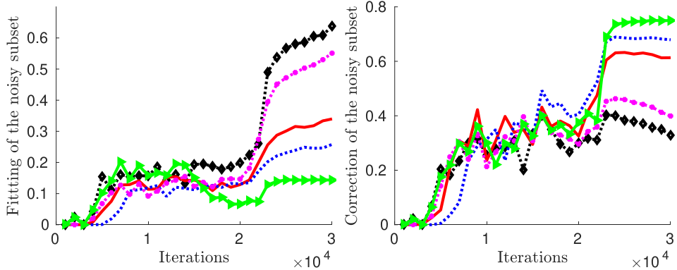
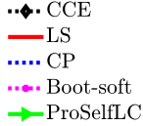
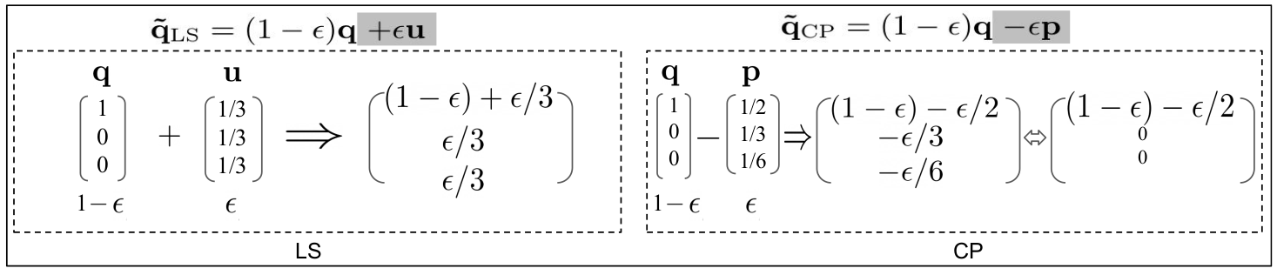
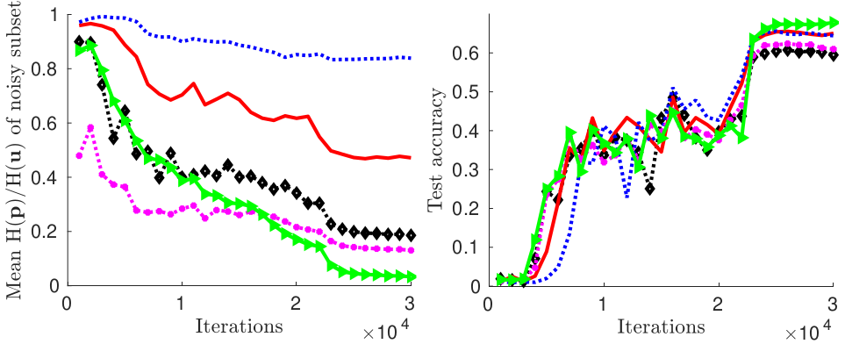
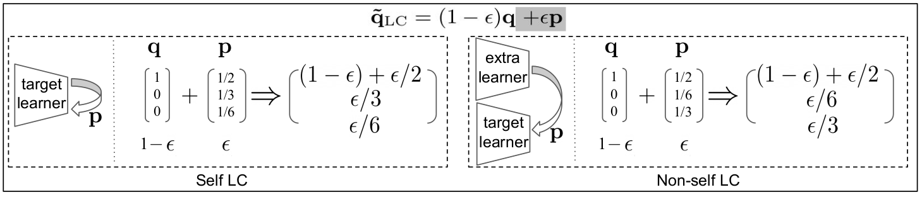
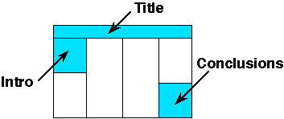
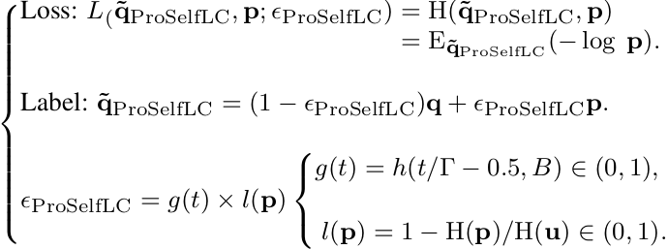
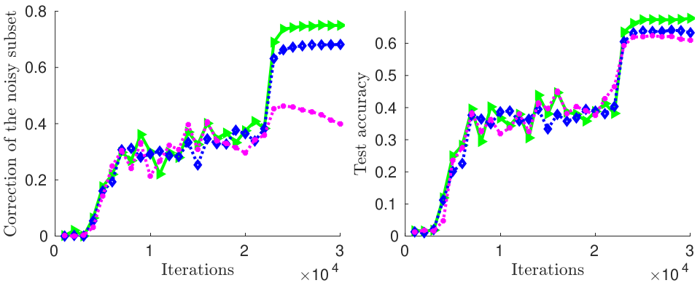

ProSelfLC: Progressive Self Label Correction for Training Robust Deep Neural Networks Xinshao Wang^{1, 2}, Yang Hua³, Elyor Kodirov¹, David A. Clifton², Neil M. Robertson^{1, 3} ¹Zenith Ai, UK. ²University of Oxford, UK. ³Queen’s University Belfast, UK
{xinshao, elyor}@zenithai.co.uk, {y.hua, n.robertson}@qub.ac.uk, {xinshao.wang, david.clifton}@eng.ox.ac.uk
A label distribution defines what to learn.
Semantic class: which class has the largest probability?
Similarity structure: how each data point is similar to different classes.
An overview of label (target) modification approaches.
Output regularisation (OR) makes similarity structure smoothed.
Label correction (LC) corrects semantic class and smoothes similarity structure.
Why Self LC? To exploit a model’s self knowledge.
OR methods naively penalise confident outputs without leveraging easily accessible knowledge from other learners or itself.
Non-self LC relies on accurate auxiliary models to generate predictions.
The core research questions we study:
In Self LC, how much should we trust a learner to leverage its knowledge?
The trust score is fixed or updated stage-by-stage in prior work. ProSelfLC modifies the target progressively, is end-to-end trainable, and requires negligible extra cost.
Should we penalise a low-entropy status or reward it?
OR methods penalise low entropy while LC rewards it.
ProSelfLC redirects and promotes entropy minimisation, which is in marked contrast to recent practices of confidence penalty [42, 33, 6].
Self knowledge or predefined annotations, how to trust?
The design principles of ProSelfLC:
Deep neural networks learn meaningful patterns before fitting noise: when a model learns from scratch, human annotations are more reliable than its own predictions in the early phase, during which the model is learning simple meaningful patterns before fitting noise [3].
Minimum entropy regularisation: as a learner attains confident knowledge as time progresses, we leverage it to revise annotated labels. This is surrounded by the minimum entropy regularisation [9, 10].
Progressive and adaptive label correction:
Global trust score g(t) denotes how much we trust a learner. It is independent of data points, thus being global.
Local trust score l(p) indicates how much we trust an output distribution p, which is data-dependent.
Experimental results
Wrong fitting
Semantic class correction
Entropy of noisy subset
Generalisation
Summary/Conclusion
ProSelfLC:
enhance the similarity structure information over training classes;
correct the semantic classes of noisy label distributions;
is the first method to trust self knowledge progressively and adaptively.
Our extensive experiments:
defend the entropy minimisation principle;
demonstrate the effectiveness of ProSelfLC in clean and noisy settings.
Code: https://github.com/XinshaoAmosWang/ProSelfLC-CVPR2021
Semantic class correction
(b) Generalisation
Notes:
‹#›

