Slide 1
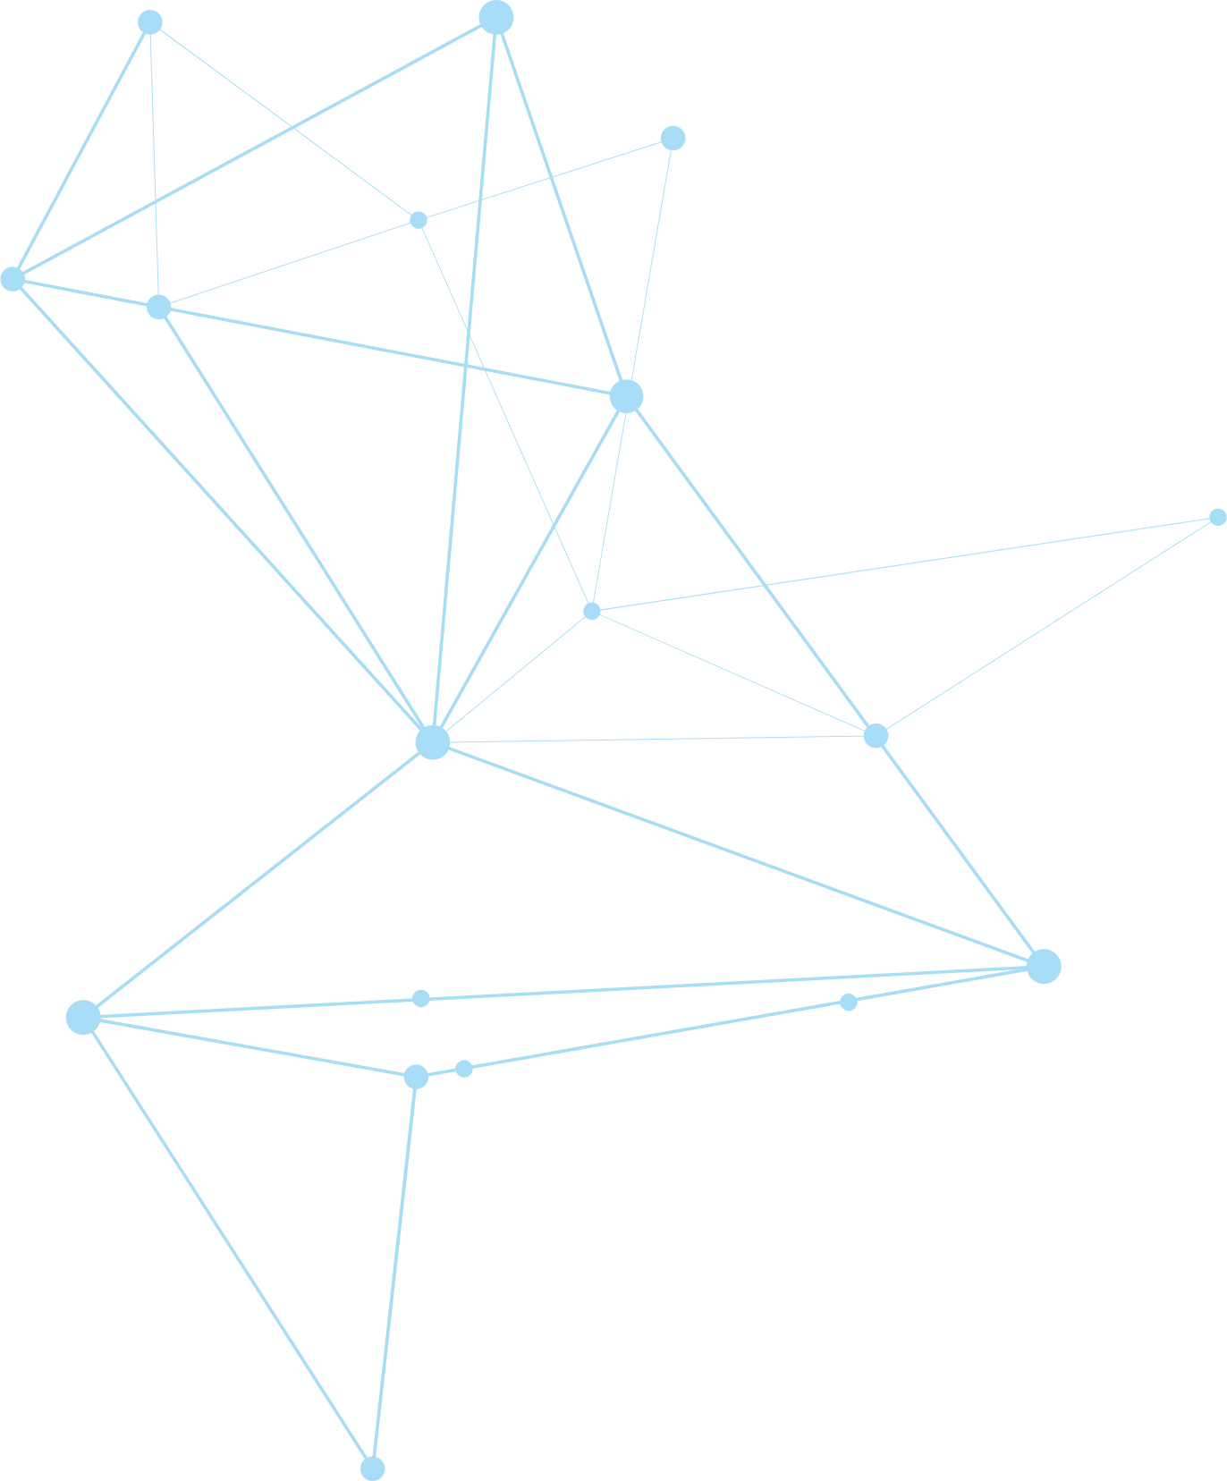


Paper Reading: deep feature space (without retraining/fine-tuning)
Detection of abnormal testing samples (OOD) &
Robust inference (removing noisy training examples)
Xinshao (Amos) Wang PhD Student
09/08/2019

Slide 2
Papers
NeurIPS-18: A Simple Unified Framework for Detecting
Out-of-Distribution Samples and Adversarial Attacks
ICML-19: Robust Inference via Generative Classifiers for Handling Noisy Labels

Slide 3
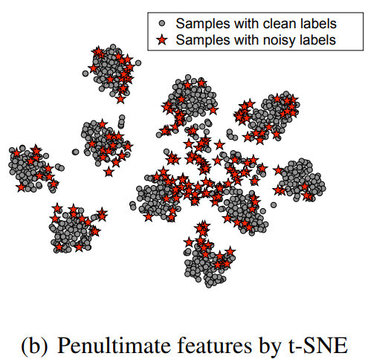
Abnormal/OOD/Adversarial/Noisy examples are related
Without fitting/using noisy training samples:
Robust training/learning, i.e., without fitting those abnormal examples, outliers, examples with noisy labels, etc.
Robust Inference: without relying on them for predicting, e.g., generative classifier, ICML-19.
Without predicting abnormal testing samples:
Predictive uncertainty (maximum value of
posterior distribution).
Know the unknown: abstain from predicting
(Out-of-distribution detection)

Slide 4
Objective & Challenge of OOD Detection
Objective: Detecting test samples drawn sufficiently far away from the training distribution statistically or adversarially is a fundamental requirement for deploying a good classifier in many real-world machine learning applications.
Challenge: Deep neural networks with the softmax classifier are known to produce highly overconfident posterior distributions even for such abnormal samples.
Lee et al. A Simple Unified Framework for Detecting Out-of-Distribution Samples
and Adversarial Attacks. NeurIPS, 2018

Slide 5
Contributions of Lee et al. NeurIPS 2018
Contribution 1: most prior methods have been evaluated for detecting either out-of-distribution or adversarial samples, but not both.
Contribution 2: more robust in harsh cases, e.g., when the training dataset has noisy labels or small number of samples.
Contribution 3: broader usage by applying it to class-incremental learning
More robust in the choice of its hyperparameters as well as against extreme scenarios
Lee et al. A Simple Unified Framework for Detecting Out-of-Distribution Samples
and Adversarial Attacks. NeurIPS, 2018

Slide 6
Introduction: basic idea, metric, empirical results
High-level idea: the probability density of test sample on feature spaces (low- and upper-level) using the concept of a “generative” (distance-based) classifier.
We define the confidence score using the Mahalanobis distance with respect to the closest class conditional distribution, where its parameters are chosen as empirical class means and tied empirical covariance of training samples.
Empirical Results: 1) generative classifier does not sacrifice the softmax classification accuracy; 2) its confidence score outperforms softmax-based ones very strongly across multiple other tasks: detecting OOD samples, detecting adversarial samples and class-incremental learning.
Lee et al. A Simple Unified Framework for Detecting Out-of-Distribution Samples
and Adversarial Attacks. NeurIPS, 2018

Slide 7
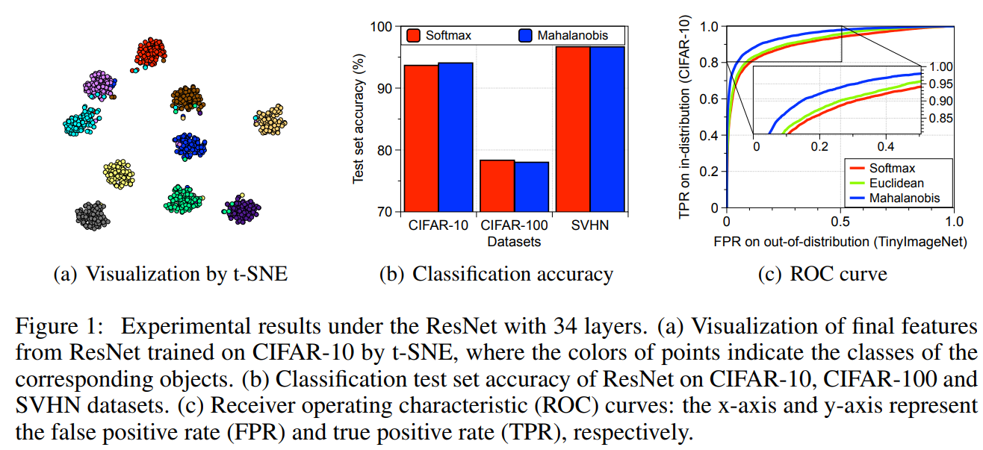
Comparison of classification accuracy & ROC curve
does not sacrifice the softmax classification accuracy
Lee et al. A Simple Unified Framework for Detecting Out-of-Distribution Samples
and Adversarial Attacks. NeurIPS, 2018

Slide 8
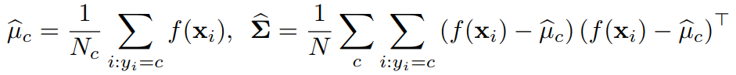
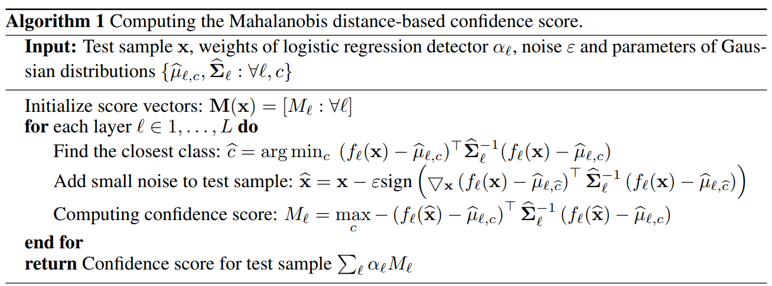
Algorithm 1: Confidence score of positive (in-distribution) examples
Class-conditional Gaussian distributions with a tied covariance:
Input pre-processing
Feature ensemble
Lee et al. A Simple Unified Framework for Detecting Out-of-Distribution Samples
and Adversarial Attacks. NeurIPS, 2018

Slide 9
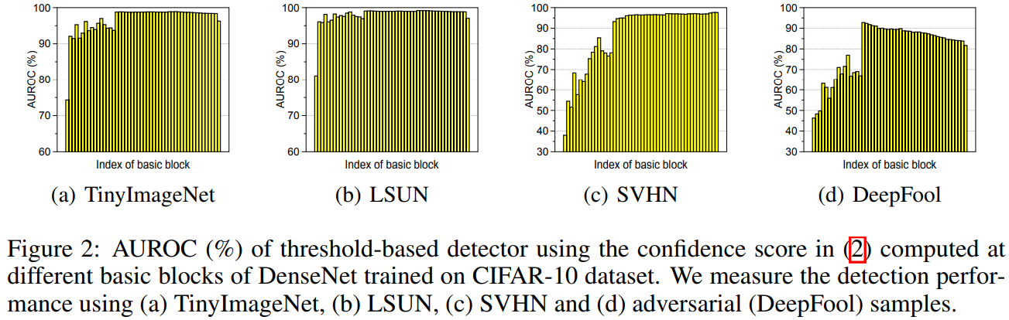
The performance of features from different levels
Lee et al. A Simple Unified Framework for Detecting Out-of-Distribution Samples
and Adversarial Attacks. NeurIPS, 2018

Slide 10
Feature ensemble strategy motivated by Figure 2
We choose the weight of each layer by training a logistic regression detector using validation samples.
We remark that such weighted averaging of confidence scores can prevent the degradation on the overall performance even in the case when the confidence scores from some layers are not effective: the trained weights (using validation) would be nearly zero for those ineffective layers.
Lee et al. A Simple Unified Framework for Detecting Out-of-Distribution Samples
and Adversarial Attacks. NeurIPS, 2018

Slide 11
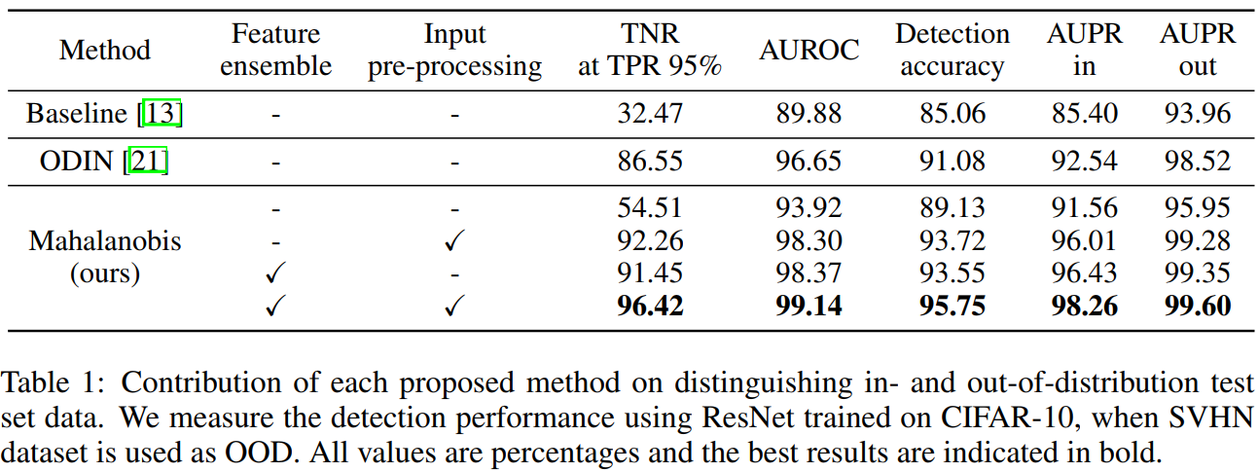
OOD Detection Results and ablation study
Lee et al. A Simple Unified Framework for Detecting Out-of-Distribution Samples
and Adversarial Attacks. NeurIPS, 2018

Slide 12
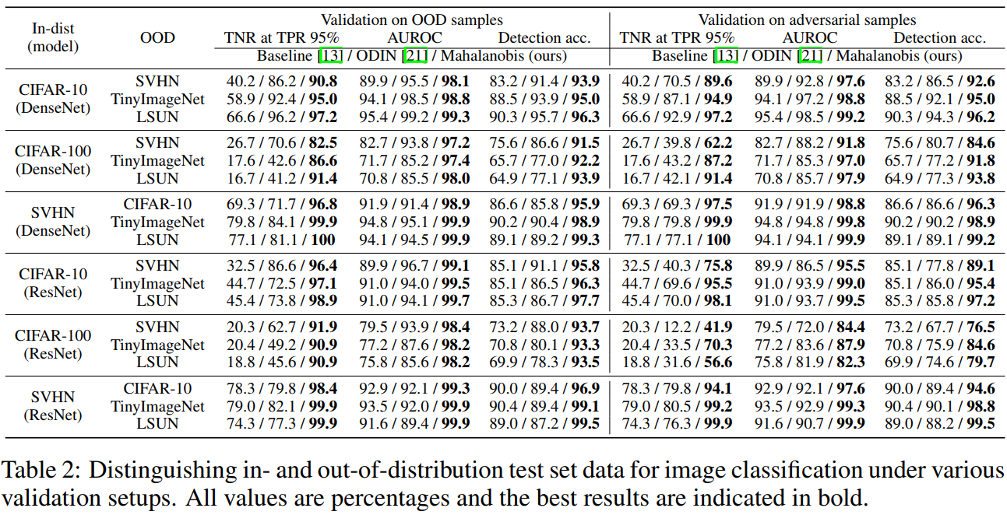
Robustness against validation data for hyper-params optimisation
Lee et al. A Simple Unified Framework for Detecting Out-of-Distribution Samples
and Adversarial Attacks. NeurIPS, 2018

Slide 13
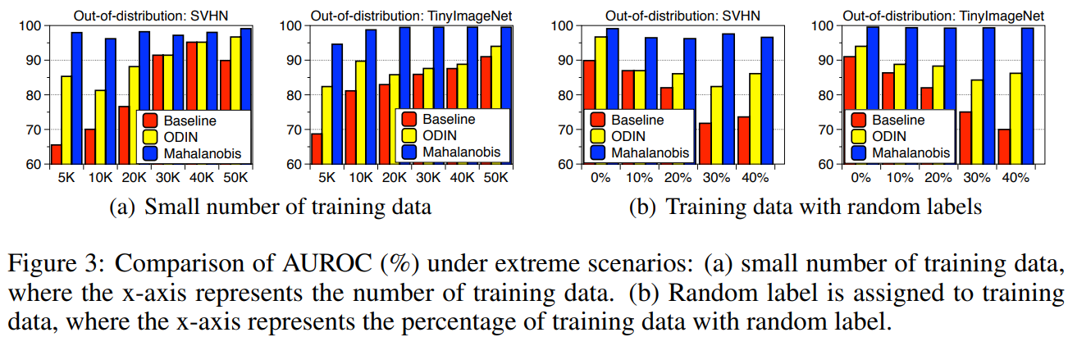
(Since our method utilizes empirical class mean and covariance of training samples, there is a caveat such that it can be affected by the properties of training data. )
Robustness against harsh training data
Lee et al. A Simple Unified Framework for Detecting Out-of-Distribution Samples
and Adversarial Attacks. NeurIPS, 2018

Slide 14
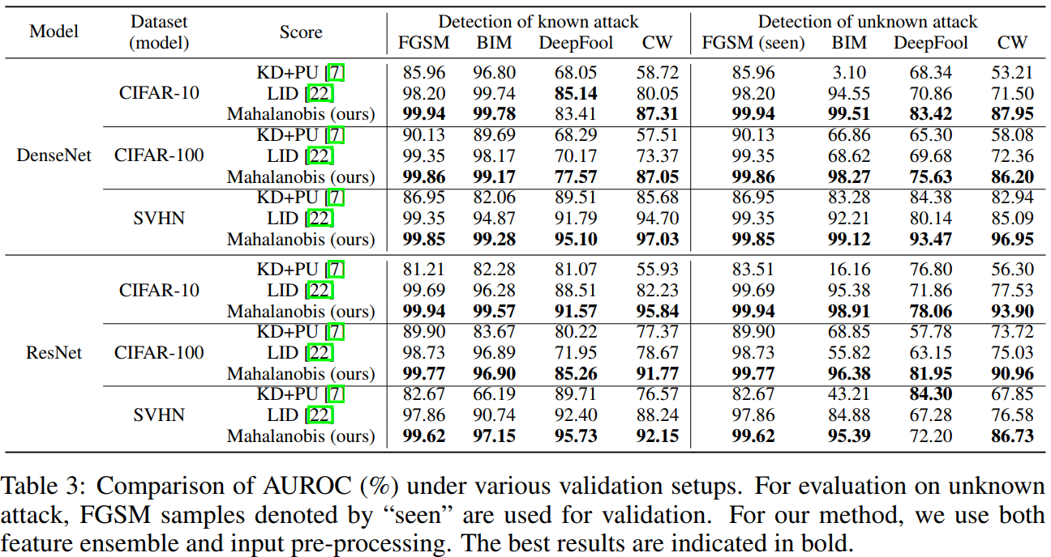
Detecting adversarial samples
As shown in the right-hand column of Table 3, our method trained on FGSM can accurately detect much more complex attacks such as BIM, DeepFool and CW.
Lee et al. A Simple Unified Framework for Detecting Out-of-Distribution Samples
and Adversarial Attacks. NeurIPS, 2018

Slide 15
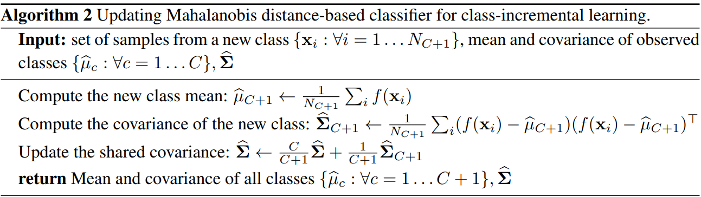
Algorithm 2: Class-incremental learning using Mahalanobis distance
Lee et al. A Simple Unified Framework for Detecting Out-of-Distribution Samples
and Adversarial Attacks. NeurIPS, 2018

Slide 16
Papers
NeurIPS-18: A Simple Unified Framework for Detecting
Out-of-Distribution Samples and Adversarial Attacks
ICML-19: Robust Inference via Generative Classifiers for Handling Noisy Labels

Slide 17
Robust Inference via Robust Generative classifier
Robust Generative classifier (RoG) = LDA (GDA) + MCD
LDA (GDA): Linear/Gaussian Discriminant Analysis
MCD: minimum covariance determinant
Complementary to the prior works: one can combine ours and a prior training method for the best performance
Belief/Assumption: the softmax DNNs can learn meaningful feature patterns
shared by multiple training examples even under datasets with noisy labels.
Lee et al. Robust Inference via Generative Classifiers for Handling Noisy Labels. ICML, 2019

Slide 18
Assumption/Observation: Clustering properties of DNN representations even when trained with noisy labels
DNN learns embedding that tend to group clean examples of the same class into the clusters while pushing away the examples with corrupt labels outside these clusters.
Lee et al. Robust Inference via Generative Classifiers for Handling Noisy Labels. ICML, 2019

Slide 19
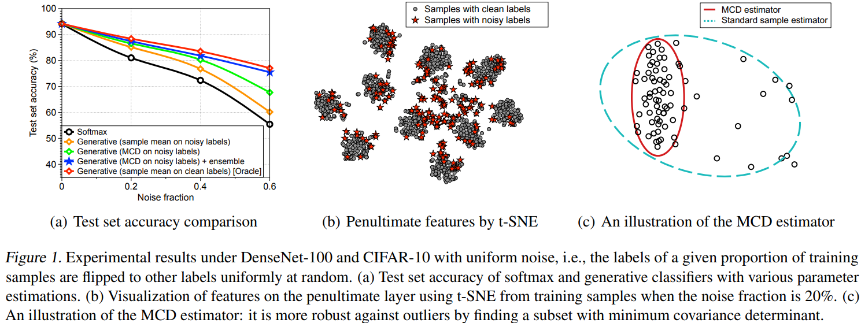
Overview
more robust
by removing the outliers which might be widely scattered
Lee et al. Robust Inference via Generative Classifiers for Handling Noisy Labels. ICML, 2019

Slide 20

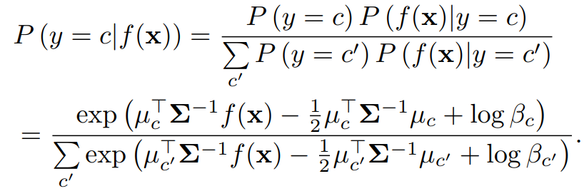
Generative classifier
Generative classifier via LDA
According to Bayesian rule:
Lee et al. Robust Inference via Generative Classifiers for Handling Noisy Labels. ICML, 2019

Slide 21
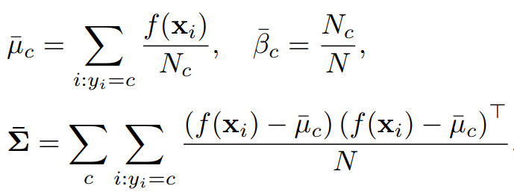

Naive and Robust MCD estimator
Naive sample estimator (outliers/training examples with noisy labels are also used)
MCD estimator: For each class, finding a subset for which the determinant of the corresponding sample covariance is minimized => outliers are removed.

Slide 22
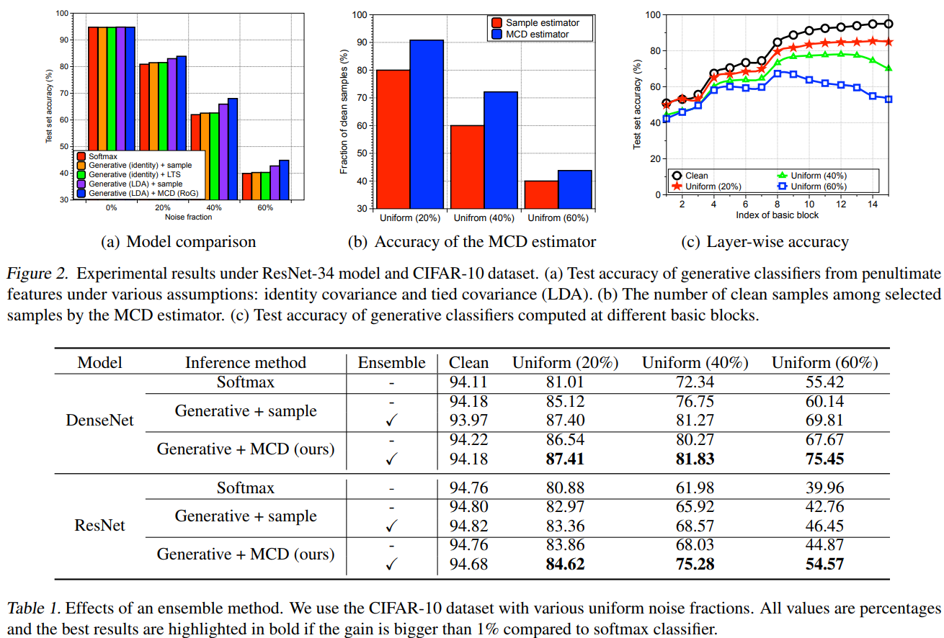
Results

Slide 23
Research Questions
Why is RoG better than softmax classifiers?
Naive Generative classifiers are generally at most competitively with softmax classifiers, as shown in the first paper `A Simple Unified Framework for Detecting Out-of-Distribution Samples and Adversarial Attacks, NeurIPS-18’.
When noisy training examples exist, softmax classifiers tend to overfit (fit noisy ones), thus softmax ones degrade in this case.
While with MCD to remove those noisy training examples, RoG > Naive
Generative classifier > Softmax
RoG can use feature ensemble from different layers, while softmax can only use the penultimate-layer feature
MCD estimator: For each class, finding a subset for which the determinant of the corresponding sample covariance is minimized => outliers are removed.

Slide 24
Many Thanks !
Any Questions on these two papers?
e.g. merits and demerits

