Slide 1
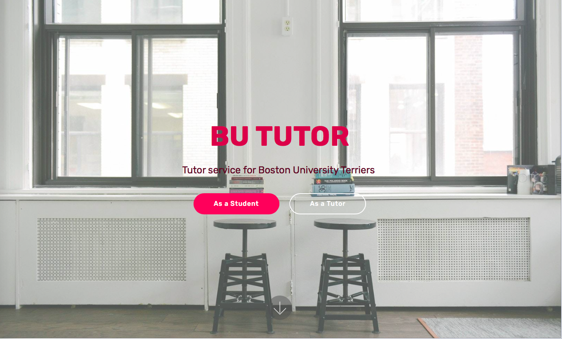
GitHub link: https://github.com/XintongHao/BU-Tutor
Trello link: https://trello.com/b/bgQIvEZm/bu-tutor

Slide 2
Implemented User Stories
Set up mongoDB as our database.
{ username: “ ” keyword: “ ”}
{ name: “ ” image: “ ” Email: “ ” Phone number: “ ” Resume: “ ” Skills: “ ” }
Allow user to sign up a new account and login with the account they created into mongoDB.
Allow the tutor to edit their basic information and upload their image and resume.

Slide 3
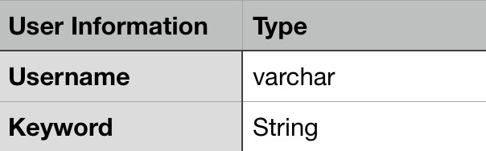
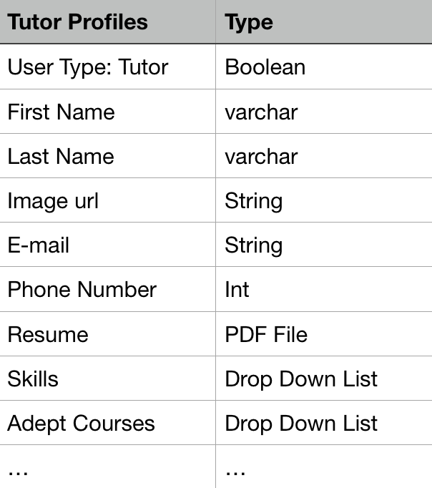
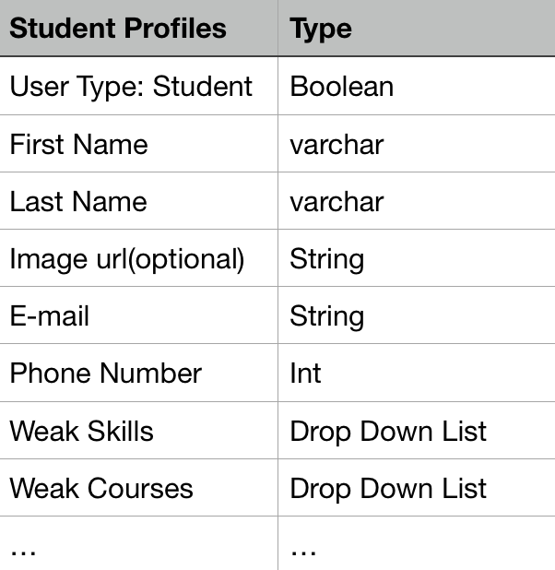
User Information
Tutor Profiles
Student Profiles

Slide 4
SW Decision
1.Use AWS Cloud9 as development environment.
AWS Cloud9 allows you to write, run and debug your code with just a browser, and share your IDE with your teammates in real time.
2.Use mongoDB as our database.
3.User HTML, CSS, JavaScript as programming language.
4.Use Google Login API and Google Calendar API.

Slide 5
Changes from Our Plan
Put the Mental Health part into waiting list.
Reason: Qualification & Privacy
2. No longer just match one tutor for a student but provide a list of tutors.
Reason: More Choices

Slide 6
Sprint 3
Develop the DataBase.
(tutor/student profile, skill, courses, language, rate)
Filter options and match data.
Extension:
Add plaza function for discussion.
Establish rating system.

Slide 7
Matching Algorithm
STUDENT:
EC503 80%
EC512 20%
Order:
TUTOR 4
TUTOR 3
TUTOR 2
TUTOR 1
0%
20%
80%
100%
TUTOR1:
EC516
EC601
EC602
EC605
TUTOR2:
EC512
EC601
EC602
EC605
TUTOR3:
EC503
EC504
EC551
EC602
TUTOR4:
EC503
EC512
EC516
EC601

Slide 8
Thank you!
Xintong Hao, Yinzhu Su, Yuchen Wang

